Slide 1
GLoBES
GLoBES = Global Long Baseline Experiment Simulator
Modular software system to simulate long-baseline neutrino oscillation experiments
Abstract Experiment Definition Language(AEDL) => describes beams, detectors & oscillation channels
AEDL-files are available for a number of experiments
The parameters can be modified easily by changing the AEDL files
GLoBES contains a variety of functions which allow to simulate various experiments on an event rate basis and to investigate their capabilities
Different analysis tools are provided

Slide 2
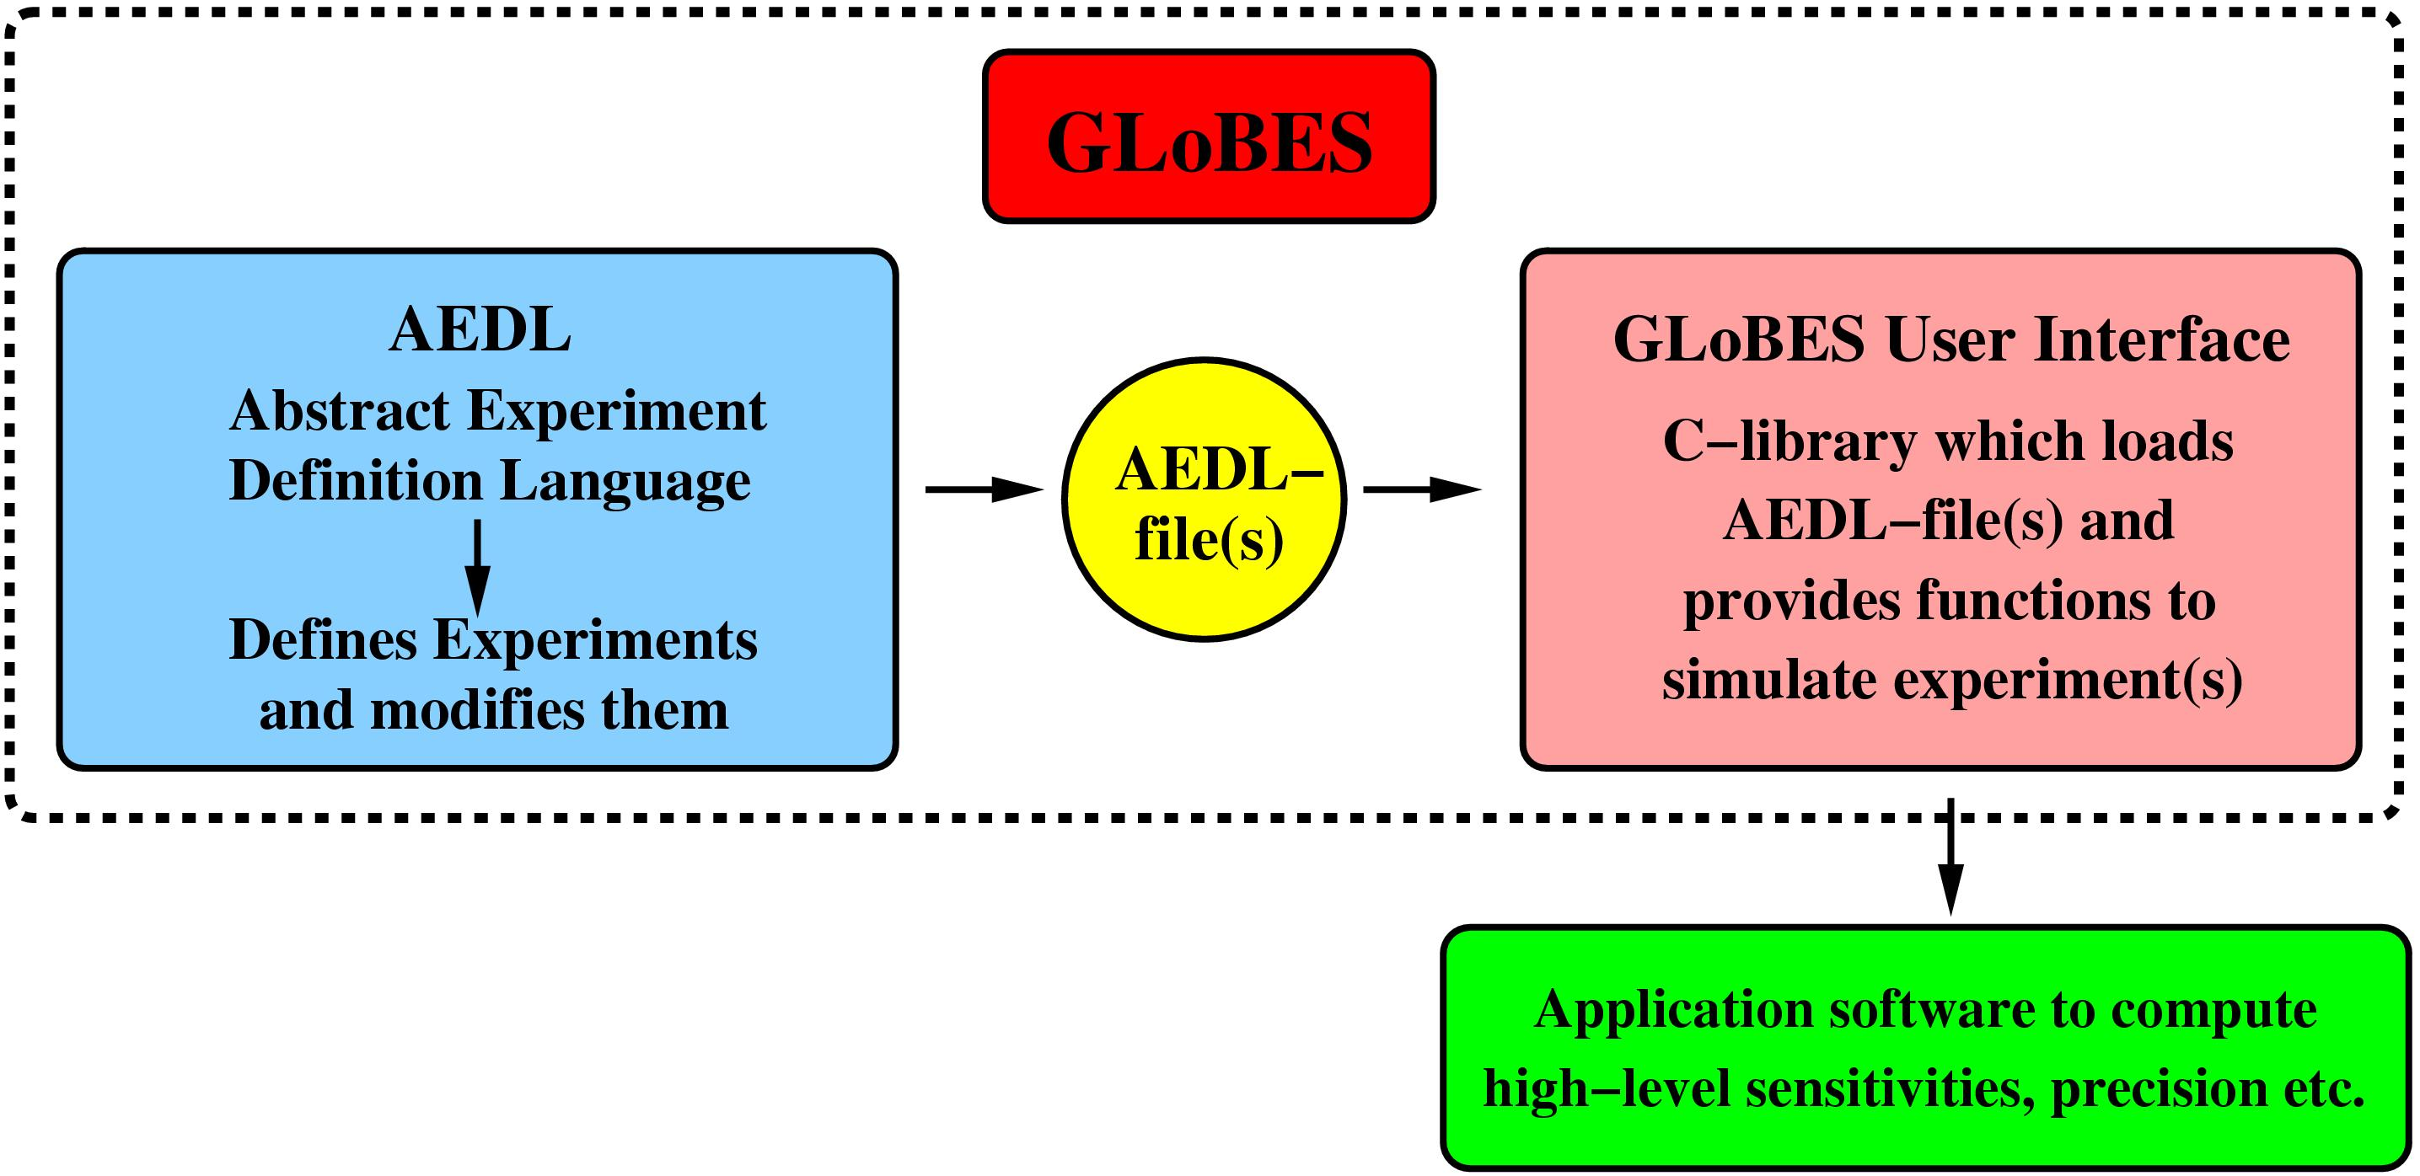
Basic Concept

Slide 3
AEDL Experiment Definition
Energy resolution functions
Different energy smearing algorithms
Arbitrary efficiencies
Definition of energy cuts, bin sizes and numbers etc.
Various systematics parameters, such as normalization and energy calibration errors
Different systematics modes, such as total rate or spectral analysis
Arbitrary matter density profiles
Arbitrary fluxes and cross sections
Built-in fluxes for neutrino factories, ...
Any number of signal-background-combinations and oscillation channels within one or more experiments
...

Slide 4
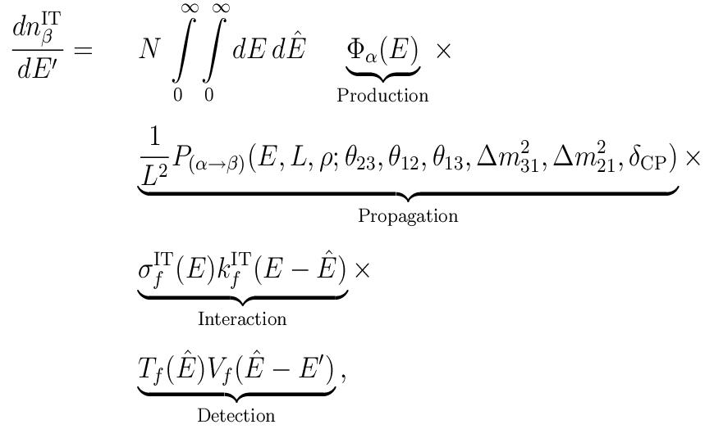
AEDL / Basics

Slide 5
AEDL Example / Setup
/* Beam data; time in `years' */
flux(#NUMI)<
@flux_file="MINOS_Spectra.dat"
@time = 5
@norm = 1.174e-12
>
$target_mass = 5.4
$bins = 30
$emin = 1.0
$emax = 6.0
/* Baseline */
$profiletype = 3
$densitytab = {2.7}
$lengthtab = {735.0}
/* Energy Resolution */
energy(#ERES)<
@type = 1
@sigma_e = {0.15,0.0,0.0}
>
/* Cross sections */
cross(#CC)<
@cross_file = "XCC.dat"
>
cross(#NC)<
@cross_file = "XNC.dat"
>

Slide 6
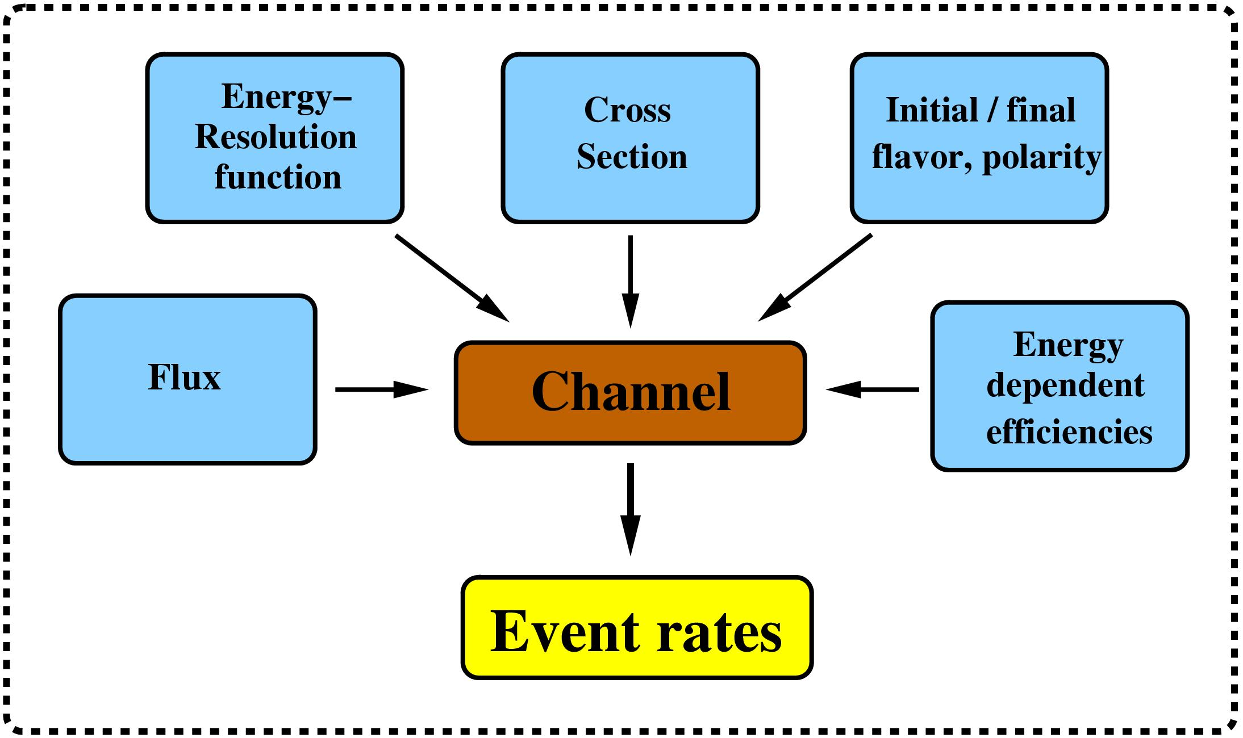
AEDL / Channels

Slide 7
AEDL Example / Channels
channel(#disappearance)<
@channel = #NUMI: +: m: m: #CC: #ERES
@post_smearing_efficiencies = {0.08333,0.16667,0.25,0.33333,0.41667,0.5,0.58333,0.66667,0.75,0.83333,0.91667,
1,1,1,1,1,1,1,1,1,1,1,1,1,1,1,1,1,1,1}
>
channel(#nu_e_appearance)<
@channel = #NUMI: +: m: e: #CC: #ERES
@post_smearing_efficiencies = {0.08333,0.16667,0.25,0.33333,0.41667,0.5,0.58333,0.66667,0.75,0.83333,0.91667,
1,1,1,1,1,1,1,1,1,1,1,1,1,1,1,1,1,1,1}
>
channel(#nu_e_beam)<
@channel = #NUMI: +: e: e: #CC: #ERES
@post_smearing_efficiencies = {0.08333,0.16667,0.25,0.33333,0.41667,0.5,0.58333,0.66667,0.75,0.83333,0.91667,
1,1,1,1,1,1,1,1,1,1,1,1,1,1,1,1,1,1,1}
>
channel(#NC_background)<
@channel = #NUMI: +: NOSC_m: NOSC_m: #NC: #ERES
@post_smearing_efficiencies = {0.08333,0.16667,0.25,0.33333,0.41667,0.5,0.58333,0.66667,0.75,0.83333,0.91667,
1,1,1,1,1,1,1,1,1,1,1,1,1,1,1,1,1,1,1}

Slide 8
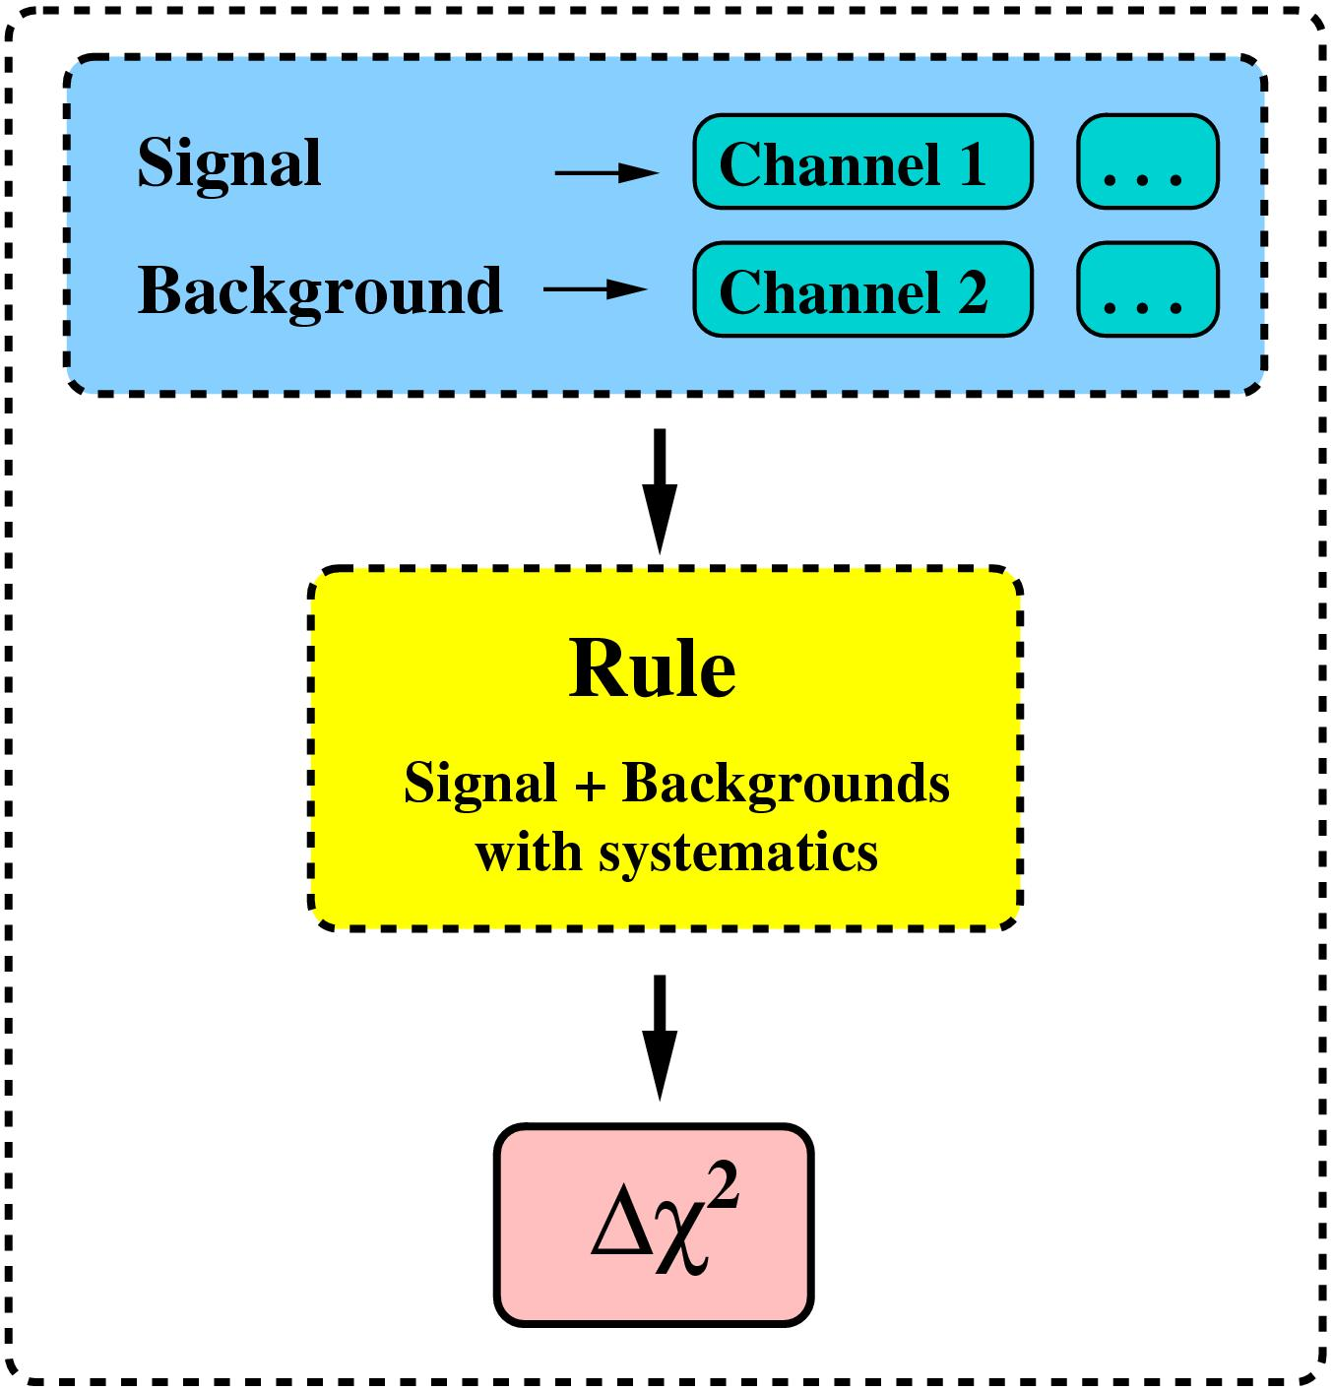
AEDL / Rules

Slide 9
AEDL Example / Rules
rule(#rule0)<
@signal = 0.4288@#nu_e_appearance
@signalerror = 0.05 : 0.0001
@background = 0.3973@#nu_e_beam : 0.004583@#disappearance : 1.7074@#nu_tau_appearance : 0.04682@#NC_background
@backgrounderror = 0.05 : 0.0001
@backgroundcenter = 1.0 : 0.0
@errordim_sys_on = 0
@errordim_sys_off = 2
@energy_window = 1 : 6
>
rule(#rule1)<
@signal = 0.9@#disappearanceWOS
@signalerror = 0.05 : 0.0001
@background = 0.05@#NC_backgroundWOS
@backgrounderror = 0.05 : 0.0001
@backgroundcenter = 1.0 : 0.0
@errordim_sys_on = 0
@errordim_sys_off = 2
@energy_window = 1 : 6

Slide 10
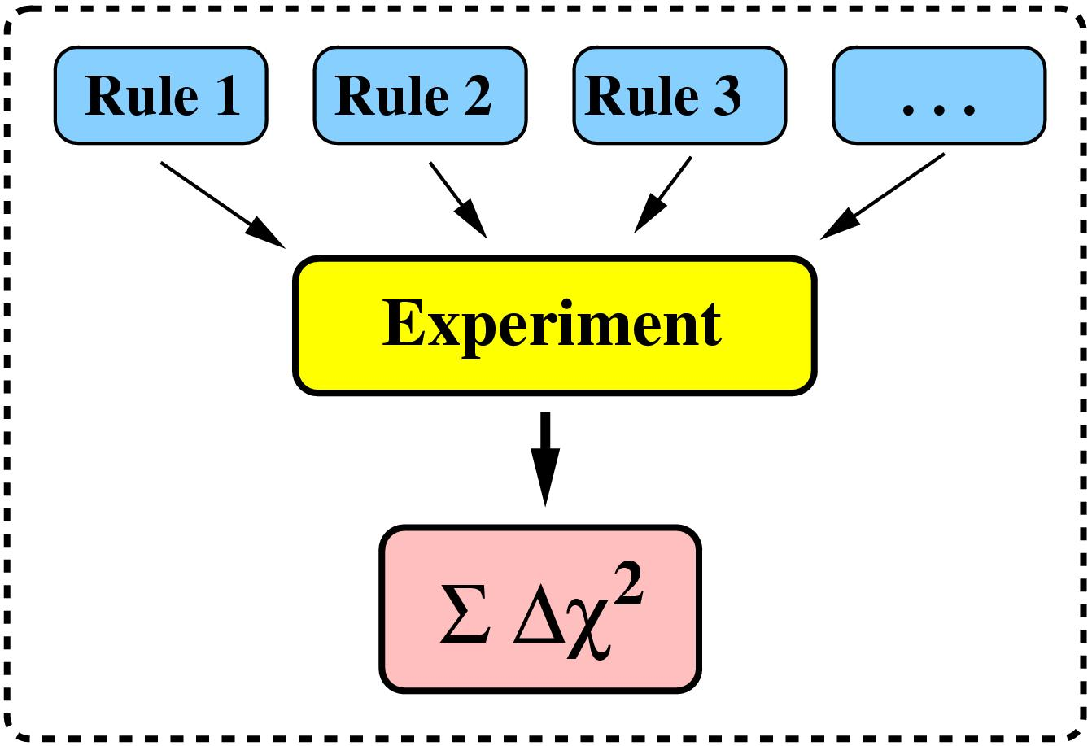
AEDL / Experiment

Slide 11
Interactive GLoBES
> globes -s MINOS.glb
--------- #rule0 ---------
1.083 0.0603374
1.25 0.254606
1.417 0.663695
1.583 1.35012
1.75 2.31606
1.917 3.49245
2.083 4.76538
2.25 6.02335
2.417 7.18871
2.583 8.21697
2.75 9.08048
2.917 9.75821
3.083 9.44848
3.25 9.00641
3.417 8.46126
3.583 7.84135
3.75 7.17314
3.917 6.48066
4.083 5.7852
4.25 5.10508
4.417 4.45543
4.583 3.8479
4.75 3.29056
4.917 2.78792
5.083 2.3413
5.25 1.94942
5.417 1.60913
5.583 1.31619
5.75 1.0659
5.917 0.853586
----------------------
Total: 135.989
..................
.........
....
.
Interactive call of globes
=> event rates

Slide 12
GLoBES C-Library
/* Initialize libglobes */
glbInit(argv[0]);
/* Initialize experiment NuFact.glb */
glbInitExperiment("NuFact.glb",&glb_experiment_list[0],&glb_num_of_exps);
/* Intitialize output */
InitOutput(MYFILE,"Format: Log(10,s22th13) deltacp chi^2 \n");
/* Define standard oscillation parameters */
double theta12 = asin(sqrt(0.8))/2;
double theta13 = asin(sqrt(0.001))/2;
double theta23 = M_PI/4;
double deltacp = M_PI/2;
double sdm = 7e-5;
double ldm = 2e-3;
/* Initialize parameter vector(s) */
glb_params true_values = glbAllocParams();
glb_params test_values = glbAllocParams();
glbDefineParams(true_values,theta12,theta13,theta23,deltacp,sdm,ldm);
glbDefineParams(test_values,theta12,theta13,theta23,deltacp,sdm,ldm);

Slide 13
GLoBES C-Library /2
/* The simulated data are computed */
glbSetOscillationParameters(true_values);
glbSetRates();
/* Iteration over all values to be computed */
double thetheta13,x,y,res;
for(x=-4.0;x<-2.0+0.01;x=x+2.0/50)
for(y=0.0;y<200.0+0.01;y=y+200.0/50)
{
/* Set vector of test values */
thetheta13=asin(sqrt(pow(10,x)))/2;
glbSetOscParams(test_values,thetheta13,GLB_THETA_13);
glbSetOscParams(test_values,y*M_PI/180.0,GLB_DELTA_CP);
/* Compute Chi^2 for all loaded experiments and all rules */
res=glbChiSys(test_values,GLB_ALL,GLB_ALL);
AddToOutput(x,y,res);
}
/* Destroy parameter vector(s) */
glbFreeParams(true_values);
glbFreeParams(test_values);
exit(0);
loop-> produces
chi^2 values in
theta_13 – delta plane

Slide 14
GloBES User Interface
Analysis of up to 32 experiments simultaneously (synergies)
Low-level information: event rate vectors, oscillation probabilities etc.
Chi^2 for individual experiments and experiment combinations
Inclusion of systematics in Chi^2
Chi^2-Cuts through the n-dimensional fit manifold
Projection of two- and multi-parameter correlations
Chi^2-Projections onto theta13- or deltacp-axis, and any other axis
Chi^2-Projections onto theta13-deltacp-plane, and any other plane
Projection of the n-dimensional fit-manifold onto any k-dim. hyperplane
Numerical location of degeneracies
Projections and cuts of degenerate solutions
Inclusion of external input (such as for solar parameters)
Simulation of matter density uncertainties
Run-time modifications: baseline, target mass, matter density profile etc.
...

Slide 15
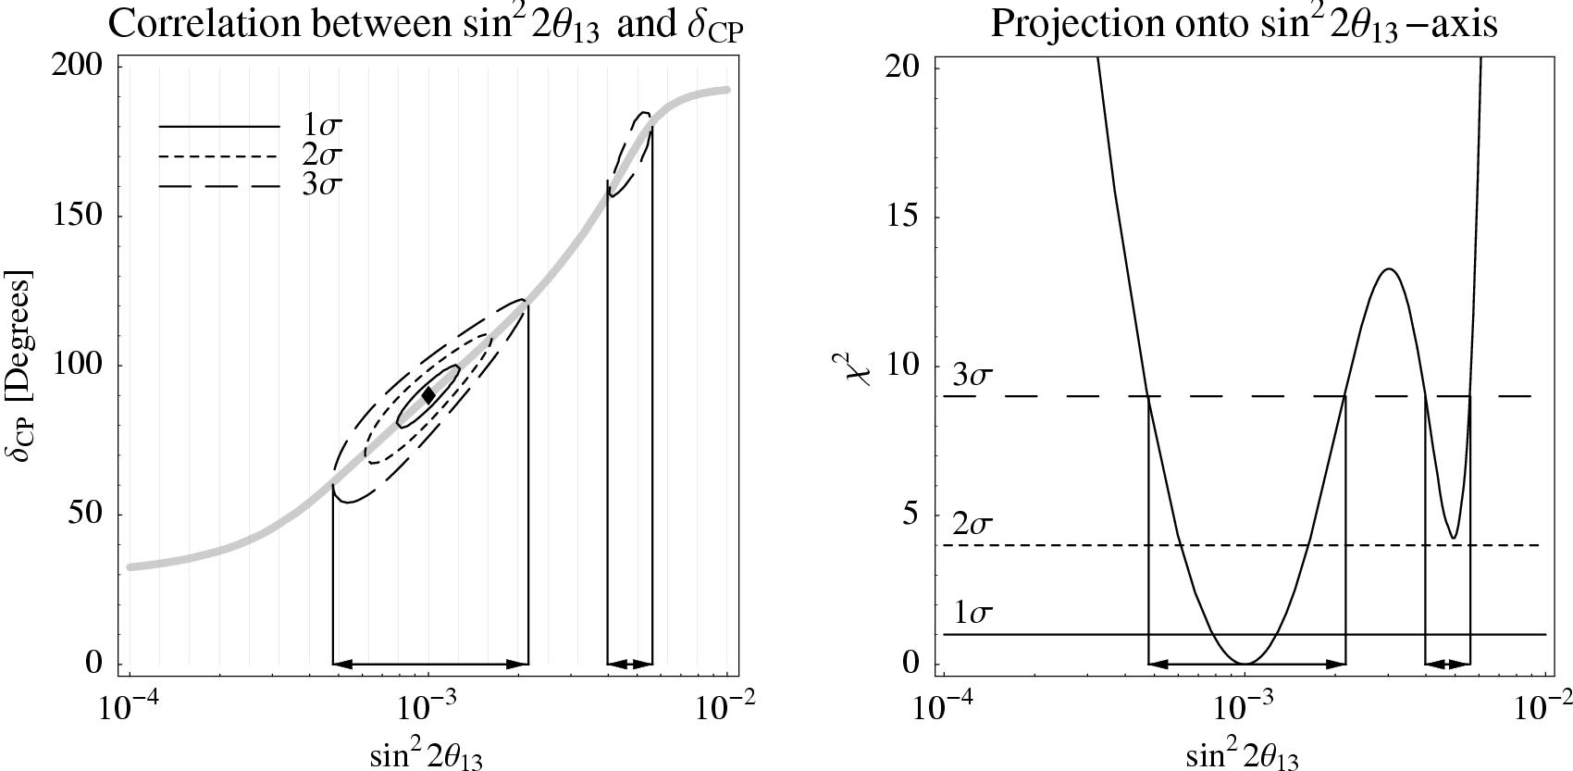
Results / Example

Slide 16
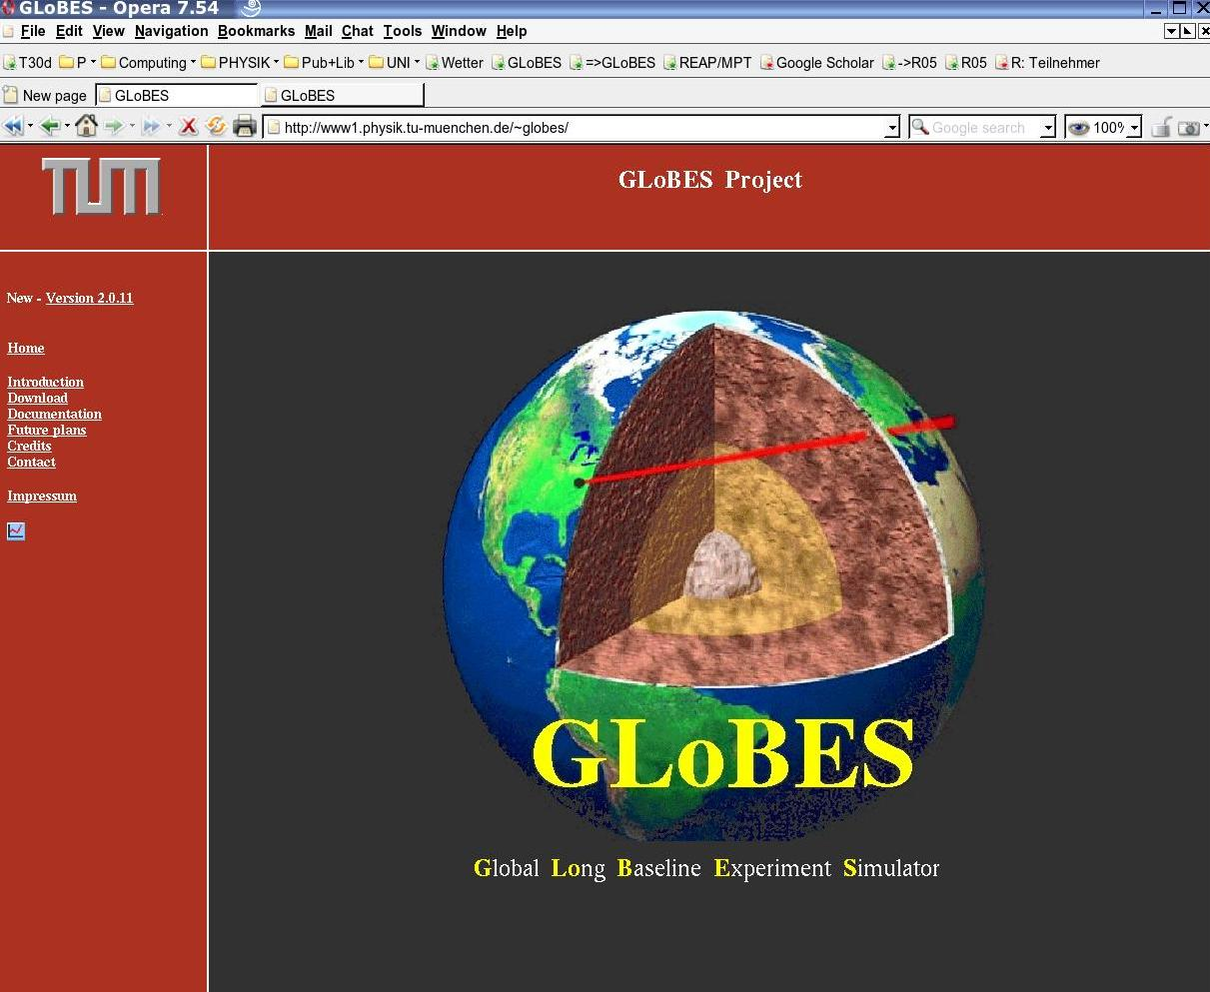

Slide 17
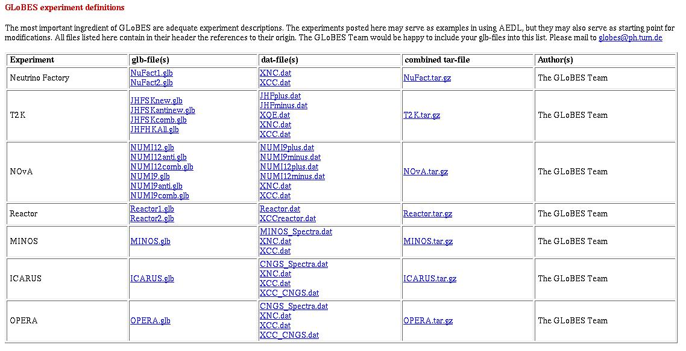
Available Setups

Slide 18
Availability / Documentation
Very powerful user's interface (C library)
Currently available for Linux and Mac OS under the GNU Public License
User's and AEDL manual ( >120 pages)
Examples for immediate compilation
Free AEDL files for conventional and super- beams, neutrino factories, reactor experiments
A program to test and debug AEDL files
Various utilities and tools
We offer to host AEDL-files on the web page

Slide 19
Summary
GloBES is a well tested simulation tool
AEDL files allow to encode and vary experiments
Powerful and free GLoBES C-library (GPL)
Allows to determine:
  physics potential of given setups
  sensitivity of setups
    dependance on source properties
    detector requirements
    synergies and power to resolve degeneracies
  crutial R&D issues
  test new ideas
We can help...

