Slide 1

Dynamic texture modeling and synthesis using Multi-kernel Gaussian process Dynamic model

Slide 2
Dynamic texture modeling and synthesis using Multi-kernel Gaussian process Dynamic model

Slide 3

Dynamic texture modeling and synthesis using Multi-kernel Gaussian process Dynamic model

Slide 4

Dynamic texture modeling and synthesis using Multi-kernel Gaussian process Dynamic model

Slide 5
Dynamic texture modeling and synthesis using Multi-kernel Gaussian process Dynamic model
MAKSIM KOPTELOV

Slide 6
Dynamic texture modeling and synthesis using Multi-kernel Gaussian process Dynamic model
MAKSIM KOPTELOV
University of Jean Monnet Master 1 MLDM 2015/2016

Slide 7
Dynamic texture modeling and synthesis using Multi-kernel Gaussian process Dynamic model
MAKSIM KOPTELOV
University of Jean Monnet Master 1 MLDM 2015/2016
Academic Supervisors:
Assoc. prof. Marianne CLAUSEL
Assoc. prof. Rémi EMONET
Prof. Olivier ALATA

Slide 8
Dynamic textures

Slide 9
What is a definition of texture?

Slide 10
What is a definition of texture?
For a single image

Slide 11
What is a definition of texture?
For a single image
Realization from stationary stochastic process

Slide 12
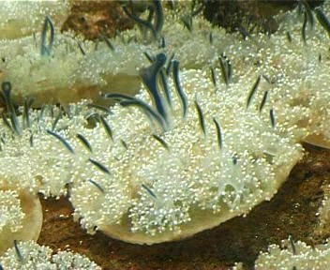
What is a definition of texture?
For a single image
Realization from stationary stochastic process

Slide 13
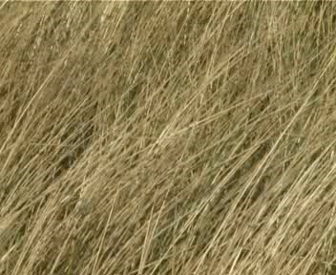
What is a definition of texture?
For a single image
Realization from stationary stochastic process

Slide 14
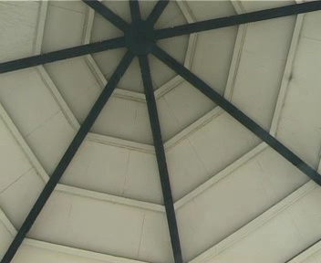
What is a definition of texture?
For a single image
Realization from stationary stochastic process

Slide 15
What is a definition of texture?
For a single image
Realization from stationary stochastic process
For a sequence of images

Slide 16
What is a definition of texture?
For a single image
Realization from stationary stochastic process
For a sequence of images
Stochastic process of interest defined over space and time.

Slide 17
What is a definition of texture?
For a single image
Realization from stationary stochastic process
For a sequence of images
Stochastic process of interest defined over space and time.

Slide 18
Why is it important?

Slide 19

Why is it important?
Applications in Computer vision:
video surveillance
object tracking
etc.

Slide 20
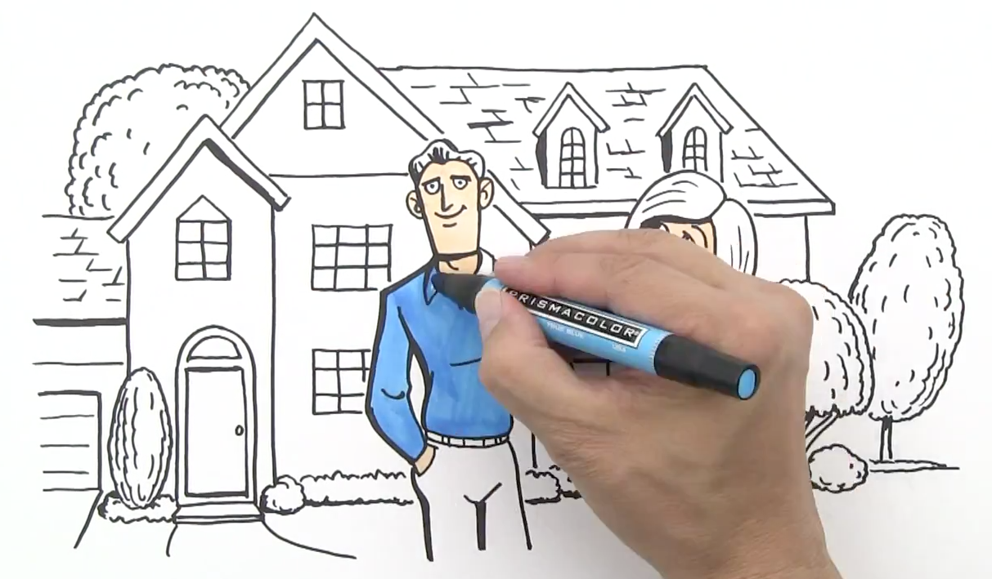
Why is it important?
Applications in Computer vision:
video surveillance
object tracking
etc.
Application in video processing fields:
video indexing
video animation
etc.

Slide 21
How?

Slide 22
How?
Dynamic texture can be captured from a video
It can be used then to synthesize new videos with necessary length of time

Slide 23
How?
Dynamic texture can be captured from a video
It can be used then to synthesize new videos with necessary length of time
Existing dynamic textures modeling and synthesis methods:
physics based – costly, not universal
sampling based – memory demanding, mostly manual
learning based methods – more universal, automatic

Slide 24
How?
Dynamic texture can be captured from a video
It can be used then to synthesize new videos with necessary length of time
Existing dynamic textures modeling and synthesis methods:
physics based – costly, not universal
sampling based – memory demanding, mostly manual
learning based methods – more universal, automatic

Slide 25
Learning based methods
high dimensionality – curse of dimensionality
most of dynamic textures are not linear – learning algorithm cannot be linear
big computational cost of optimization – necessary to have a good performance

Slide 26
Learning based methods
high dimensionality – curse of dimensionality
dimensionality reduction process must be applied
most of dynamic textures are not linear – learning algorithm cannot be linear
more flexible model must be found
big computational cost of optimization – necessary to have a good performance
first-order Markov model for dynamical texture synthesis can be used

Slide 27
Gaussian process

Slide 28
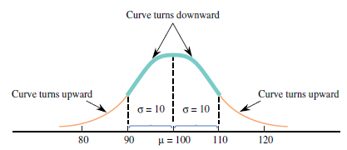
Gaussian distribution
Gaussian (normal) distribution – continuous probability distribution, bell shaped and symmetric. Characterized by mean and standard deviation. Total area under the distribution curve equals to 1.
Mean – describes where corresponding curve is centered.
Standard deviation – describes how much the curve spreads out around center.

Slide 29
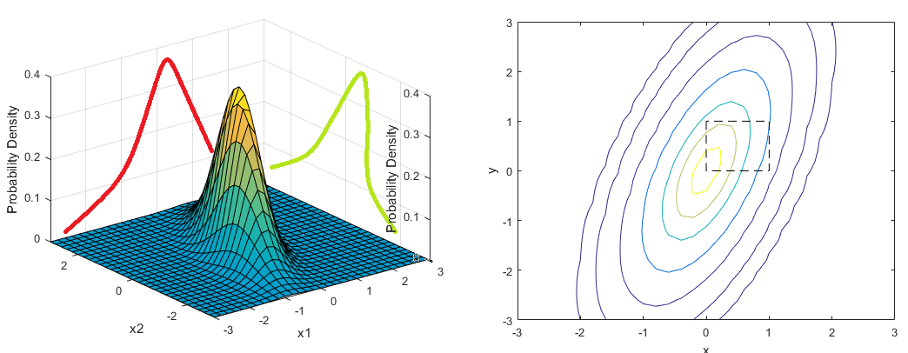
Joint distribution of two events
Joint distribution of two dependent/independent events

Slide 30
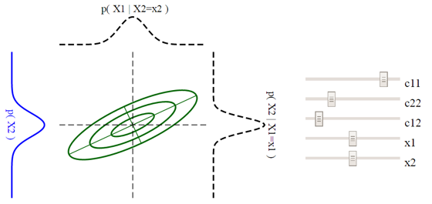
Multivariate Gaussian distribution
Bivariate case – for any fixed X1 value the distribution of associated X2 values is normal and for any fixed X2 value the distribution of X1 value is normal.
Multivariate case (2 or more dimensions) – characterized by:
Mean vector – the same size as data
Covariance matrix – squared matrix NxN, where N – dimensionality
Shape of a cut – 2D projection)

Slide 31
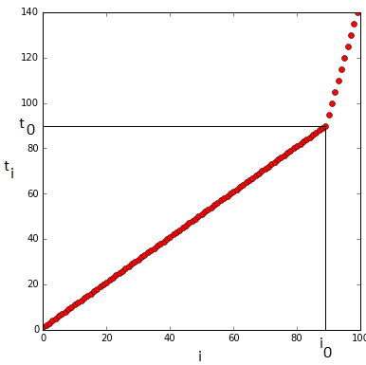
Gaussian process
Definition
Gaussian processes – infinite-dimensional generalization of multivariate normal distributions
Initially we have:
d random variables (X_{t1},…, X_{td}) not equally spaced
timeline t_{i}
d = 100
100 time indexes t_{i}
i₀ – index when space is increased

Slide 32
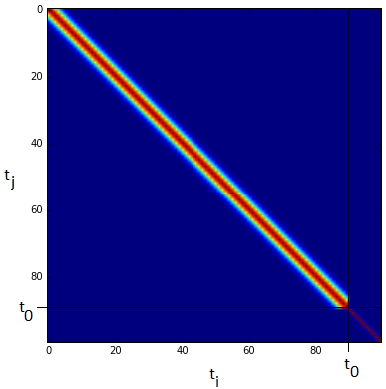

Gaussian process
Characterized by mean and covariance
all the vector of interest are centered – zero mean initially
assume a specific form for the covariance of any subsample (X_{t1},…, X_{td})
Parameters:
a - scale parameter,
l - dispersion parameter

Slide 33
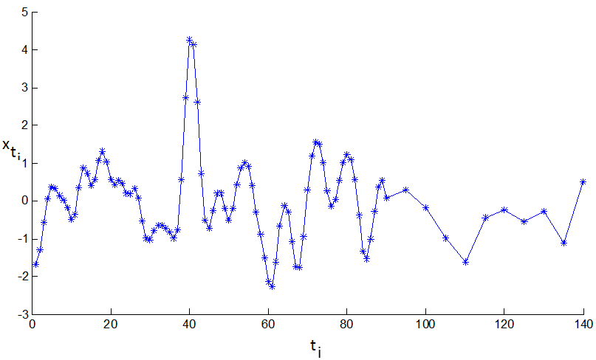
Gaussian process
From one covariance matrix and one sequence of time (t₁,…,t_{k}) possible Gaussian distribution (X_{t1},…, X_{tk}) with zero mean and covariance C
On the axis:
x_{ti} – values of random variables
t_{i} – time indexes
Trend of samples is not spoiled
by not equally spaced time indexes
and can be easily seen

Slide 34
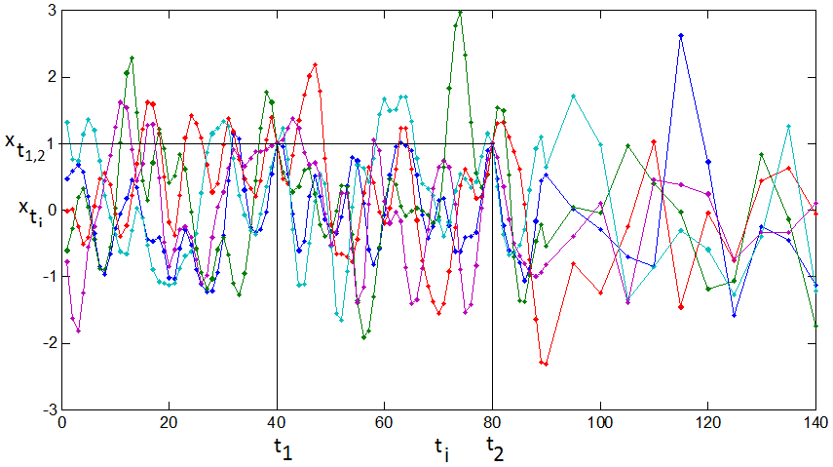
Gaussian process
Now assume that we are conditioning our stochastic process for example:
x_{t1} = 1, x_{t2} = 1 with t₁ = 40, t₂ = 80
Compute new mean vector and covariance matrix (multivariate conditional density):
f* – Gaussian vector x* = x_{{t ∈ T \ T’}}
f – Gaussian vector x_{f} = x_{{t ∈ T’}}
K – covariance matrices associated to two
random variable sets X* = X_{{t ∈ T \ T’}}, X_{f} = X_{{t ∈ T’}}
New set of realizations of multivariate
conditional distribution:

Slide 35
Kernels
List of most popular kernels along with its covariance matrices for the given timeset

Slide 36

GP with latent variables
new class of models
mappings from a latent space X ∈ R^{Q} to an observed space Y ∈R^{D} ,Q << D
through a set of parameters W
one kernel function is used
X, Y – multivariate Gaussian processes
In a simplest case – probabilistic version of PCA
likelihood of the full data set is given by:
W can then be found through maximizing:

Slide 37
Linear dynamic system

Slide 38
Linear dynamic system
In this work dynamical texture modeling consists of two steps:
dimensionality reduction
dynamic texture learning

Slide 39

Linear dynamic system
In this work dynamical texture modeling consists of two steps:
dimensionality reduction
dynamic texture learning
They can be expressed as:
– linear dynamic model
– dimensionality reduction
x_{t} - latent variable which affects dynamic behavior, x_{t} ∈ R^{Q}
y_{t} - column vector unfolded from the frame at time t, y_{t} ∈ R^{D}, D – large, Q<<D
n_{x},_{t}, n_{y},_{t} - represent the noise

Slide 40
GP dynamic model

Slide 41
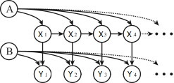

GP dynamic model
latent variable model
mapping from a latent space X to the observation space Y
mapping dynamic behavior of latent variables
two kernel functions
Y_{i} is a multivariate Gaussian process indexed by X_{i} expressed by likelihood

Slide 42

Multi-kernel GP dynamic model
To achieve nonlinear mapping from a latent space X to the observation space Y
special squared exponential covariance function is used
To map dynamic behavior of latent variables
Latent dynamic behavior varies greatly among different types of dynamic textures
Difficult to design the most suitable kernel for a dynamic texture empirically
Multi-kernel dynamic model for dynamic texture modeling is proposed

Slide 43
Multi-kernel GP dynamic model
In this case the likelihood function extends to
X – latent variable vector
Y – observed dynamic texture sequence vector
N – number of frames in original sample
Q – latent dimensionality
W – vector of weights of kernel functions K = k_{l}, l ∈ [1,M]
M – number of different kernel functions used
λ – set of parameters of kernels used in kernel K_{X}

Slide 44


Mean prediction method
The goal of the model – to generate new videos using learned dynamic texture
estimate necessary parameters
predicting new sequence of dynamic texture
To synthesize new data:
adopted mean-prediction method
based on first-order Markov
using Gaussian prediction

Slide 45
contribution

Slide 46
Reimplementation
Reimplementation of the method in Python – understand things:
sequence of steps of learning algorithm
functions which must be optimized
functions gradients derivation
dimensionality analysis

Slide 47
Algorithm understanding
In general two main steps:
fix W and perform optimization with respect to X, θ and λ using SCG (Scaled conjugate gradient)
W – weights vector
X – latent variable
θ – vector of hyperparameters of kernel K_{Y}
Λ – vector of parameters of kernel K_{X}
fix obtained X, θ and λ and perform optimization with respect to W using gradient descent
Functions are not convex – repeat these two main steps for I times, I – fixed

Slide 48
Results

Slide 49
Matlab implementation properties
Implementation given in Matlab has problems:
Inexplicable instability – often crashes with SVD computation error
Static result – sometimes generated dynamic texture does not move at all
Attempt | Linear | RBF | Poly | RatQuad | MLP | Matern32
1 | 0.040278 | 0.682626 | 0 | 0 | 0 | 0.277096
3 | 0.067891 | 0.720069 | 0 | 0 | 0.212038 | 0
7 | 0.003638 | 0.368365 | 0 | 0.345235 | 0.069727 | 0.213032

Slide 50
Matlab implementation properties
Implementation given in Matlab has problems:
Inexplicable instability – often crashes with SVD computation error
Static result – sometimes generated dynamic texture does not move at all
Repetition of original sequences of frames
Sample | Linear | RBF | Poly | RatQuad | MLP | Matern32
straw | 0.040278 | 0.682626 | 0 | 0 | 0 | 0.277096
actinia | 0.289421 | 0.312588 | 0.076728 | 0 | 0.318424 | 0.00284
seawave | 0.192753 | 0.318292 | 0.092731 | 0 | 0.396224 | 0
sunshade | 0.511561 | 0.003422 | 0.008163 | 0 | 0.476782 | 7.18E-05

Slide 51
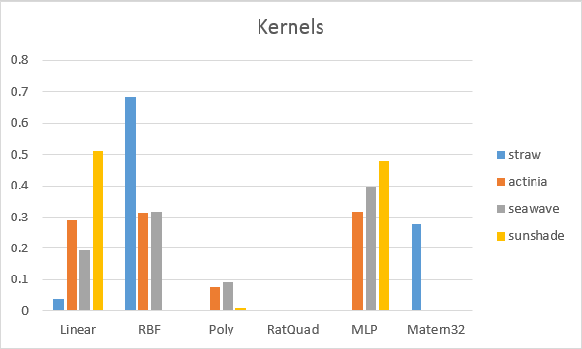
Matlab implementation properties
Sample | Linear | RBF | Poly | RatQuad | MLP | Matern32
straw | 0.040278 | 0.682626 | 0 | 0 | 0 | 0.277096
actinia | 0.289421 | 0.312588 | 0.076728 | 0 | 0.318424 | 0.00284
seawave | 0.192753 | 0.318292 | 0.092731 | 0 | 0.396224 | 0
sunshade | 0.511561 | 0.003422 | 0.008163 | 0 | 0.476782 | 7.18E-05

Slide 52
Python implementation properties
Gaussian process latent variables model
models joint distribution of observed data and low-dimensional latent space
Dimensionality of latent space was fixed to 20
For kernel function – combination of six kernel functions presented was chosen
For optimization function – Scaled conjugate gradient method
For synthesizing new sequence of latent variables – mean prediction method

Slide 53
Python implementation properties
Implementation in Python:
GPLVM is not a dynamical model –no separate kernel function for dynamic modeling
data are generated independently, ignoring temporal structure
The results are quite surprising:
it is stable
it is able to generate new sequences of dynamic textures without visible repetitions
it takes a lot of time to perform optimization
visible result is still not good due to some random noise

Slide 54
Example

Slide 55
Examples
Matlab implementation:
Input videos sunshade.avi and straw.avi
Example of a good result (sunshade.avi)
Example of a bad result (straw.avi)
Python implementation
Example of a good result (straw.avi)

Slide 56
Perspectives

Slide 57
Perspectives
MK-GPLVM reimplementation in Python is not finished – problems with gradients
no numerical criteria for quality measuring – implement an evaluation method
GPLVM implementation in Python is done and provides quite interesting result – improve the results
try wavelets to reduce dimensionality of original input to decrease time for optimization

Slide 58
QUESTIONS ?

Slide 59
Thank you !

