Slide 1

Dynamic texture modeling and synthesis using Multi-kernel Gaussian process Dynamic model

Slide 2
Dynamic texture modeling and synthesis using Multi-kernel Gaussian process Dynamic model

Slide 3

Dynamic texture modeling and synthesis using Multi-kernel Gaussian process Dynamic model

Slide 4

Dynamic texture modeling and synthesis using Multi-kernel Gaussian process Dynamic model

Slide 5
Dynamic texture modeling and synthesis using Multi-kernel Gaussian process Dynamic model
MAKSIM KOPTELOV

Slide 6
Dynamic texture modeling and synthesis using Multi-kernel Gaussian process Dynamic model
MAKSIM KOPTELOV
University of Jean Monnet Master 1 MLDM 2015/2016

Slide 7
Dynamic texture modeling and synthesis using Multi-kernel Gaussian process Dynamic model
MAKSIM KOPTELOV
University of Jean Monnet Master 1 MLDM 2015/2016
Academic Supervisors:
Assoc. prof. Marianne CLAUSEL
Assoc. prof. Rémi EMONET
Prof. Olivier ALATA

Slide 8
Dynamic textures

Slide 9
What is a definition of texture?
1

Slide 10
What is a definition of texture?
For a single image
1

Slide 11
What is a definition of texture?
For a single image
Realization from stationary stochastic process
1

Slide 12
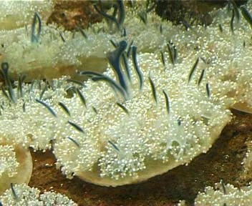
What is a definition of texture?
For a single image
Realization from stationary stochastic process
1

Slide 13
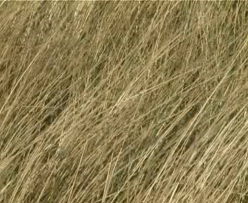
What is a definition of texture?
For a single image
Realization from stationary stochastic process
1

Slide 14
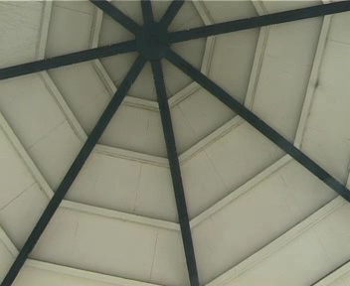
What is a definition of texture?
For a single image
Realization from stationary stochastic process
1

Slide 15
What is a definition of texture?
For a single image
Realization from stationary stochastic process
For a sequence of images
2

Slide 16
What is a definition of texture?
For a single image
Realization from stationary stochastic process
For a sequence of images
Stochastic process of interest defined over space and time.
2

Slide 17
What is a definition of texture?
For a single image
Realization from stationary stochastic process
For a sequence of images
Stochastic process of interest defined over space and time.
2

Slide 18
Why is it important?
3

Slide 19

Why is it important?
Applications in Computer vision:
video surveillance
object tracking
etc.
3

Slide 20
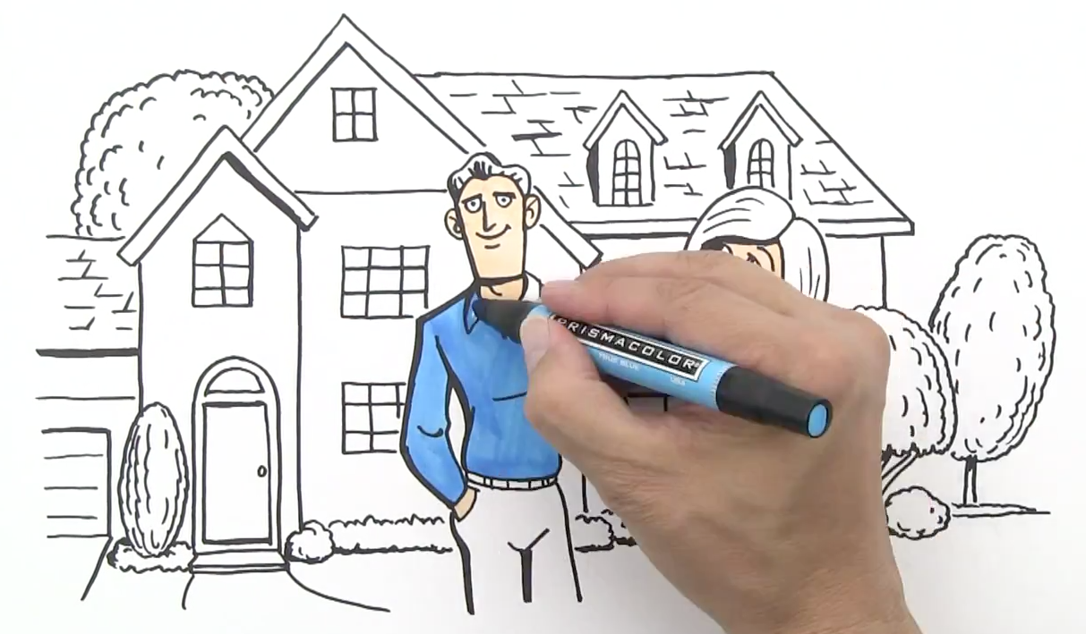
Why is it important?
Applications in Computer vision:
video surveillance
object tracking
etc.
Application in video processing fields:
video indexing
video animation
etc.
3

Slide 21
What we are doing
4

Slide 22
What we are doing
Input – video t1 seconds
Output – new videos t2 seconds, t2 > 0
Dynamic texture can be captured from a video
It can be used then to synthesize new videos with necessary length of time
4

Slide 23
What we are doing
Input – video t1 seconds
Output – new videos t2 seconds, t2 > 0
Dynamic texture can be captured from a video
It can be used then to synthesize new videos with necessary length of time
Existing dynamic textures modeling and synthesis methods:
physics based – costly, not universal
sampling based – memory demanding, mostly manual
learning based methods – more universal, automatic
4

Slide 24
What we are doing
Input – video t1 seconds
Output – new videos t2 seconds, t2 > 0
Dynamic texture can be captured from a video
It can be used then to synthesize new videos with necessary length of time
Existing dynamic textures modeling and synthesis methods:
physics based – costly, not universal
sampling based – memory demanding, mostly manual
learning based methods – more universal, automatic
4

Slide 25
contribution

Slide 26
Contribution
First mission – understand the model
Reimplementation of the method in Python – understand things:
Gaussian process
MK-GPDM
sequence of steps of learning algorithm
functions which must be optimized
functions gradients derivation
dimensionality analysis
5

Slide 27
Learning based methods
high dimensionality – curse of dimensionality
most of dynamic textures are not linear – learning algorithm cannot be linear
big computational cost of optimization – necessary to have a good performance
6

Slide 28
Learning based methods
high dimensionality – curse of dimensionality
dimensionality reduction process must be applied - infers by Gaussian process
most of dynamic textures are not linear – learning algorithm cannot be linear
more flexible model must be found – based of Gaussian process
big computational cost of optimization – necessary to have a good performance
first-order Markov model - based on Gaussian process
6

Slide 29
Learning based methods
high dimensionality – curse of dimensionality
dimensionality reduction process must be applied - infers by Gaussian process
most of dynamic textures are not linear – learning algorithm cannot be linear
more flexible model must be found – based of Gaussian process
big computational cost of optimization – necessary to have a good performance
first-order Markov model - based on Gaussian process
Why Gaussian process? Not many approaches can be used for modeling and synthesis
6

Slide 30
Gaussian process

Slide 31
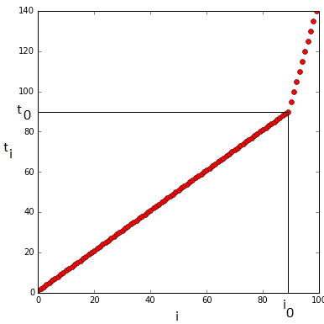
Gaussian process
Definition
Gaussian processes – infinite-dimensional generalization of multivariate normal distributions
Initially we have:
d random variables (X_{t1},…, X_{td}) not equally spaced
timeline t_{i}
d = 100
100 time indexes t_{i}
i₀ – index when space is increased
not regular sampling
7

Slide 32
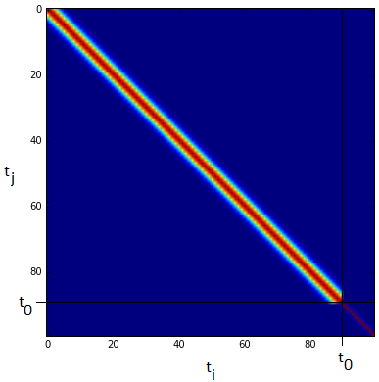

Gaussian process
Characterized by mean and covariance
all the vector of interest are centered – zero mean initially
assume a specific form for the covariance of any subsample (X_{t1},…, X_{td})
Parameters:
a - scale parameter,
l - dispersion parameter
8

Slide 33
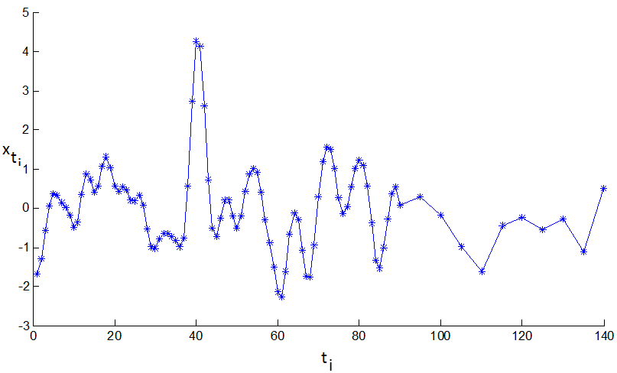
Gaussian process
From one covariance matrix and one sequence of time (t₁,…,t_{k}) possible Gaussian distribution (X_{t1},…, X_{tk}) with zero mean and covariance C
On the axis:
x_{ti} – values of random variables
t_{i} – time indexes
Trend of samples is not spoiled
by not equally spaced time indexes
and can be easily seen
9

Slide 34
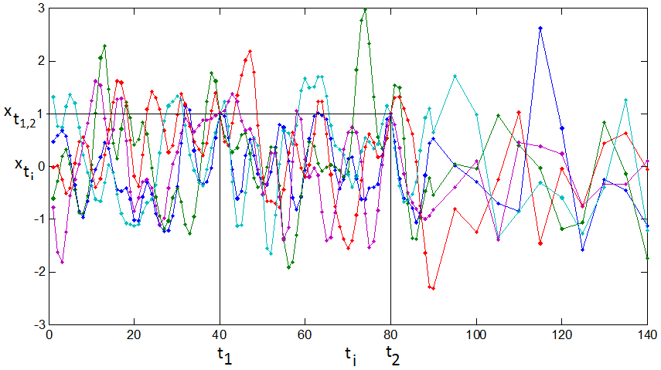
Gaussian process
Now assume that we are conditioning our stochastic process for example:
x_{t1} = 1, x_{t2} = 1 with t₁ = 40, t₂ = 80
Compute new mean vector and covariance matrix (multivariate conditional density):
f* – Gaussian vector x* = x_{{t ∈ T \ T’}}
f – Gaussian vector x_{f} = x_{{t ∈ T’}}
K – covariance matrices associated to two
random variable sets X* = X_{{t ∈ T \ T’}}, X_{f} = X_{{t ∈ T’}}
New set of realizations of multivariate
conditional distribution:
Important property of Gaussian processes
Interpolation can be performed using this approach
10

Slide 35
GP with latent variables
11

Slide 36


GP with latent variables
new class of models
mappings from a latent space X ∈ R^{Q} to an observed space Y ∈R^{D} ,Q << D
through a set of parameters W
one kernel function is used
X, Y – multivariate Gaussian processes
In a simplest case – probabilistic version of PCA
likelihood of the full data set is given by:
W can then be found through maximizing:
11

Slide 37
Dynamic system
12

Slide 38
Dynamic system
In this work dynamical texture modeling consists of two steps:
dimensionality reduction
dynamic texture learning
12

Slide 39

Dynamic system
In this work dynamical texture modeling consists of two steps:
dimensionality reduction
dynamic texture learning
They can be expressed as:
– dynamic model
– dimensionality reduction
x_{t} - latent variable which affects dynamic behavior, x_{t} ∈ R^{Q}
y_{t} - column vector unfolded from the frame at time t, y_{t} ∈ R^{D}, D – large, Q<<D
n_{x},_{t}, n_{y},_{t} - represent the noise
12

Slide 40
GP dynamic model
13

Slide 41
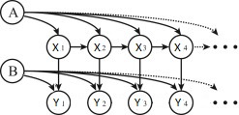

GP dynamic model
latent variable model
2 mappings: from a latent space X to the observation space Y and dynamic behavior of latent variables
2 kernel functions
X – sequence of row-vectors of artificial frames, Y – sequence of row-vectors of observed frames
A – K_{Y} parameters θ, B – K_{X} kernel weights W
Y_{i} is a multivariate Gaussian process indexed by X_{i} expressed by likelihood
13

Slide 42
Multi-kernel GP dynamic model
1
The likelihood extends to the following equation:
X – latent variable vector
Y – observed dynamic texture sequence vector
N – number of frames in original sample
Q – latent dimensionality
W – vector of weights of kernel functions K = k_{l}, l ∈ [1,M]
M – number of different kernel functions used
Reference [1]:
Z. Zhu, et al., Dynamic texture modeling and synthesis using multi-kernel Gaussian process dynamic model, Signal Processing (2015) http://dx.doi.org/10.1016/j.sigpro.2015.10.025
14

Slide 43

Multi-kernel GP dynamic model
1
To achieve nonlinear mapping from a latent space X to the observation space Y
special squared exponential covariance function is used
To map dynamic behavior of latent variables
Latent dynamic behavior varies greatly among different types of dynamic textures
Difficult to design the most suitable kernel for a dynamic texture empirically
Multi-kernel dynamic model for dynamic texture modeling is proposed
Reference [1]:
Z. Zhu, et al., Dynamic texture modeling and synthesis using multi-kernel Gaussian process dynamic model, Signal Processing (2015) http://dx.doi.org/10.1016/j.sigpro.2015.10.025
15

Slide 44
Algorithm understanding
Maximum a posteriori estimation – main method. In Matlab specific library for optimization is used.
In general two main steps:
fix W and perform optimization with respect to X, θ and λ using SCG (Scaled conjugate gradient)
W – weights vector
X – latent variable
θ – vector of hyperparameters of kernel K_{Y}
Λ – vector of parameters of kernel K_{X}
fix obtained X, θ and λ and perform optimization with respect to W using gradient descent
Functions are not convex – repeat these two main steps for I times, I – fixed
16

Slide 45
Results

Slide 46
Matlab implementation properties
Implementation given in Matlab has problems:
Inexplicable instability – often crashes with SVD computation error
Static result – sometimes generated dynamic texture does not move at all
Repetition of original sequences of frames
17

Slide 47
Matlab implementation properties
Implementation given in Matlab has problems:
Inexplicable instability – often crashes with SVD computation error
Static result – sometimes generated dynamic texture does not move at all
Repetition of original sequences of frames
Attempt | Linear | RBF | Poly | RatQuad | MLP | Matern32
1 | 0.040278 | 0.682626 | 0 | 0 | 0 | 0.277096
3 | 0.067891 | 0.720069 | 0 | 0 | 0.212038 | 0
7 | 0.003638 | 0.368365 | 0 | 0.345235 | 0.069727 | 0.213032
17

Slide 48
Python implementation properties
Implementation in Python:
GPLVM does not have specific kernel function to capture the dynamic behavior
Temporal structure is included in covariance
The results are quite surprising:
it is stable
it is able to generate new sequences of dynamic textures without visible repetitions
it takes a lot of time to perform optimization
visible result is still not good due to some random noise
18

Slide 49
Example

Slide 50
Examples
Matlab implementation:
Input videos sunshade.avi and straw.avi
Example of a good result (sunshade.avi)
Example of a bad result (straw.avi)
Python implementation
Example of a good result (straw.avi)
19

Slide 51
Perspectives

Slide 52
Perspectives
MK-GPLVM reimplementation in Python is not finished – problems with gradients
no numerical criteria for quality measuring – implement an evaluation method
GPLVM implementation in Python is done and provides quite interesting result – improve the results
try wavelets to reduce dimensionality of original input to decrease time for optimization
20

Slide 53
Thank you !

