Slide 1
Where Learning Helps and Where It Doesn't (v10)
Stage attribution · learned infeasibility test · scaling wall at 60×150
neuroMCTS project · July 2026

Slide 2
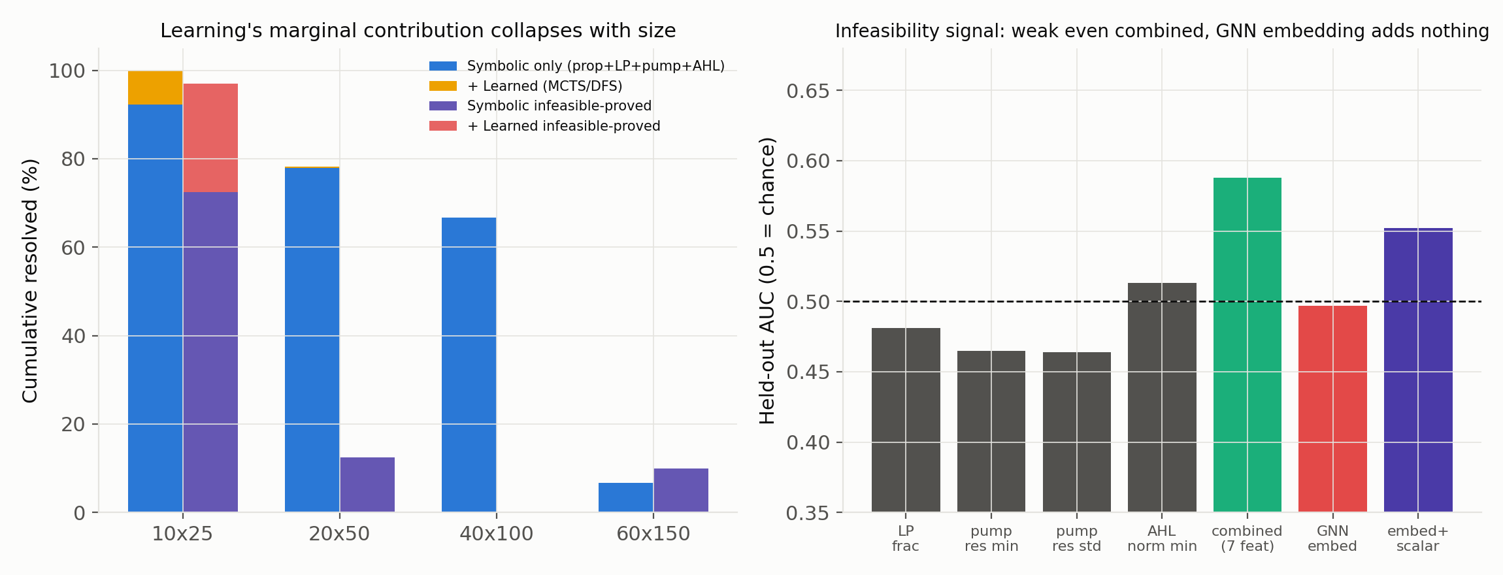
Learning's marginal value converges to exactly zero with size
10×25: learning adds +7.6-7.75pp solved, +24.5pp infeasibility proofs — meaningful
20×50: shrinks to +0.4pp solved, +0pp proofs
40×100 & 60×150: learning contributes literally ZERO instances

Slide 3
Sixth negative: infeasibility signal is weak, GNN embedding is null
New feature: AGGREGATE stats from 15 pump restarts + 8 cheap AHL tries per instance
Combined scalar features: AUC 0.588 (single features: 0.46-0.54) — real but weak
Pretrained GNN embedding alone: AUC 0.497 — exactly uninformative
At best precision: 1 in 3 flagged infeasible is actually feasible — unusable at FN=0

Slide 4
Discovered scaling wall: an accuracy cliff at 60×150
N=40 statistical spot check at 60×150 (never trained/evaluated before)
Solution accuracy: 66.67% (40×100) → 6.67% (60×150) — a cliff, not a gradual decline
Mean time: 22.0s → 108.0s; learning contributes zero here too
Small-N as instructed (not exhaustive) — sufficient to LOCATE the boundary

Slide 5
Conclusion: three precise, falsifiable statements
1. Learning helps only at the smallest size, inside an already-narrow residue
2. Learning cannot classify feasibility — not even from its own GNN representation
3. The symbolic AHL attack that does the real work has its own wall near n≈150
State of the art: strong to n≈100, a measured wall beyond it

