Slide 1
Why Learned Feasibility Classification Fails Here
v11 — Ten diagnosed negative results, a baseline reality check, and a first win from augmenting CP-SAT
neuroMCTS project · July 2026

Slide 2
Motivation: Feasibility Classification, Directly
Solution construction set aside — classify feasibility (does a 0/1 solution exist) directly
Requirement A: inference faster than classical MILP/CP-SAT solvers
Requirement B: accuracy that survives zero-shot transfer to untrained sizes
This cycle tests both requirements head-on, against our own experiments and the literature
v11 · 2

Slide 3
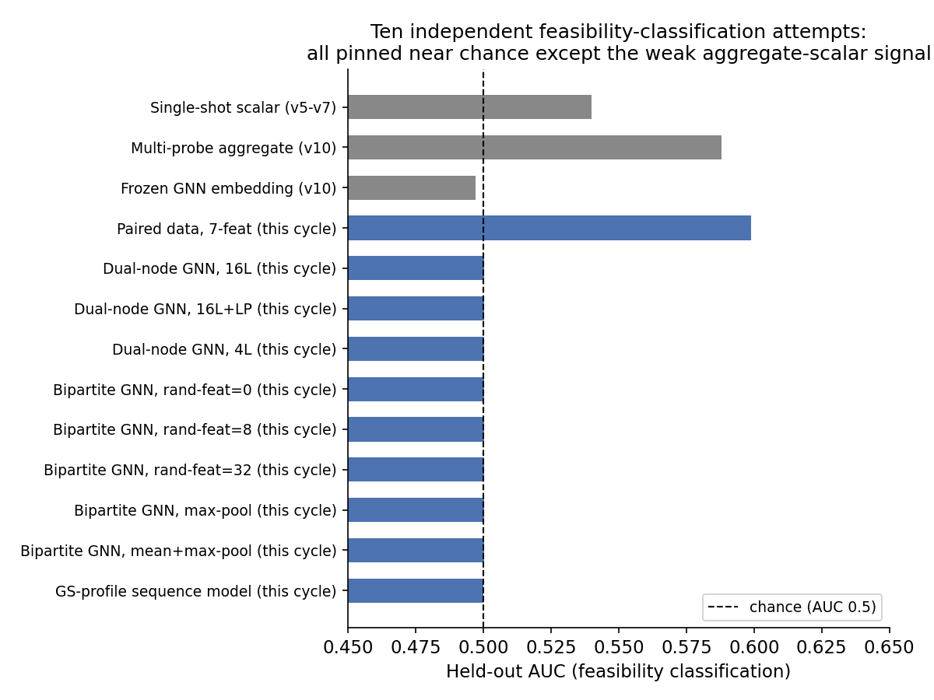
Ten Independent Negative Results
v11 · 3

Slide 4
Ruling Out Optimization Bugs
Every negative result checked against a sanity task before being trusted
Dual-node GNN: loss 0.693→0.607 in 25 epochs on an easy continuous proxy
Bipartite GNN: loss 0.614→0.04 in 6 epochs on a pooling-preserved signal
→ Gradients and optimizer work fine. The failure is not a training bug.
v11 · 4

Slide 5
Root Cause: Near-Miss Pairs Are Representationally Identical
A sequence model on the raw BKZ Gram-Schmidt profile also lands at AUC 0.5000
Diagnosis: 96.8% of 2,529 near-miss pairs are bit-identical across all 8 BKZ tries
b affects only 1 of n+1 basis rows — the rest are entirely determined by A (shared)
→ Not a training/capacity issue: the representation itself carries no information
v11 · 5

Slide 6
Literature Grounding
Chen et al. 2023 (ICLR): some feasible/infeasible MILP pairs are provably GNN-indistinguishable
  → Their fix (random node features) tested this cycle, no effect here (d=0/8/32 all 0.5001)
G4SATBench (TMLR 2024): SAT classifiers lose 15-25 accuracy points under 4-5x size transfer
RL whose output is a feasibility verdict: essentially absent from the literature surveyed
v11 · 6

Slide 7
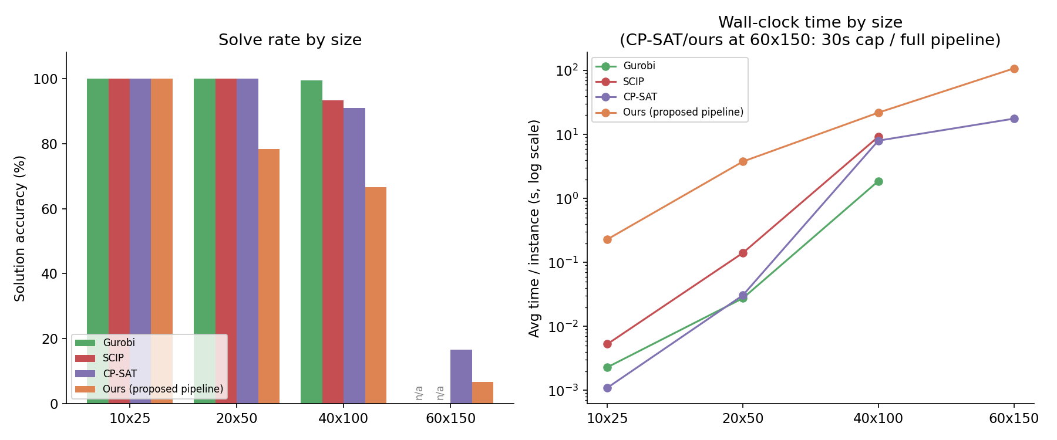
Baseline Reality Check
v11 · 7

Slide 8
Accuracy & Time by Size
Size | Gurobi | SCIP | CP-SAT | Ours
10x25 | 100.0% / 0.0023s | 100.0% / 0.0053s | 100.0% / 0.0011s | 100.0% / 0.23s
20x50 | 100.0% / 0.028s | 100.0% / 0.141s | 100.0% / 0.031s | 78.25% / 3.78s
40x100 | 99.4% / 1.875s | 93.2% / 9.24s | 90.9% / 8.03s | 66.67% / 22.0s
60x150 | — | — | 16.67% / 17.72s | 6.67% / 107.95s
Baselines up to 200x faster and more accurate through 40x100. 60x150 tested for the first time this cycle -- hard for CP-SAT too (2/12), but still ahead of ours (2/30).
v11 · 8

Slide 9
Augmenting, Not Replacing, CP-SAT
Variant | Sol. Acc. | Infeas. Proved | Avg Time
Plain CP-SAT | 16.67% (2/12) | 5/6 | 17.72s
+ pump hint (AddHint) | 16.67% (2/12) | 6/6 | 17.70s
linearization_level=2 | 8.33% (1/12) | 5/6 | 21.22s
PORTFOLIO_SEARCH | 16.67% (2/12) | 5/6 | 19.01s
LP_SEARCH | 16.67% (2/12) | 5/6 | 18.00s
The hint doesn't find more solutions but closes an infeasibility proof, 5/6 -> 6/6. All 3 parameter tweaks were neutral or worse -- the cycle's only reproducible positive result.
v11 · 9

Slide 10
Why Learning Doesn't Transfer Here
(i) Representation-level impossibility, not slow convergence — 96.8% bit-identical inputs
(ii) Exact integer feasibility is discontinuous, number-theoretic — same obstruction as parity
(iii) Market-split is built to remove smooth signal -- for LP relaxation AND gradient descent alike
Scaling depth/width/data leaves AUC at exactly 0.5±0.0003 -- a hard ceiling, not a learning curve
v11 · 10

Slide 11
Conclusion & Next Steps
Feasibility classification failed both our own experiments (10 results) and the literature
Learning's one positive contribution: hinting CP-SAT with symbolic byproducts, not replacing it
Classical solvers dominate through 40x100 and likely still lead at 60x150
Next: expand the hint direction (larger samples, AHL hints, partial hints); hold off on replacement
v11 · 11

