Slide 1
Neuro-Symbolic Search for Binary Linear Systems:
LP-Guided MCTS with Null-Space Projection and
Policy-Guided Complete Backtracking
neuroMCTS project · Research meeting · July 2026

Slide 2
Laser NDT image recovery is a binary linear system that demands both feasibility detection and exact solutions
Task: find x ∈ {0,1}ⁿ with Ax = b, or certify that none exists
Noisy scans (dust) make the system infeasible — a false negative discards a recoverable scan
Market-split-type systems: NP-complete; LP-based branch-and-bound degrades sharply with m

Slide 3
Our approach: stage cheap null-space certificates before learned search, and turn search failures into proofs
Kernel pump: alternating projection onto {x : Ax = b} — walks the null space, certifies feasibility constructively
AlphaZero-aligned MCTS: policy trained on full visit distributions + root Dirichlet noise
Policy-guided DFS: complete backtracking under the learned ordering — solution or infeasibility proof

Slide 4
Inference spends symbolic certificates first and reserves learned search for the hard residue
1 Constraint propagation + probing → contradiction = infeasibility proof
2 LP hard rule → LP infeasible ⇒ binary infeasible
3 Kernel pump → exact solution = feasibility certificate
4 GNN feasibility head (threshold calibrated on training data only)
5 MCTS + 1-ply backtracking + pump repair
6 Policy-guided DFS (20k-node budget) → solve or prove infeasible

Slide 5
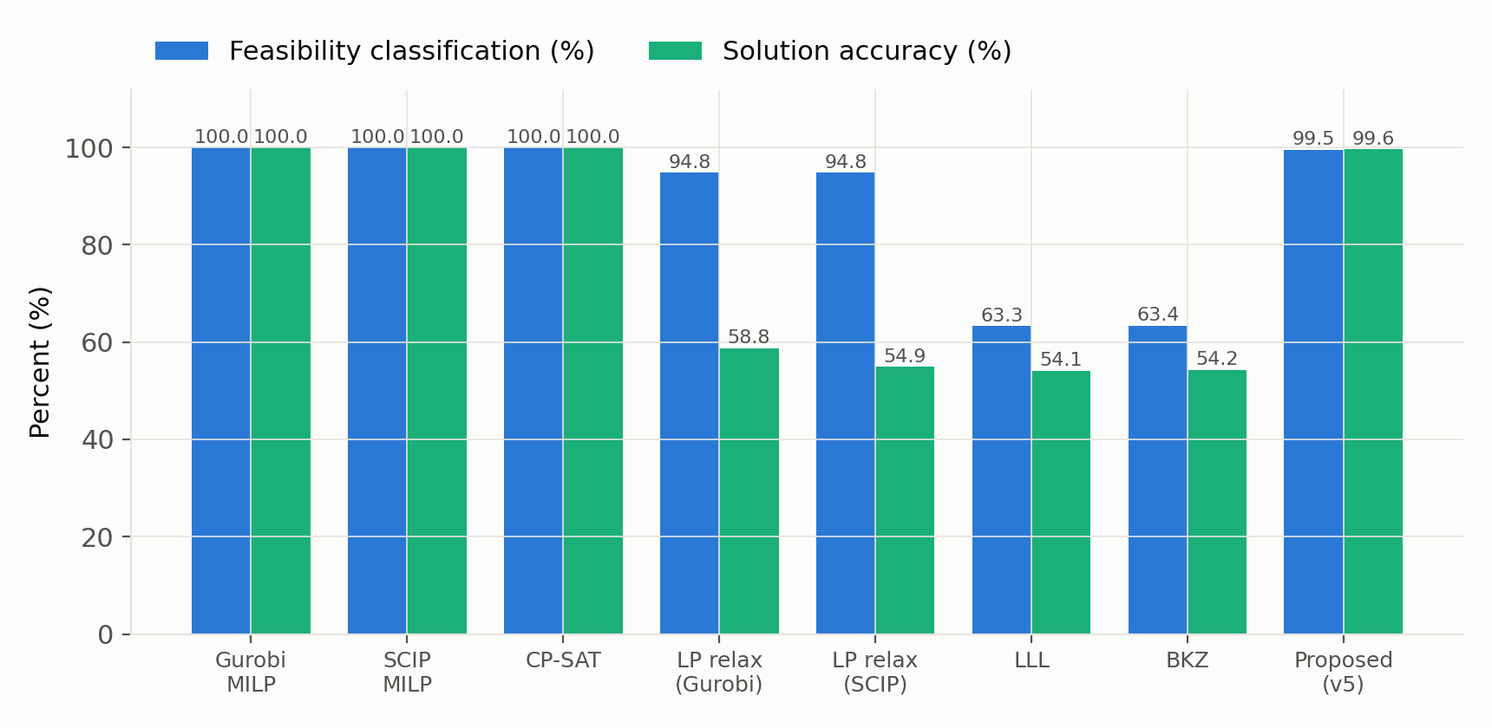
The pipeline beats every inexact baseline: 99.5% feasibility, 99.6% solution accuracy
Key finding
Zero false negatives (800/800)
+40.9 pp solution accuracy vs. best LP rounding
Exact solvers stay perfect and ~10³× faster at 10×25 — our case rests on scaling, not this size
Test set: 1,000 instances (800 feasible / 200 infeasible), 10×25, time incl. all preprocessing

Slide 6
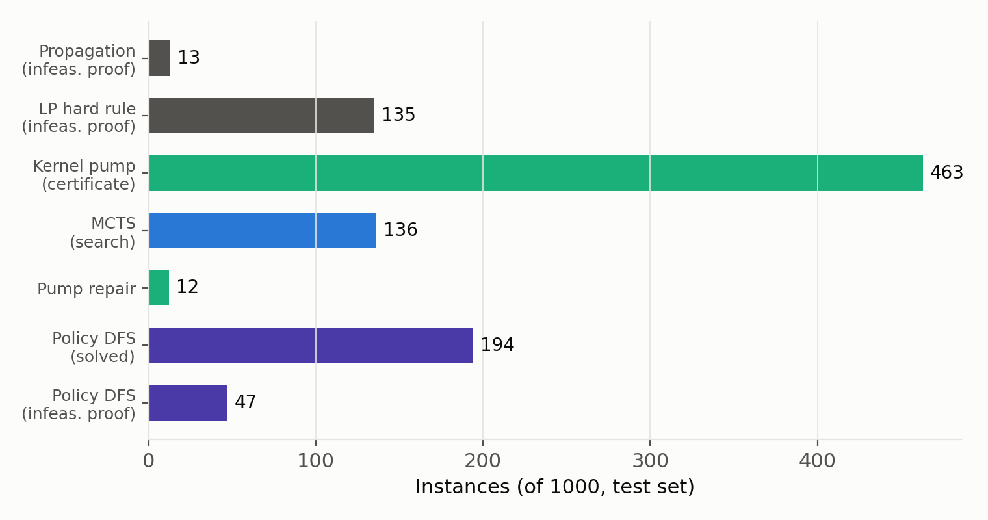
61% of instances close before any neural inference; the learned policy closes most of the rest
Attribution
Symbolic proofs: 148 infeasible
Kernel pump: 463 solved (0.78 ms each)
Learned search: 128 MCTS + 194 DFS solved, 47 DFS infeasibility proofs
Residue: 5 FP + 3 unsolved (budget)

Slide 7
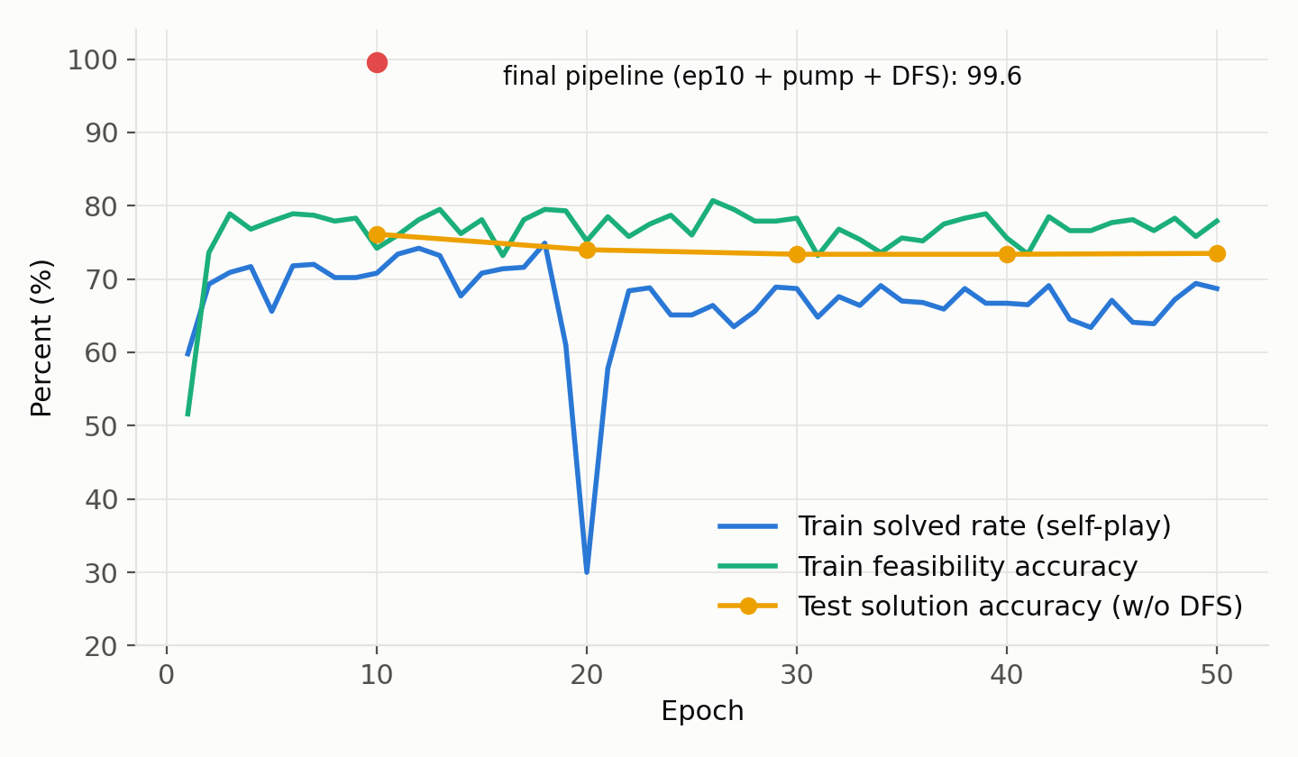
Test accuracy peaks at epoch 10 and drifts down — a fixed training pool induces memorization
Interpretation
Train metrics recover after the ep-20 collapse, test does not follow
Checkpoint chosen on a training-derived calibration set
Next cycle: held-out eval + on-the-fly instance generation

Slide 8
Proofs beat probabilities: the learned feasibility head contributed zero correct rejections
Hard cases (LP-feasible, binary-infeasible) are inseparable to the head — probabilities cluster above 0.84 for both classes
Every feasibility gain came from proofs: propagation, pump certificates, DFS exhaustion
Learning helps inside the search (ordering, value) — consistent with the learned-branching literature

Slide 9
Null-space structure plus budgeted complete search met the operational targets; size scaling is the next milestone
Targets met: feasibility 99.50% (≥ 95), solution 99.62% (≥ 75) on held-out test
Honest bound: exact solvers remain perfect and faster at 10×25
Next: feasibility-head redesign, on-the-fly instances, size-generalization study

Slide 10
References
Aardal, K., Bixby, R. E., Hurkens, C. A. J., Lenstra, A. K., & Smeltink, J. W. (2000). Market split and basis reduction: Towards a solution of the Cornuéjols–Dawande instances. INFORMS Journal on Computing, 12(3), 192–202.
Cornuéjols, G., & Dawande, M. (1998). A class of hard small 0–1 programs. IPCO 1998, 284–293.
Gasse, M., Chételat, D., Ferroni, N., Charlin, L., & Lodi, A. (2019). Exact combinatorial optimization with graph convolutional neural networks. NeurIPS 32.
Nair, V., et al. (2020). Solving mixed integer programs using neural networks. arXiv:2012.13349.
Selsam, D., et al. (2019). Learning a SAT solver from single-bit supervision. ICLR.

