Slide 1
Lattice-Reduction Attack as a Pipeline Stage:
v8 Results and Why the Alternatives Failed
neuroMCTS project · Research meeting · July 2026

Slide 2
Three search technologies, one hard benchmark: only the AHL embedding works
Conflict learning (CBJ): 0/60 at 500k nodes — dense rows make conflict reasons vacuous
Kernel-lattice enumeration: 2/40 — box pruning too loose on dense kernels
AHL solution embedding + BKZ: 19/40 at 70 ms median — reduction reveals solutions directly

Slide 3
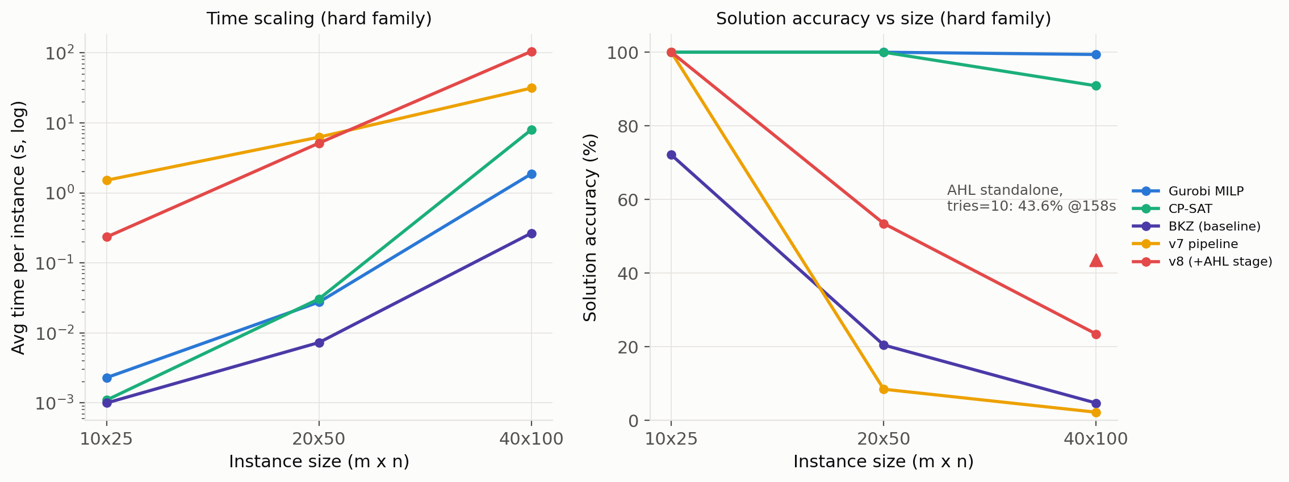
v8 = pipeline + AHL stage: strongest inexact method at every size
20x50: 9.6% -> 53.5% @5.2s | 40x100: 2.25% -> 23.5% (43.6% at full budget) | 10x25: 100% kept, 6.5x faster

Slide 4
Why it works where others fail — and where learning goes next
Solutions are short vectors (2x-1 | -1 | 0), norm sqrt(n+1): reduction finds them without search
Verified-only returns: zero false positives on infeasible inputs, zero false negatives kept
Learning roles ahead: try-scheduling (median 2 tries to hit; failures burn 10), hardness routing, fail-first proofs
Honest bound: exact solvers still ahead where they finish (Gurobi 99.4% @1.9s at 40x100)

Slide 5
References
Aardal, K., Bixby, R. E., Hurkens, C. A. J., Lenstra, A. K., & Smeltink, J. W. (2000). Market split and basis reduction. INFORMS Journal on Computing, 12(3), 192-202.
Schnorr, C. P., & Euchner, M. (1994). Lattice basis reduction: Improved practical algorithms and solving subset sum problems. Mathematical Programming, 66, 181-199.

