Slide 1
Tuning the Lattice Stage for Scale (v9)
Size-dependent block optimum · weak scheduler · 78%/67% at low time
neuroMCTS project · July 2026

Slide 2
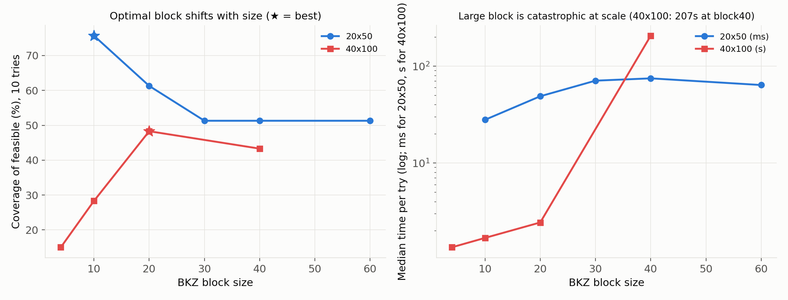
The dominant lever: the optimal BKZ block shifts with size
20×50: coverage peaks at block 10 (75.7%), flat at 51.3% for block ≥30
40×100: unimodal, peaks at block 20 (48.3%), declines by block 40
v8 used block 40 — suboptimal at both sizes

Slide 3
Block 40 is catastrophic at scale: 207s per try at 40×100
BKZ cost explodes as block → lattice dimension (n+1)
40×100 per try: block 20 = 2.4s vs block 40 = 207s (~85× for LOWER coverage)
Scalability rule: tune block DOWN as instances grow — better coverage AND time
Tries = secondary lever (independence law, diminishing, parallelizable)

Slide 4
Learned scheduler rejected — signal too weak (AUC 0.54–0.58)
Best feature (first-try shortest-vector norm): AUC 0.542 (eventual), 0.576 (next-try)
Above chance but far from usable — cutting tries would discard solvable instances
Rejected on cost–benefit; fifth cross-cycle negative for learned components

Slide 5
Result: 78.25% at 20×50, 66.67% at 40×100, 13× faster
20×50: block 40→10 lifts 57.5% → 78.25%, time 4.93s → 3.78s (more, faster, fewer tries)
40×100: block 20 → 66.67% at 22.0s vs block 40 70% at 296s — 13× speedup, equal coverage
vs pre-lattice v7 (2.25%): ~30× solution-accuracy gain, now at ~3× CP-SAT time (was 37×)
Feasibility unchanged (82.5/80.0) — AHL finds solutions; refutation gap persists

Slide 6
Conclusion: scale comes from symbolic tuning, not learning
Scale = tune BKZ block down with size (primary) + modest parallel tries (secondary)
Both are symbolic knobs; learning does not help (fifth negative result)
Positive levers (null-space pump, lattice reduction) also scale by budget, not training
Method lesson: verify against raw artifacts — a truncated log nearly inverted this paper
Next: genuinely larger sizes (60×150+), and the open refutation gap

