Slide 1

Performance Evaluation of Digital Modulation Techniques Used in Bluetooth Physical/Radio Layer
Islam Galal
(islam.galal@bhit.bu.edu.eg)
Electrical Engineering Department
Benha Faculty of Engineering
Benha University
Prof. Dr. Abdelhalim Zekry
Dr. Mostafa E. A. Ibrahim
Dr. Hossam E. Ahmed

Slide 2
Outline
Objectives
Bluetooth Radio Specifications
General Block Diagram of a Typical Bluetooth Physical Layer Transceiver.
Utilized Modulation Techniques.
Gaussian Frequency Shift Keying (GFSK).
π/4 shifted Differential Quadrature Phase Shift Keying (π/4 - DQPSK).
π/8 shifted Differential Eight Phase Shift Keying (π/8 – D8PSK).
Frequency Hopping (FH).
Transmitter Modulated Waveforms after Applying FH.
BER Comparisons For All Simulated Systems.
Conclusions.

Slide 3
Objectives
Provide a brief description of the Bluetooth standard including the Physical Layer.
Achieve modulation with power efficient implementation , and Minimum Bit Error Rates.
Give a high level view of the Radio Communication issues in various modulation schemes used by Bluetooth.
Focus on developing MATLAB/SIMULINK models for the Different Bluetooth transceivers.

Slide 4
Bluetooth Radio Specifications
Bluetooth Physical Layer
Transmitter
  Operates in the 2.4 GHz unlicensed ISM band.
  79 hop frequencies: f = 2402+k MHz, k= 0, 1, 2, ..., 78.
  Nominal output power = 0 dBm (1 mW).
Receiver
  BER < 10⁻³ for GFSK:
    –70dBm input power level.

Slide 5
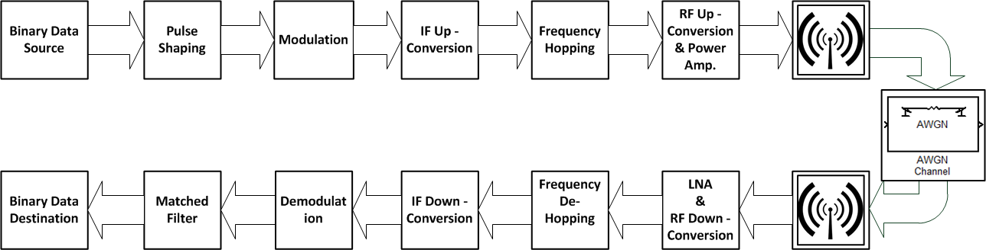
General Block Diagram of a
Typical Bluetooth Physical Layer Transceiver

Slide 6
Utilized Modulation Techniques
Gaussian Frequency Shift Keying (GFSK)
  GFSK System Simulation Parameters.
  Pulse shaping: Gaussian Pulse Shape Filter.
  Impact of Gaussian Filter on Constellation Diagram, Time Domain Waveforms and Power Spectral Density (PSD).
  GFSK BER Simulation Results

Slide 7
Utilized Modulation Techniques
Continued…1
π/4 shifted Differential Quadrature Phase Shift Keying (π/4 - DQPSK)
  π/4 - DQPSK System Simulation Parameters.
  π/4 - DQPSK & π/8 – D8PSK Modulator/Demodulator.
  Pulse shaping: Raised Cosine (RC) Filter.
  Impact of RC Filter on Constellation Diagram, Time Domain Waveforms and Power Spectral Density.
  π/4 - DQPSK BER Simulation Results

Slide 8
Utilized Modulation Techniques
Continued…2
π/8 shifted Differential Eight Phase Shift Keying (π/4 – D8PSK)
  π/8 – D8PSK System Simulation Parameters.
  Impact of RC Filter on Constellation Diagram, Time Domain Waveforms and Power Spectral Density.
  π/8 – D8PSK BER Simulation Results

Slide 9
GFSK System Simulation Parameters:
First: Gaussian Frequency Shift Keying (GFSK)
Data Rate Rb | 1Mbps
Modulation Index β | 0.28 - 0:35
Frequency Deviation ∆F | 140 - 175 KHz
Gaussian Filter With BT | 0.5
Effective Signal Bandwidth 3dB | 1MHZ
FHSS - AFH (79 frequencies) | 2.402 + k MHz, k=0, …, 78 - 160 Khps - slot time = 6.25 uSec
Transmitting Bandwidth | 2.400-2.4835 GHz
AWGN Channel
 | Eb/No (e.g.) | 5 dB
 | Number of bits per symbol | 1 bps
 | Input signal power | 2.5mW
 | Symbol period | 1uSec

Slide 10
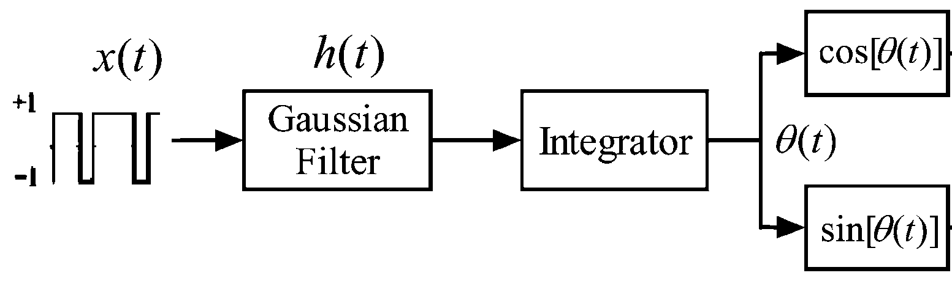
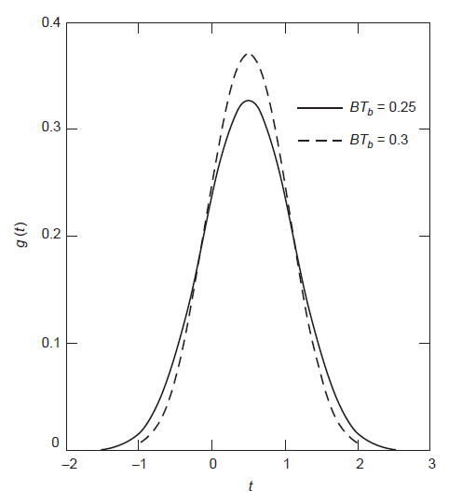
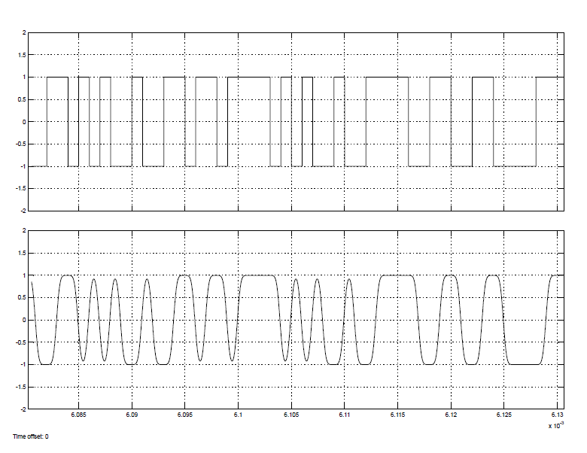
Pulse Shaping: Gaussian Pulse Shape Filter
GFSK
Continued…1
GFSK Modulator

Slide 11
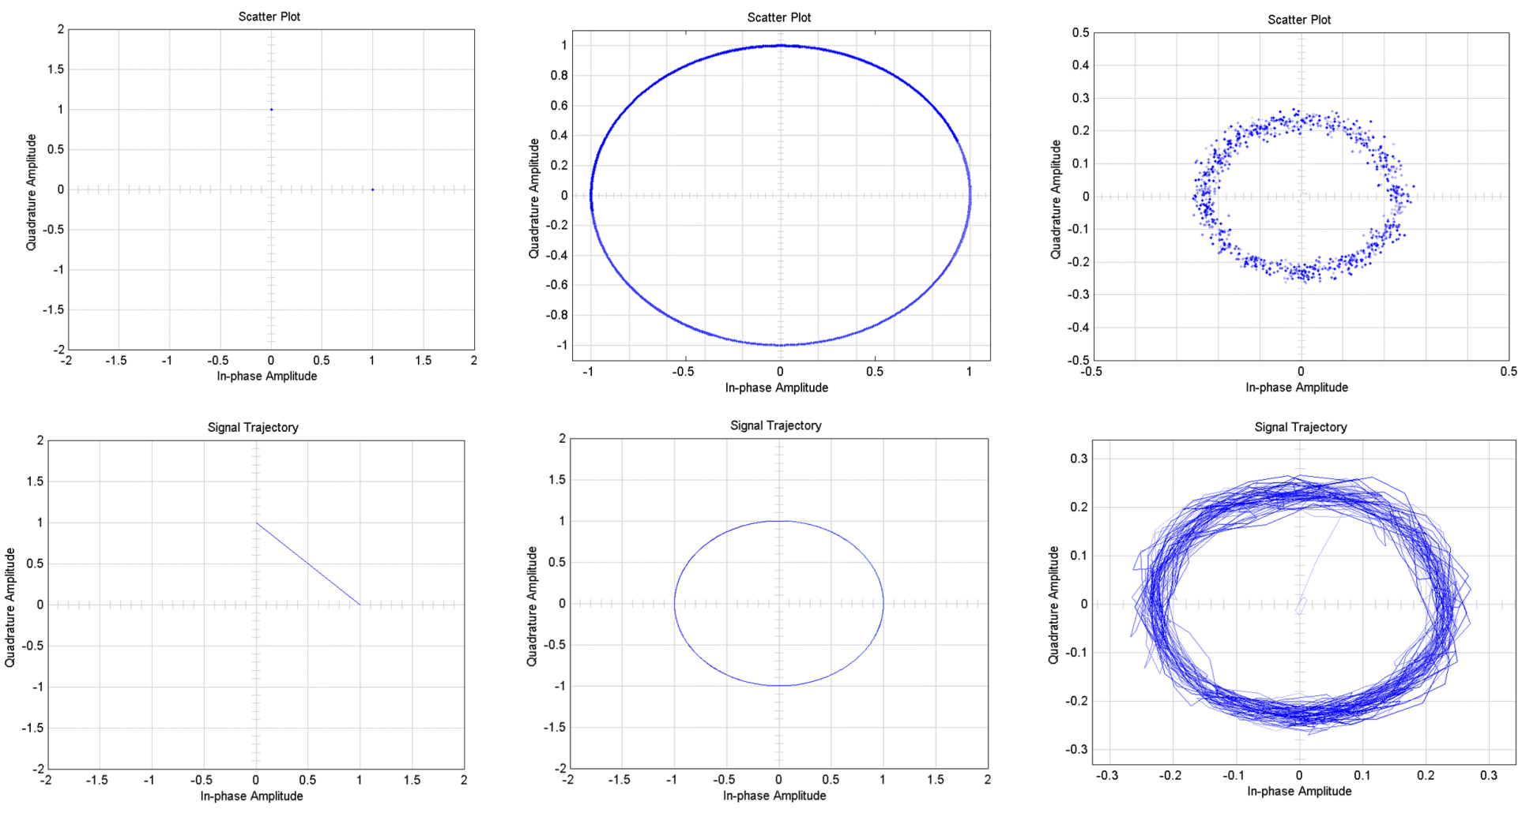
Impact of Gaussian Filter on Constellation Diagram
GFSK
Continued…2

Slide 12
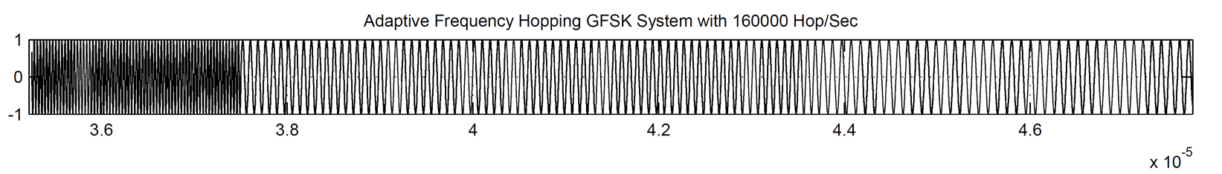
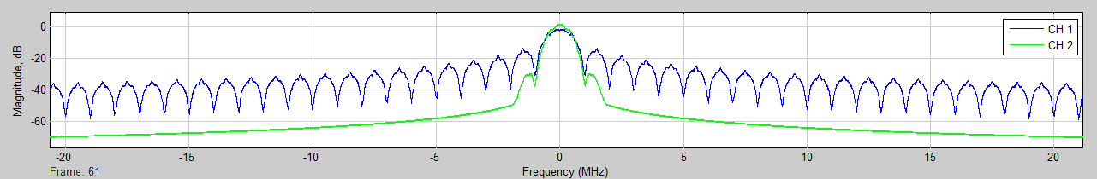
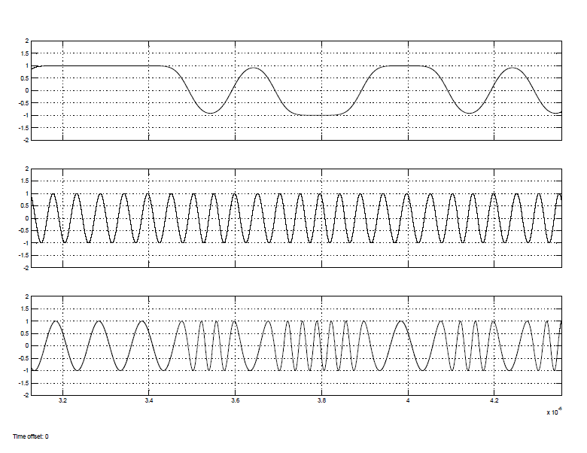
Impact of Gaussian Filter on Time Waveforms & PSD
GFSK
Continued…3
Constant Envelope - Highly Power Efficient
Lower Adjacent Channel Emission

Slide 13
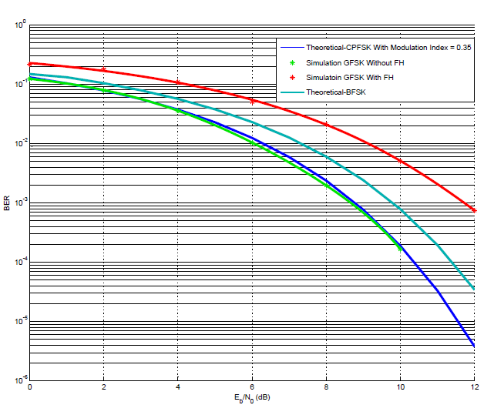
GFSK BER Simulation Results
GFSK
Continued…4

Slide 14
π/4 - DQPSK System Simulation Parameters:
Second: π/4 shifted Differential Quadrature Phase Shift Keying
(π/4 - DQPSK)
Data Rate Rb: | 2Mbps
SRRC filter with Roll-off Factor α: | 0.4
Effective Signal Bandwidth 3dB | 1MHZ
FHSS - AFH (79 frequencies) | 2.402 + k MHz, k=0, …, 78 - 160 Khps - slot time = 6.25 uSec
Transmitting Bandwidth | 2.400-2.4835 GHz
AWGN Channel
 | Eb/No (e.g.) | 5 dB
 | Number of bits per symbol | 2 bps
 | Input signal power | 2.5mW
 | Symbol period | 1uSec

Slide 15
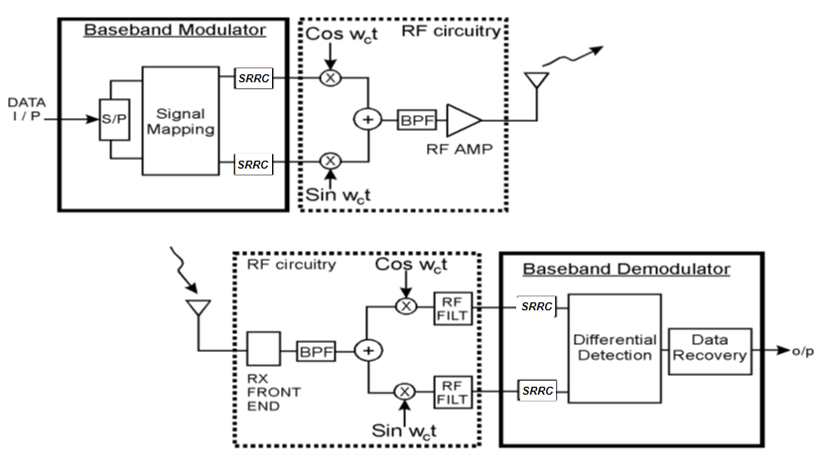
π/4 - DQPSK - π/8 – D8PSK Modulator / Demodulator
π/4 – DQPSK
Continued…1

Slide 16
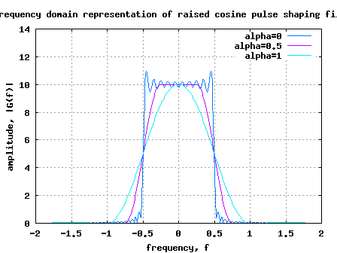
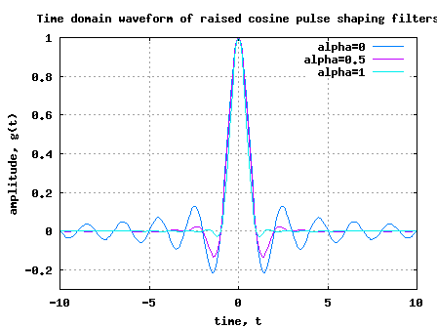
Square Root Raised Cosine (SRRC) Filter
π/4 – DQPSK
Continued…2
At alpha = 0 its Rect but duo to the divide by zero is not-permitted
Thus, in Matlab we devide by 0+1e-18

Slide 17
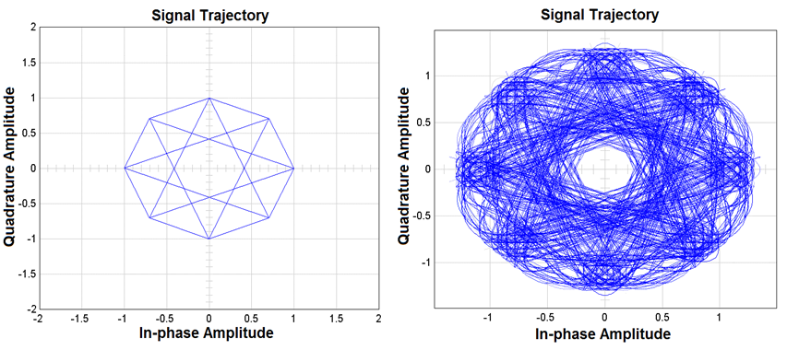
Impact of RC Filter on π/4 – DQPSK Constellation Diagram
π/4 – DQPSK
Continued…3

Slide 18
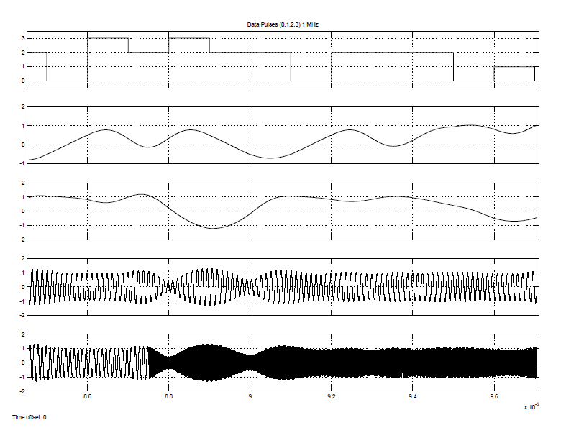
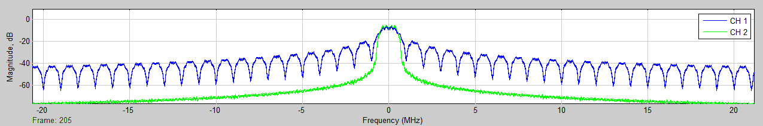
Impact of RC Filter on Time Waveforms & PSD
π/4 – DQPSK
Continued…4
Lower Adjacent Channel Emission But Non-constant Envelope
Less Power Efficiency

Slide 19
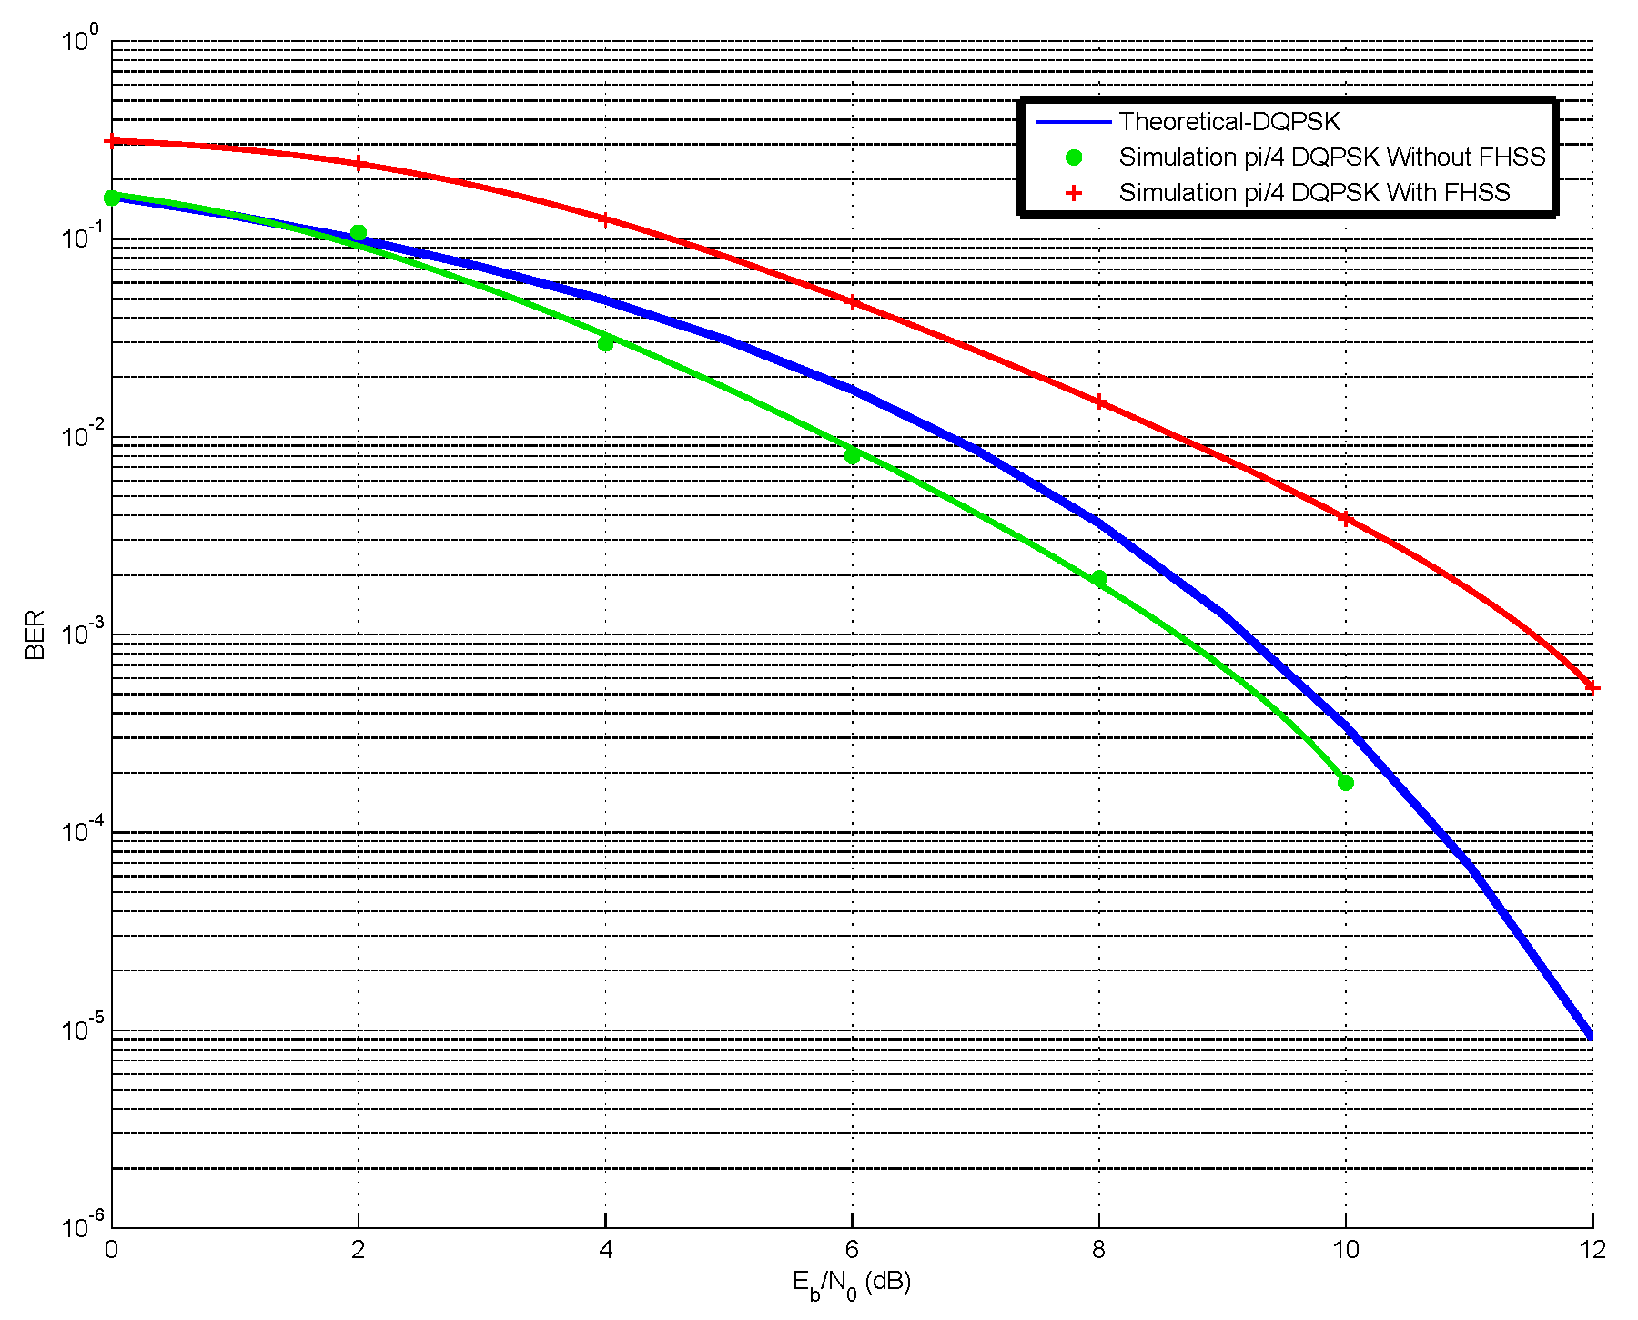
RC π/4 - DQPSK BER Simulation Results
π/4 – DQPSK
Continued…5

Slide 20
π/8 – D8PSK System Simulation Parameters:
Third: π/8 shifted Differential Eight Phase Shift Keying (π/8 – D8PSK)
Data Rate Rb: | 3Mbps
SRRC filter with Roll-off Factor α: | 0.4
Effective Signal Bandwidth 3dB | 1MHZ
FHSS - AFH (79 frequencies) | 2.402 + k MHz, k=0, …, 78 - 160 Khps - slot time = 6.25 uSec
Transmitting Bandwidth | 2.400-2.4835 GHz
AWGN Channel
 | Eb/No (e.g.) | 5 dB
 | Number of bits per symbol | 3 bps
 | Input signal power | 25mW
 | Symbol period | 1uSec

Slide 21
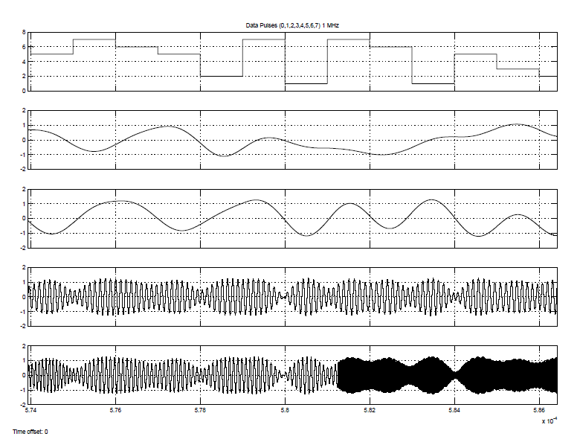
Impact of RC Filter on Time Waveforms & PSD
π/8 – D8PSK
Continued…1

Slide 22
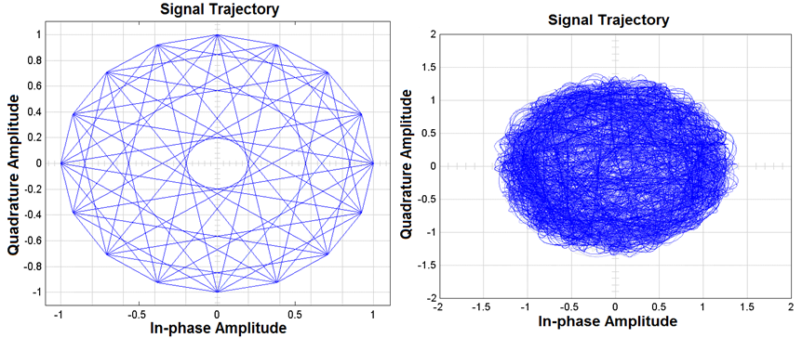
Impact of RC Filter on π/8 – D8PSK Constellation Diagram
π/8 – D8PSK
Continued…2

Slide 23
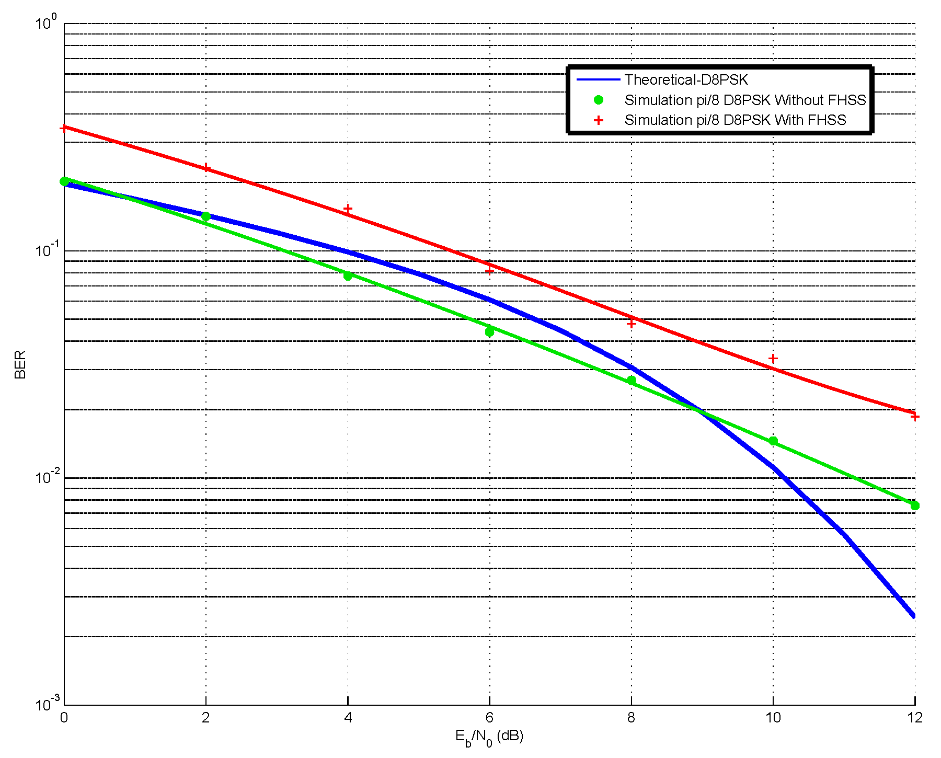
RC π/8 – D8PSK BER Simulation Results
π/8 – D8PSK
Continued…3

Slide 24
Frequency Hopping (FH)
FH occurs by jumping from one channel to another in pseudorandom sequence.
Resists interference and multipath effects.
Provides a form of multiple access among collocated devices in different piconets.
Total bandwidth divided into 1 MHz channels.

Slide 25
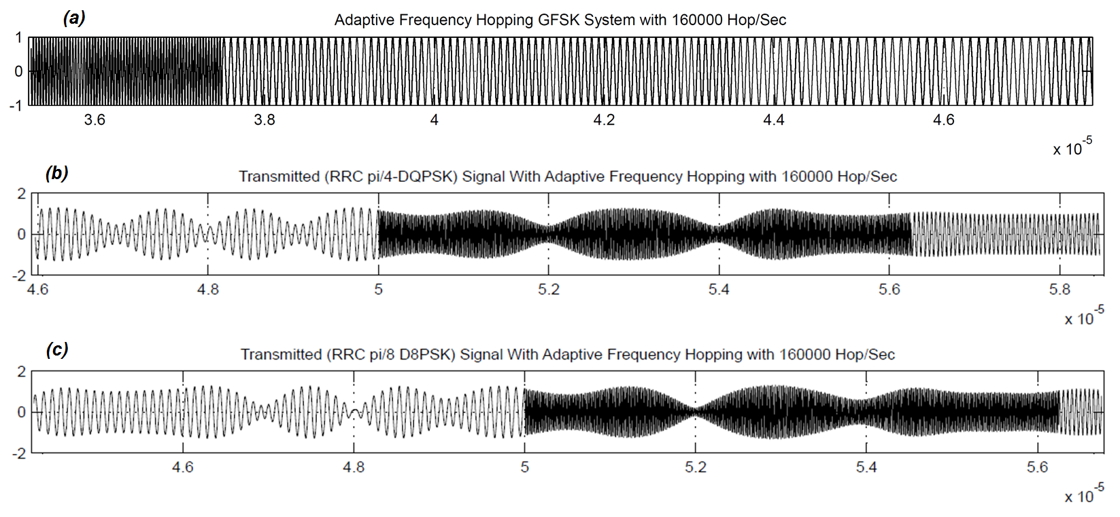
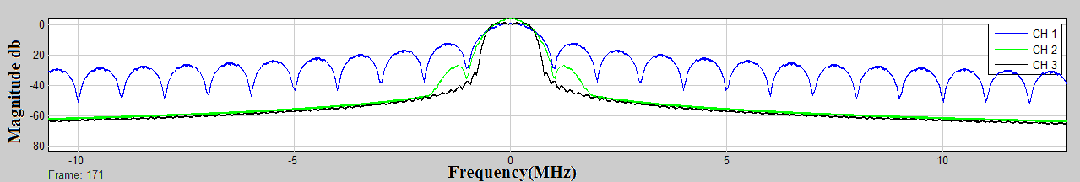
Transmitter Modulated Waveforms after Applying FH

Slide 26
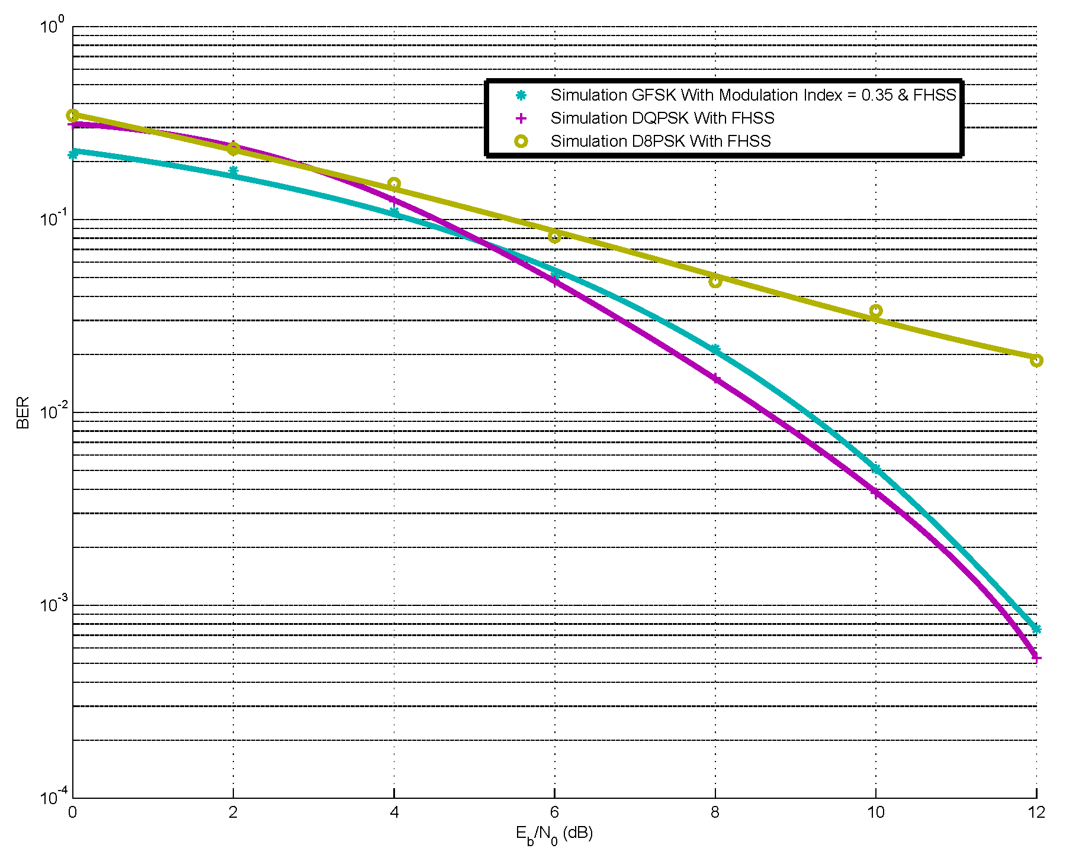
BER Comparisons For All Simulated Systems

Slide 27
Conclusions
In this work three different models for Bluetooth TX/RX with three different modulation schemes have been done.
GFSK has the best power efficient transmission.
Utilizing RC filter has better decay in side-loop suppressions than Gaussian filter.
π/4 - DQPSK and π/8 - D8PSK modulation schemes have higher bandwidth efficiency compared to the GFSK.
π/4 - DQPSK model achieves the best performance under AWGN channel
This work is a first step towards a SDR-based implementation of the Bluetooth transceiver using USRP.

Slide 28
Thanks For Your Attention.
Questions??

