Slide 1
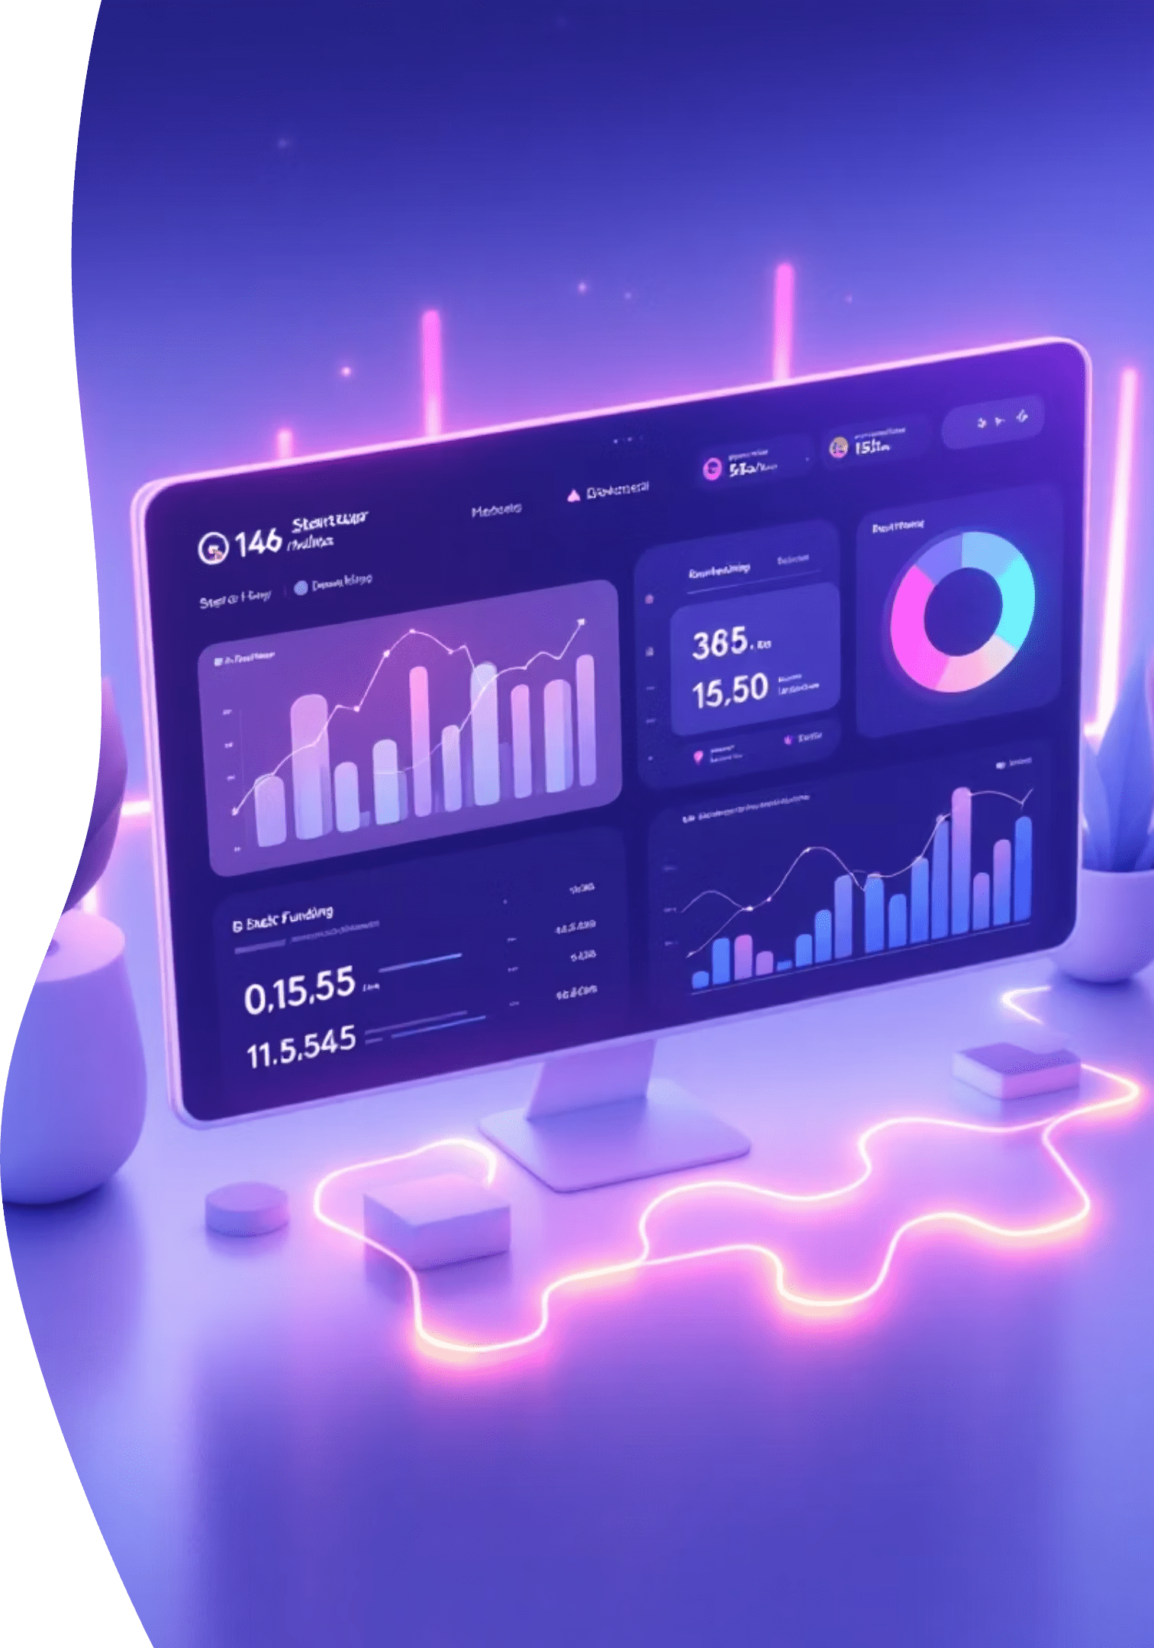
End-to-End Startup Funding Intelligence System
Web Scraping → Data Engineering → ML → Full-Stack Dashboard
Python | Selenium | Pandas | MySQL | XGBoost | Streamlit

Slide 2




Project Overview
Data Collection
ML Models
Web scraping pipeline capturing 10,000+ funding events from multiple sources
3 XGBoost models for predictions and investor scoring
Authentication
Interactive UI
Secure multi-user system with personalization features
Full-featured Streamlit dashboard with real-time analytics
A production-grade analytics platform combining advanced data engineering with machine learning to deliver actionable startup funding insights.

Slide 3

Technology Stack
Data & Backend
Frontend & Security
Web Scraping: Selenium + ChromeDriver (headless)
UI Framework: Streamlit Multi-page
Processing: Pandas, NumPy
Visualization: Plotly Express
Database: MySQL with connection pooling
Authentication: SHA-256 hashing + session state
ML: XGBoost + Sklearn Pipeline
Target: startuptalky.com

Slide 4

Phase 1: Data Acquisition
Kaggle Dataset
Period: 2015–2019
1
Method: CSV download
Rows: ~3,100 funding events
Web Scraping
Period: 2020–2025
2
Method: Selenium + Headless Chrome
Rows: ~9,800 funding events
Data Integration
3
Standardized column names, cleaned duplicates, normalized cities & sectors
Final Output: 5,862 merged funding events

Slide 5
Phase 2: Data Cleaning & Standardization
5,862
4,183
5,302
Total Rows
Unique Companies
Unique Investors
Funding events from Jan 2015 to Oct 2025
Diverse startup portfolio analyzed
Comprehensive investor network mapped
01
02
Fuzzy name matching for entity resolution
Currency conversion ($ → ₹ Cr)
03
04
Date parsing with synthetic stable dates
Sector/Sub-sector mapping & duplicate removal

Slide 6

Phase 3: Feature Engineering
Built 4 production-ready tables with leakage-proof features for robust ML predictions:
df_enhanced_fixed.csv
Cumulative funding metrics
Rolling 6-month & 12-month windows
company_enhanced_fixed.csv
Total funding per company
Round counts & progression
investor_enhanced_fixed.csv
HHI concentration index
Average unique leads & top sectors
market_signals_summary_fixed.csv
6-month average funding
Market momentum indicators

Slide 7
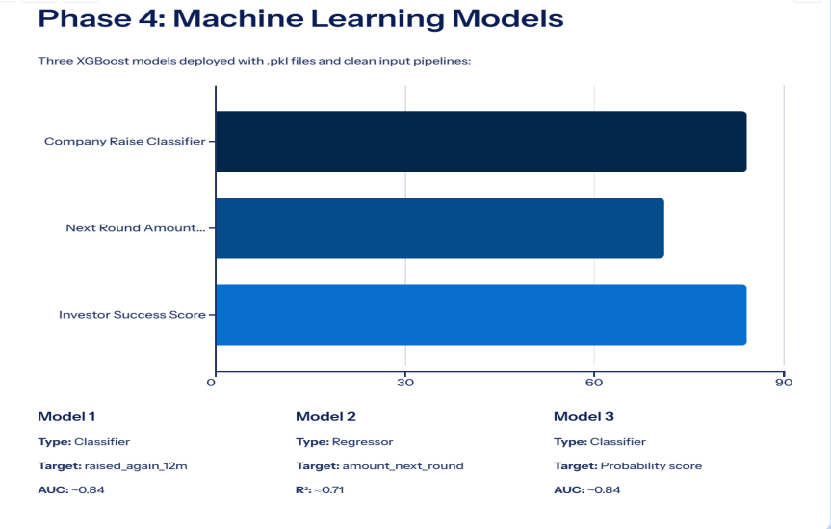

Slide 8





Database & Authentication System
Signup
SHA-256 hashing → INSERT users table
Login
Verify credentials → session_state.logged_in=True
Onboarding
First login → save user preferences
Tracking
Log every action for personalization
MySQL Schema: users, preferences, activity, watchlist, insights tables with full relational integrity

Slide 9
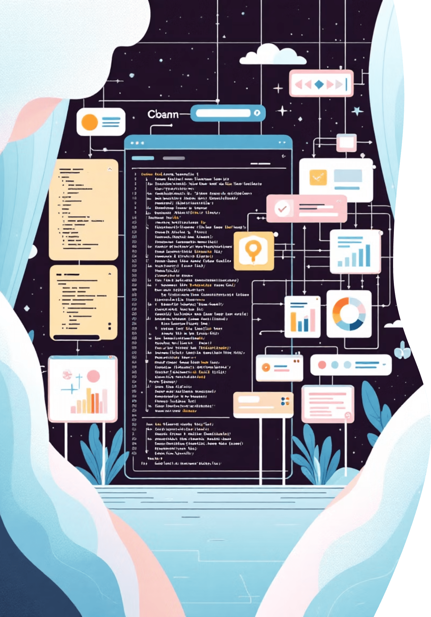
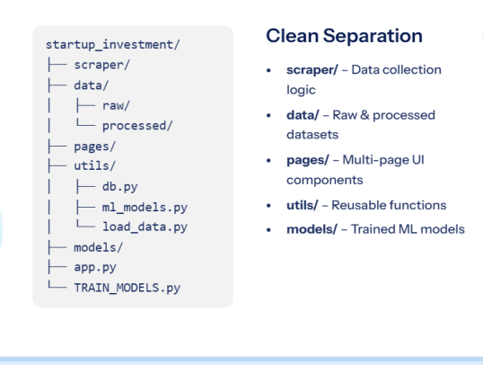
Modular Code Architecture

Slide 10
Key Engineering Wins
Anti-Bot Measures
Data Leakage Prevention
Lightweight Auth
Multi-Page Navigation
Selenium + random delays + proxy rotation to bypass detection
SHA-256 + session_state without Django overhead
Streamlit switch_page() for seamless UX
Strict lagged features ensuring model integrity
Robust Data Handling
Smart Personalization
clean_input() function managing missing values
Activity logging driving tailored insights

Slide 11
Dashboard Highlights
Overview Trends
Company Deep Profile
Investor Network Graph
Market Heatmap
Track funding patterns and market movements in real-time.
Comprehensive insights into startup performance and history.
Identify hot sectors and emerging opportunities at a glance.
Visualize connections between investors and portfolio companies.
Live ML Forecasts
Personalized "For You"
AI-powered predictions for funding trends and valuations.
Tailored insights based on your interests and portfolio.

Slide 12
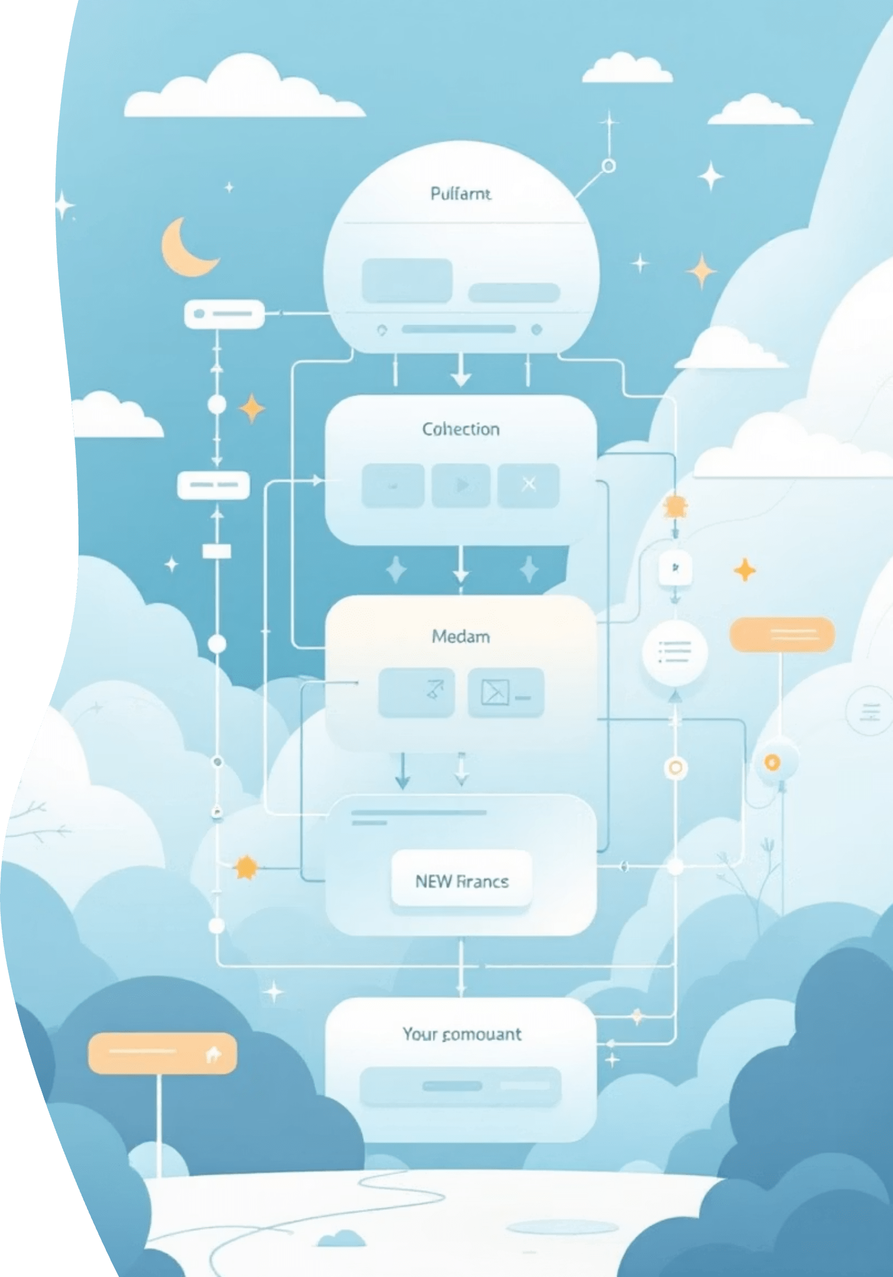
Results Summary
5,862
16+
3
Clean Funding Events
Engineered Features
Production ML Models
Validated and structured data points across multiple years
Advanced data transformations for ML model training
Deployed models delivering real-time predictions
Full User System
Modular Architecture
Complete authentication and personalization capabilities for tailored experiences
Scalable design enabling easy expansion and maintenance

Slide 13




Technical Challenges & Solutions
Dynamic Website Elements
Implemented WebDriverWait for reliable element detection and interaction
Structure Changes
Built fallback XPATHs to handle evolving website architectures
Infinite Scroll
Developed JS-based scroll simulation for complete data capture
Missing Dates
Generated synthetic dates to maintain data continuity

Slide 14




Data Quality & Security
Leakage Prevention
Used lagged features only to ensure model integrity
Custom Authentication
Implemented SHA-256 security system for user protection
Smart Personalization
Rule-based engine with NLP-ready architecture

Slide 15

Future Roadmap
Expanding capabilities with advanced NLP and AI technologies to deliver even deeper insights and automation

Slide 16
NLP-Powered Intelligence
01
02
Auto Sector Tagging
Smart Investor Matching
Leverage IndicBERT for automatic industry classification
Use NLP embeddings to connect startups with ideal investors
03
04
Company Similarity Engine
Sentiment Analysis
Deploy Sentence Transformers to find comparable companies
Analyze funding news to gauge market sentiment and trends
05
06
Auto-Extract New Deals
Voice-Enabled Queries
Combine RSS feeds with NLP for real-time deal discovery
Integrate Whisper and RAG for natural language interactions

Slide 17
End-to-End Production System
Scraping
1
Automated data collection from multiple sources
2
Engineering
Feature creation and data transformation
Machine Learning
3
Model training and prediction generation
4
Dashboard
Interactive visualization and insights
Personalization
5
Tailored user experiences and recommendations

Slide 18

Conclusion
A production-ready system delivering real, multi-year Indian startup funding intelligence
Comprehensive
Intelligent
Scalable
Full pipeline from data collection to actionable insights
ML-powered predictions and personalized recommendations
Modular architecture ready for future enhancements

