Slide 1
Notes:
Each blue box is a step of the flow, and each green box shows the outputs of related design step.
FPGA DESIGN & VERIFICATION FLOW
1. Planning
2. Conceptual Design
3. Implementation
4. Simulation and Verification (CC, FC)
Well-understood & Clarified Design Requirements (Reqs. shall be updated by Team Lead && || System Architect in ALM tools)
Researches, Ideas, Brainstormings, Notes && Drawings for the Best Solution
Realization of Requirements
(by Reusing && Producing Reusable Outputs)
Simulated && Verified Design
(via Self-Checking Testbenches, Custom Libraries && UVM/UVVM/OSVVM)
OPTINAL STEP:
Conceptual Design Review by Team Lead && || System Architect
5. Resource and Timing Optimization
6. Design and Code Review
7. Regression, Qualification and System Integration
8. Documentation
Constraint Files,
Fully Constrained Design, Optimized Resource Usage && Timing Performance
Reviewed Design (both Manual & Automatic Reviews result in Improved Reusability && Know-How Transfer)
Regression Tests via Simulation (+ SWIL && || HWIL), Qualification, System Integration
Design Documents (Extremely Benefits from the Outputs of First 7 Steps)

Slide 2
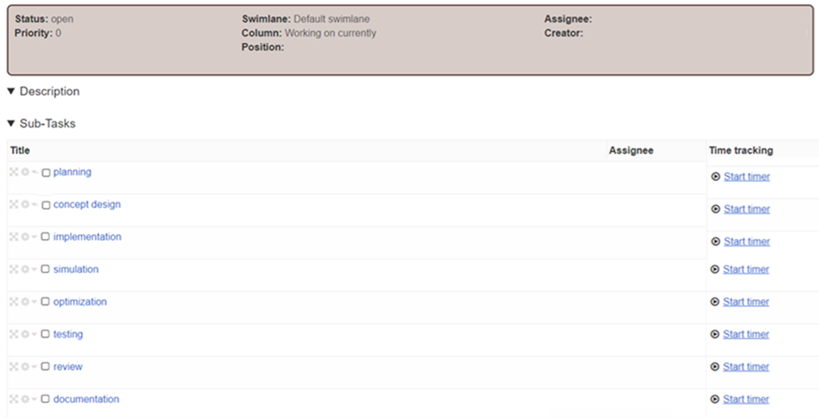

TASK MANAGEMENT TOOL: Project A
TASK 1
DESIGN TASK
DESIGN SUB-TASKS

