Slide 1

mexiqui.to
A web app for a
local mexican restaurant

Slide 2
Purpose
Replace paper processes
Browse menu, make food order
Dine in, or take away
More efficient business operation

Slide 3
Features
Customers:
View menu
Filter and search
Add to cart
Checkout
View order status

Slide 4
Features
Employees / Management
View pending orders
Manage menu
Edit orders

Slide 5
Target Audience
Local customers
Dine in or take away
Employees
Waiters, Cooks, Managers

Slide 6
Tech Stack - Frontend
React
JavaScript
Netlify hosting

Slide 7
Key react dependencies
react-router
react-table
react-use-cart
axios
bootstrap
jest
react-testing-library

Slide 8
Tech Stack - Backend
Rails
Ruby
Heroku hosting
PostgreSQL database
Amazon S3 image storage

Slide 9
Key rails dependencies
devise
devise-jwt
aws-sdk-s3
rack-cors
database-cleaner
factory-bot
faker
rubocop
cors-rack
cancancan

Slide 10
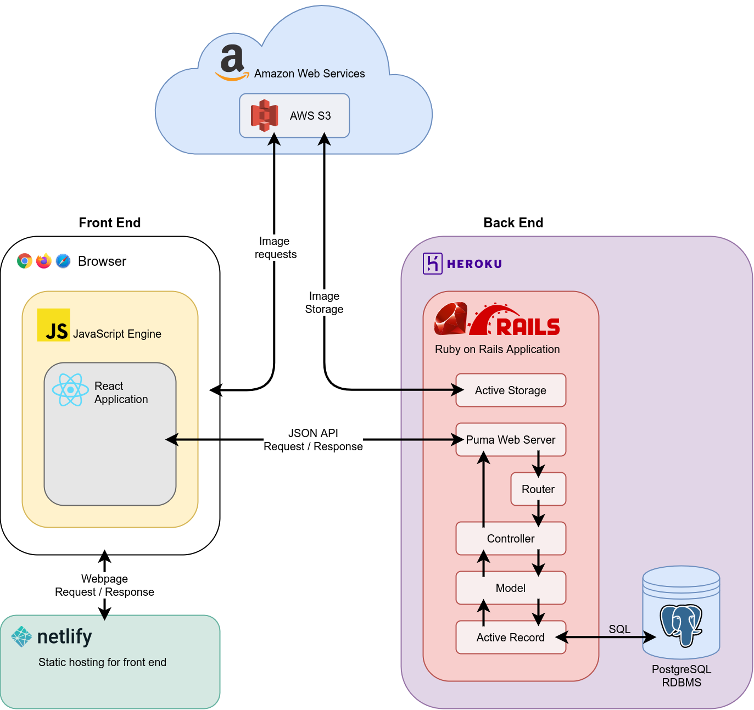
Application Architecture Diagram

