Slide 1

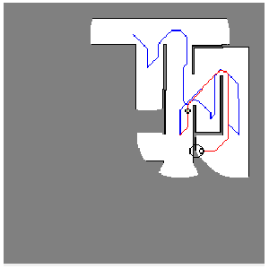
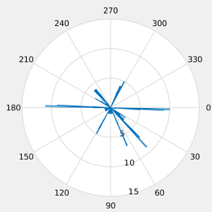
Introductional Research Project
Exploration & Path Planning
Histogram Based Frontier Exploration
  Goals are selected by weighting frontier distance and size
  Uncover multiple frontiers at one exploration pass

Slide 2
Introductional Research Project
Exploration & Path Planning
Histogram Based Frontier Exploration - Extension
  The probability of a relation between frontiers with large distance is low
  Path planning through unknown environment
  Rational planning - Selection of routes with high information gain

Slide 3
Future Topics
Assessability by humans
Security
Path Planning
Rational decisions
User centric High Level Task Planning in Service Robotics
Semantic Mapping
Human-Robot-Interface
Cognitive Robotics

