Slide 1
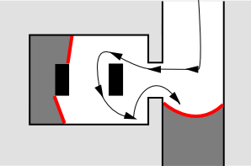
The Frontier Tree Algorithm
A robot's memory during the exploration process
Autonomous exploration of domestic environment
Based on frontiers and greedy exploration
Eliminates disadvantages of a nearest neighbour approach
Tree data structure for frontier organisation

Slide 2
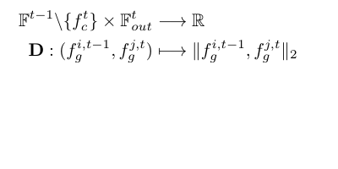
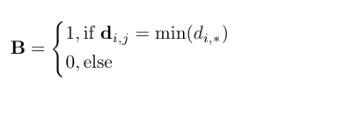
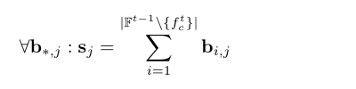
The Frontier Tree Algorithm
Synchronizing
Synchronizing the current map and tree data structure with a binary relation matrix and an identification vector
F* are sets of frontiers at time t-1 and t
Distance matrix D
Relation matrix B
Identification vector s

Slide 3
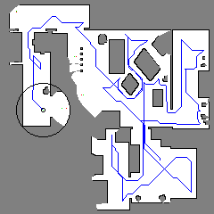
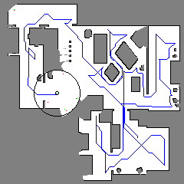
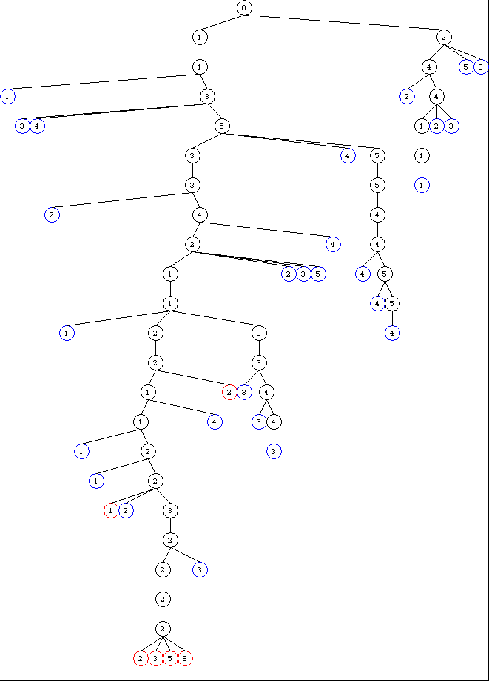

The Frontier Tree Algorithm
Loop detection and improved exploration path
Up to 10% reduction of travel cost

