Slide 1
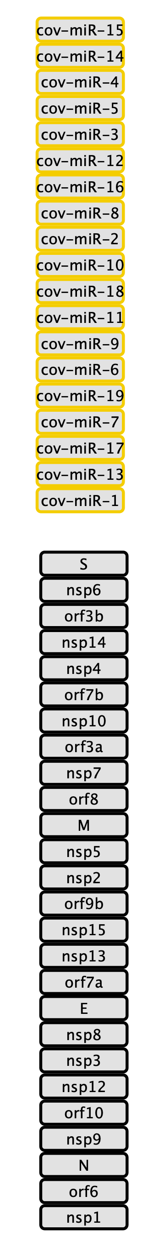
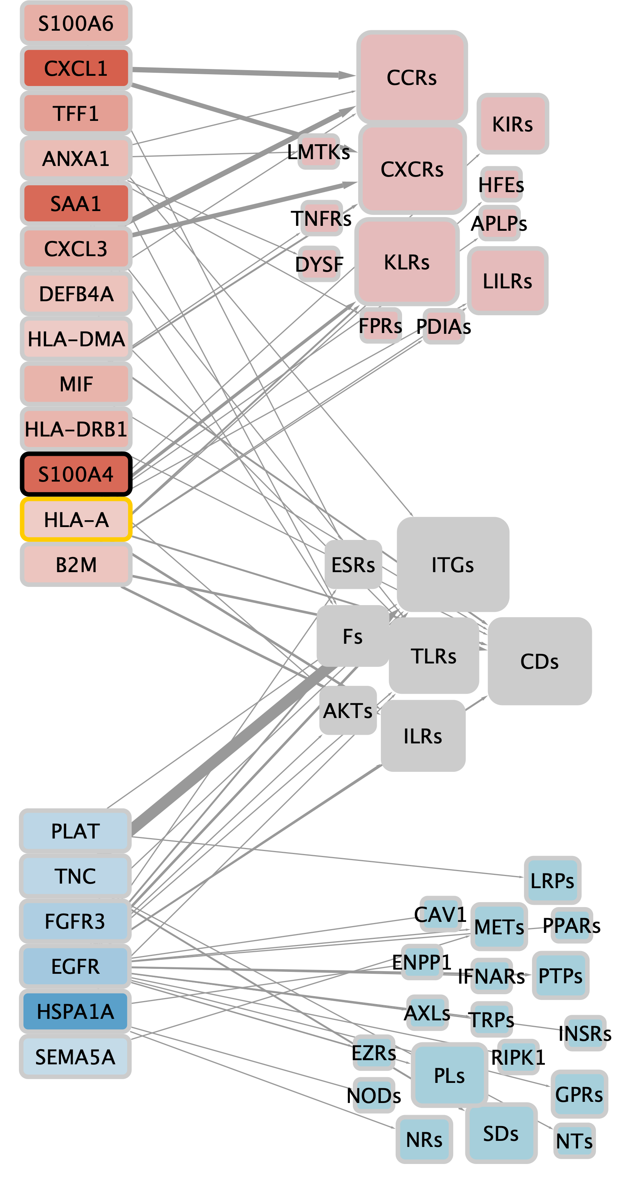
v1
Laminin interactions
Non-integrin membrane ECM interactions
Cell motility (MET/PK2 signaling)
Antigen processing and presentation
Chemokine signaling
Cytokine signaling
Defense response mechanisms
Cell migration (+)
Interleukin signaling (IL4/13)
MAPK signaling
PI3K signaling
Response to growth factors/estrogen receptor signalling
Integrin-mediated cell adhesion
ECM interactions
Laminin interactions
Syndecan interactions
Hemostasis
WNT signaling
NF-kB signaling
Regulation of T cell proliferation & innate immune response
Cell cycle (negative regulation of G2/M transition)
Interleukin signaling (IL1)
Signaling by Hedgehog

Slide 2
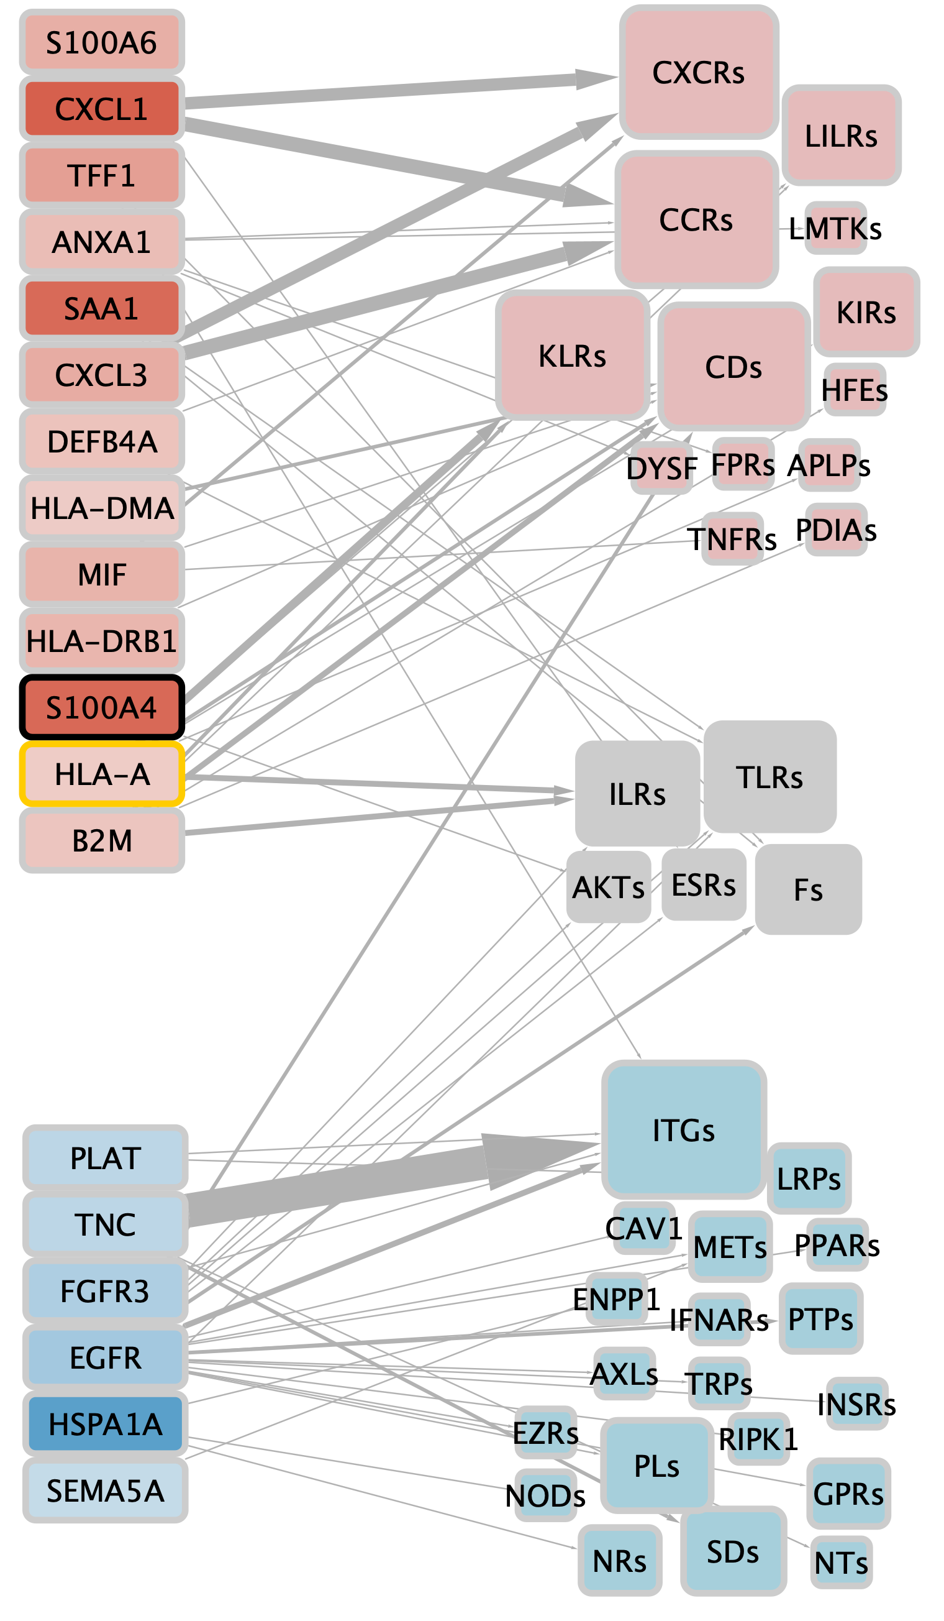
Laminin interactions
ECM interactions
Cell motility
v2
Antigen processing and presentation
Chemokine signaling
Cytokine signaling
Defense response mechanisms
Cell migration (+)
Interleukin signaling
MAPK signaling
PI3K signaling
Estrogen receptor signalling
Integrin-mediated cell adhesion
ECM interactions
Laminin interactions
Syndecan interactions
Hemostasis
WNT signaling
NF-kB signaling
Interleukin signaling
Regulation of T cell proliferation
Innate immune response
Cell cycle arrest
Signaling by Hedgehog

