Slide 1
Traveling Salesman Problem
Branch and Bound Algorithm — Performance Analysis
Group Project Presentation

Slide 2
The Traveling Salesman Problem
Given n cities and distances between each pair, find the shortest route that visits every city exactly once and returns to the start.
NP-hard combinatorial optimization problem.
Real-world applications: logistics, PCB drilling, DNA sequencing, route planning.
This project: Compare Brute Force, Branch & Bound, and Nearest Neighbor algorithms.

Slide 3
Branch and Bound Algorithm
Branching: DFS recursive exploration of partial tours.
Bounding: Compute lower bound = current cost + sum of minimum outgoing edges of unvisited cities.
Pruning: If lower bound >= current best cost, discard the entire branch.
Heuristic ordering: Visit nearest neighbors first to find good solutions early.
Result: Significant reduction in search space while guaranteeing optimality.

Slide 4
Lower Bound & Pruning Logic
LB = current_path_cost + Σ min_outgoing_edge(unvisited_city_i)
min_outgoing_edge(i) is the shortest edge from city i to any unvisited city (or the start city).
This is an admissible heuristic: it never overestimates the true remaining cost.
If LB >= best_cost → prune (safe: this branch cannot yield a better solution).
More aggressive pruning = smaller search space = faster runtime.

Slide 5
Experimental Setup
Random TSP instances: n = 4, 5, 6, 7, 8, 9, 10 cities.
5 random instances per size (coordinates uniformly distributed in 1000x1000 grid).
Three algorithms tested: Brute Force (control), Branch & Bound, Nearest Neighbor.
Metrics: runtime (s), visited nodes, pruned branches, pruning rate, solution quality.
All tests run on identical datasets for fair comparison.

Slide 6
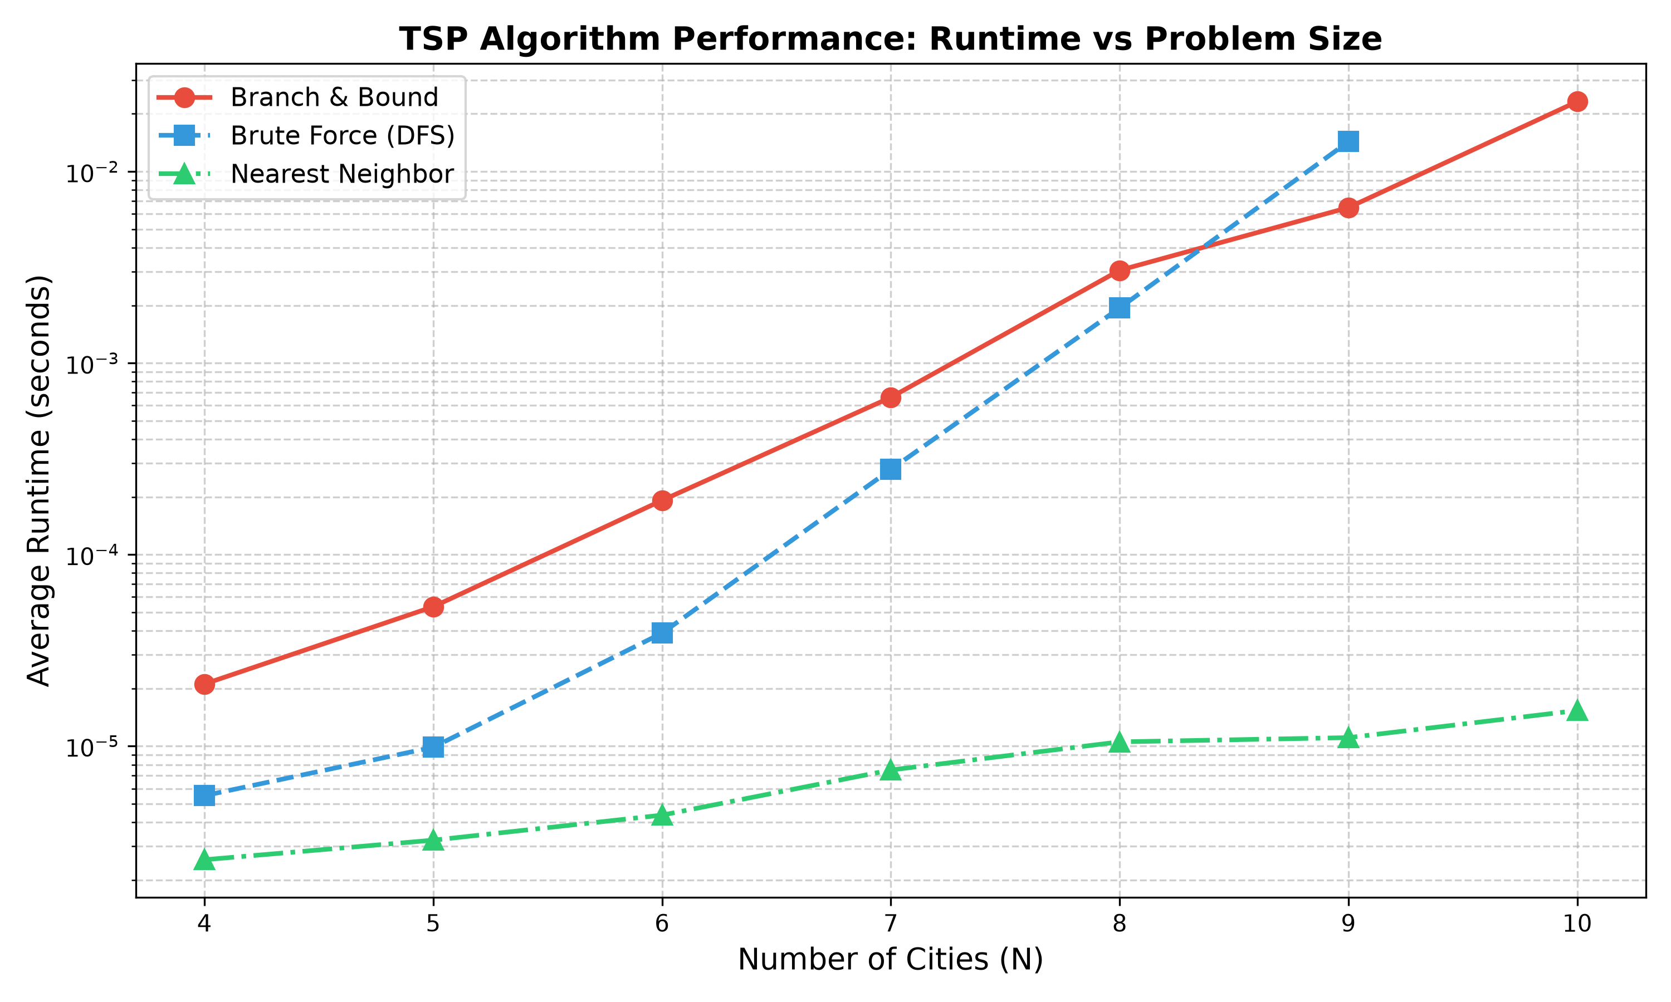
Results: Runtime vs Problem Size

Slide 7
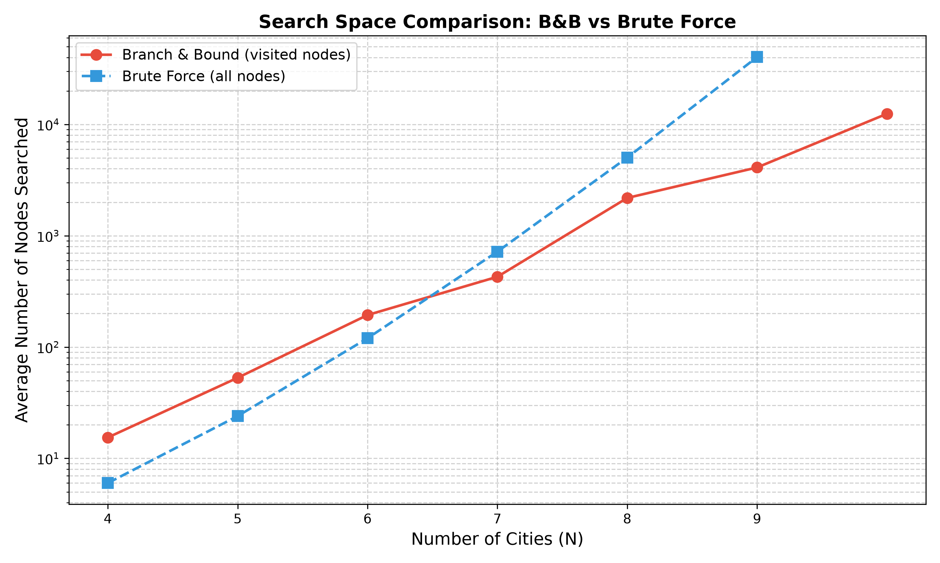
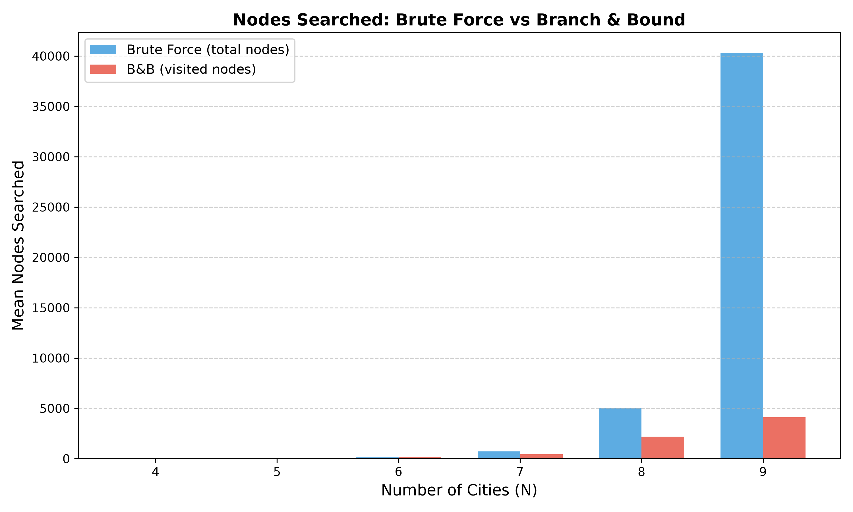
Results: Search Space Reduction

Slide 8
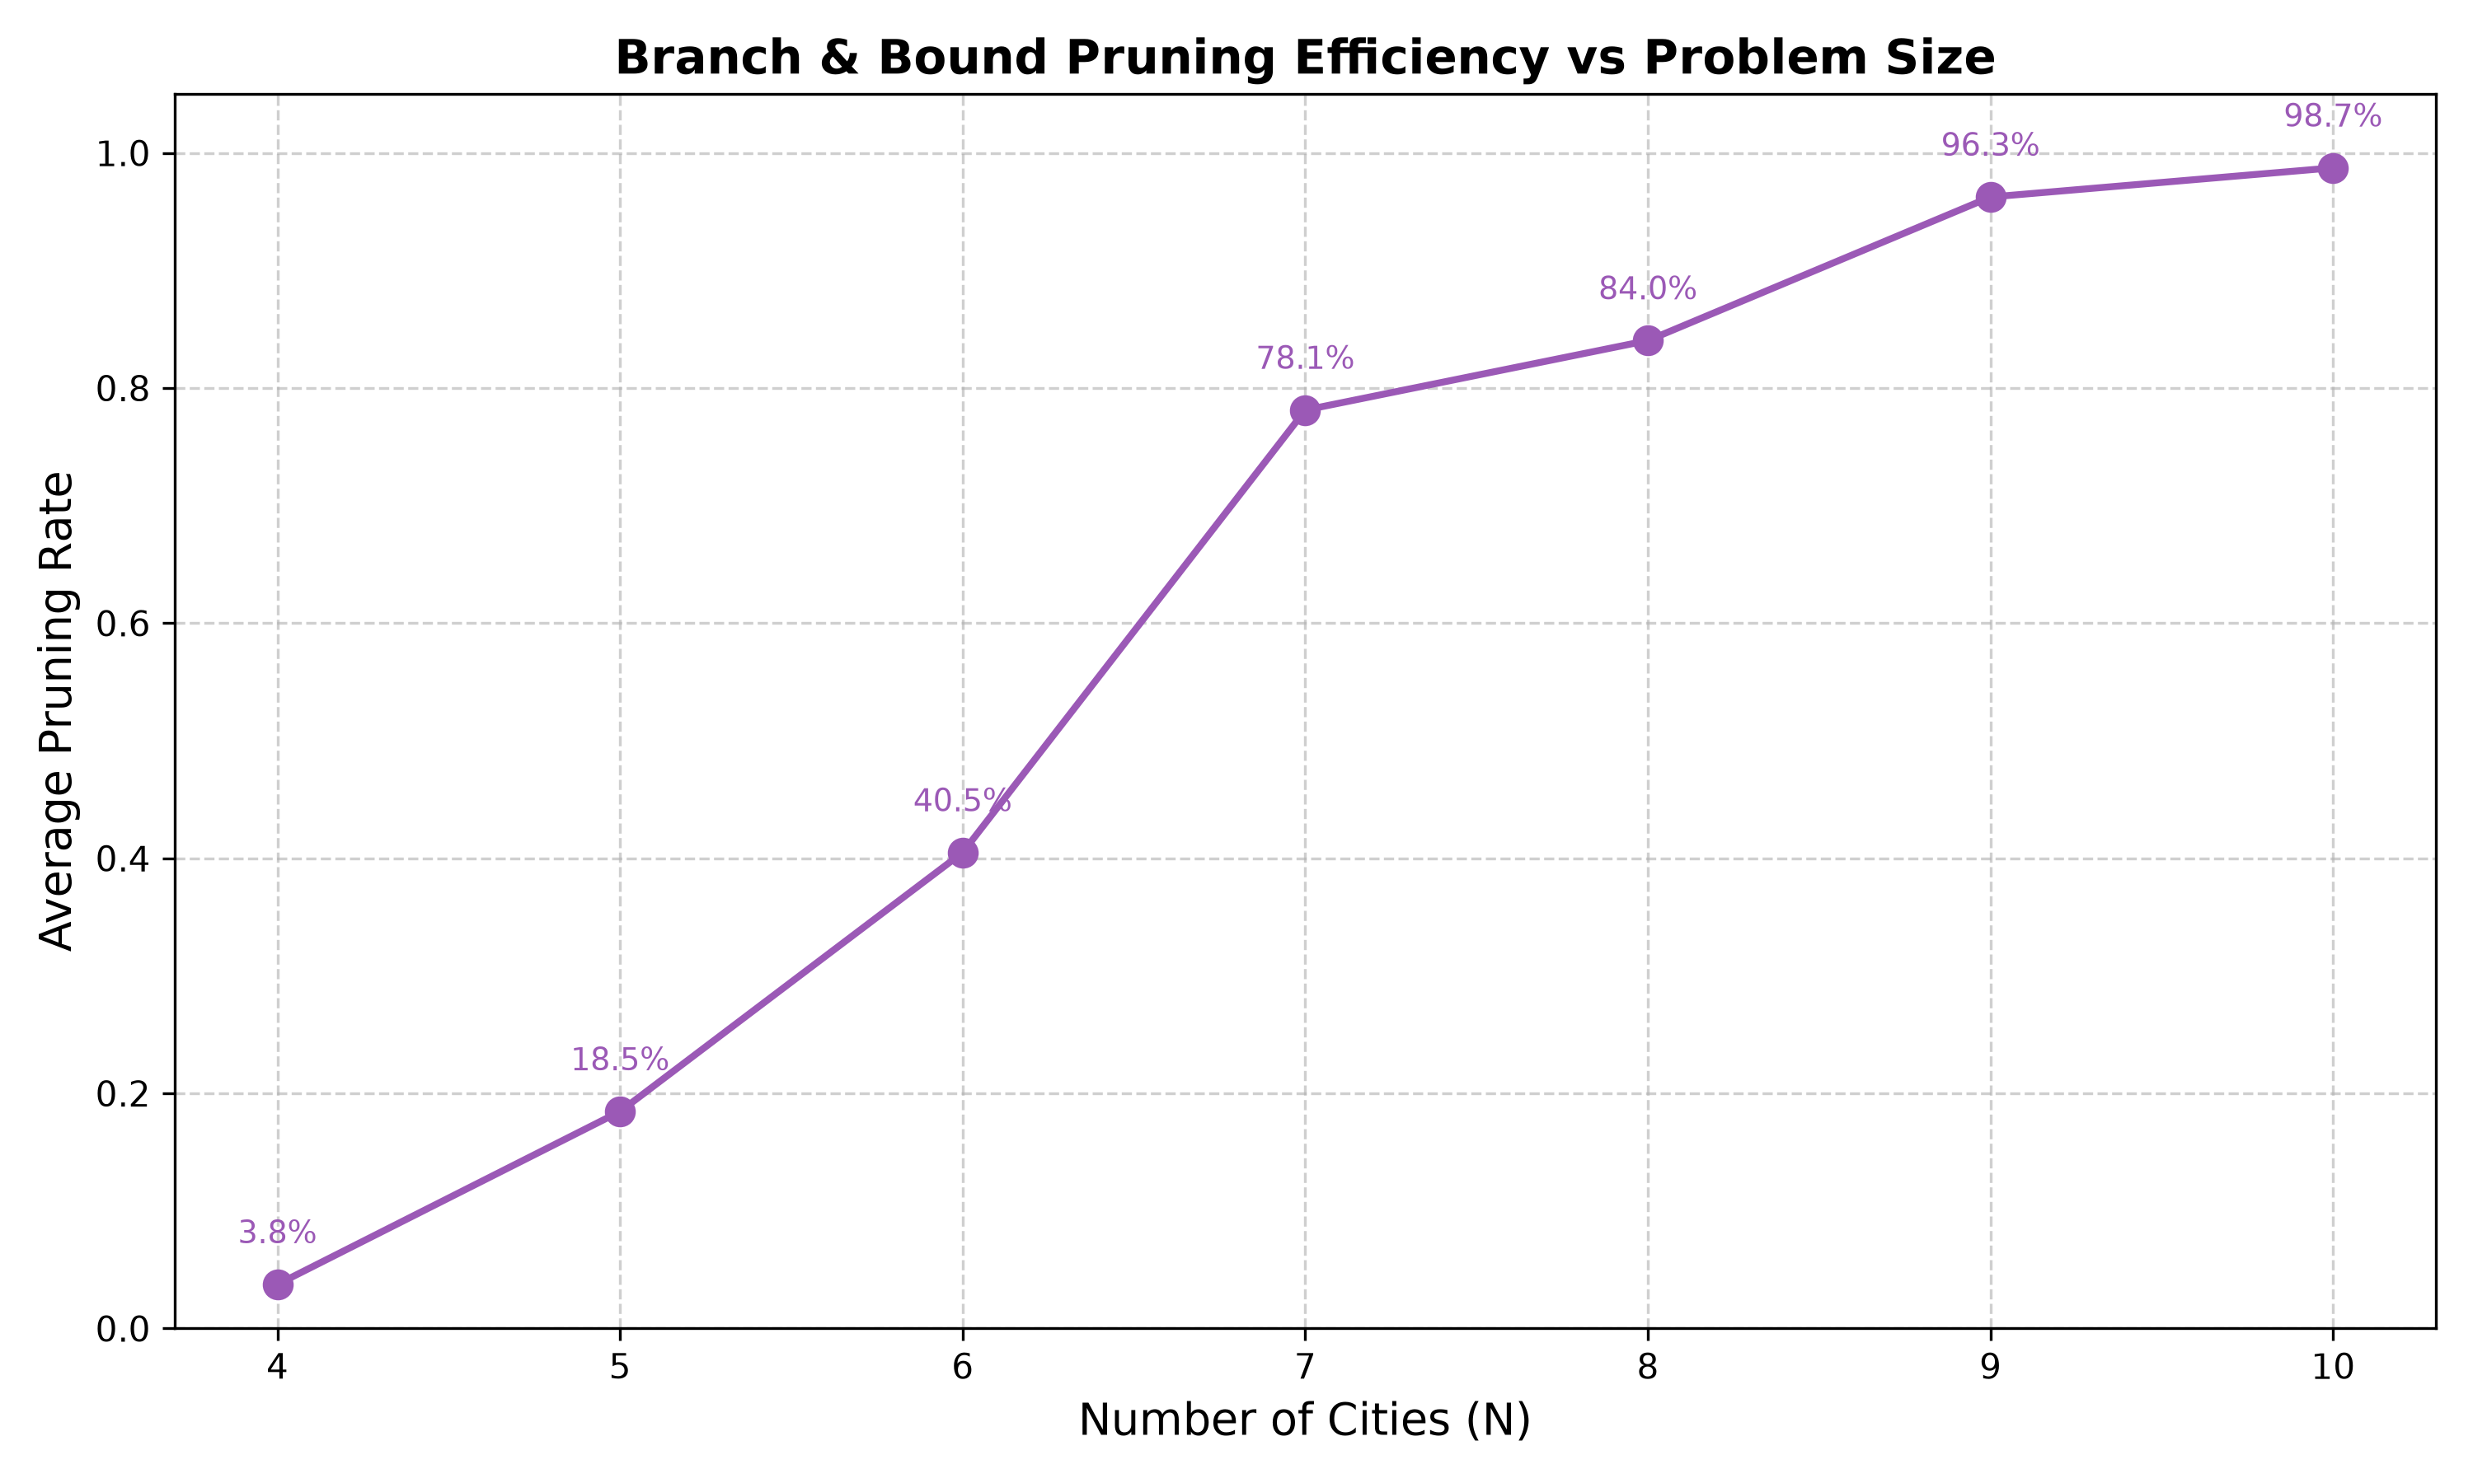
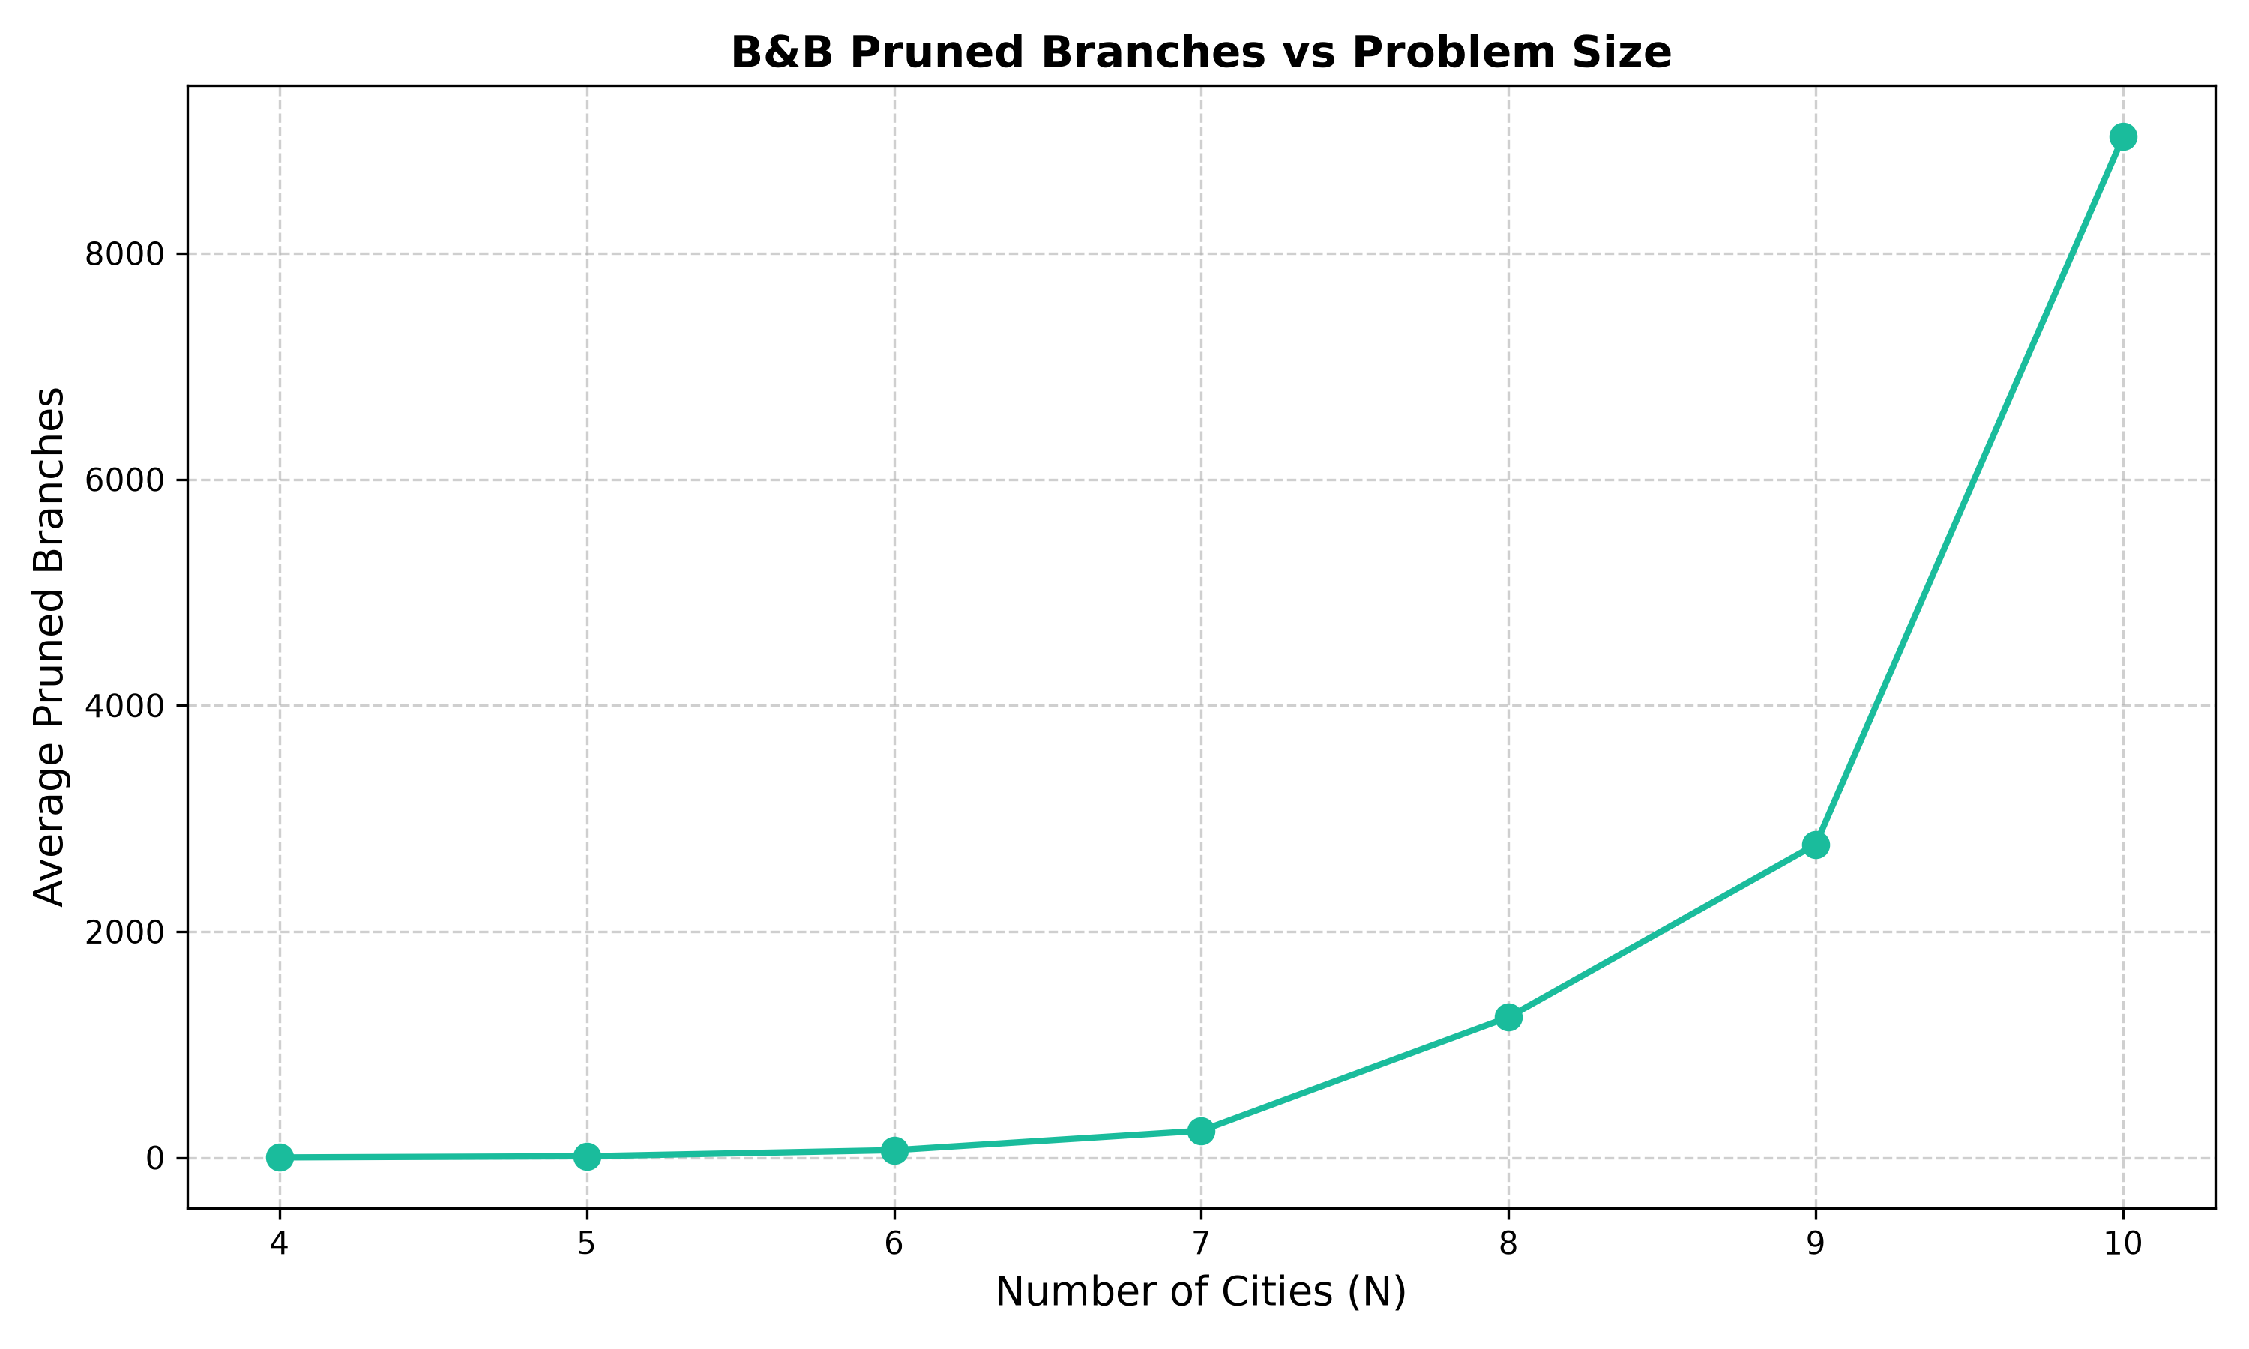
Results: Pruning Efficiency

Slide 9
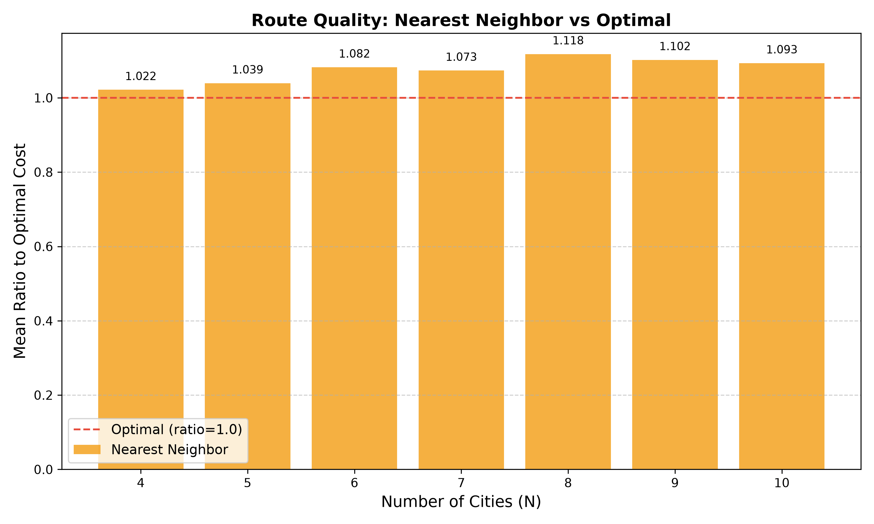
Results: Route Quality (NN vs Optimal)

Slide 10
Summary: Three Algorithms Compared
Brute Force — Exact baseline. Enumerates all (n-1)!/2 permutations. Guarantees optimality but O(n!). Impractical beyond n=10.
Branch & Bound — Exact with pruning. DFS + lower bound evaluation. Cuts branches when LB >= best_cost. Optimal, far more efficient.
Nearest Neighbor — Greedy heuristic. Always picks the closest unvisited city. O(n²) speed but 2–10% above optimal on average.
Takeaway: B&B strikes the best balance between correctness and efficiency for exact TSP solving at small to medium scale.

Slide 11
Summary: Key Results
N | B&B Runtime | BF Runtime | B&B Nodes | BF Nodes | Pruning Rate
4 | 0.02ms | 0.006ms | 15 | 6 | 3.8%
7 | 0.66ms | 0.28ms | 428 | 720 | 78.1%
9 | 6.5ms | 14.3ms | 4,107 | 40,320 | 96.3%
10 | 23ms | N/A | 12,472 | 1,814,400 | 98.7%
Key insight: B&B prunes 98.7% of search space at n=10. It becomes faster than BF from n=7 onward. For n=10, BF is infeasible (1.8M paths) while B&B completes in 23ms.

Slide 12
Summary: Conclusions
Branch and Bound is the best choice among these three methods when we need an exact TSP solution but also want better efficiency than simple exhaustive search.
The pruning mechanism becomes more effective as problem size increases — the lower bound provides increasing value for larger instances.
Nearest Neighbor is the fastest but may produce longer routes. Suitable when speed is critical and optimality can be sacrificed.
Brute Force is accurate but does not scale. Its exponential growth makes it unusable beyond 10–12 cities.
Limitation: B&B remains exponential; for n > 20 it becomes impractical. Tighter bounds (MST, Held-Karp) could improve pruning.

Slide 13
Key Findings
B&B finds provably optimal solutions (same as brute force) for all tested instances.
At n=10, B&B prunes 98.7% of the search space — visiting only 1.3% of all possible nodes.
B&B is ~2.2× faster than brute force at n=9; gap widens with larger n.
Nearest Neighbor runs in near-zero time but solutions are 2-10% above optimal.
B&B is practical for n ≤ 14; beyond that, heuristics are needed.

Slide 14
Conclusion & Future Work
Branch and Bound is an effective exact algorithm for small TSP instances.
The minimum-edge-sum lower bound provides substantial pruning even at modest n.
Future work: Compare with MST-based and Held-Karp lower bounds.
Future work: Implement parallel B&B for larger instances.
Future work: Hybrid approaches combining B&B with metaheuristics.

Slide 15
Thank You
Questions?

