Slide 1
Useful Groupware
잘했조
채효원
박지혜
안선영
이대원
전성원

Slide 2
목차
프로젝트 개요
개발배경 및 목표
개발범위, 주요기능
조직구성
프로젝트 설계
개발전략
개발환경, 적용기술
개발일정
시스템 상세내역
다이어그램
명세서
구현내역
메뉴구조도
페이지구성
유효성검사
이슈및 해결방안
느낀점
QnA

Slide 3
시스템 아키텍쳐
UI 레이어
프리젠테이션
레이어
서비스 발행
레이어
비지니스로직
레이어
데이터접근
레이어
데이터레이어
Web Browser
Web Application Server
Spring Framework
DBMS
HTML
Web
Container
Spring
Container
Spring Container
DB
(Oracle)
CSS
Servlet
Control
Service
DAO
JavaScript
jQuery
Rest
Controller
MyBatis
jsp
POJO
SqlSession
Factory
Ajax
sqlSession
POJO
Sql-mapper
jqGrid

Slide 4
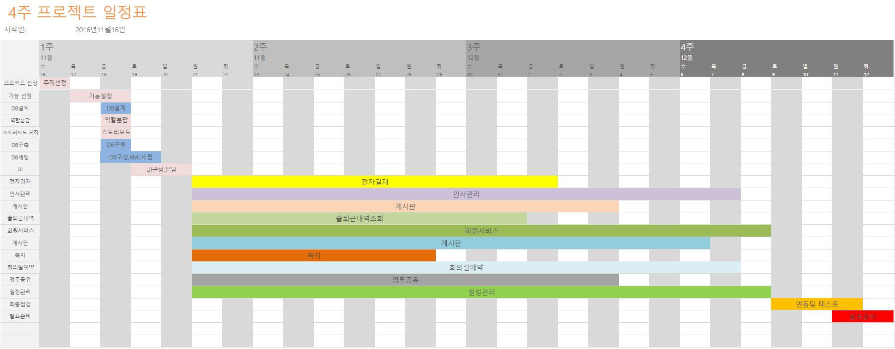
개발일정

Slide 5
Colour scheme
Background
Text &
Lines
Shadows
Title Text
Fills
Accent
Accent &
Hyperlink
Followed
Hyperlink

Slide 6

Picture slide
Bullet 1
Bullet 2

Slide 7
Sample Graph (3 colours)

Slide 8
Example of a table
Title | Title
Data | Data
Note: PowerPoint does not allow you to have nice default tables – but you can cut and paste this one

Slide 9
Two column bullet points
Bullets go in here
And also in here

Slide 10
Examples of default styles
Text and lines are like this
Hyperlinks like this
Visited hyperlinks like this
Table
Text box
Text box
With shadow

Slide 11
Use of templates
You are free to use these templates for your personal and business presentations.
We have put a lot of work into developing all these templates and retain the copyright in them. They are not Open Source templates. You can use them freely providing that you do not redistribute or sell them.
Do
Use these templates for your presentations
Display your presentation on a web site provided that it is not for the purpose of downloading the template.
If you like these templates, we would always appreciate a link back to our website. Many thanks.
Don’t
Resell or distribute these templates
Put these templates on a website for download. This includes uploading them onto file sharing networks like Slideshare, Myspace, Facebook, bit torrent etc
Pass off any of our created content as your own work
You can find many more free templates on the Presentation Magazine website www.presentationmagazine.com

