Slide 1
After ARC : Verification about “Self-Tunable”
Jaehwan Jeong, Tackhee Lee
밑빠진독에코인붓기

Slide 2
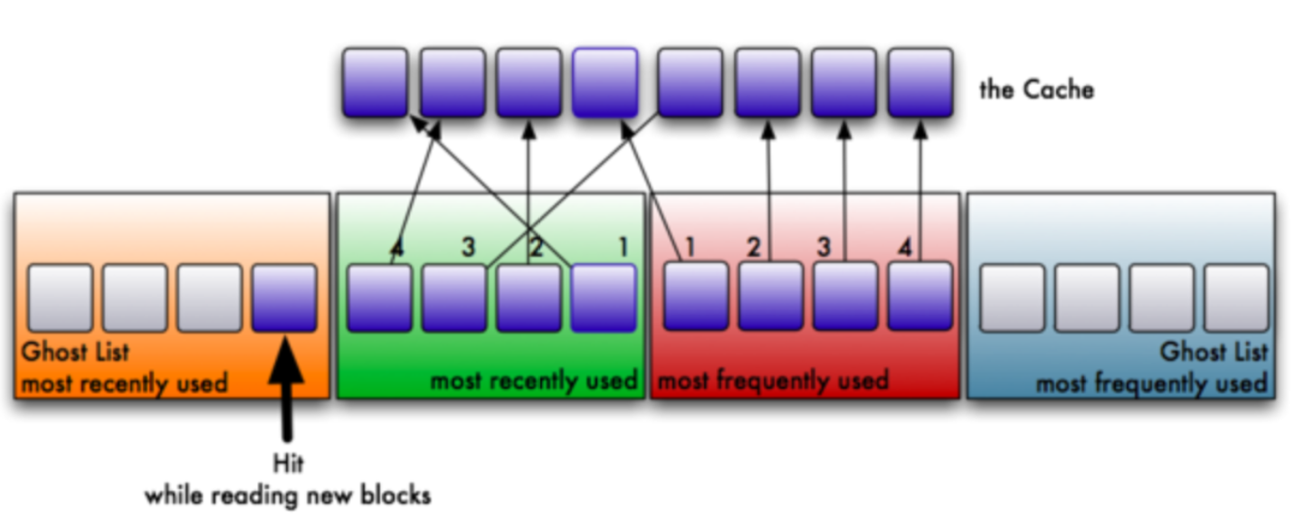
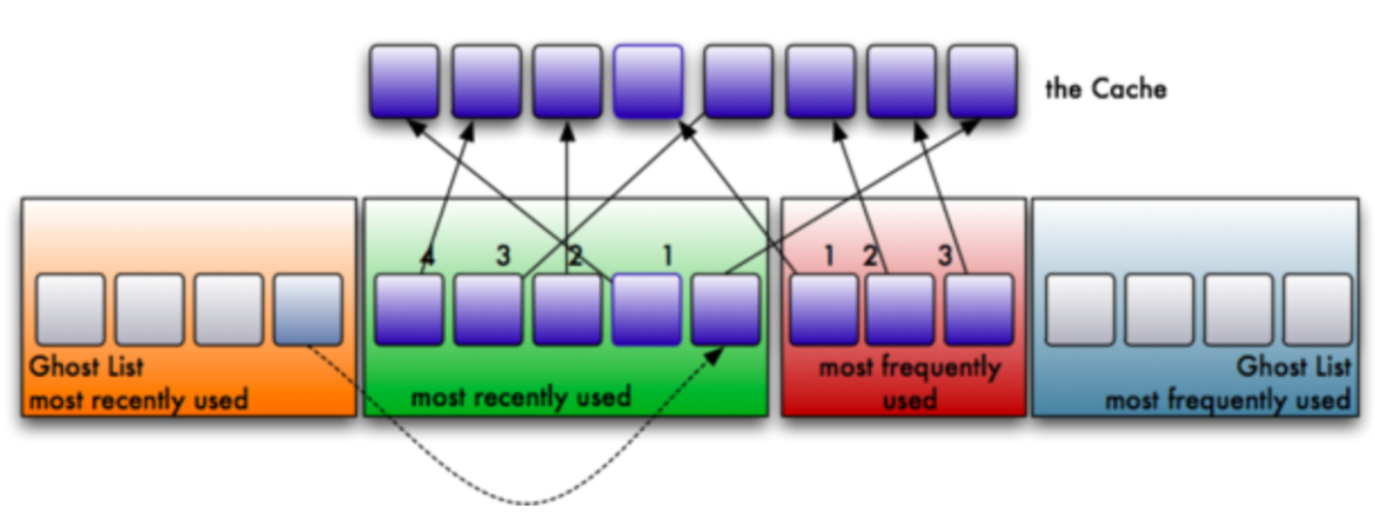
Problem Definition
Main Problem : Cache Replacement Algorithm
ARC : Adaptive Replacement Cache
Cache Miss(Phantom Hit)
Adaptive Re-sizing
Key idea : Phantom Hit -> re-size

Slide 3
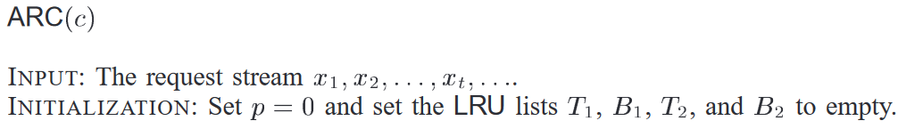

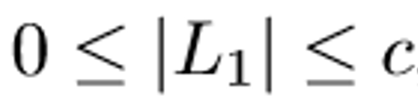
Motivation
Is it truly “Self-tunable”?
1) Initial Value
2) Adaptive Re-Sizing
Why?
3) Size Limit of LRU Portion

Slide 4

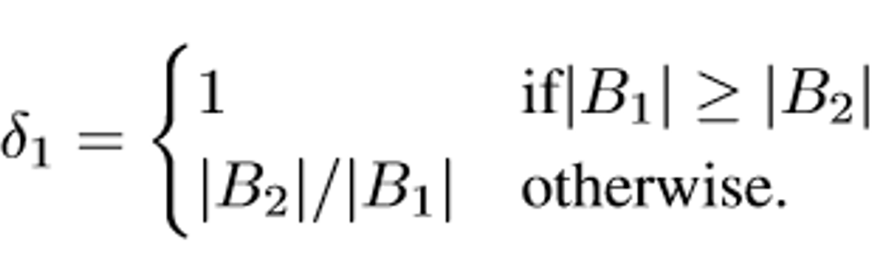











Our Idea
Find a tunable-parameter which gives more higher hit ratio
p=0
1) Initial Value
p=c
+2, -2 (CONST)
$log_{2}δ$ (LOG)
$2^{δ}$ (EXP)
2) Adaptive Re-Sizing
(=Learning Rate)
$$LRU :LFU$$
$p_{max}$=$\frac{1}{3}c$
$$(1:5)$$
$p_{max}$=$\frac{2}{3}c$
$$(1:2)$$
$p_{max}$=$\frac{4}{3}c$
$$(2:1)$$
3) Size Limit of LRU Portion
$p_{max}$=$\frac{5}{3}c$
$$(5:1)$$

Slide 5

Design - Traces
Real-Life benchmark disk I/O traces
EXCH : MS Exchange Server (mail server)
DAP-DS : Display ads platform data server
MSN : MSN metadata and file server
RAD-AS : remote-access authentication server
RAD-ES : remote-access back-end SQL server
HOMES : NFS server from FIU
WEB-VM : Virtual machine traces on running 2 web servers.
MAIL : Mail server from FIU
Summary : Diverse, Realistic Disk I/O traces

Slide 6
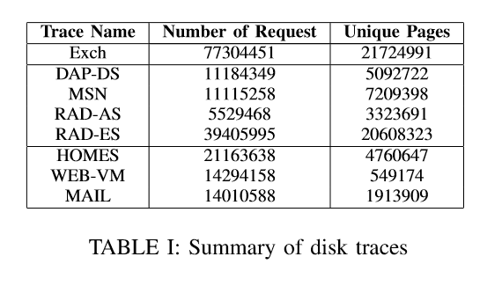
Design
Parsing Disk I/O Trace Result

Slide 7
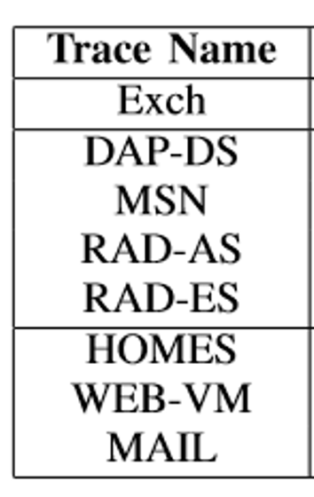






Methodology
Cache Behavior Simulation
p=0
Page-size : 4KB
Disk Cache : 256MB
p=c
+2, -2 (CONST)
$log_{2}δ$ (LOG)
$2^{δ}$ (EXP)
Higher Hit Ratio!
ARC
After-ARC
$p_{max}$=$\frac{1}{3}c$
$p_{max}$=$\frac{2}{3}c$
$p_{max}$=$\frac{4}{3}c$
Real-world
Disk I/O traces
$p_{max}$=$\frac{5}{3}c$

Slide 8
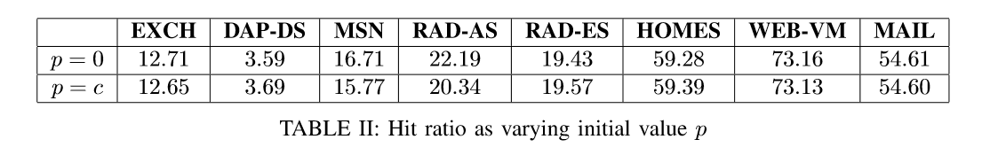
Evaluation
Minor Difference
p=0 wins up to 2% on RAD-AS
p=0 -> good-choice

Slide 9
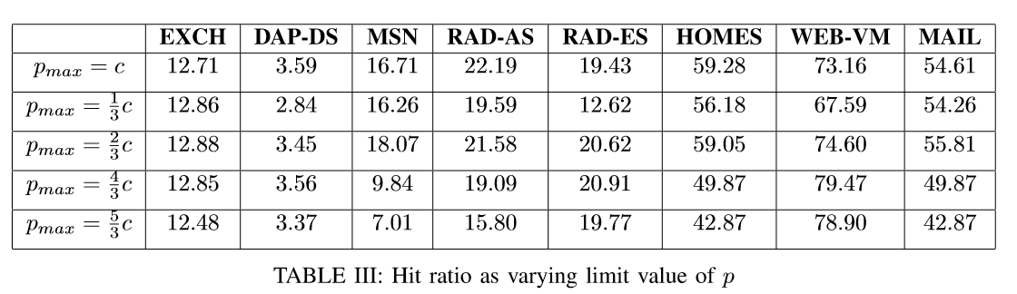
Evaluation
Big-Difference on Many trace
Worst-case always occurs in (1:5) or (5:1)
Best-case sometimes occurs in (1:2) or (2:1) -> not all workloads!
p=c (always above the average)-> best-choice
Finding 1 : ARC performs well better than LRU! (see (5:1) case)

Slide 10
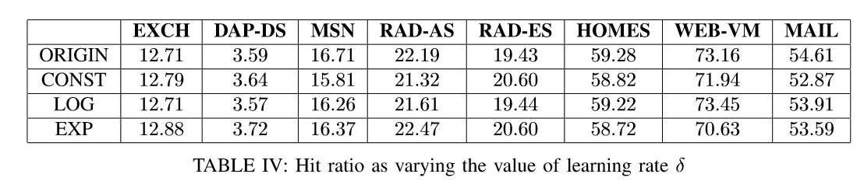
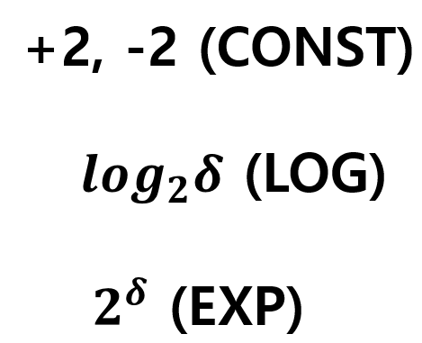
Evaluation
EXP Wins 4 traces, ORIGIN wins 3, LOG wins 1.
Finding 2 : EXP is quite good-choice
ORIGIN -> above the average for all workloads.

Slide 11
Contribution & Conclusion
Contribution
Implementing ARC with tunable-parameter and real-world trace
Traces : Was So Big
Finding 1) : Effectiveness of ARC is still valid on current I/O traces!
Finding 2) : EXP is quite good-choice
Summary - ARC is well-made
- Suggest EXP with diverse disk I/O pattern trace.
Point 1
Point 2
Conclusion

Slide 12

Q&A
Come and Get Some

