Slide 1
Database design
CSE3207 Project #1
Assignment Date : April 5, 2021
Due Date : April 30, 2021
Notes:
The first project of this course is implementing the disk….
Today we’ll briefly introduce about project.

Slide 2
Table of contents
Project description
Environment setting
Notes:
As you already know, B+tree is the most Widely Used Index structure.
B+tree represents sorted data in a way that allows for efficient insertion, retrieval and removal of records, each of which is identified by a key.
In a B+ tree, all records are stored at the leaf level of the tree; only keys are stored in interior nodes.
It is a dynamic, multilevel index, with maximum and minimum bounds on the number of keys in each index segment (usually called "node").
In our disk based structure, A B+Tree stored in a single data file. A node is corresponding to a page.
Pages are stored in data file. If you need a certain page in the data file, you have to find the page and load to memory.
PID(Page ID) stores a page index in the B+Tree data file.
Using this page ID, we can seek the position of necessary node in the file.

Slide 3

Project Descripiton
You’ll make a code on Java to control the DBMS
Your Applications
(Java)
DB Connectivity API
DBMS

Slide 4
Project Description
Translate given statements into SQLs and process the query using your application
Create tables
Initial data input
Insert additional data
Select statements
Update statements
Delete statements
(See project specification)
Notes:
As you already know, B+tree is the most Widely Used Index structure.
B+tree represents sorted data in a way that allows for efficient insertion, retrieval and removal of records, each of which is identified by a key.
In a B+ tree, all records are stored at the leaf level of the tree; only keys are stored in interior nodes.
It is a dynamic, multilevel index, with maximum and minimum bounds on the number of keys in each index segment (usually called "node").
In our disk based structure, A B+Tree stored in a single data file. A node is corresponding to a page.
Pages are stored in data file. If you need a certain page in the data file, you have to find the page and load to memory.
PID(Page ID) stores a page index in the B+Tree data file.
Using this page ID, we can seek the position of necessary node in the file.

Slide 5
Project Description
You need to design database for Movie
You need to design 13 Table in DB
director (directorID, directorName, dateOfBirth, dateOfDeath)
actor (actorID, actorName, dateOfBirth, dateOfDeath, gender)
movie (movieID, movieName, releaseYear, releaseMonth, releaseDate, publisherName, avgRate)
award (awardID, awardName)
genre (genreName)
movieGenre (movieID, genreName)
movieObtain (movieID, awardID, year)
actorObtain (actorID, awardID, year)
directorObtain (directorID, awardID, year)
casting (movieID, actorID, role)
make (movieID, directorID)
customerRate (customerID, movieID, rate)
customer (customerID, customerName, dateOfBirth, gender)
Notes:
As you already know, B+tree is the most Widely Used Index structure.
B+tree represents sorted data in a way that allows for efficient insertion, retrieval and removal of records, each of which is identified by a key.
In a B+ tree, all records are stored at the leaf level of the tree; only keys are stored in interior nodes.
It is a dynamic, multilevel index, with maximum and minimum bounds on the number of keys in each index segment (usually called "node").
In our disk based structure, A B+Tree stored in a single data file. A node is corresponding to a page.
Pages are stored in data file. If you need a certain page in the data file, you have to find the page and load to memory.
PID(Page ID) stores a page index in the B+Tree data file.
Using this page ID, we can seek the position of necessary node in the file.

Slide 6
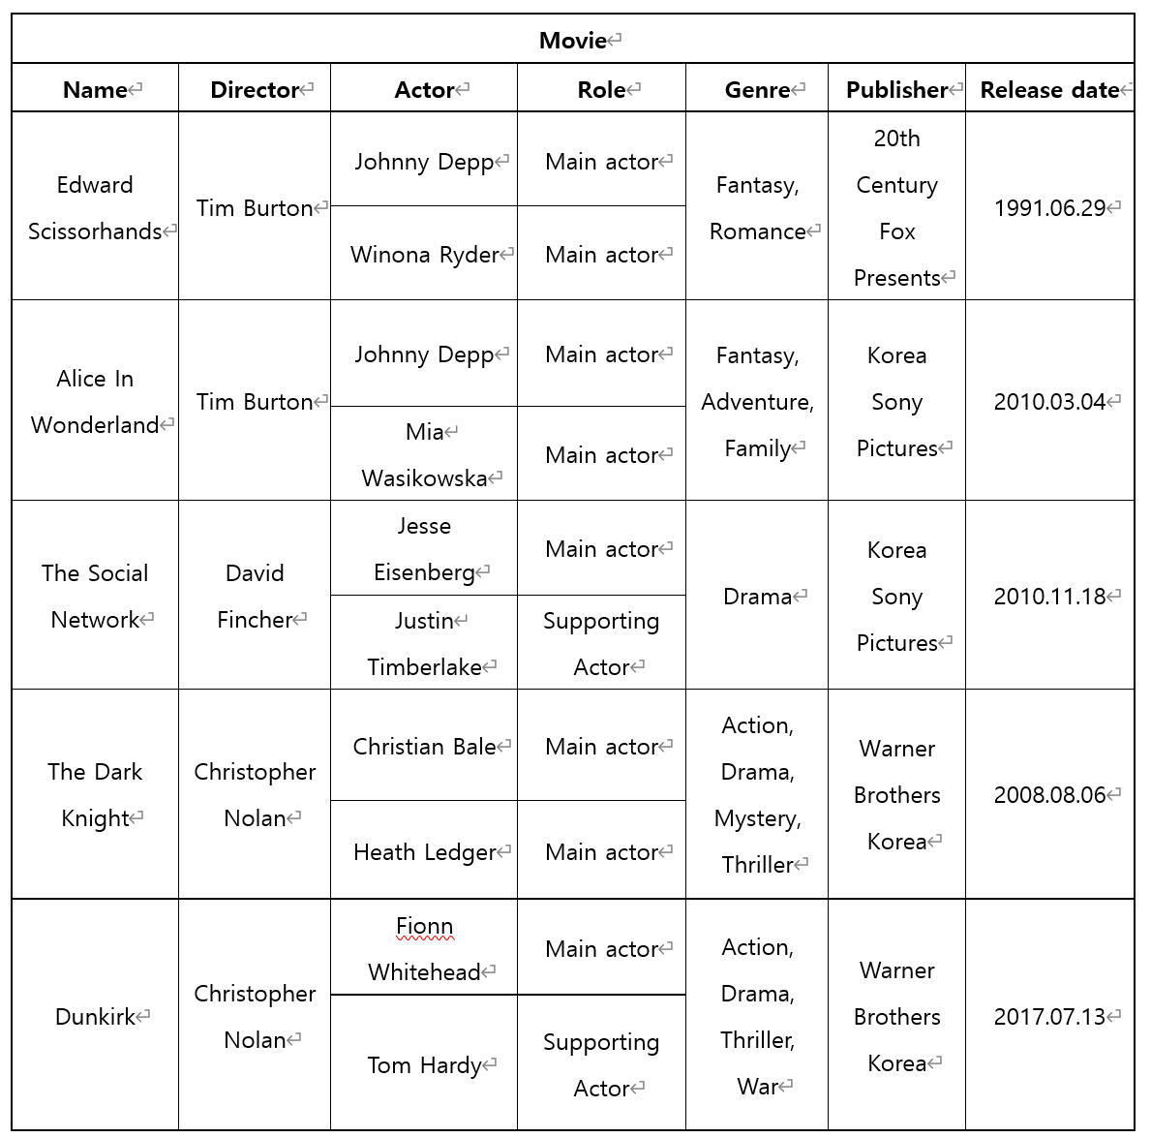
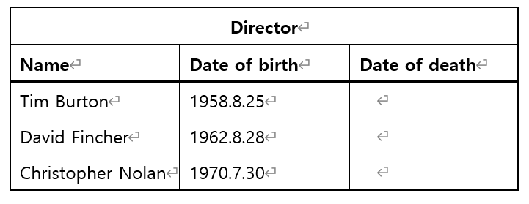
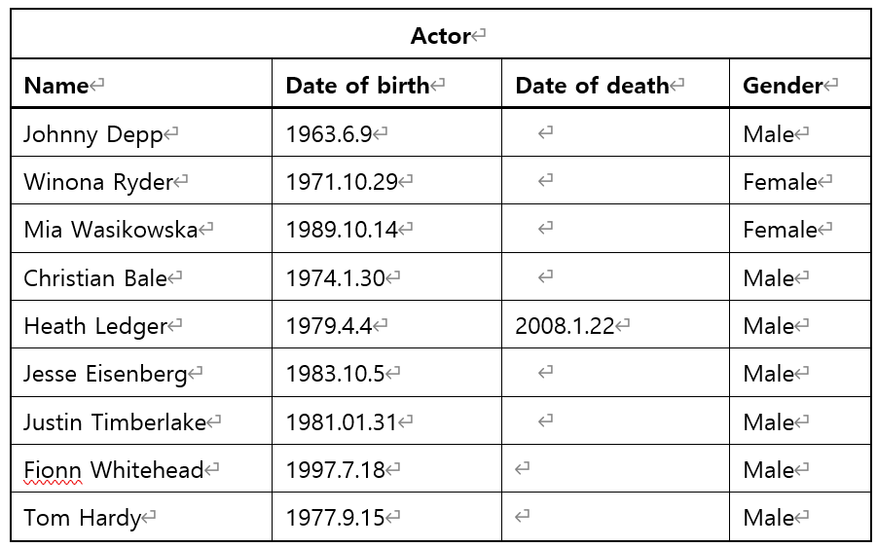
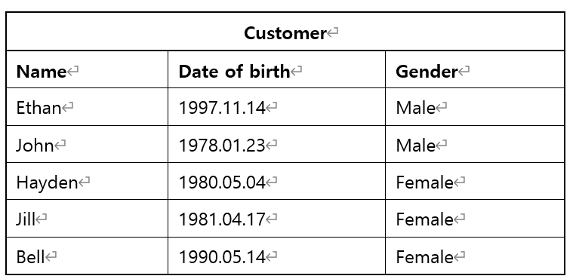
Project Description
Initial data
Notes:
As you already know, B+tree is the most Widely Used Index structure.
B+tree represents sorted data in a way that allows for efficient insertion, retrieval and removal of records, each of which is identified by a key.
In a B+ tree, all records are stored at the leaf level of the tree; only keys are stored in interior nodes.
It is a dynamic, multilevel index, with maximum and minimum bounds on the number of keys in each index segment (usually called "node").
In our disk based structure, A B+Tree stored in a single data file. A node is corresponding to a page.
Pages are stored in data file. If you need a certain page in the data file, you have to find the page and load to memory.
PID(Page ID) stores a page index in the B+Tree data file.
Using this page ID, we can seek the position of necessary node in the file.

Slide 7
Project Description
Queries
1. Create the tables and insert the proper data based on the provided data. You should make the movie, actor, director, and customer tables first and insert data into other related tables.
2. Insert the proper data from the following statements.
2.1. Winona Ryder won the “Best supporting actor” award in 1994
2.2. Tom Hardy won the “Best supporting actor” award in 2018
2.3. Heath Ledger won the “Best villain actor” award in 2009
2.4. Johnny Depp won the “Best main actor” award in 2011
2.5. Edward Scissorhands won the “Best fantasy movie” award in 1991
2.6. Alice In Wonderland won the “Best fantasy movie” award in 2011
2.7. The Dark Knight won the “Best picture” award in 2009
2.8. Christopher Nolan won the “Best director” award in 2018
3. Insert data to the proper tables based on the following statements and update avgRate if necessary.
3.1 Ethan rates 5 to “Dunkirk”.
3.2 Bell rates 5 to the movies whose director is “Tim Burton”.
3.3 Jill rates 4 to the movies whose main actor is female.
3.4 Hayden rates 4 to the fantasy movies.
3.5 John rates 5 to the movies whose director won the “Best director” award
4. Select the names of the movies whose actor are dead.
5. Select the names of the directors who cast the same actor more than once.
6. Select the names of the movies and the genres, where movies have the common genre.
7. Delete the movies whose director or actor did not get any award and delete data from related tables.
8. Delete all customers and delete data from related tables.
9. Delete all tables and data (make the database empty).
Notes:
As you already know, B+tree is the most Widely Used Index structure.
B+tree represents sorted data in a way that allows for efficient insertion, retrieval and removal of records, each of which is identified by a key.
In a B+ tree, all records are stored at the leaf level of the tree; only keys are stored in interior nodes.
It is a dynamic, multilevel index, with maximum and minimum bounds on the number of keys in each index segment (usually called "node").
In our disk based structure, A B+Tree stored in a single data file. A node is corresponding to a page.
Pages are stored in data file. If you need a certain page in the data file, you have to find the page and load to memory.
PID(Page ID) stores a page index in the B+Tree data file.
Using this page ID, we can seek the position of necessary node in the file.

Slide 8
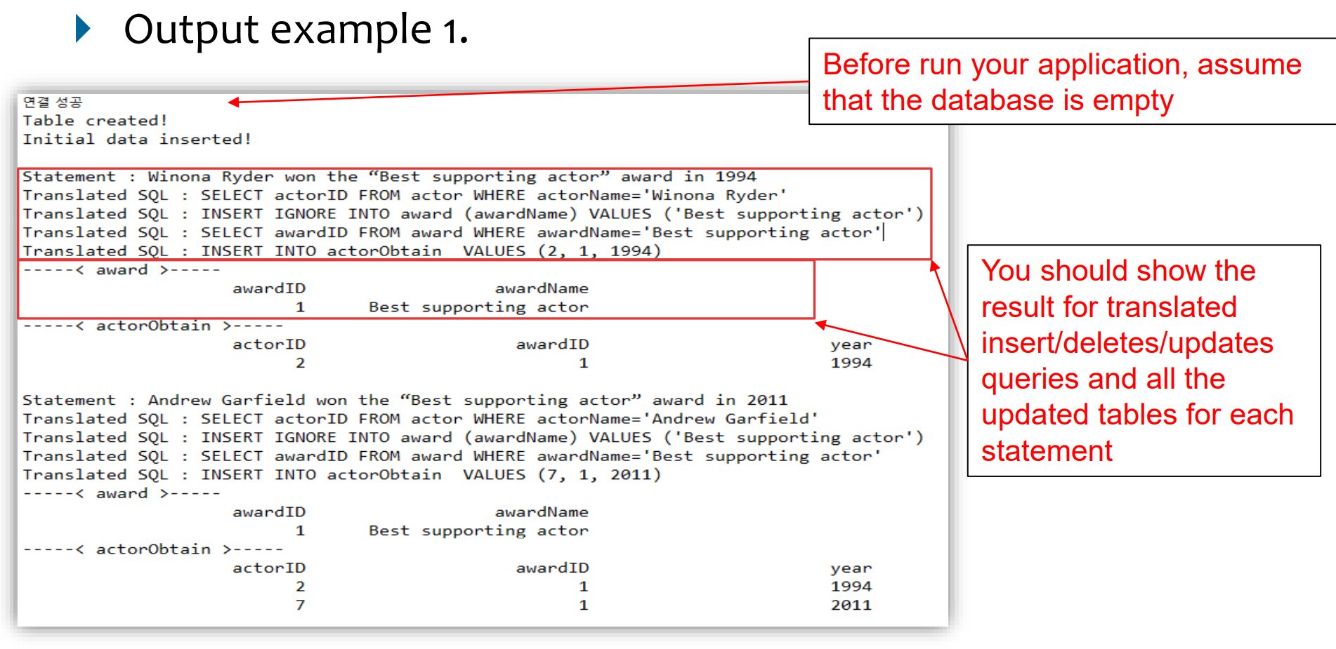
Project Description
Output example
Notes:
As you already know, B+tree is the most Widely Used Index structure.
B+tree represents sorted data in a way that allows for efficient insertion, retrieval and removal of records, each of which is identified by a key.
In a B+ tree, all records are stored at the leaf level of the tree; only keys are stored in interior nodes.
It is a dynamic, multilevel index, with maximum and minimum bounds on the number of keys in each index segment (usually called "node").
In our disk based structure, A B+Tree stored in a single data file. A node is corresponding to a page.
Pages are stored in data file. If you need a certain page in the data file, you have to find the page and load to memory.
PID(Page ID) stores a page index in the B+Tree data file.
Using this page ID, we can seek the position of necessary node in the file.

Slide 9
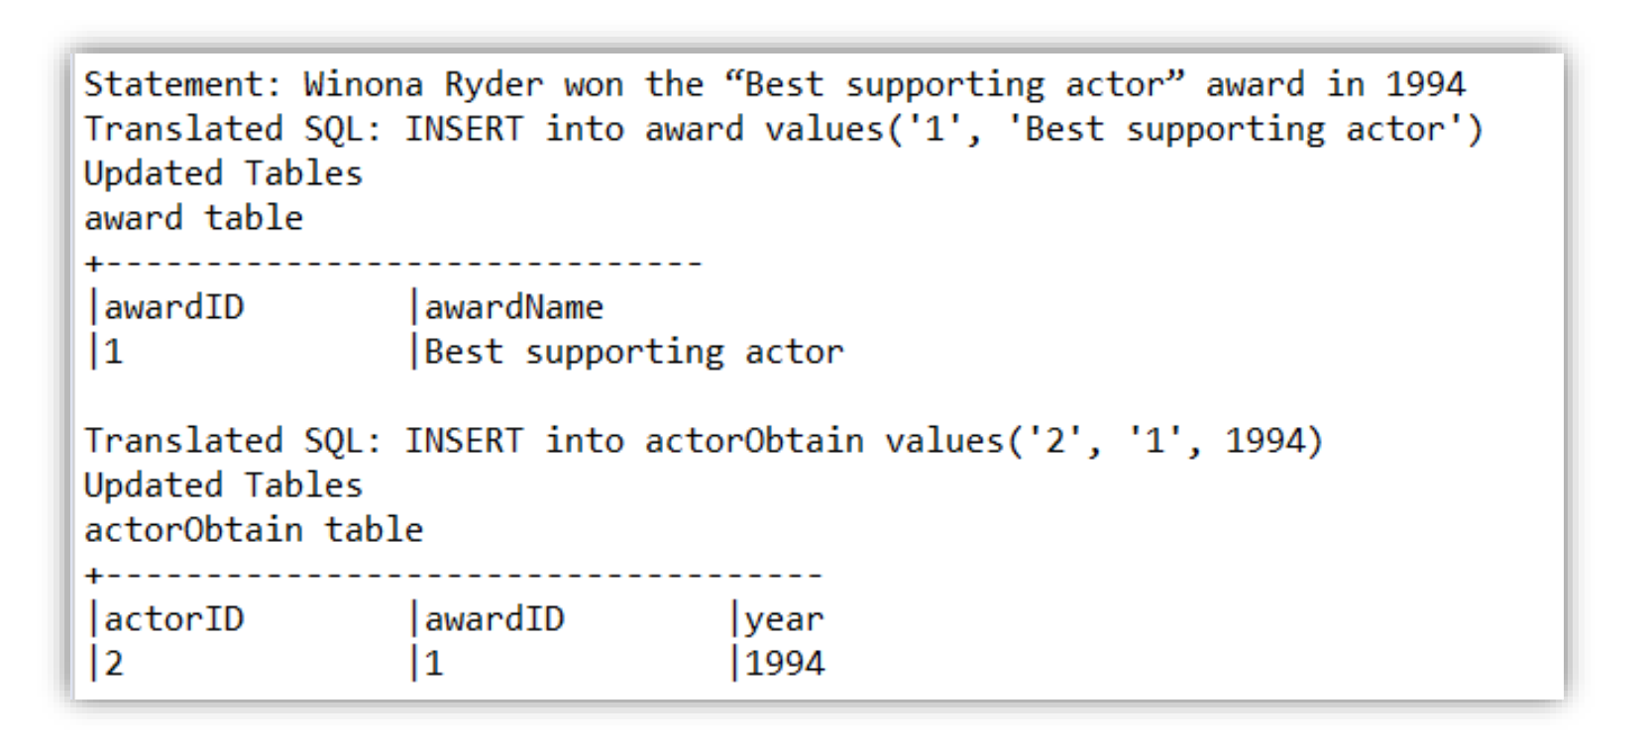
Project Description
Output example 2
Notes:
As you already know, B+tree is the most Widely Used Index structure.
B+tree represents sorted data in a way that allows for efficient insertion, retrieval and removal of records, each of which is identified by a key.
In a B+ tree, all records are stored at the leaf level of the tree; only keys are stored in interior nodes.
It is a dynamic, multilevel index, with maximum and minimum bounds on the number of keys in each index segment (usually called "node").
In our disk based structure, A B+Tree stored in a single data file. A node is corresponding to a page.
Pages are stored in data file. If you need a certain page in the data file, you have to find the page and load to memory.
PID(Page ID) stores a page index in the B+Tree data file.
Using this page ID, we can seek the position of necessary node in the file.

Slide 10
Project Description
Rules in project (if you don’t follow this, you can have penalty)
Programming Languages: JAVA
DBMS: PostgreSQL (mandatory)
You should use DB connector by JDBC
DBMS setting
Database name: project_movie
Root id: postgres // Password: cse3207
Port: 5432
Tables are should be named as project specification
Database should be installed at localhost
Recommend full variable name not recommended: name, pw, htn recommend: username, db_passward, hostNumber
Notes:
As you already know, B+tree is the most Widely Used Index structure.
B+tree represents sorted data in a way that allows for efficient insertion, retrieval and removal of records, each of which is identified by a key.
In a B+ tree, all records are stored at the leaf level of the tree; only keys are stored in interior nodes.
It is a dynamic, multilevel index, with maximum and minimum bounds on the number of keys in each index segment (usually called "node").
In our disk based structure, A B+Tree stored in a single data file. A node is corresponding to a page.
Pages are stored in data file. If you need a certain page in the data file, you have to find the page and load to memory.
PID(Page ID) stores a page index in the B+Tree data file.
Using this page ID, we can seek the position of necessary node in the file.

Slide 11
Environment setting
Grading environment (I’ll run & check your code on following environment)
OS : Linux Ubuntu 20.04
Java version: OpenJDK 16
PostgreSQL: 13.2
PostgreSQL JDBC: 4.2 Driver (42.2.19)
주의사항: 리눅스에서는 영어 대소문자 구분을 하기 때문에, 대소문자를 구분하지 않을 경우 오류가 발생합니다.

Slide 12
Submission
To the I-Class website
Upload a zip file containing the followings:
All the source files and execution file
README.doc explaining:
What you’ve implemented and what you’ve NOT
Brief explanation of your implementation (Do not try to make it look fancy, Less than 1 page)
How to compile and run
Result display for all queries
Talk about your experience of doing this project
Contact information (just in case)

Slide 13
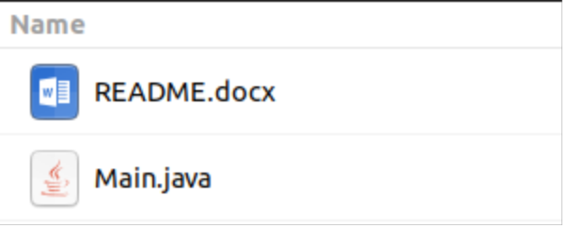

Submission
Your submission ZIP file must have only:
Java source code (you should submit only one source code file)
README.doc
Example :
Do NOT include other module except main.java (main.py)
Submission Form: 학번_이름_분반.zip
zip
Notes:
As you already know, B+tree is the most Widely Used Index structure.
B+tree represents sorted data in a way that allows for efficient insertion, retrieval and removal of records, each of which is identified by a key.
In a B+ tree, all records are stored at the leaf level of the tree; only keys are stored in interior nodes.
It is a dynamic, multilevel index, with maximum and minimum bounds on the number of keys in each index segment (usually called "node").
In our disk based structure, A B+Tree stored in a single data file. A node is corresponding to a page.
Pages are stored in data file. If you need a certain page in the data file, you have to find the page and load to memory.
PID(Page ID) stores a page index in the B+Tree data file.
Using this page ID, we can seek the position of necessary node in the file.

Slide 14
Environment setting
Install postgreSQL (https://www.postgresql.org/download/)
Set DBMS
Install JDBC (in Java) (https://jdbc.postgresql.org/download.html)
Set JDBC (in java)
Check DB connection on IDE (Eclipse or Intellij etc…)
Notes:
There are three pages.
As we can see, the root page id is 3.
PID starts from 1. 0 is used to represent NULL.
Physical offset of a page in the B+Tree data file is calculated as follows:
12 + ((PID-1) * PageSize)

Slide 15
Environment setting
DBMS setting (You must follow below setting!)
Database name: project_movie
Root id: postgres
Password: cse3207
Port: 5432
Host: localhost (127.0.0.1)
Notes:
There are three pages.
As we can see, the root page id is 3.
PID starts from 1. 0 is used to represent NULL.
Physical offset of a page in the B+Tree data file is calculated as follows:
12 + ((PID-1) * PageSize)

Slide 16
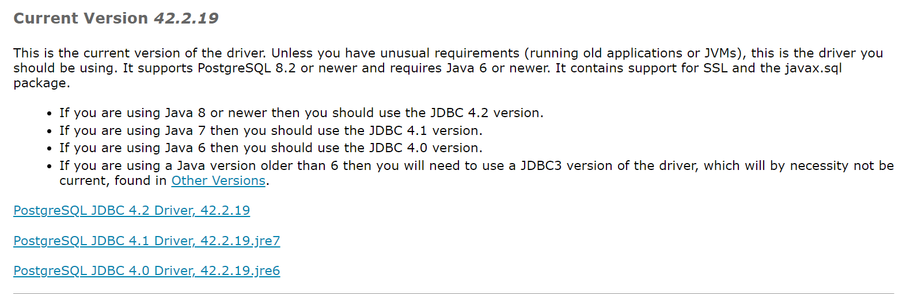
2. Install JDBC (Java)
Go to https://jdbc.postgresql.org/download.html
Download and unzip file
Notes:
There are three pages.
As we can see, the root page id is 3.
PID starts from 1. 0 is used to represent NULL.
Physical offset of a page in the B+Tree data file is calculated as follows:
12 + ((PID-1) * PageSize)

Slide 17


2. Install JDBC (Java)
Prepare ‘postgresql-42.2.19.jar’ file
Add library in JAVA IDE In eclipse, Properties – Java Build Path – Libraries – Add External JARs In IntelliJ, Project Structure – Libraries – click + button – Java – find jar file
test DB connection in JAVA IDE
Notes:
There are three pages.
As we can see, the root page id is 3.
PID starts from 1. 0 is used to represent NULL.
Physical offset of a page in the B+Tree data file is calculated as follows:
12 + ((PID-1) * PageSize)

Slide 18
Install JDBC(Java)
Test code
import java.sql.*;
public class Main {
public static void main(String[] args) throws Exception {
try {
Class.forName("org.postgresql.Driver");
} catch (ClassNotFoundException e) {
System.out.println("Where is your PostgreSQL JDBC Driver? Include in your library path!");
e.printStackTrace();
return;
} /// 이 부분에서 에러가 난다면, jdbc driver(.jar file)를 제대로 ide에 추가하도록 하세요
System.out.println("PostgreSQL JDBC Driver Registered!");
Connection connection = null;
try {
connection = DriverManager.getConnection(
"jdbc:postgresql://127.0.0.1:5432/project_movie", "postgres", "cse3207");
} catch (SQLException e) {
System.out.println("Connection Failed! Check output console");
e.printStackTrace();
return;
}/// 이 부분에서 에러가 난다면, connection 변수에 비밀번호, 데이터베이스 명, user 명 등을 확인주세요
/// 이후의 문제는 콘솔에 출력된 에러를 구글에 검색해보세요…
if (connection != null) {
System.out.println(connection);
System.out.println("You made it, take control your database now!");
} else {
System.out.println("Failed to make connection!");
}
////////// 여기에 코드 작성 //////////
connection.close();
}
}

Slide 19
Environment setting
Recommended: Google may know everything, ask to google plz…!
Should you have any problem in progress, feel free to contact me ☺
(wauri6@gmail.com, bigdata lab room 1414)
Notes:
There are three pages.
As we can see, the root page id is 3.
PID starts from 1. 0 is used to represent NULL.
Physical offset of a page in the B+Tree data file is calculated as follows:
12 + ((PID-1) * PageSize)

