Slide 1
ACDC: ordered field map
Application
Delegation/Issuance
Service Authority (Issuer)
1
Agrees on capability & obligation.
'i': Issuer
'a': issuee vid, resource, ability, limitation
'r': obligations, assumptions
Delegation
Agrees on capability & obligation
'i': Issuer
'a': issuee vid, resource, ability, limitation
'r': obligations, assumptions
'e': I2I edge
3'
2
Delegation/Issuance
Invocation/Authorization
Other Issuers of authorities
1'
Agent
(Client)
3
Service
(Server)
Agrees on capability & obligation.
'i': Issuer
'a': issuee vid, resource, ability, limitation
'r': obligations, assumptions
VID
VID
MCP
4
Delegation & Invocation
A2A
Agrees on terms of use
'i': Issuer -"bespoke"
'a': issuee vid, resource, ability, limitation
'r': obligations, assumptions
'e': I2I edge 1, 2, …
Other Agent
DRAFT
Authorization <-> Presentation<->Invocation

Slide 2
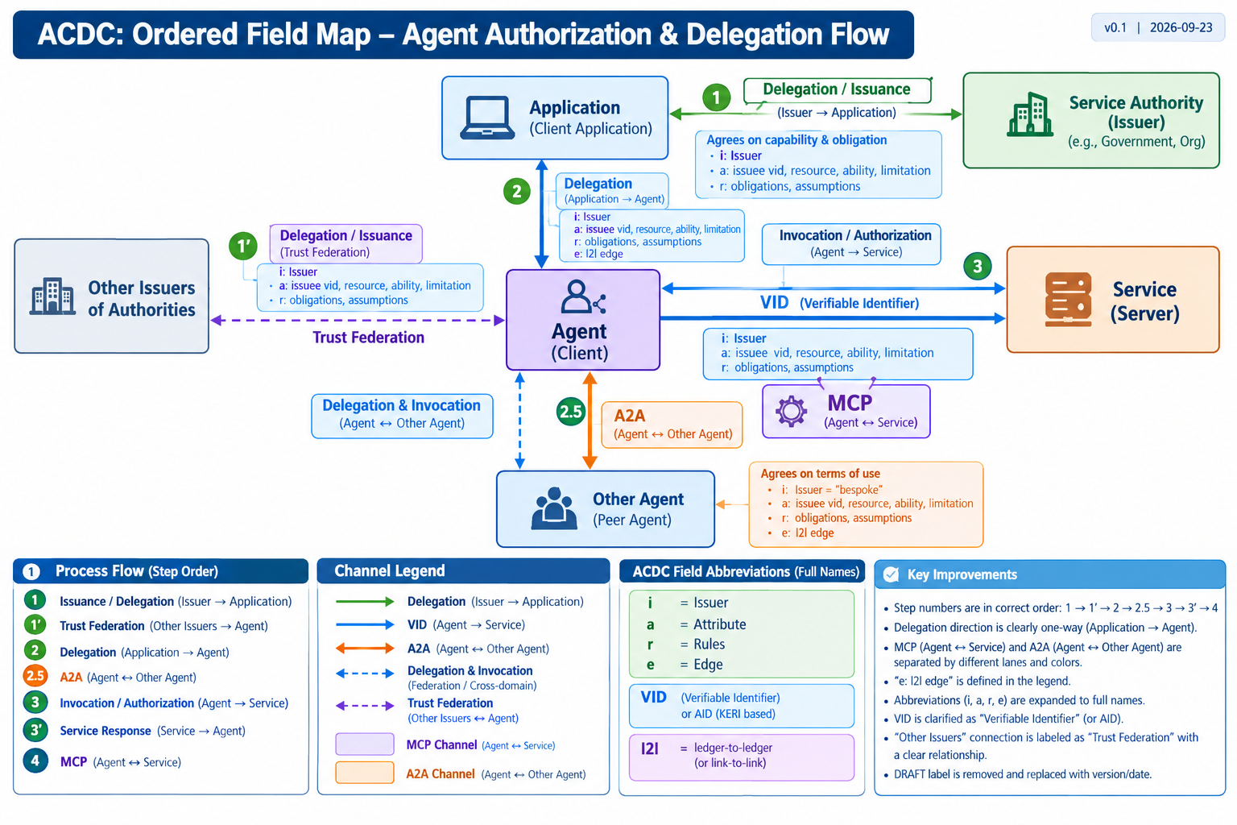
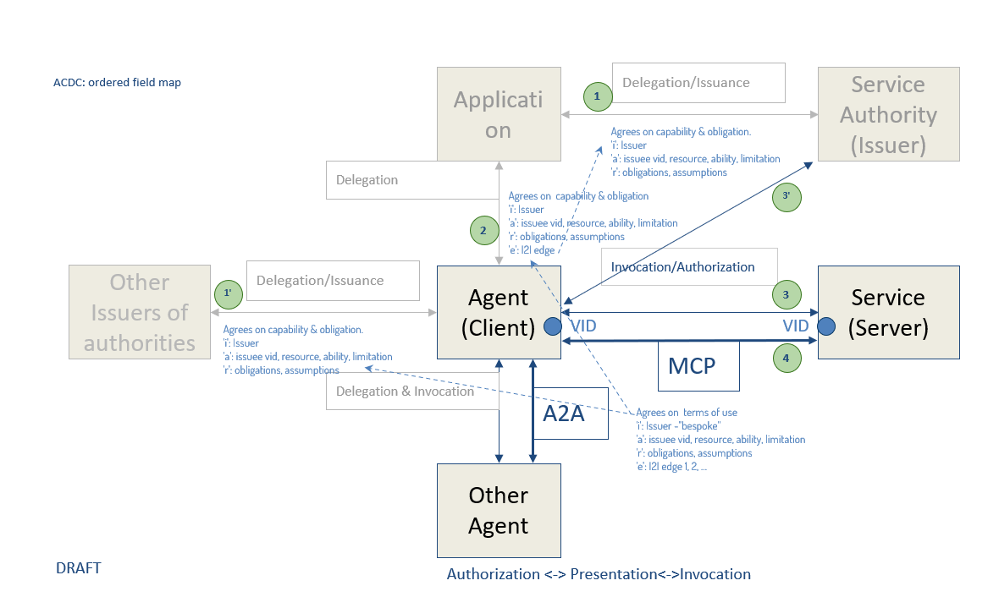

Slide 3
ACDC: Ordered Field Map – Agent Authorization & Delegation Flow
v0.1 | 2026-09-23
Application
(Client Application)
Delegation / Issuance
Service Authority
(Issuer)
1
Issuer → Application
Agrees on capability & obligation
• i: Issuer
• a: issuee VID, resource, ability, limitation
• r: obligations, assumptions
Delegation
(Application → Agent)
i / a / r / e
Delegation
2
Application → Agent
Invocation / Authorization
Other Issuers
of Authorities
Delegation / Issuance
3
Service
(Server)
1’
Agent
(Client)
Trust Federation
VID
Trust Federation
• i: Issuer
• a: issuee VID, resource, ability, limitation
• r: obligations, assumptions
Service Response
3’
Agrees on terms of use
• i: Issuer – “bespoke”
• a: issuee VID, resource, ability, limitation
• r: obligations, assumptions
• e: l2l edge
A2A
MCP
4
Agent ↔ Service
Agent ↔ Other Agent
A2A
Agent ↔ Other Agent
2.5
Other Agent
(Peer Agent)
PROCESS FLOW (STEP ORDER)
1 Issuance/Delegation 1′ Trust Federation 2 Delegation 2.5 A2A 3 Invocation/Authorization 3′ Service Response 4 MCP
CHANNEL LEGEND
Delegation → VID → A2A ↔ Trust Federation ⇄ MCP ↔ Service
ACDC FIELD ABBREVIATIONS
i = Issuer a = Attribute
r = Rules e = Edge
l2l = ledger-to-ledger (or link-to-link)
KEY IMPROVEMENTS
• Correct step order: 1 → 1′ → 2 → 2.5 → 3 → 3′ → 4
• One-way delegation is explicit
• MCP and A2A are visually separated
• VID = Verifiable Identifier / AID (KERI-based)
• Other Issuers = Trust Federation
Editable PowerPoint diagram – all major elements are native shapes/text.

Slide 4
Process Flow (Step Order)
Channel Legend
ACDC Field Abbreviations
Key Improvements
1
Issuance / Delegation
→ Delegation (Issuer → App)
i = Issuer
a = Attribute
•
Step numbers ordered: 1 → 1' → 2 → 2.5 → 3 → 3' → 4
1'
Trust Federation
→ VID (Agent → Service)
r = Rules
e = Edge
•
Delegation direction is strictly one-way.
2
Delegation
↔ A2A (Agent ↔ Other Agent)
VID: Verifiable Identifier (AID KERI)
I2I: Ledger-to-ledger / Link-to-link
•
MCP & A2A channels clearly separated.
2.5
A2A Channel
⤏ Delegation & Invocation
•
Abbreviations expanded to full field names.
3
Invocation / Authorization
⤏ Trust Federation
3'
Service Response
4
MCP Channel

