Slide 1
Vidya Nirmaan
AI-Powered School Infrastructure Planning & Monitoring
IndiaAI Innovation Challenge — Problem Statement 5
Department of School Education, Andhra Pradesh
319
57
707
3
5
Schools
Districts
Mandals
AI Models
User Roles
March 2026 | Flutter + Supabase + FastAPI | Offline-First Mobile App
Koreidea Innovations | Vidya Nirmaan | IndiaAI Innovation Challenge | 1 / 12

Slide 2
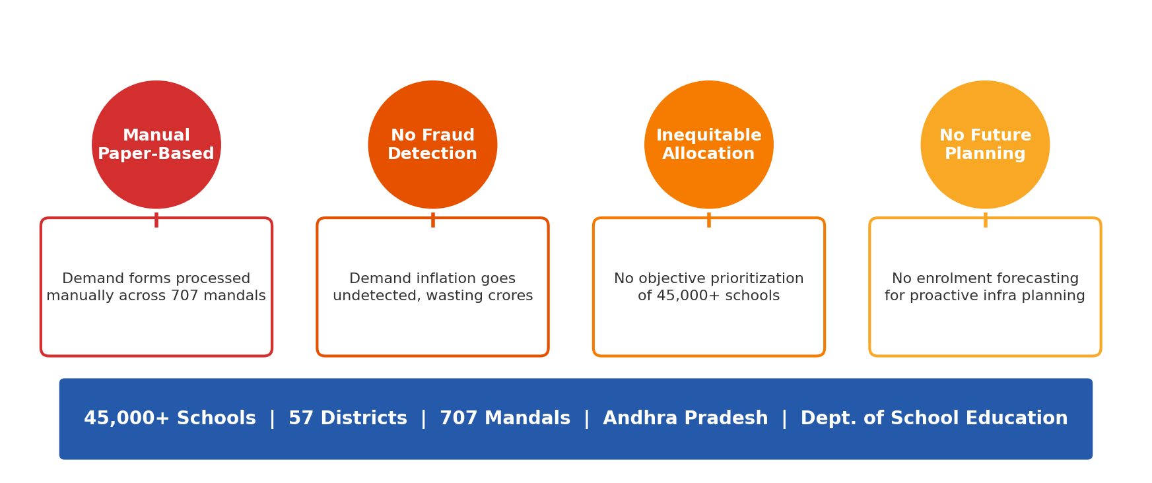
THE PROBLEM
Reimagining School Infrastructure Planning
Andhra Pradesh manages 45,000+ government schools with manual, paper-based infrastructure planning. No automated fraud detection, no objective prioritization, no future-readiness.
Koreidea Innovations | Vidya Nirmaan | IndiaAI Innovation Challenge | 2 / 12

Slide 3
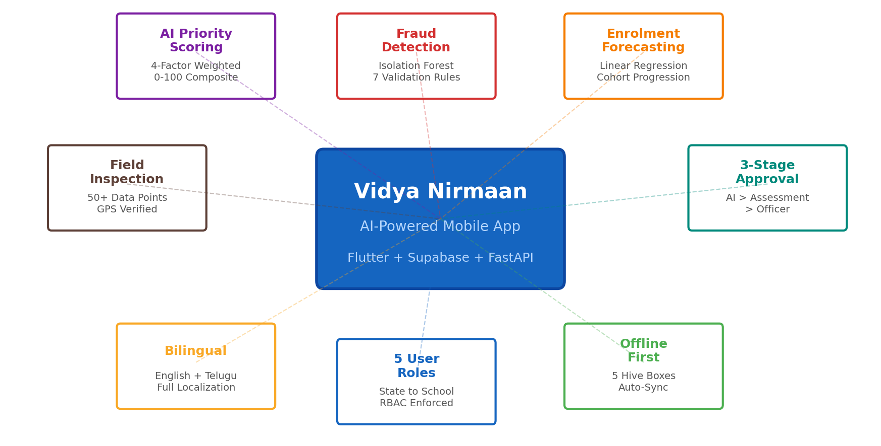
OUR SOLUTION
Vidya Nirmaan — End-to-End AI Platform
A mobile-first application that digitizes the entire infrastructure lifecycle: demand → validation → assessment → approval, powered by 3 AI/ML models.
Koreidea Innovations | Vidya Nirmaan | IndiaAI Innovation Challenge | 3 / 12

Slide 4
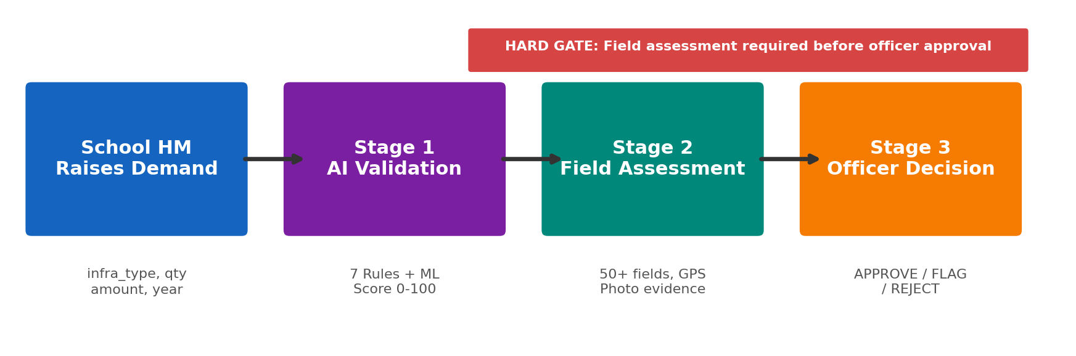
HOW IT WORKS
3-Stage Demand Approval Pipeline
Every infrastructure demand passes through AI validation, field verification, and officer approval. A hard gate ensures no demand is approved without ground-truth inspection.
AI-First Validation
Ground-Truth Verification
Officer Oversight
Full Audit Trail
7 automated rules + Isolation Forest ML
50+ inspection fields with GPS verification
Manual approve/flag/reject with justification notes
Every stage timestamped and tracked
Koreidea Innovations | Vidya Nirmaan | IndiaAI Innovation Challenge | 4 / 12

Slide 5
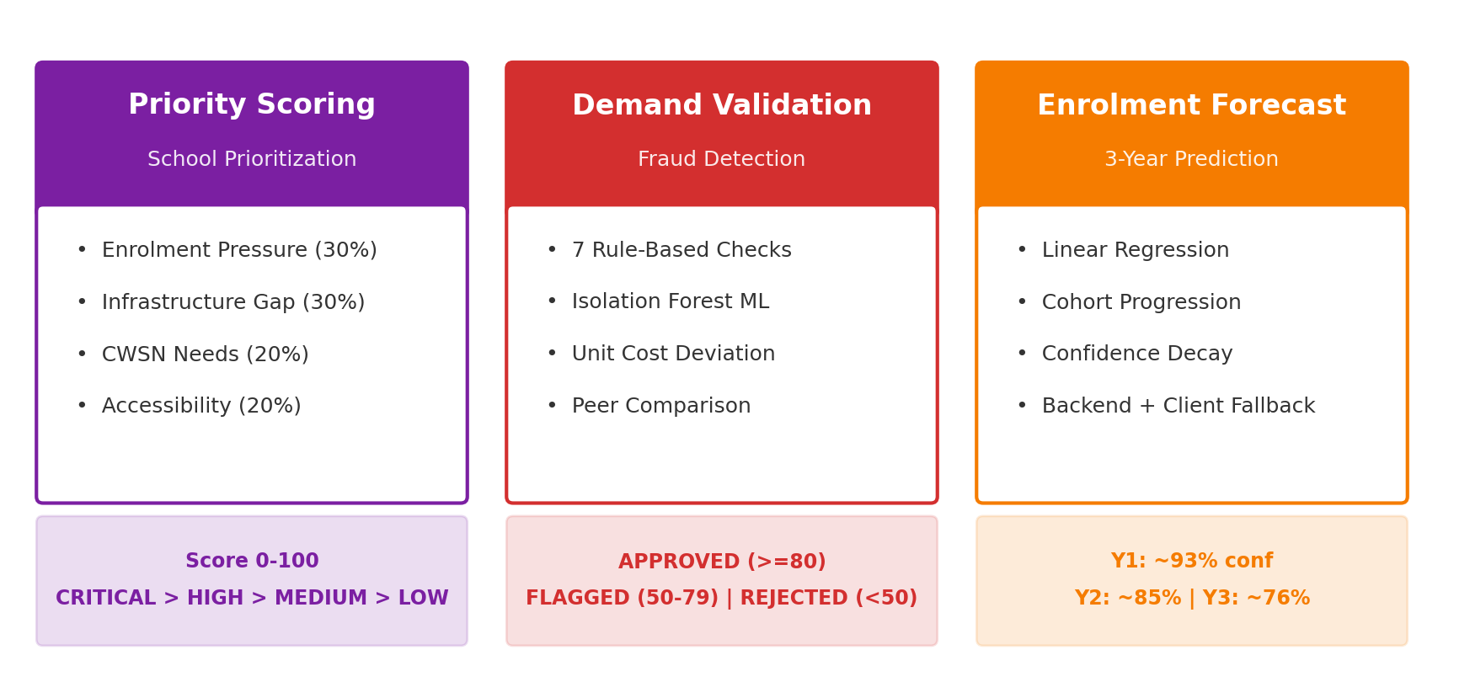
AI / ML INNOVATION
Three AI Models Working in Concert
Client-side + backend ML: priority scoring for objective allocation, Isolation Forest for fraud detection, dual-model forecasting for future planning.
Koreidea Innovations | Vidya Nirmaan | IndiaAI Innovation Challenge | 5 / 12

Slide 6
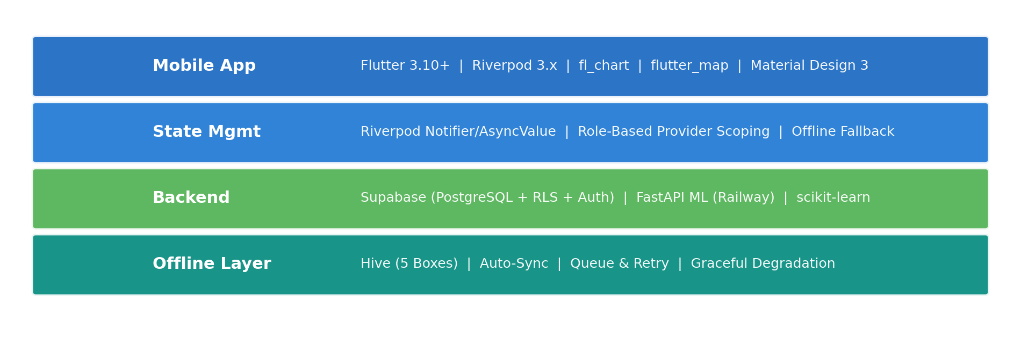
TECHNOLOGY
Modern, Scalable Architecture
Cross-Platform
Real-Time Backend
ML Pipeline
Offline-First
Single codebase for iOS + Android
Supabase PostgreSQL with Row Level Security
scikit-learn models on Railway cloud
Hive local storage with auto-sync
Flutter + Dart
Supabase + RLS
FastAPI + Python
Hive + Queue
Koreidea Innovations | Vidya Nirmaan | IndiaAI Innovation Challenge | 6 / 12

Slide 7
BY THE NUMBERS
Platform at a Glance
319
4,638
799
50+
Schools in Pilot Dataset
Enrolment Records Analyzed
Demand Plans Validated
Inspection Data Points
7
3
5
2
Validation Rules + Isolation Forest
AI/ML Models Deployed
User Roles with RBAC Enforcement
Languages EN + Telugu
100%
< 2s
0
45,000+
Offline Capable Full Functionality
AI Validation Response Time
Manual Steps in Fraud Detection
Schools Scalability Target
Koreidea Innovations | Vidya Nirmaan | IndiaAI Innovation Challenge | 7 / 12

Slide 8
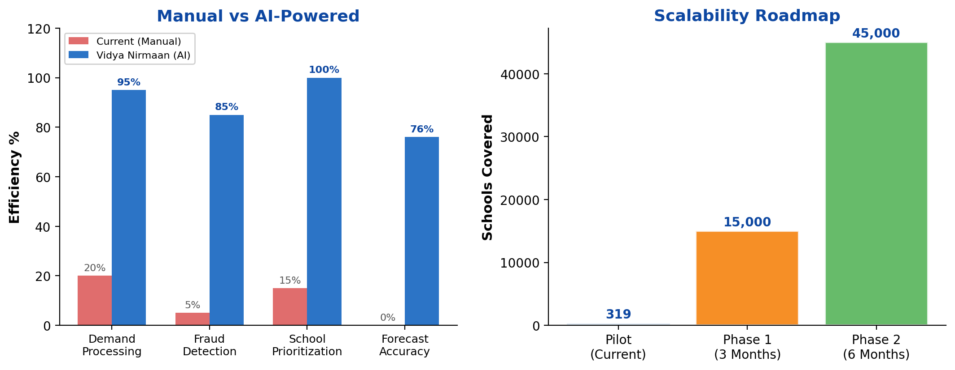
IMPACT & SCALABILITY
Transforming Infrastructure Planning
Reduced Processing Time
Automated Fraud Detection
Objective Prioritization
Proactive Planning
From weeks to seconds with AI validation
Isolation Forest catches anomalies humans miss
4-factor scoring replaces subjective decisions
3-year forecasts enable proactive investment
Koreidea Innovations | Vidya Nirmaan | IndiaAI Innovation Challenge | 8 / 12

Slide 9
RESPONSIBLE AI
Ethical, Transparent, Accountable
Principle | Implementation
Transparency | All AI decisions show detailed rule-by-rule breakdown with scores. Officers see exactly why a demand was approved, flagged, or rejected.
Human Oversight | 3-stage pipeline ensures human officers make final decisions. AI assists but never auto-approves without assessment + officer review.
Fairness | Objective 4-factor scoring algorithm treats all schools equally. No geographic or administrative bias in prioritization.
Privacy | No personal student data collected. Only aggregate enrolment counts. Supabase Row Level Security enforces data access boundaries.
Accountability | Full audit trail: every validation, assessment, and officer decision is timestamped with the officer name and justification notes.
Inclusivity | CWSN (Children With Special Needs) weighted at 20% in priority scoring. Bilingual interface (English + Telugu) for accessibility.
Offline Equity | Full offline-first design ensures rural schools with poor connectivity are not disadvantaged. Auto-sync when connected.
Koreidea Innovations | Vidya Nirmaan | IndiaAI Innovation Challenge | 9 / 12

Slide 10
DATA GOVERNANCE
Secure, Compliant, Role-Scoped
Aspect | Approach | Details
Data Source | Government Official Data | UDISE+ school database, Samagra Shiksha norms, AP Dept. of Education records
Access Control | 5-Role RBAC | State Official sees all; District Officer sees district; Block Officer/Inspector sees mandal; HM sees own school only
Database Security | Row Level Security | Supabase PostgreSQL RLS policies enforce data isolation per user role at the database level
Encryption | In-Transit + At-Rest | HTTPS for all API calls. Supabase provides AES-256 encryption at rest. JWT auth tokens for sessions
Data Minimization | Aggregate Only | No personal student data (names, IDs). Only aggregate enrolment counts (boys, girls, total per grade)
Offline Security | Local-Only Cache | Hive cache stored on device only. No cross-device data sharing. Cache cleared on logout
Audit Logging | Full Traceability | Every validation, assessment, and officer decision recorded with timestamp, officer name, and justification
Consent | Govt Authorization | Data usage authorized under IndiaAI Innovation Challenge. No third-party data sharing
Koreidea Innovations | Vidya Nirmaan | IndiaAI Innovation Challenge | 10 / 12

Slide 11
THE TEAM
Built by Engineers Who Ship
Role | Focus Area | Expertise
CEO | Product Vision & Architecture | End-to-end product development, Mech Engg background, AI/ML, Mobile & Cloud
COO | Operations & Strategy | Business operations, government project coordination, strategic planning
Lead Engineer | Full-Stack Development | Full-stack engineering, 5+ years experience, frontend & backend
Product Dev Engineer | Product Development | Product development engineering, prototyping, testing & deployment pipelines
Organization: EdTech startup focused on AI-powered solutions for government education — school infrastructure (Vidya Nirmaan), early childhood development (ECD monitoring), and personalized learning companions for children.
Koreidea Innovations | Vidya Nirmaan | IndiaAI Innovation Challenge | 11 / 12

Slide 12
Vidya Nirmaan
Transforming school infrastructure planning from manual paper-based workflows to an AI-powered, transparent, accountable, and equitable system.
3 AI Models
7 Validation Rules
5 User Roles
Offline-First
Priority Scoring Validation Forecasting
Rule-Based + Isolation Forest ML
State to School Role-Based Access
Works Without Internet
Ready for Pilot Deployment Across Andhra Pradesh
iOS + Android | English + Telugu | Built for 45,000+ Schools
Koreidea Innovations | Vidya Nirmaan | IndiaAI Innovation Challenge | 12 / 12

