Slide 1
GitHub

Slide 2
Getting started
ראשית יש להרשם באתר של :github
https://github.com/
כעת ניצור יחד Repository, וכל זוג סטודנטים ייצור Branch משלו ויכניס שינויים.

Slide 3
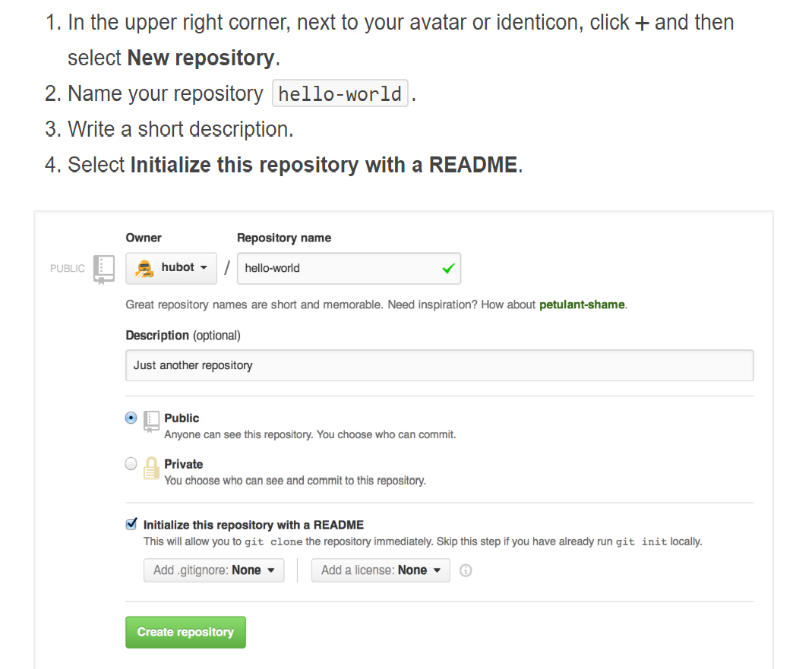
Repository
A repository is usually used to organize a single project. Repositories can contain folders and files, images, videos, spreadsheets, and data sets – anything your project needs.
It is recommend to include a README, or a file with information about your project.

Slide 4
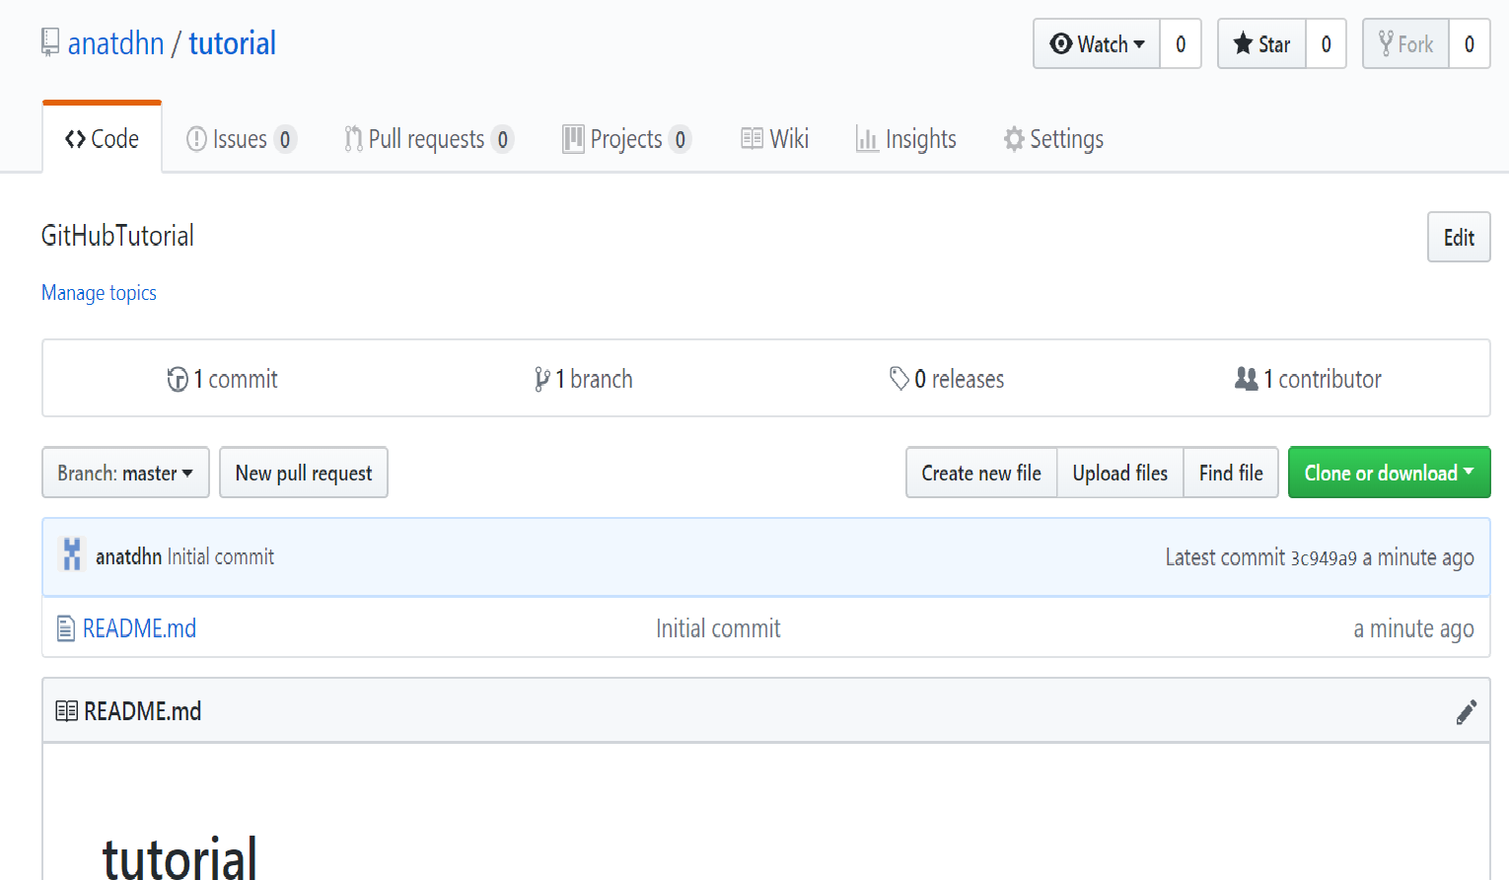
Repository
For this tutorial we will create 1 repository for each group where all students will add their comments.

Slide 5
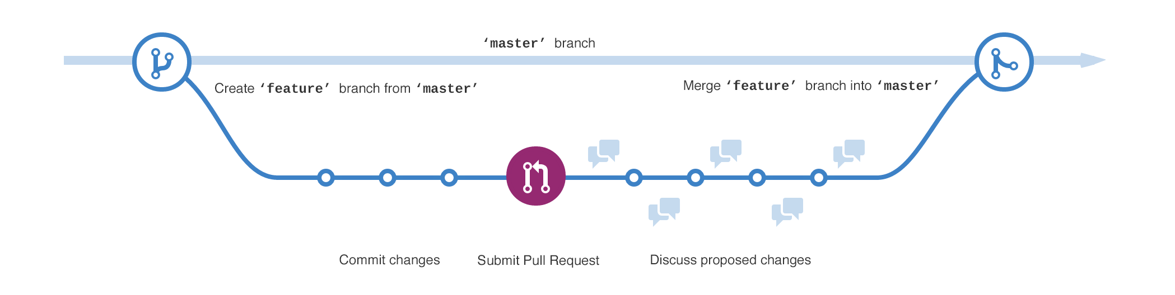
Branches
Branching is the way to work on different versions of a repository at one time.
By default your repository has one branch named master which is considered to be the definitive branch. We use branches to experiment and make edits before committing them to master.
When you create a branch off the master branch, you’re making a copy, or snapshot, of master as it was at that point in time. If someone else made changes to the master branch while you were working on your branch, you could pull in those updates.
In diagram: The master branch, A new branch called feature (because we’re doing ‘feature work’ on this branch). The journey that feature takes before it’s merged into master

Slide 6
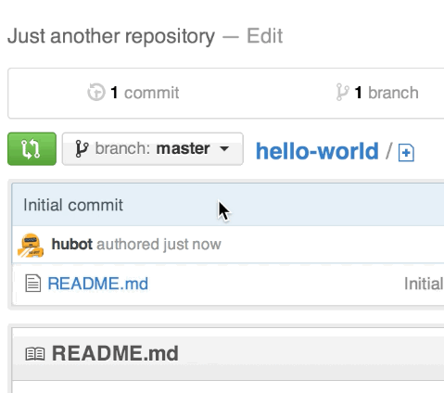
Branches
To create a new branch
Go to our new repository tutorial-groupx
Click the drop down at the top of the file list that says branch: master.
Type a branch name, studentnames-edits, into the new branch text box.
Select the blue Create branch box or hit “Enter” on your keyboard.
Tasktodo :Each pair should create its own branch

Slide 7
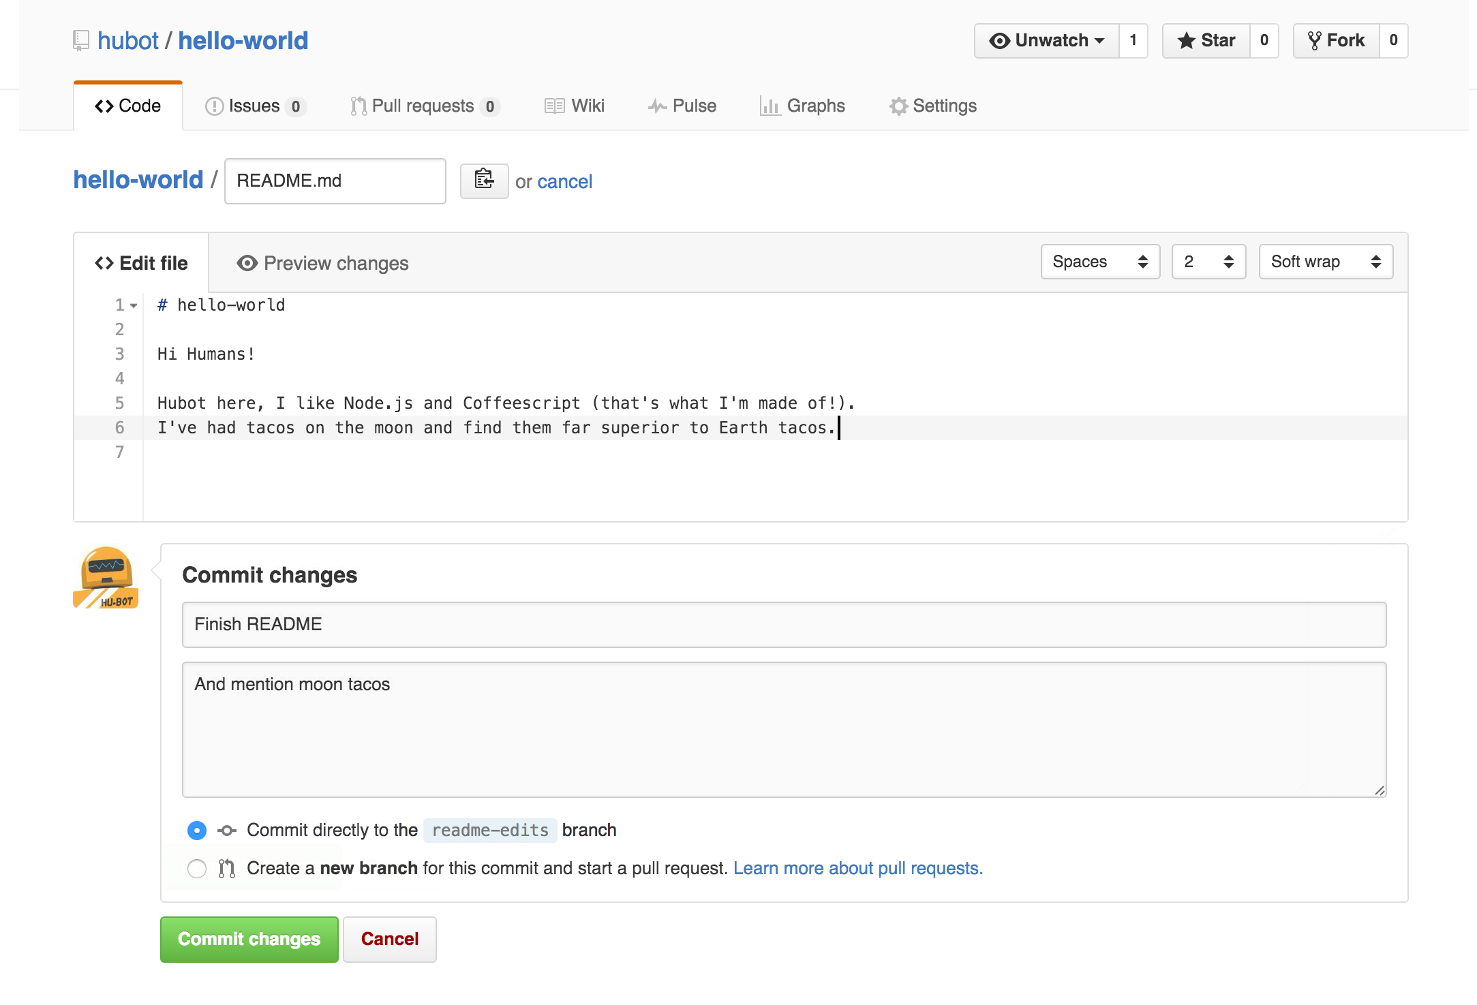
Make and commit changes
On GitHub, saved changes are called commits. Each commit has an associated commit message, which is a description explaining why a particular change was made.
Commit messages capture the history of your changes, so other contributors can understand what you’ve done and why.

Slide 8
Make and commit changes
Click the README.md file.
Click the pencil icon in the upper right corner of the file view to edit.
In the editor, write your names and something about yourselves.
Write a commit message that describes your changes.
Click Commit changes button.

Slide 9
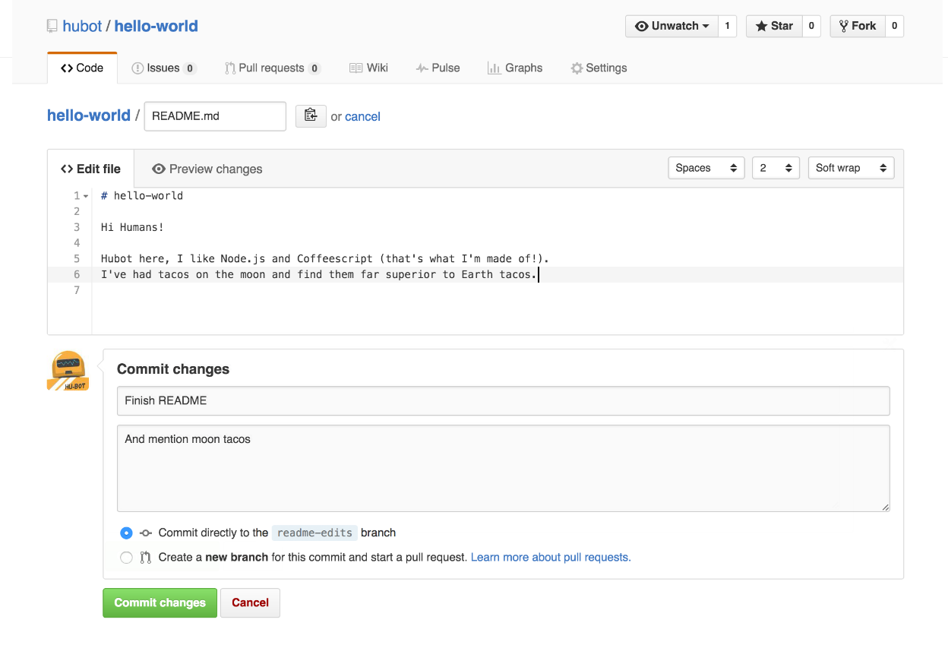
Make and commit changes
Now each pair of students has a different branch, which is different from the master branch.

Slide 10
Make and commit changes
Nice edits! Now that you have changes in a branch off of master, you can open a pull request.
Pull Requests are the heart of collaboration on GitHub. When you open a pull request, you’re proposing your changes and requesting that someone review and pull in your contribution and merge them into their branch. Pull requests show diffs, or differences, of the content from both branches. The changes, additions, and subtractions are shown in green and red.
By using GitHub’s @mention system in your pull request message, you can ask for feedback from specific people or teams, whether they’re down the hall or 10 time zones away.

Slide 11
Make and commit changes
Click the Pull Request tab, then from the Pull Request page, click the green New pull request button.
In the Example Comparisons box, select the branch you made, student-edits, to compare with master (the original).

Slide 12
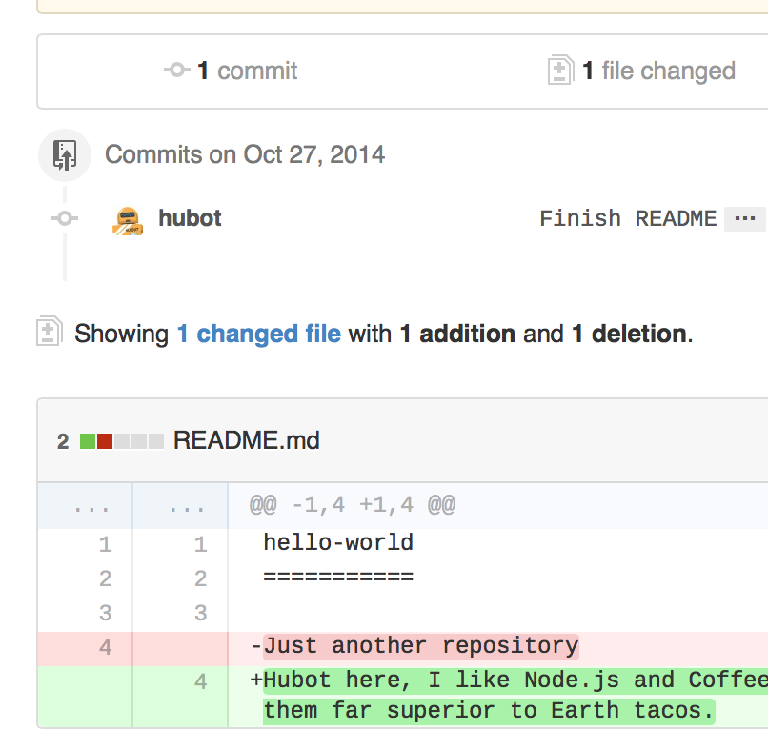
Make and commit changes
Look over your changes in the diffs on the Compare page, make sure they’re what you want to submit.

Slide 13
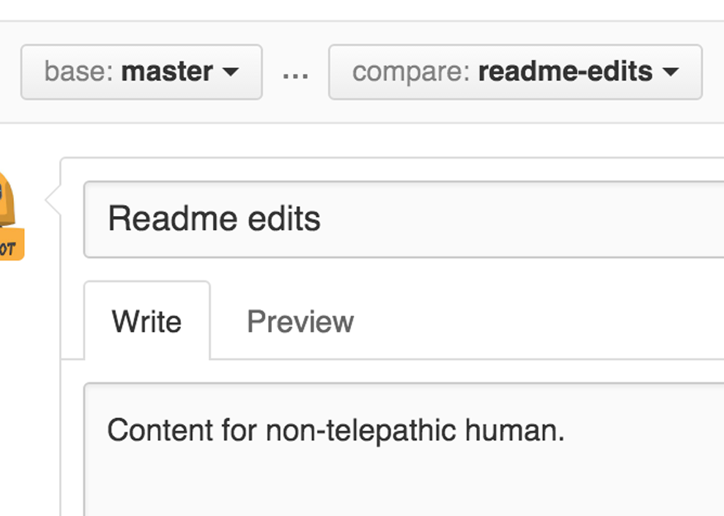
Make and commit changes
When you’re satisfied that these are the changes you want to submit, click the big green Create Pull Request button.
Give your pull request a title and write a brief description of your changes.

Slide 14
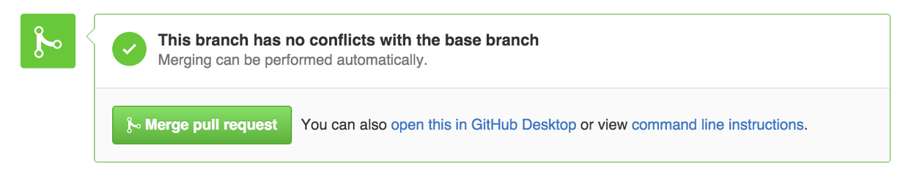
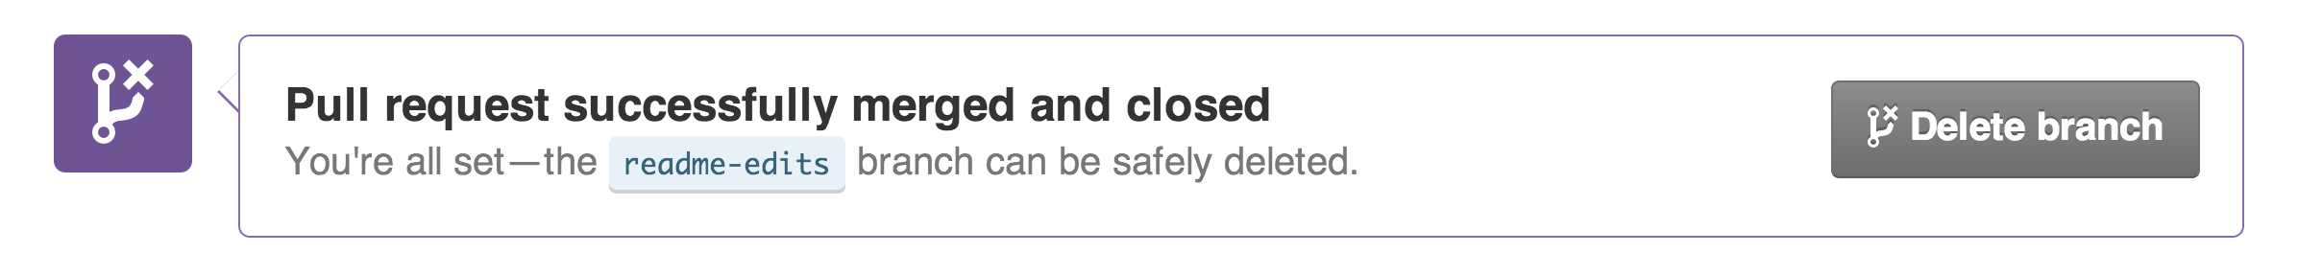
Merge
n this final step, it’s time to bring your changes together – merging your readme-edits branch into the master branch.
Click the green Merge pull request button to merge the changes into master.
Click Confirm merge.
Go ahead and delete the branch, since its changes have been incorporated, with the Delete branch button in the purple box.

