Slide 1
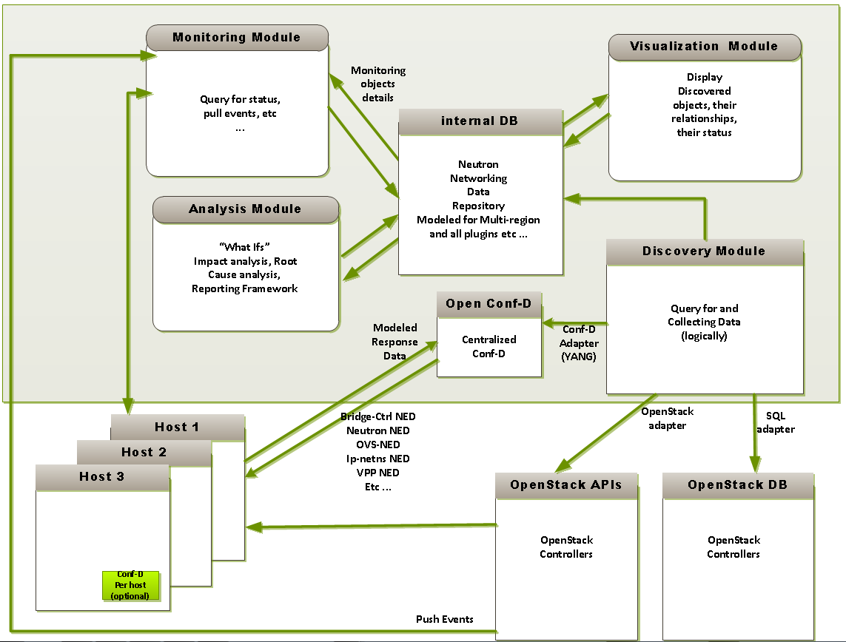
High Level: OS-DNA Modules

Slide 2
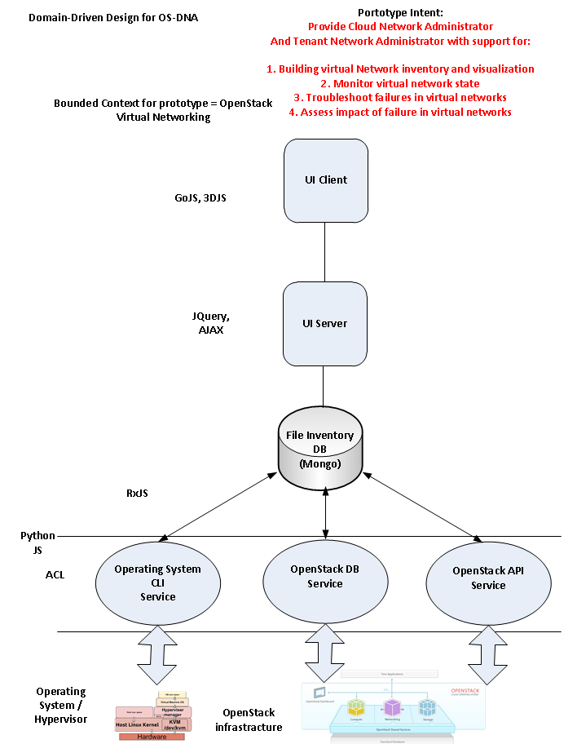
High Level: Domain Design (1)

Slide 3
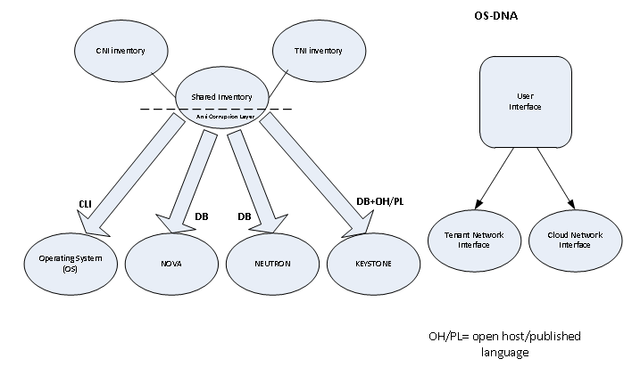
High Level: Domain Design (2)

Slide 4
UML

