Slide 1
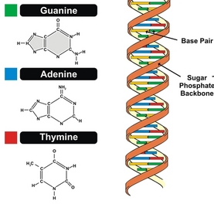

OS-DNA
OpenStack network Discovery and Assurance
Notes:
OSAND stands for Open Stack Assurance and Network Discovery.

Slide 2
OpenStack User Survey
“When the comments across the various free text responses were analysed, Neutron remained at the number one area of pain (16% of comments).”
http://superuser.openstack.org/articles/openstack-user-survey-insights-november-2014
Notes:
Neutron is the part of OpenStack that deals with networking. Recent surveys show that many users find it to be very painful to use.

Slide 3
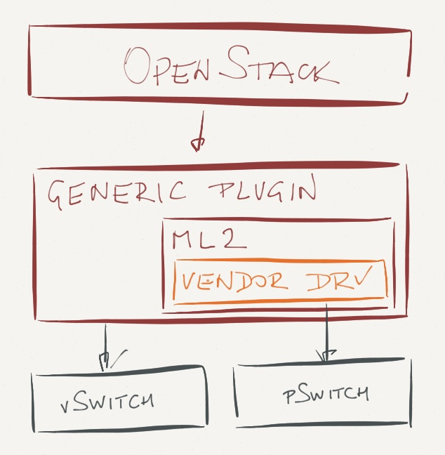
Neutron as an ‘Umbrella’ Controller…

Slide 4
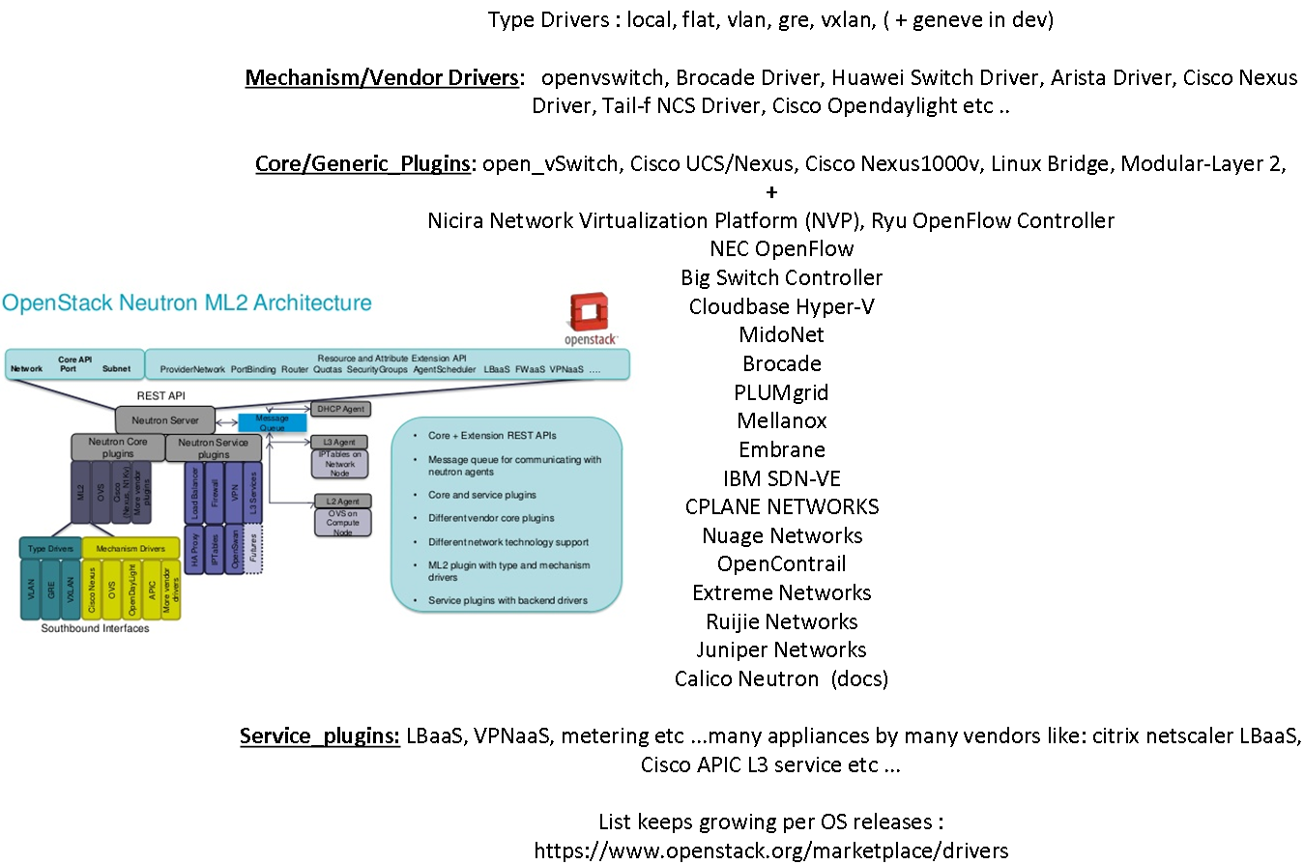
Neutron Plugins (customer choice)– effects the final discovered objects and inter-connections
+VPP (soon as a neutron plugin) …

Slide 5
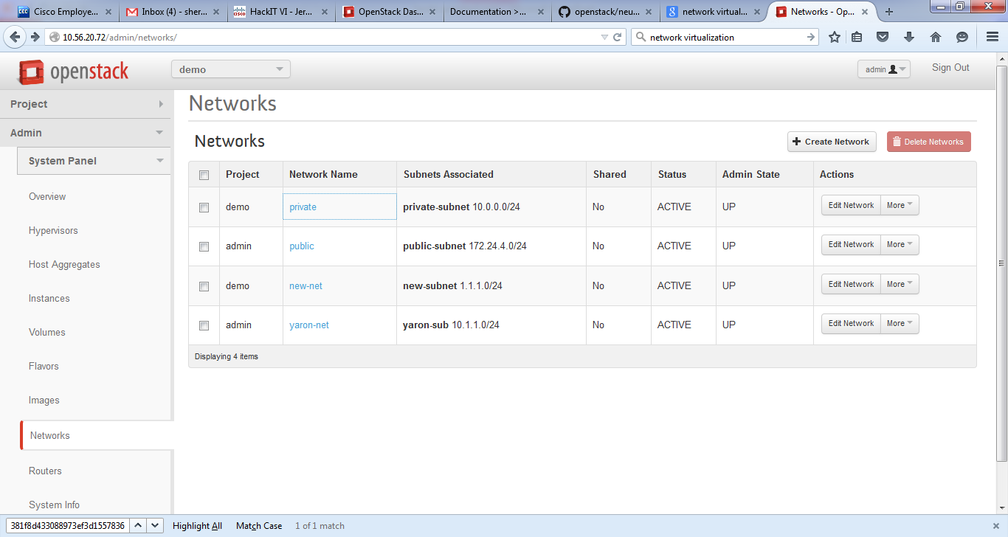
Problem statement…
Is it really up?
Real Answer: It depends!! …on many things …the dependencies are missing, nobody really knows for sure without a lot of manual queries…
Notes:
Today a system engineer cannot be certain whether a network is really up and running. This is because there are many neutron components that are not monitored and there is no auto discovery.

Slide 6
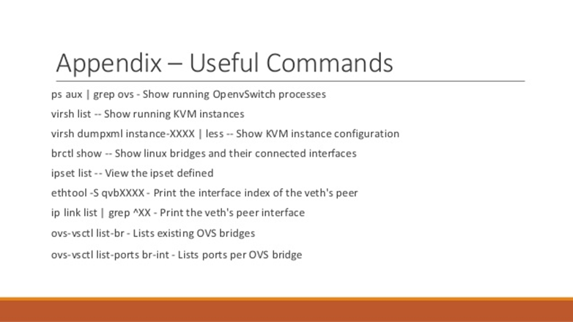
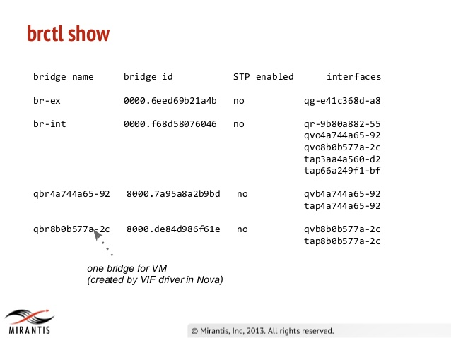
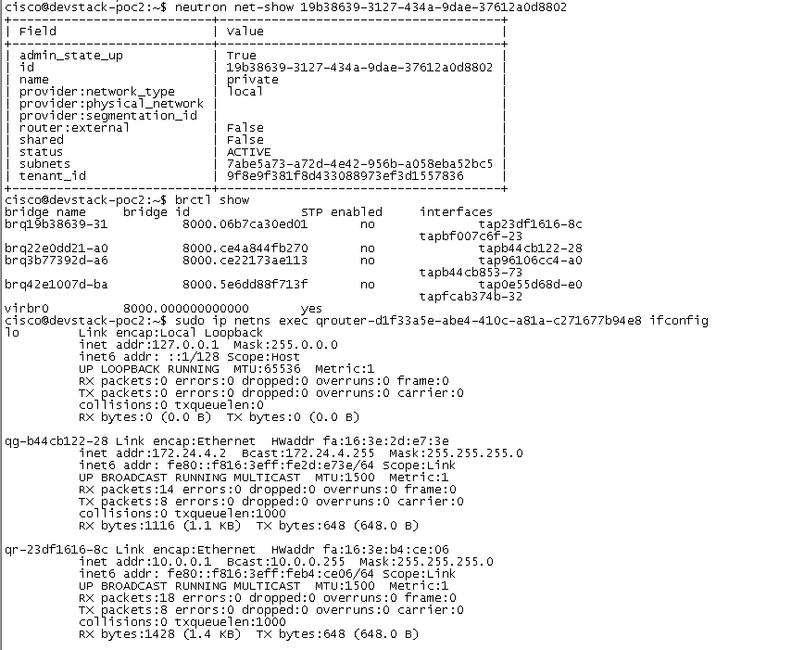
Manual discovery today …per VM, Host etc…
goto Neutron Manager, specific Hypervisor Node,
specific Network Node and make quarries …write it down and draw your favorite type of picture …

Slide 7
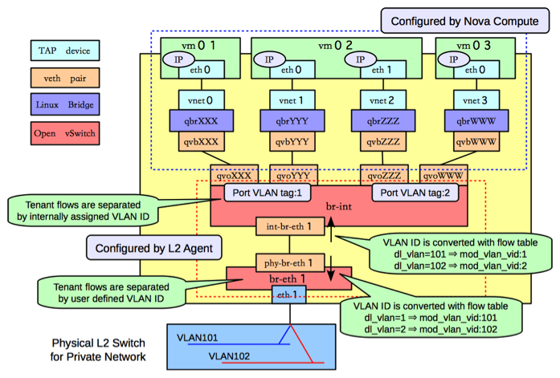
Manual drawings based on manual discovery , depends on plugin type etc…
Today – manual drawings (plugin, distro dependent)
Notes:
If you look on Google for OpenStack “Under the Hood”, you will find many diagrams that people had to draw manually. They do this in order to try and understand the different objects in the Hypervisor and how they are connected to each other and to other hypervisors and external networks etc …

Slide 8
OS-DNA Discovery Process …
Business Value
OpenStack APIs, mySQL, CLI (confD)
JSON per distro, cell, server/node
UML and SVG
Graphical display
Smart Discovery
Format Data
Display Data
Visualize
Monitor and Analyze
Notes:
Here you can see our proposed solution in red, and in blue you can see how we actually implemented it in the hackathon. The business value for Cisco lies in Discovery on the left, and Visualization on the right, because currently these have no other competing solutions.

Slide 9
What we Discover?
1. Distribution (RedHat, Canonical, Mirantis...etc…)
2. OpenStack Version (Juno, Kilo, Icehouse etc …)
3. Neutron version (yes…totally possible…)
4. OS Hierarchy (Provider->Region->Cell->Aggregates, Avail-zones->nodes…node-types etc …
5. Compute and Network Nodes
6. All Neutron Plugins (service, ML2, driver and mechanisms…)
7. Multi-tenancy associations
8. Low level components at controller level
8. Low level components at host/server level
GOAL: Incorporate this solution into ANY OpenStack customer/user environment, any application on top of OS.
(IT: Cisco Intercloud, Webex, VIRL etc …Customers: cVPN, BT, etc…)

Slide 10
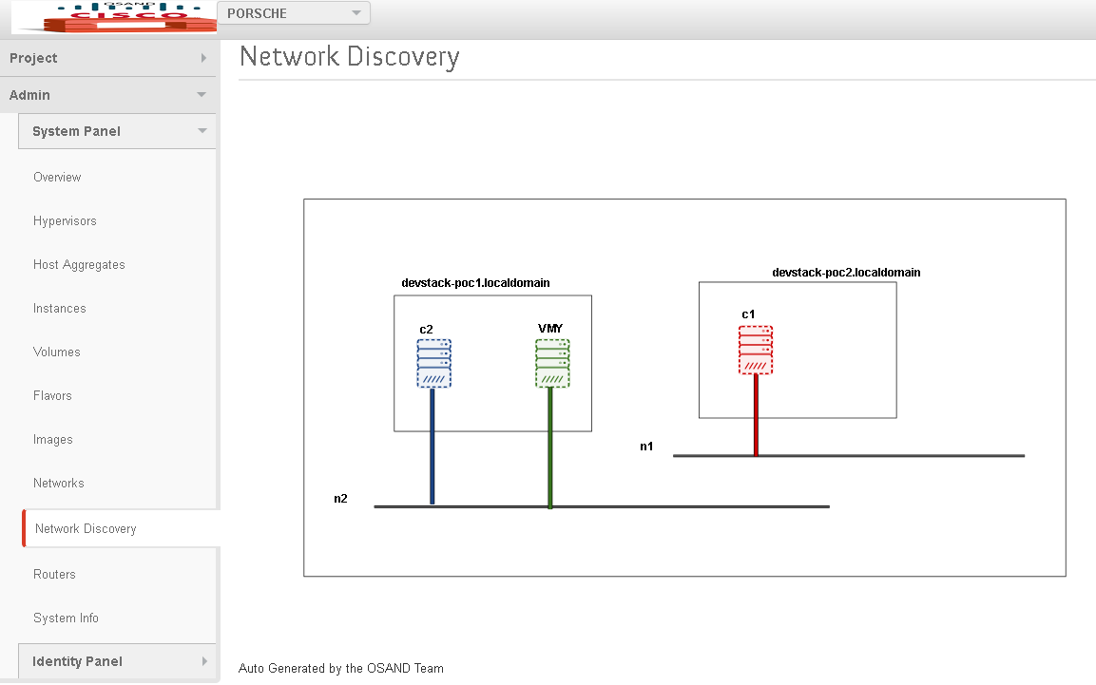
Plugin to horizon (POC)

Slide 11
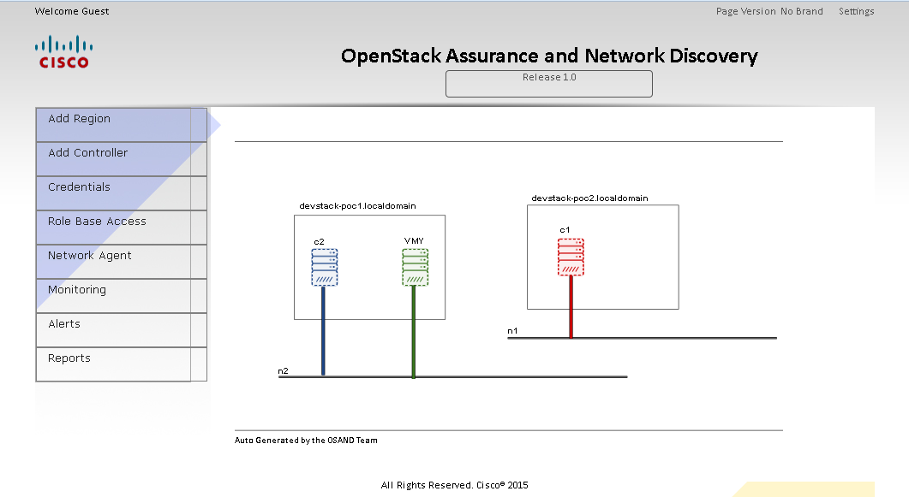
Standalone (POC)..
OSAND

Slide 12
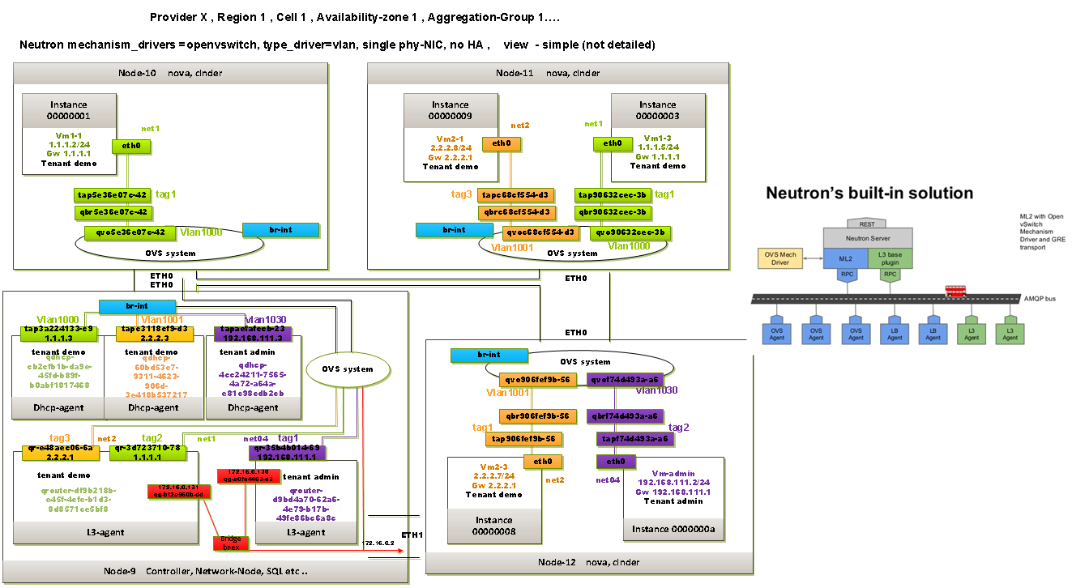
Discovery details (example)
Zoom in …

Slide 13
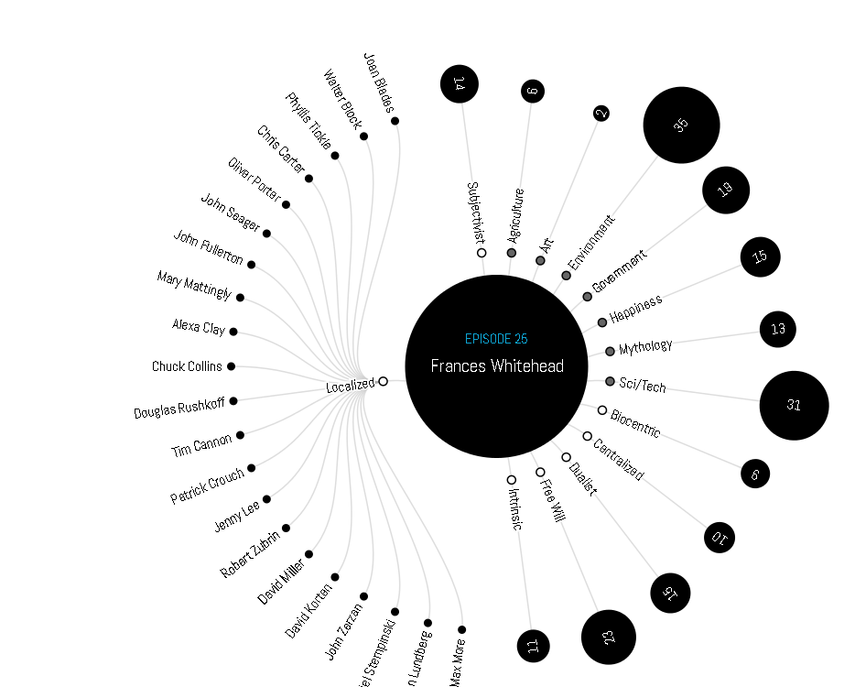
Visualization library under investigation 4 POC…:

