Slide 1

DATA ENGINEERING 2
CHAPTER 2
Laszlo Sallo
OCTOBER 2020

Slide 2

THE ELEPHANT IN THE ROOM
HOW TO HANDLE
LARGE
UNSTRUCTURED
DATA?
Notes:
WHAT MAKES UNSTRUCTURED HARD?

Slide 3
UNSTRUCTURED DATA
YOU CANNOT CREATE AN EFFICIENT INDEX ON UNSTRUCTURED DATA
YOU NEED TO SCAN YOUR DATA WHEN YOU ARE SEARCHING

Slide 4

READ/WRITE EFFORT
SMALL
STRUCTURED DATA
LARGE
UNSTRUCTURED DATA
W
CREATE INDEX
WRITE DATA
WRITE DATA
R
RETURN
DATA
SCAN DATA
RETURN
DATA
DISTRIBUTE!

Slide 5
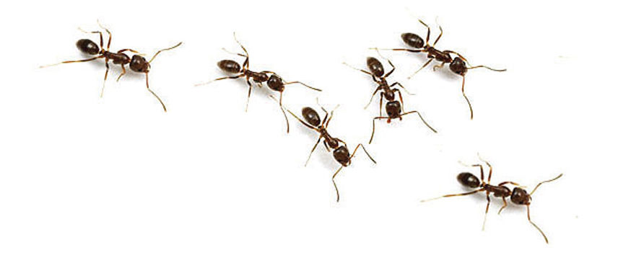
DATA LAKES
OPERATIONS
PRODUCTION
DB
Data lake
(Raw Data)
Advanced DS
DB
Analytics
DB
Stream
Reporting

Slide 6
DATA WAREHOUSE VS DATA LAKE
 | DATA WAREHOUSE | DATA LAKE
Data form | Structured | Anything / Mainly unstructured
Stored data | Relevant data | Raw data
Volume | Large | Ultra large
Users | Analysts | Analysts
Data quality | High control | Low control
Price | High upfront cost | Lower pay-as-you-go cost
Hardware | Large servers | Commodity
Implementation time | Months | Hours

Slide 7

NOSQL

Slide 8
INTEGRITY AND CONSISTENCY
BASICALLY AVAILABLE
SOFT STATE
EVENTUAL CONSISTENCY
BASE
NO ACID
TRANSACTION IS
NOT HANDLED BY DB

Slide 9
INTERFACE
SQL
ActionScript Bash C C# C++ Clojure Common Lisp Crystal D Dart Delphi Elixir emacs lisp Erlang Fancy gawk GNU Prolog Go Haskell Haxe Io Java Julia Lasso Lua Matlab mruby Nim Node.js Objective-C OCaml Pascal Perl PHP PL/SQL Pure Data Python R Racket Rebol Ruby Rust Scala Scheme Smalltalk Swift Tcl VB VCL Xojo …

Slide 10

SCHEMALESS OR SCHEMA FREE
A SMART DATABASE CAN FIGURE OUT
THE DATATYPE
THE STRUCTURE

Slide 11

ALGORITHMS DEEP IN THE DATABASE
NO NEED TO MINE

Slide 12


MADE FOR CLOUD

Slide 13
NOSQL VARIETY
100s
OF NOSQL
SOLUTIONS
CLOUD BASED
TIME SERIES DB WITH
TIME AGGREGATION FUNCTIONS
USING SQL
SCHEMA FREE JSON
DOCUMENT STORE
WITH TRANSACTION HANDLING
GRAPH DATABASE WITH GQL AND
NETWORK VISUALIZATION
1
2
3

Slide 14
NOSQL CLASSIFICATION
KEY-VALUE STORES
TIME SERIES DBMS
DOCUMENT STORES
COLUMN STORES
GRAPH DBMS
SEARCH ENGINES

Slide 15
DB-ENGINES.COM
YOUR ULTIMATE SOURCE TO
EXPLORE
http://db-engines.com/en/system/MySQL
http://db-engines.com/en/system/Elasticsearch
CATEGORIZE / KNOW THE TRENDS
http://db-engines.com/en/ranking_categories
http://db-engines.com/en/ranking_osvsc
http://db-engines.com/en/ranking_trend
COMPARE
http://db-engines.com/en/system/Elasticsearch%3BMongoDB

Slide 16
EXERCISE
CAN I INSTALL REDSHIFT ON MY LAPTOP ?
WHAT ARE THE TYPICAL APPLICATION SCENARIOS FOR CASSANDRA ?
CAN NEO4J PARTION DATA OVER MULTIPLE NODES ?

Slide 17
THE NEW TOOLS
NOSQL
SET OF SOLUTIONS
PERFORMANCE ORIENTED
DATABASE
OPERATIONAL AND ANALYTICAL
STRUCTURED/ SEMI-STRUCTURED
BIG DATA
SET OF SOLUTIONS
DATA VOLUME ORIENTED
DATA FRAMEWORK
ANALYTICAL
MAINLY UNSTRUCTURED

Slide 18
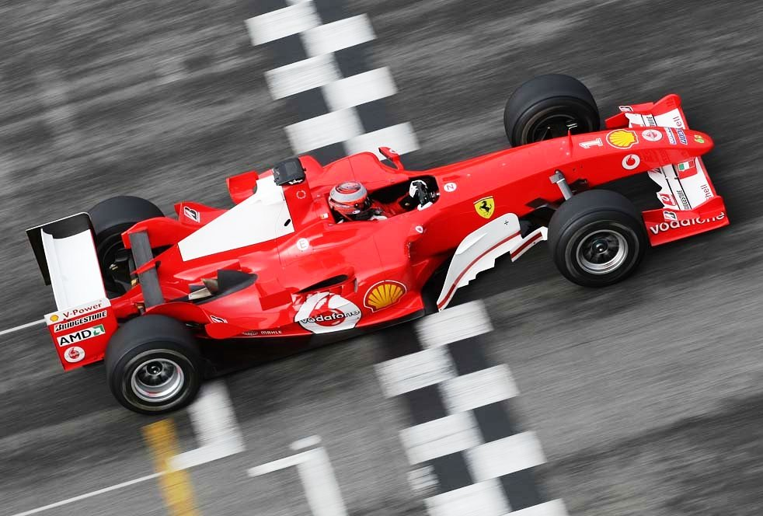
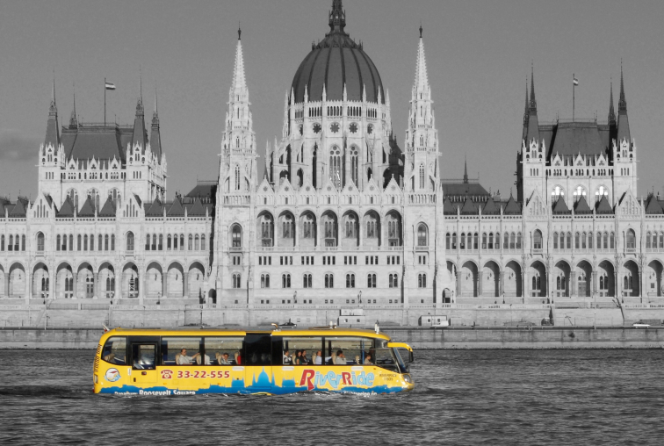
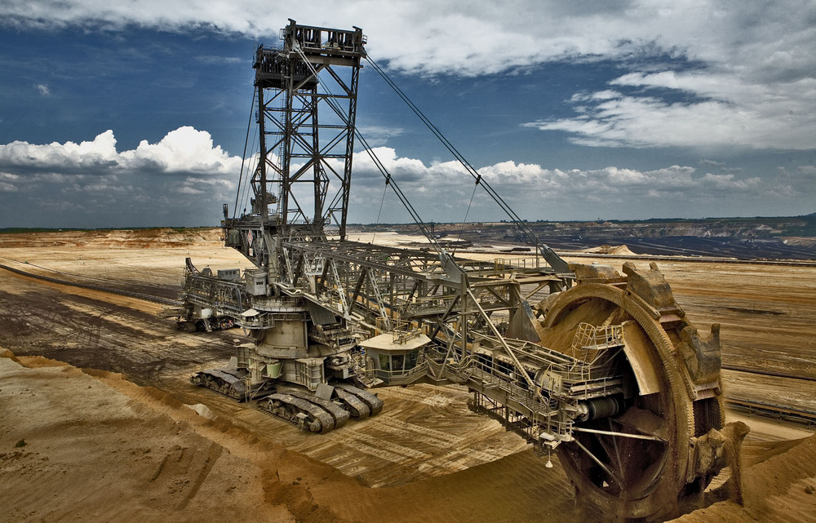
GAME
WHICH ONE YOU
WOULD ASSOCIATE
WITH
RDBMS,
NOSQL,
BIGDATA ?
1
2
3

Slide 19
NOSQL CLASSIFICATION
KEY-VALUE STORES
TIME SERIES DBMS
DOCUMENT STORES
COLUMN STORES
GRAPH DBMS
SEARCH ENGINES

Slide 20
KEY-VALUE DATA FORM - EXAMPLES
key | value
1 | John
2 | Mary
3 | Peter
key | value
War and Peace | ‘Well, Prince, so Genoa and Lucca are now just family …”
The Master and Margarita | “At the sunset hour of one warm spring day two men were to be seen …”
The Winter of Our Discontent | “I wonder how many people I've looked at all my life and never seen.”

Slide 21
KEY-VALUE STORE FEATURES
SIMPLEST DBMS VARIANT
EASY TO SCALE
HIGH PERFORMANCE

Slide 22
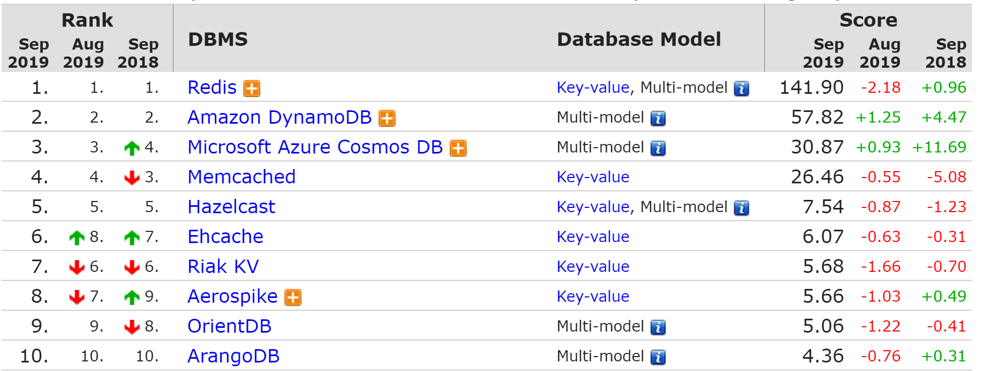
KEY-VALUE STORE RANK

Slide 23
REDIS
IN MEMORY (VERY FAST )
SUPPORTS TRANSACTION
EXPIRING KEY

Slide 24






REDIS IN CLOUD

Slide 25
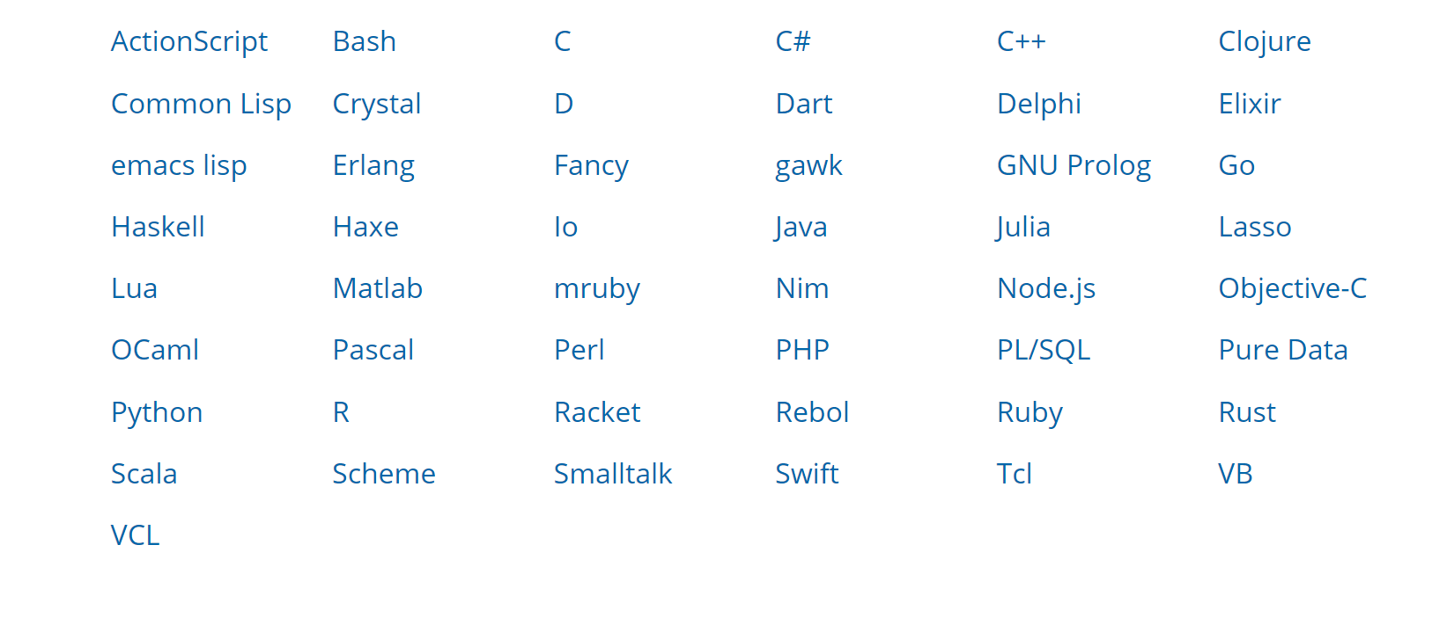
ACCESS REDIS

Slide 26
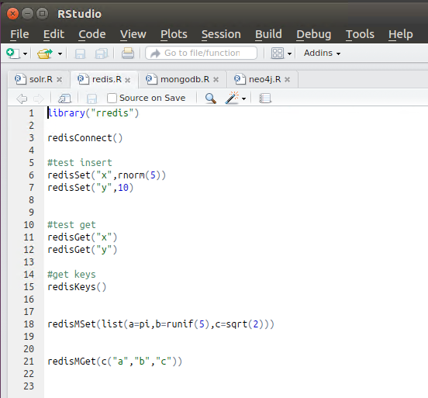
R STUDIO

Slide 27

REDIS PRACTICE WITH ZEPPELIN NOTEBOOK

Slide 28

SUITABLE USE CASES
USER PROFILE FOR
UI
USER PROFILE
TAG
SEARCH ENGINE
AS OF 2013 PINTEREST HAD 8000+ REDIS SHARDS ON AMAZON CLOUD

Slide 29
SUITABLE USE CASES
MESSAGING
PROCESSOR
DB
SOURCE
QUEUE
PROCESSOR
QUEUE DB

Slide 30
SUITABLE USE CASES
RESPONSE CACHE
DW
SELECT ITEM FROM SALES WHERE COUNTRY=‘HU’
REPORT
Sales ID | Country | Item
1 | HU | Chair
2 | HU | Flower
3 | HU | Space ship
4 | HU | Oracle DB

Slide 31
SUITABLE USE CASES
RESPONSE CACHE
DW
REPORT
CACHE
KEY: QUERY
VALUE: RESULT

Slide 32
USAGE
DO NOT USE WHEN YOU …
HAVE TO QUERY FOR RELATIONSHIPS
HAVE TO QUERY FOR HIERARCHY
HAVE TO QUERY BY MULTIPLE DIMENSIONS
WHEN YOU CANNOT CREATE A DISTINCT KEYS

