Slide 1

DATA ENGINEERING 2
CHAPTER 3
Laszlo Sallo
OCTOBER 2020

Slide 2
NOSQL CLASSIFICATION
KEY-VALUE STORES
TIME SERIES DBMS
DOCUMENT STORES
COLUMN STORES
GRAPH DBMS
SEARCH ENGINES

Slide 3
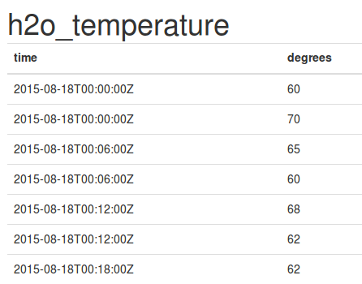
TIME SERIES DBMS
KEY: TIME
VALUE: TIME SERIES DATA (MEASUREMENT, EVENT ETC)

Slide 4
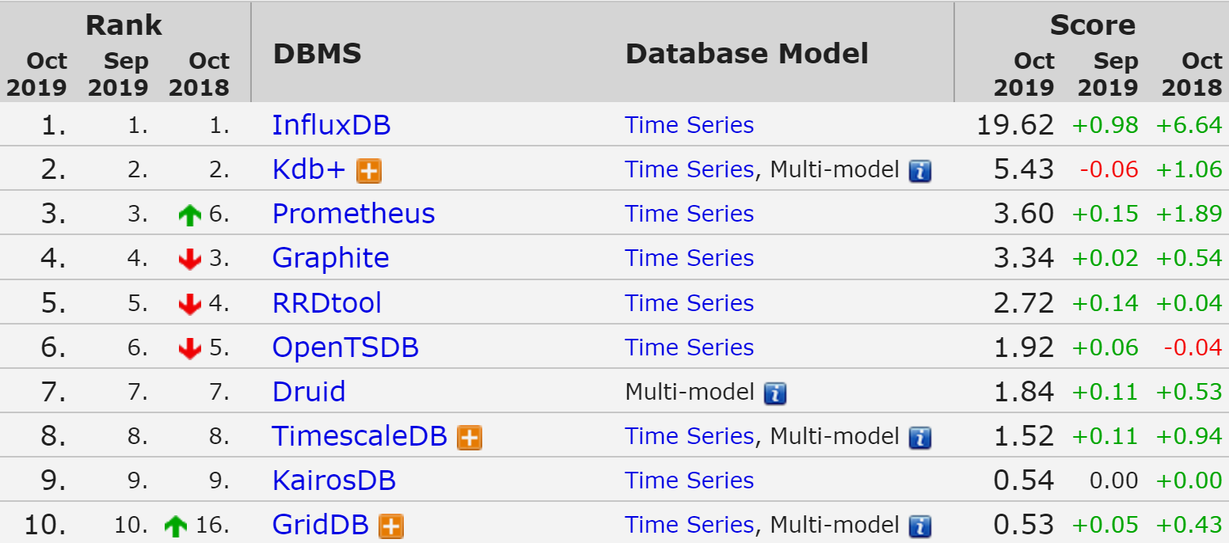
TIME SERIES DBMS

Slide 5
TIME SERIES DBMS - FEATURES
QUERY BY TIME
HIGH PERFORMING WRITE
STATISTICAL OPERATION ON TIME SERIES

Slide 6
INFLUX DB FUNCTIONS
Aggregations | Selectors | Transformations | Predictors | Technical Analysis
COUNT() | BOTTOM() | ABS() | HOLT_WINTERS() | CHANDE_MOMENTUM_OSCILLATOR()
DISTINCT() | FIRST() | ACOS() |  | EXPONENTIAL_MOVING_AVERAGE()
INTEGRAL() | LAST() | ASIN() |  | DOUBLE_EXPONENTIAL_MOVING_AVERAGE()
MEAN() | MAX() | ATAN() |  | KAUFMANS_EFFICIENCY_RATIO()
MEDIAN() | MIN() | ATAN2() |  | KAUFMANS_ADAPTIVE_MOVING_AVERAGE()
MODE() | PERCENTILE() | CEIL() |  | TRIPLE_EXPONENTIAL_MOVING_AVERAGE()
SPREAD() | SAMPLE() | COS() |  | TRIPLE_EXPONENTIAL_DERIVATIVE()
STDDEV() | TOP() | CUMULATIVE_SUM() |  | RELATIVE_STRENGTH_INDEX()
SUM() |  | DERIVATIVE()
 |  | DIFFERENCE()
 |  | ELAPSED()
 |  | EXP()
 |  | FLOOR()
 |  | HISTOGRAM()
 |  | LN()
 |  | LOG()
 |  | LOG2()
 |  | LOG10()
 |  | MOVING_AVERAGE()
 |  | NON_NEGATIVE_DERIVATIVE()
 |  | NON_NEGATIVE_DIFFERENCE()
 |  | POW()
 |  | ROUND()
 |  | SIN()
 |  | SQRT()
 |  | TAN()

Slide 7
INFLUX
DOWNSAMPLING AND DATA RETENTION
SQL LIKE QUERIES
ECOSYSTEM FOR ACQUISITION,
STORAGE,
PROCESSING,
AND VISUALIZATION

Slide 8
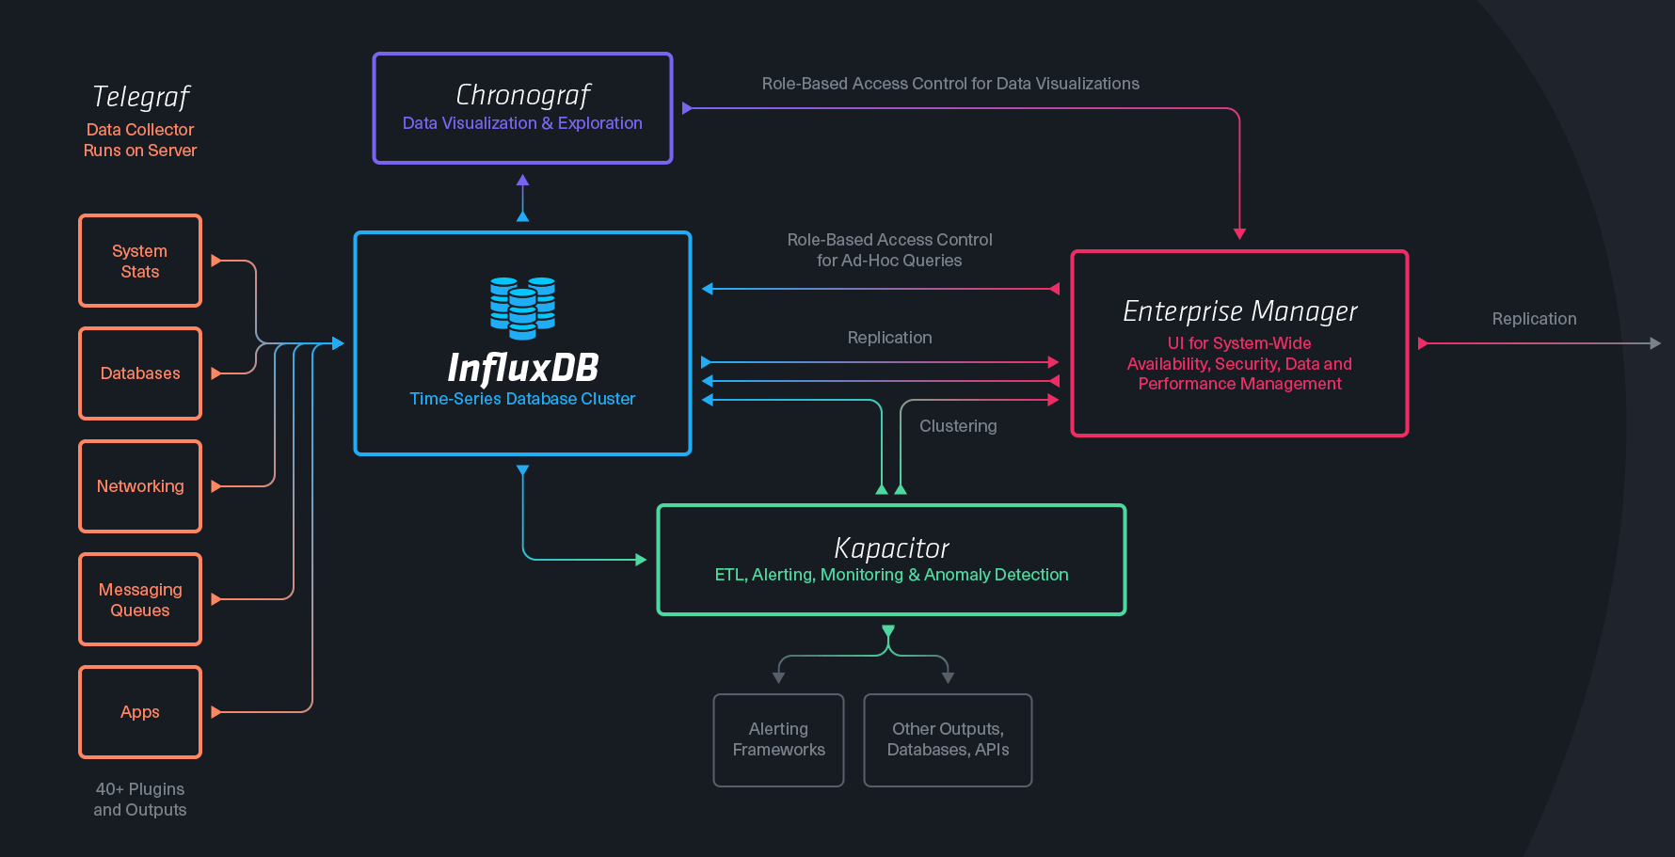
INFLUX TICK STACK

Slide 9
TERMINOLOGY
SQL SERVER | INFLUX
Database | Database
Table | Measurement
Index | Index
Row | Point
Column | Field,Tag
Joining | Join
Partition | Sharding

Slide 10

INFLUXDB PRACTICE

Slide 11

USE CASE EXAMPLE
VISUALIZE
IoT
Metrics Influx
(Aggregate)
PROCESSOR
SENSORS
Event Influx
(Interpret)
QUEUE
PROCESSOR
KEY VALUE
MONITOR

Slide 12
USAGE
TIME SERIES DATA FLUX WHICH YOU WANT TO
VISUALIZE TRANSFORM / AGGREGATE
DO REAL TIME ANALYTICS

Slide 13
USE CASES
IOT
SYSTEM / INFRASTRUCTURE MONITORING
SMART CITY
INDUSTRY 4.0
ANOMALY DETECTION
TRADING DATA

Slide 14
USAGE
DO NOT USE WHEN YOU …
DON’T HAVE TIME SERIES DATA FLUX
NEED TRANSACTION

Slide 15
NOSQL CLASSIFICATION
KEY-VALUE STORES
TIME SERIES DBMS
DOCUMENT STORES
COLUMN STORES
GRAPH DBMS
SEARCH ENGINES

Slide 16
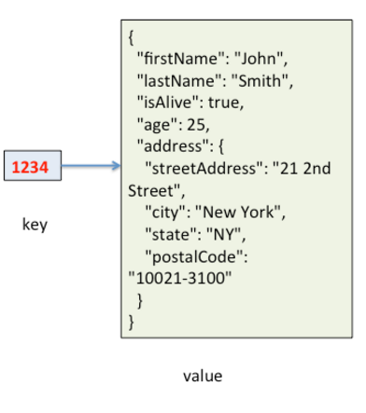
DOCUMENT STORES
KEY: ID
VALUE: QUERYABLE STRUCTURED DOCUMENT

Slide 17
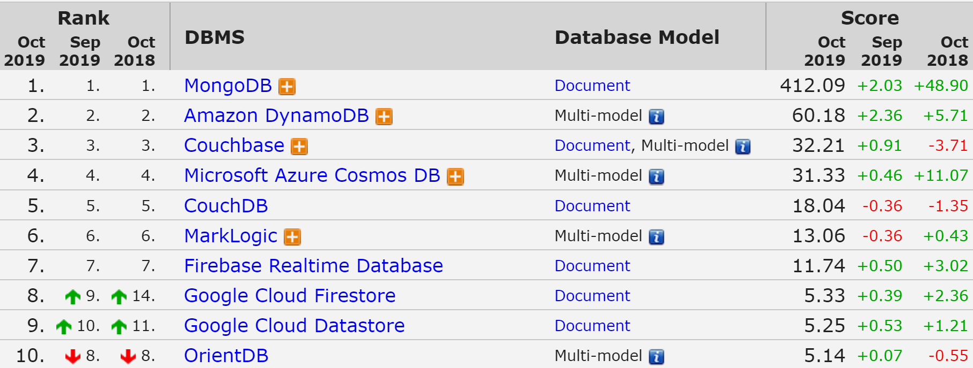
DOCUMENT STORES

Slide 18
MONGODB
THE MOST USED NOSQL
CLOSER TO GENERAL PURPOSE / SLOWER
HIGH AVAILABILITY / AUTOMATIC FAILOVER
HIGHLY SCALABLE / REBALANCING
SELECTABLE CONSISTENCY
NO TRANSACTION SUPPORT
DYNAMIC SCHEMA

Slide 19
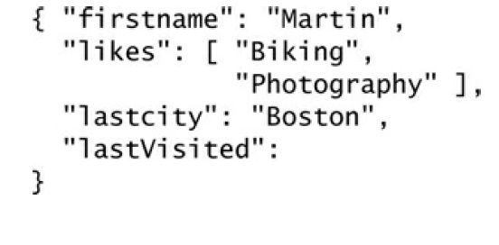
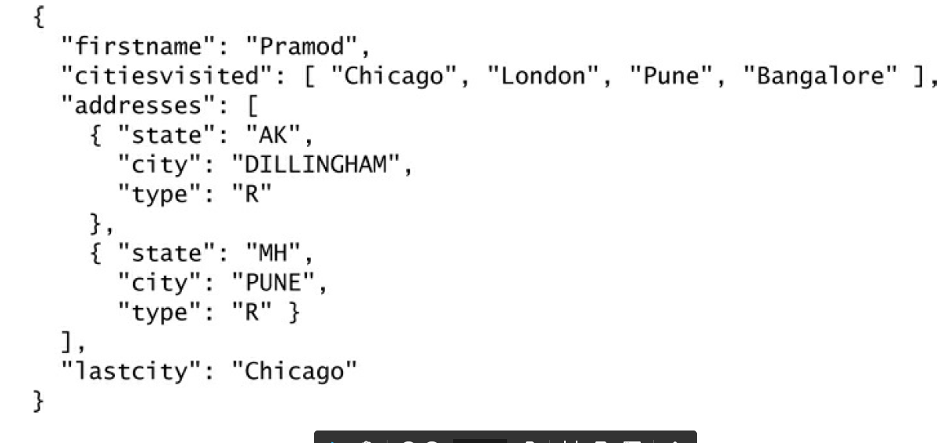
DYNAMIC SCHEMA
BE CAREFUL!

Slide 20
TERMINOLOGY
SQL SERVER | MONGODB
Database | Database
Table | Collection
Index | Index
Row | Document
Column | Field
Joining | Linking & Embedding
Partition | Sharding

Slide 21




MONGO ACCESS
BI TOOLS
PROGRAMING LANGUAGES

Slide 22

MONGO PRACTICE

Slide 23
USAGE
WHEN YOU WANT TO STORE/QUERY HIGH VOLUME OF MULTIDIMENSIONAL DATA
AND
FAILOVER, HIGH AVAILABILITY AND CONSISTENCY MATTERS FOR YOU

Slide 24



USES CASES
https://www.mongodb.com/industries/

Slide 25
WHEN NOT TO USE
DO NOT USE WHEN
MONGO CAN’T HANDLE YOUR DATA SIZE
YOU NEED TRANSACTIONS
YOU NEED COMPLEX AGGREGATIONS
YOU HAVE COMPLEX RELATIONS

