Slide 1
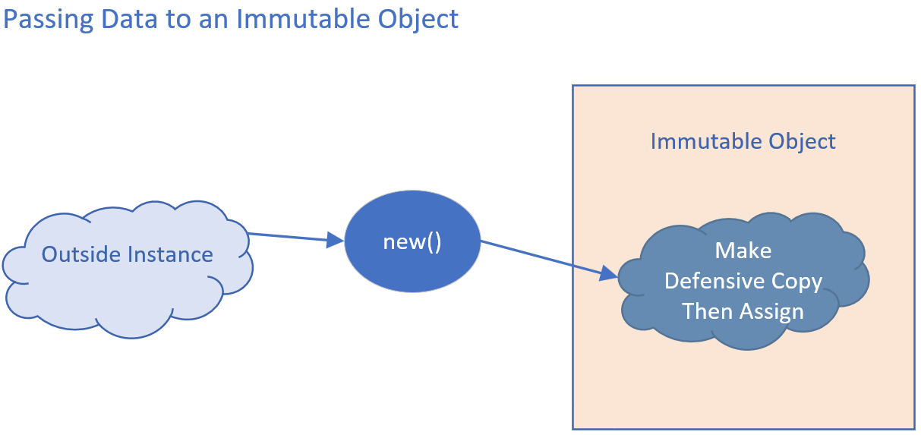

Defensive Copies as input
When you pass mutable types to an immutable object, a defensive copy should be made.
The defensive copy should then be assigned to the instance field.
COMPLETE JAVA MASTERCLASS
Defensive Copies, Shallow and Deep Copies

Slide 2
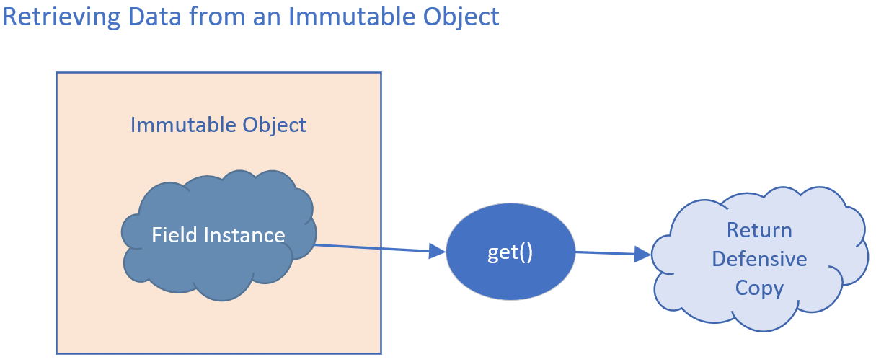
Defensive Copies as output
When you retrieve data, you should first make a defensive copy, and pass the defensive copy back to the calling code.
COMPLETE JAVA MASTERCLASS
Defensive Copies, Shallow and Deep Copies

Slide 3
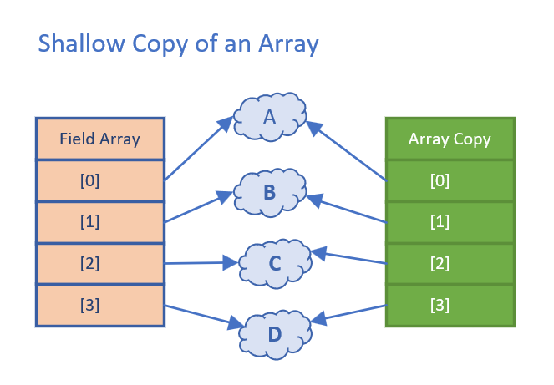
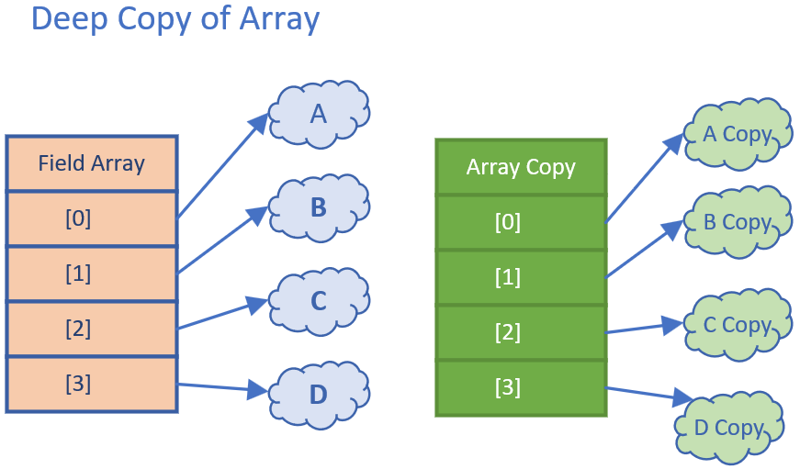
What's a copy? Shallow Copy vs Deep Copy
This slide is showing you two very different copies of an array.
A shallow copy only makes a copy of the structure, and not a copy of the elements in the structure.
A deep copy makes a copy of both the structure, and copies of each element in that structure.
COMPLETE JAVA MASTERCLASS
Defensive Copies, Shallow and Deep Copies

Slide 4
Shallow Copy
When you use copy methods on interfaces and helper classes, the copy that's made will probably be a shallow copy.
A shallow copy of an array, means a new array structure is created, with the same number of indexed positions.
Each indexed position is assigned the same value that was in the previous array, at that same position.
A copy of the referenced element isn't made.
You can see in this diagram, that both arrays, have indexed references, pointing to the same set of instances in memory.
COMPLETE JAVA MASTERCLASS
Defensive Copies, Shallow and Deep Copies

Slide 5
Deep Copy
Deep copies usually have to be manually implemented if you need it.
This slide demonstrates a deep copy of an array.
Each array element has been cloned for the array copy.
Deep copies may need to be applied to arrays and collections, as well as composite classes, to ensure immutability.
COMPLETE JAVA MASTERCLASS
Defensive Copies, Shallow and Deep Copies

Slide 6
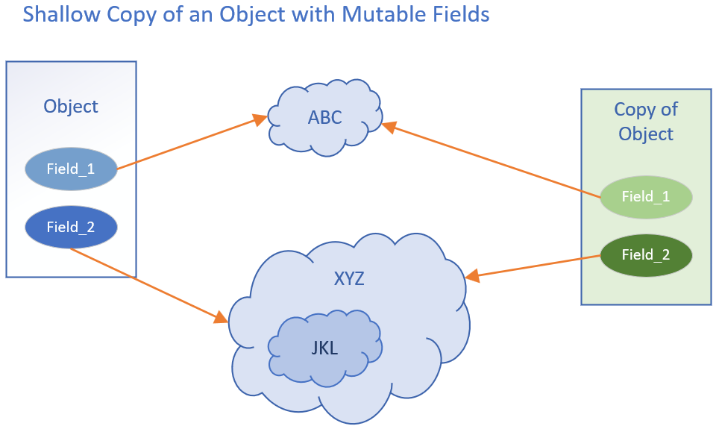
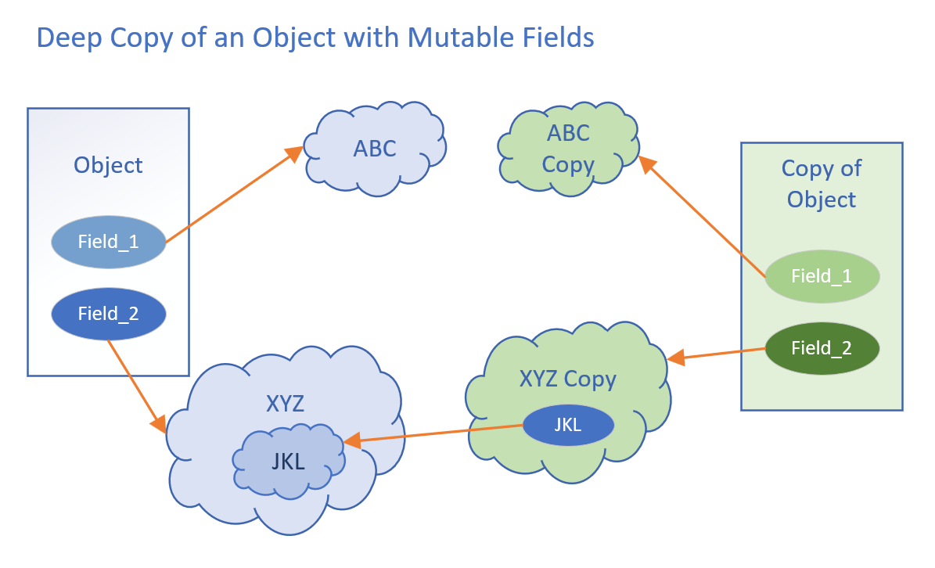
Shallow Copy vs Deep Copy of a composite object
It's not just arrays and collections you need to worry about.
A class can be composed of other classes, meaning its fields are instances of classes.
COMPLETE JAVA MASTERCLASS
Defensive Copies, Shallow and Deep Copies

Slide 7
Shallow Copy vs Deep Copy of a composite object
When you clone or copy this type of object, you may also need to copy or clone the class's more complex fields.
This slide shows a shallow copy of an instance of a composite class, comparing it to a deep copy.
COMPLETE JAVA MASTERCLASS
Defensive Copies, Shallow and Deep Copies

Slide 8
Shallow Copy vs Deep Copy of a composite object
Nesting of a composite class can be multi-leveled, as I show here with the JKL instance.
JKL is a field on XYZ, which is a field on our Object.
The deep copy created new instances of ABC, and XYZ, the fields on the object, as well as a copy Object.
It didn't however make a deep copy of XYZ, which is why JKL is still referencing the same instance, in the original xyz.
COMPLETE JAVA MASTERCLASS
Defensive Copies, Shallow and Deep Copies

