Slide 1
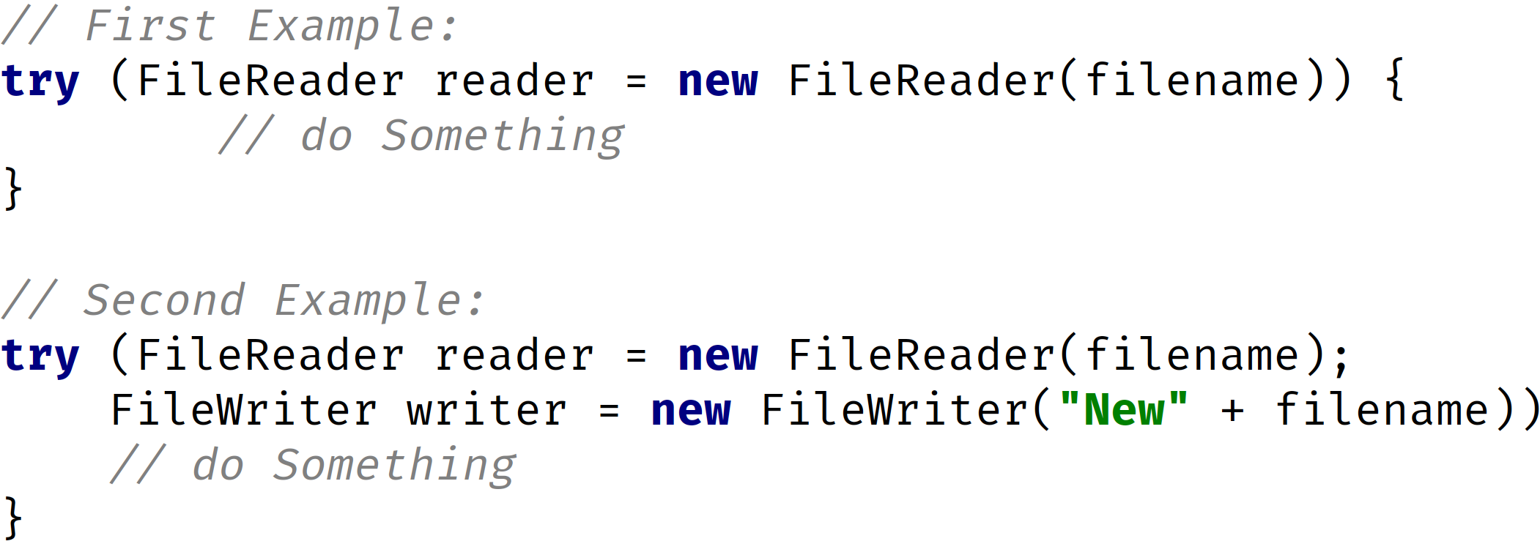
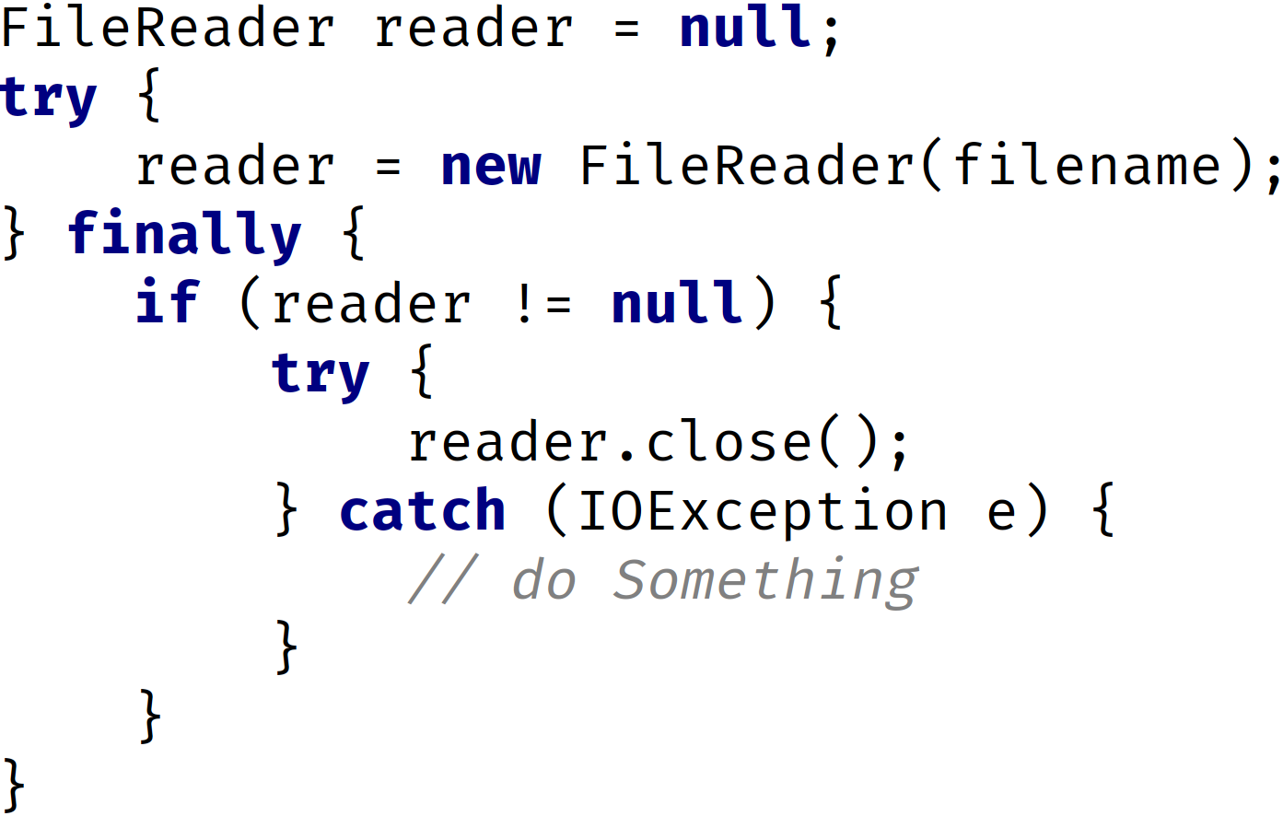

Comparing try-with-resources to the traditional try clause
try-with-resources examples | traditional try clause
The try-with-resources takes a colon delimited list of resource variables.
The resources in this list must implement the AutoCloseable or the Closeable interface.
The try-with-resources statement can be used without a finally block, because all resources are automatically closed when this type of try block completes, or if it gets an exception.
COMPLETE JAVA MASTERCLASS
Exception Handling: Try with Resources

Slide 2
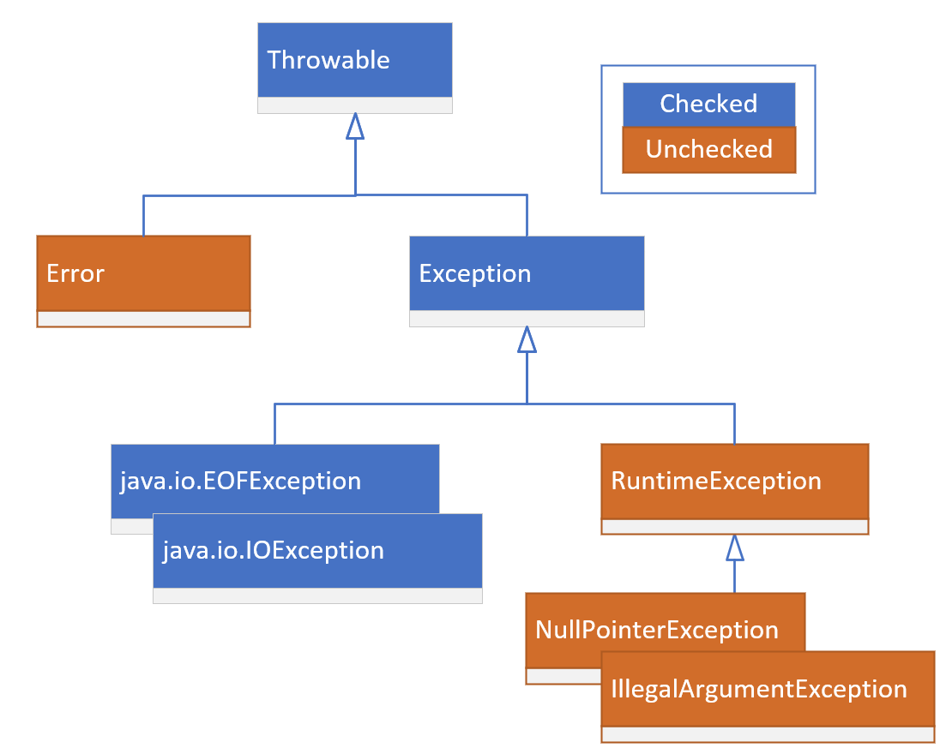
Throwable
This chart shows you which classes are Checked, in blue, and Unchecked, in Reddish Brown.
The Error class indicates serious problems, that a reasonable application shouldn't try to catch or recover from.
I've already mentioned there are two types of Exceptions, those that subclass from RuntimeException, and those that don't.
This hierarchy becomes important for the second variation of a catch clause.
COMPLETE JAVA MASTERCLASS
Exception Handling: Try with Resources

