Slide 1

CallableStatement Challenge
In this challenge, I want you to revisit the storefront database.
The stored procedure has four parameters.
Two are input parameters
OrderDate, a DATETIME parameter.
OrderDetails, A JSON parameter.
Two are output parameters
OrderId, an INT parameter.
InsertedRecords, another INT parameter.
This stored procedure inserts the order and it's details, if it can't find an existing order, for the date time specified.
COMPLETE JAVA MASTERCLASS
Challenge: CallableStatement

Slide 2
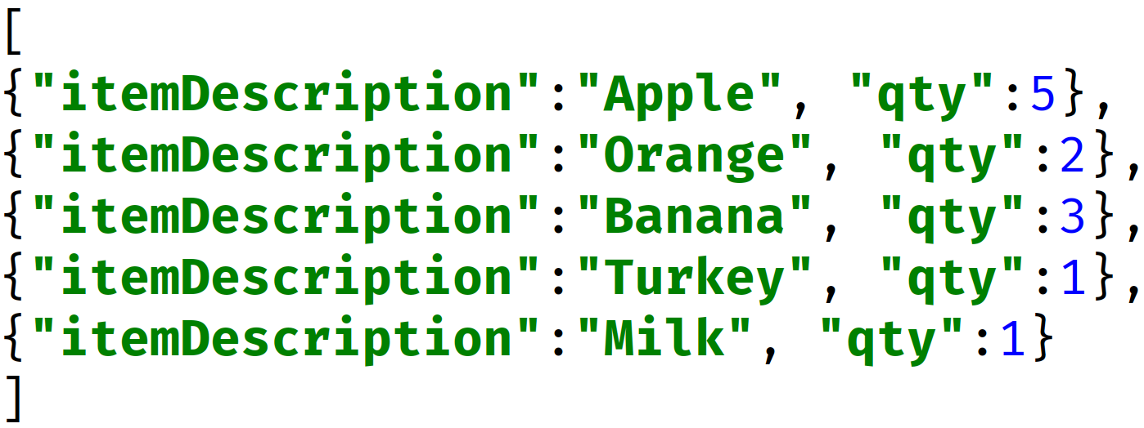
CallableStatement Challenge
Your Java code should use a CallableStatement, to call the addOrder procedure.
You'll pass a java.sql.TimeStamp as the first parameter.
Next, you'll pass a string as the second parameter.
This will be the json string, representing an array of order details.
Finally, you'll need to register two output parameters, both ints, for the order id, and the number of order detail records inserted.
COMPLETE JAVA MASTERCLASS
Challenge: CallableStatement

Slide 3
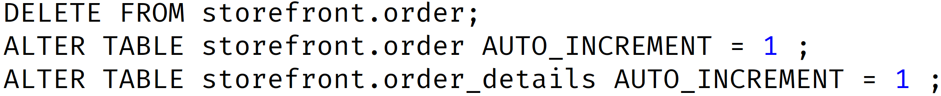
Challenge Helpful Hints
Make sure you delete the orders in a MySQL Workbench session, which were inserted in the previous challenge.
COMPLETE JAVA MASTERCLASS
Challenge: CallableStatement

Slide 4
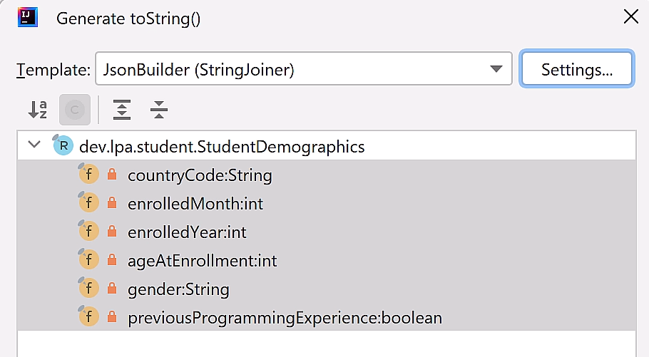
Challenge Helpful Hints - Use JsonBuilder template
Earlier in the course, we created a toString template, and called it JsonBuilder, which used the StringJoiner.
You could leverage this to create the JSON string parameter.
Alternately, you could just write your own method to do this.
COMPLETE JAVA MASTERCLASS
Challenge: CallableStatement

Slide 5
Challenge Helpful Hints
Use the DateTimeFormatter, with the pattern shown on this slide.
Using the u pattern, versus the y pattern.
I'm suggesting you use the u pattern in this challenge, because it causes the parsing to fail, with an exception, on the one bad date in our data, when using what's called strict parsing.
https://stackoverflow.com/questions/41177442/uuuu-versus-yyyy-in-datetimeformatter-formatting-pattern-codes-in-java
COMPLETE JAVA MASTERCLASS
Challenge: CallableStatement

Slide 6
Challenge Helpful Hints
You can create a LocalDateTime, using the DateTimeFormatter, and then transform it to a SQL TimeStamp type.
A TimeStamp field, can be used for a SQL parameter of type DateTime.
COMPLETE JAVA MASTERCLASS
Challenge: CallableStatement

