Slide 1
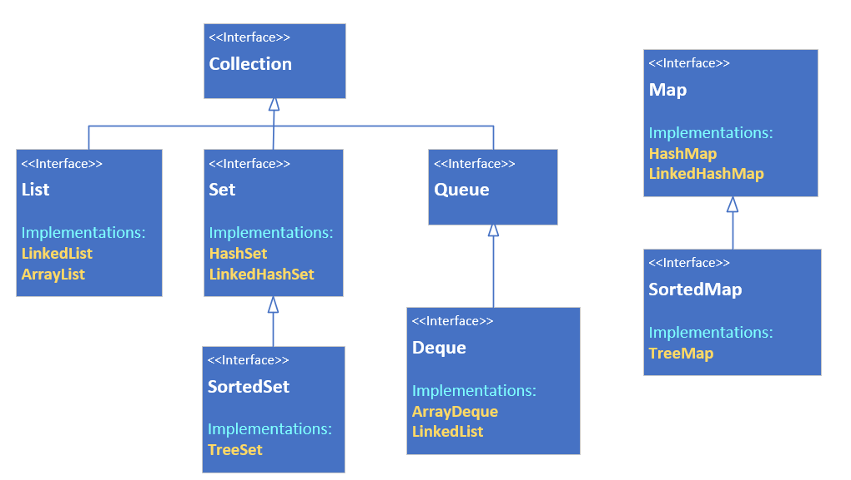

The Map Interface, why is it different?
From this diagram on the slide, you can obviously see the Map is out here on its own.
COMPLETE JAVA MASTERCLASS
The Map Interface and functionality

Slide 2
The Map Interface, why is it different?
A map in the collections framework is another data structure.
Although it's still a grouping of elements, it's different, because elements are stored with keyed references.
This means a Map requires two type arguments, as you can see on this slide, where I'm showing the root interface, Collection, compared to the Map interface.
The Map has K for it's key type, and V for the value type.
As with any generic classes, the only restriction on these types is, they must be reference types, and not primitives.
Collection Interface | Map Interface
COMPLETE JAVA MASTERCLASS
The Map Interface and functionality

Slide 3
Map characteristics
A Java Map can't contain duplicate keys.
Each key can only map to a single value.
COMPLETE JAVA MASTERCLASS
The Map Interface and functionality

Slide 4
Map Implementations (the classes that implement Map)
In the next few lectures, I'll be looking at 3 of the Java classes that implement the map interface, the HashMap, the LinkedHashMap, and the TreeMap.
The HashMap is unordered, the LinkedHashMap is ordered by insertion order, and the TreeMap is a sorted map.
COMPLETE JAVA MASTERCLASS
The Map Interface and functionality

