Slide 1
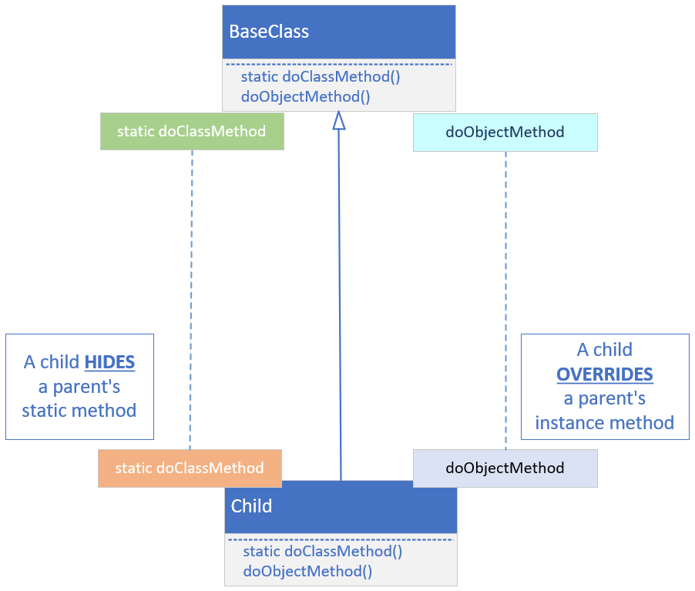

Hiding vs. Overriding
COMPLETE JAVA MASTERCLASS
The final modifier applied to methods, and local variables

Slide 2
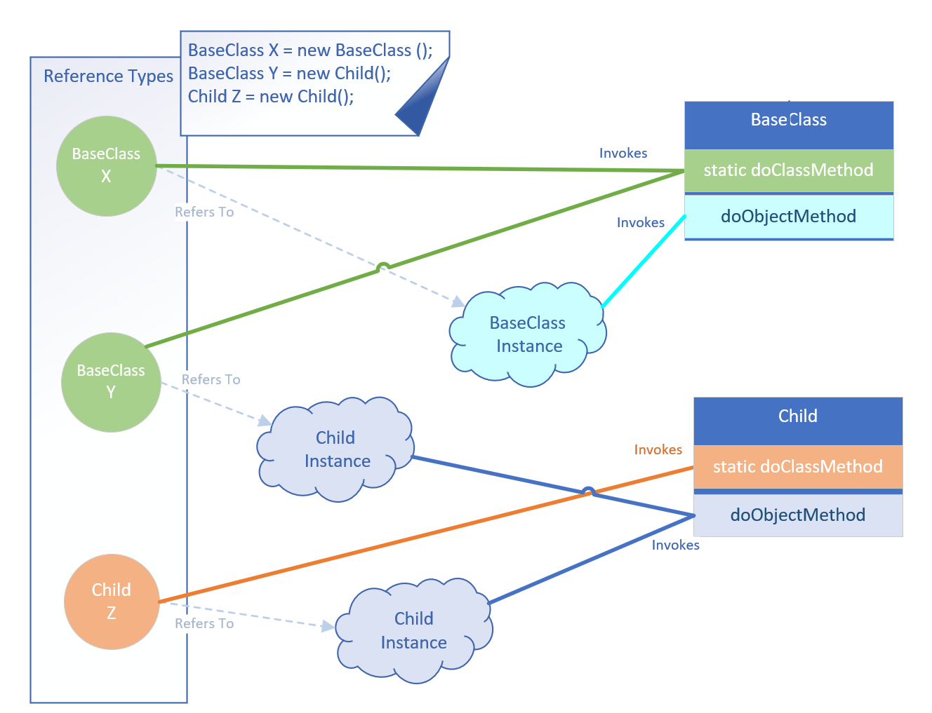
Hiding vs. Overriding
COMPLETE JAVA MASTERCLASS
The final modifier applied to methods, and local variables

Slide 3
Recommendation: Always use the type, to invoke the static method
Best practice recommends always using the type reference, when executing a static method.
If you're hiding a static method on a parent class, make sure you understand what the implications are, for doing this.
If you stick to using a qualifier, the type reference, to execute the specific static method, you'll avoid the confusion shown on the previous slide.
COMPLETE JAVA MASTERCLASS
The final modifier applied to methods, and local variables

Slide 4
Using final for variables
It's important to understand, when you use final, it doesn't mean the variable is immutable at that point.
It means you can't assign or reassign a new instance, or variable or expression to it, after the initialization.
If you use final for a local variable in a code block, you can only initialize it fully, or assign it a value, just once.
Any other additional assignments will result in a compiler error.
If you use final for method parameters, this means you cannot assign any values to the method parameters in the code.
COMPLETE JAVA MASTERCLASS
The final modifier applied to methods, and local variables

