Slide 1





Complete Selenium Automation Engineer Bootcamp: Go from Zero to Hero

Slide 2
Automation Using Selenium WebDriver
Install Selenium WebDriver Gem using the command below in terminal/command prompt.
Go to terminal/command prompt of your computer
Verify if the ruby is installed on your O.S by entering following command
ruby -v
Install Selenium WebDriver gem by entering the following command
gem install selenium-webdriver
gem list – Make sure selenium-webdriver is in the list.

Slide 3
Newtours Login Validation Testcase
Launch the browser(Firefox, Chrome, IE)
Go to http://www.newtours.demoaut.com/ website
Enter the following credentials
username: selenium
password: selenium
Click Sign in Button
Validate the title in next page(Flight Details page). The title should be “Find a Flight: Mercury Tours:”

Slide 4
GeckoDriver Installation - Mac
GeckoDriver – Driver needed for Firefox Browser.
Install GeckoDriver from the link below.
https://github.com/mozilla/geckodriver/releases
Go to downloads where the GeckoDriver is downloaded.
Give permissions for the file using the command below.
chmod +x geckodriver
Move geckodriver from downloads folder to the /usr/local/bin folder.
sudo mv geckodriver /usr/local/bin

Slide 5
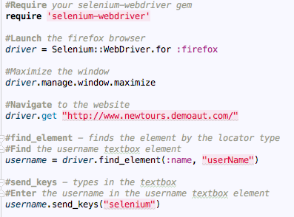
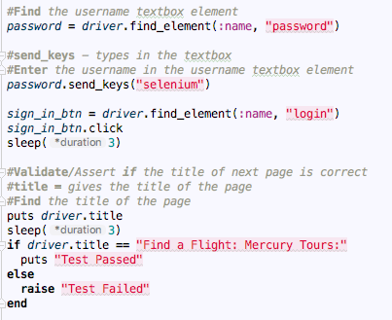
Login Automated Script Using Firefox

Slide 6
ChromeDriver Installation - Mac
ChromeDriver – Driver needed for Chrome Browser.
Install ChromeDriver.exe from the link below.
http://chromedriver.storage.googleapis.com/index.html
Go to downloads where the ChromeDriver.exe is downloaded.
Give permissions for the chromedriver file.
chmod +x chromedriver
Move chromedriver from Downloads to the /usr/local/bin folder.
sudo mv chromedriver /usr/local/bin

Slide 7
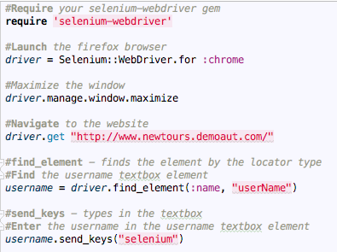
Login Automated Script Using Chrome

Slide 8
SafariDriver Installation – Mac Only
SafariDriver – Driver needed for Safari Browser.
SafariDriver installed by default in OS El Capitan.
Go to Safari > Preferences > Advanced
Check on “Show Develop menu in menu bar”
Open Safari and Click on Develop Menu from Menu bar.
Click “Allow Remote Automation” from the Develop Menu bar.

Slide 9
InternetExplorerDriver Installation
InternetExplorerDriver – Driver needed for Internet Explorer Browser.
Install IEDriver.exe based on your OS from the link below.
http://www.seleniumhq.org/download/
http://selenium-release.storage.googleapis.com/index.html
Go to downloads where the IEDriver.exe is downloaded.
Move IEWebDriver to the C:/Windows/System32.
Go to Internet Explorer Options > Security.
Check/Uncheck “Enable Protected Mode” in Internet Explorer for all trust/security zones.

Slide 10
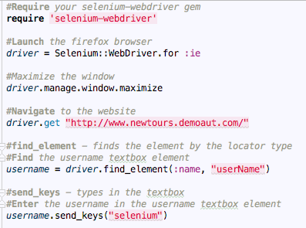
Login Automated Script Using IE

Slide 11
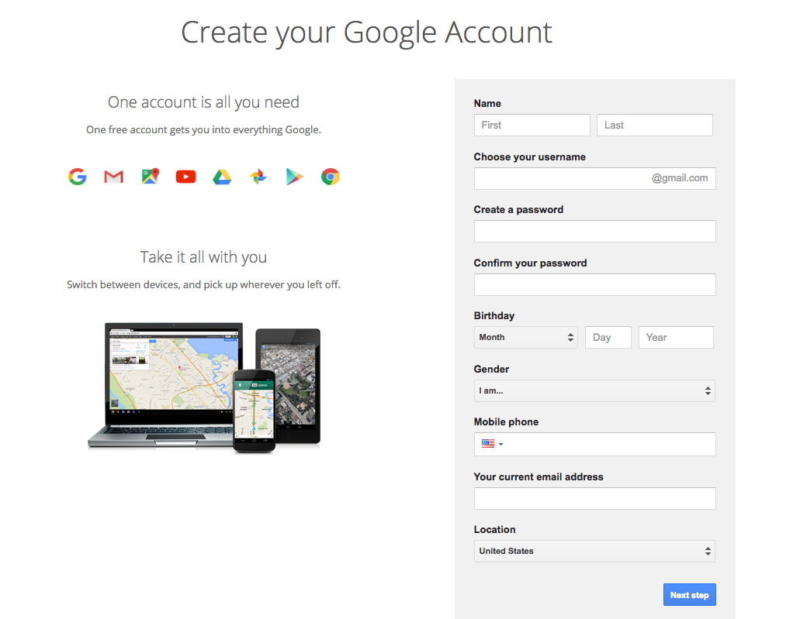
Elements of Web Application
Elements of Web Application HTML Page
Textbox
Radio Buttons
Buttons
Checkboxes
Hyperlinks
Page Title
Page Header
Text
Images/Picture
Scroll Button
Calendar

