Slide 1





Complete Selenium Automation Engineer Bootcamp: Go from Zero to Hero

Slide 2
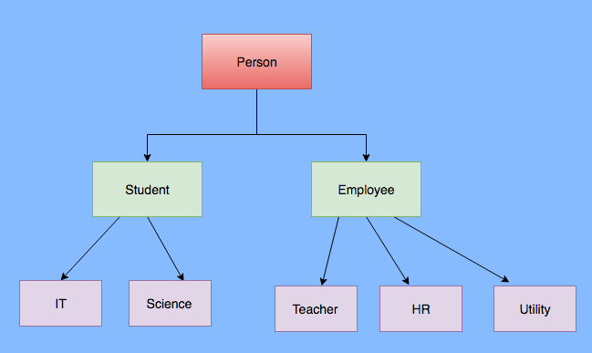
Inheritance
Relation between two classes where a child class inherits all features of its parent class.
Methods from the parent can be overridden in the child and new logic can be added.

Slide 3
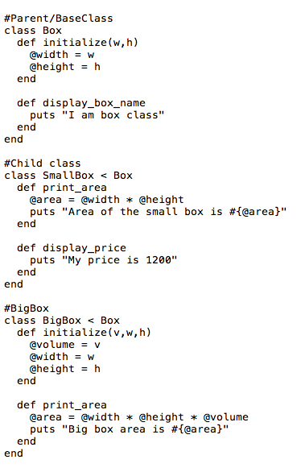
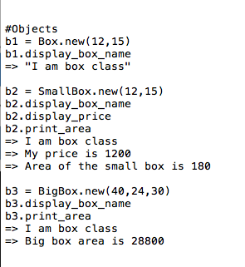
Inheritance Contd..

