Slide 1





Complete Selenium Automation Engineer Bootcamp: Go from Zero to Hero

Slide 2
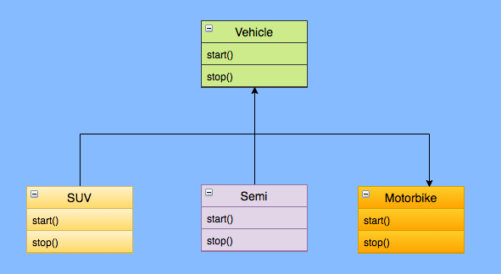
Polymorphism
Polymorphism derives from the Greek word “Poly” meaning much or many form or shape.
Polymorphism in programming refers to the ability to use same methods in different ways for different objects or data types.

Slide 3
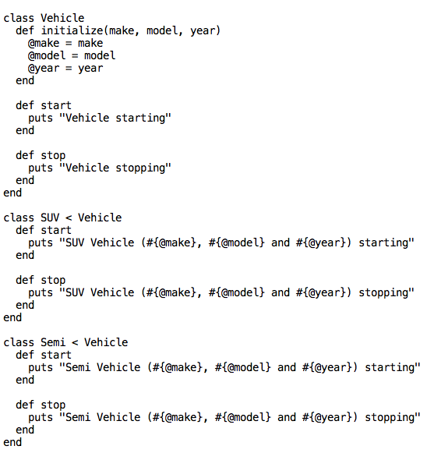
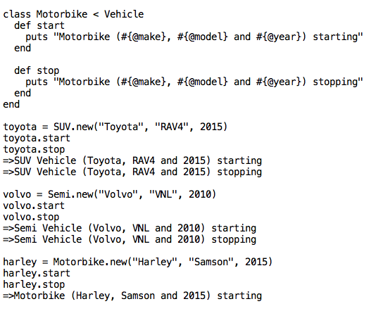
Polymorphism Contd..

