Slide 1





Complete Selenium Automation Engineer Bootcamp: Go from Zero to Hero

Slide 2
Selenium Element Locators
name
driver.find_element(:name, “sp_q”).send_keys(“selenium”)
id
driver.find_element(:id, “s_Text”).send_keys(’selenium’)
class
driver.find_element(:class, “keywords”).send_keys(‘selenium’)
link_text
driver.find_element(:linktext, “donate now”).click
xpath
driver.find_element(:xpath, “html/body/form/div[3]/div[2]/div[1]/div/div[1]/div/div[2]/div/div/div/div/div/a”).click
driver.find_element(:xpath, “//a[@class='btn btn-primary']”).click
css
driver.find_element(:css, “a[class='btn btn-primary']").click

Slide 3
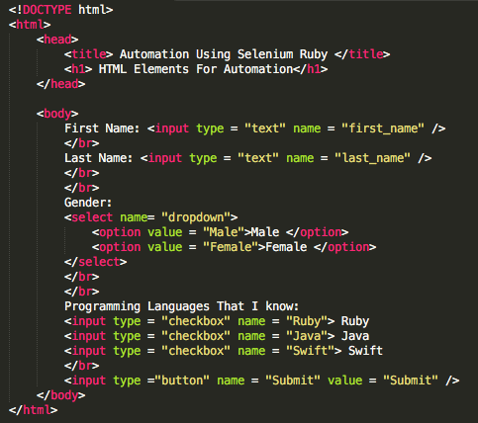
XPath – Selenium Element Locators
XPath is used to navigate through elements and attributes in an XML/HTML document.
The fundamental logic behind locating elements using XPath is the traversing between various elements across the entire page and thus enabling a user to find the element with the reference of another element.
One of the very commonly used locators in Selenium.
XPaths can be found in two ways.
Absolute XPath - Full path of the element
driver.find_element(:xpath, “/html/head/body/input/input/select”)
Relative XPath – Relative path of the element
driver.find_element(:xpath, “//input[@name=’Ruby’]”)

Slide 4
CSS – Selenium Element Locators
CSS Selectors is combination of an element selector and a selector value which identifies the web element within a webpage.
The composite of elements elector and selector value is known as Selector Pattern.
Source: https://saucelabs.com/selenium/css-selectors
Ex:
driver.find_element(:css,"input[name=‘Ruby’]")

