Slide 1





Complete Selenium Automation Engineer Bootcamp: Go from Zero to Hero

Slide 2
OOP(Object Oriented Programming)
OOP – Programming Language Model organized around objects rather than “actions” and data rather than logic.
Logical procedure that takes input data, processes it, and produces output data.
In OOP, Everything is an object just like real world.
OOP Types
Encapsulation
Inheritance
Polymorphism

Slide 3
Encapsulation
Process of packing of data and functions into a single component.
Internal representation of an object hidden from outside.
Can be used in order to prevent modification of variables from objects.
Attribute Accessors Types
attr_reader: Read Only Access
attr_writer: Write access.
attr_accessor: Read and Write Access

Slide 4
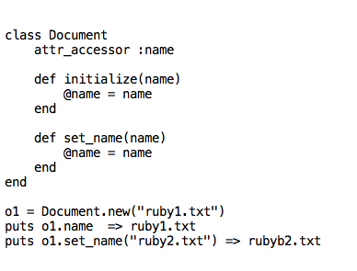
ENCAPSULATION - CONTD

Slide 5
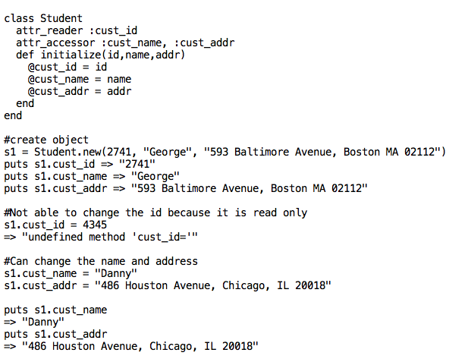
ENCAPSULATION - CONTD

