Slide 1





Complete Selenium Automation Engineer Bootcamp: Go from Zero to Hero

Slide 2
Looping
A loop is a sequence of instructions that is continually repeated until a certain condition is reached.
Looping is used to iterate over the range of number, text, array elements, hash elements and so on..
Problem: Print “Hello World”10 times.
Without Loop
puts “Hello World”
puts “Hello World”
puts “Hello World”
puts “Hello World”
puts “Hello World”
puts “Hello World”
puts “Hello World”
puts “Hello World”
puts “Hello World”
puts “Hello World”
With Loop
for i in 1..10
puts “Hello World - #{i}”
end

Slide 3
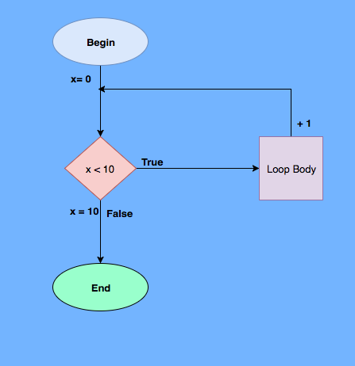
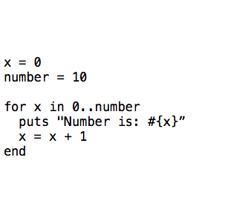
Looping – For Loop

Slide 4
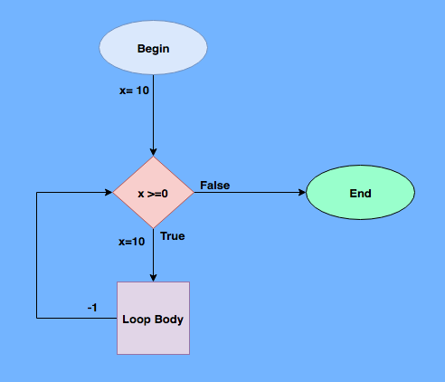
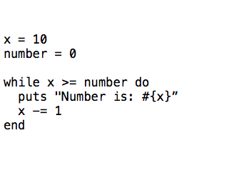
Looping – While Loop

Slide 5
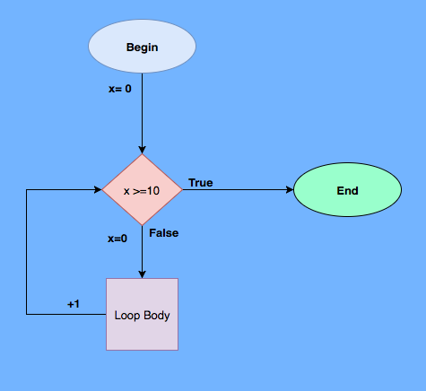
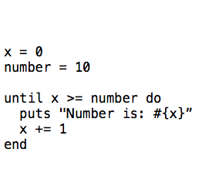
Looping – Until Loop

