Slide 1





Complete Selenium Automation Engineer Bootcamp: Go from Zero to Hero

Slide 2
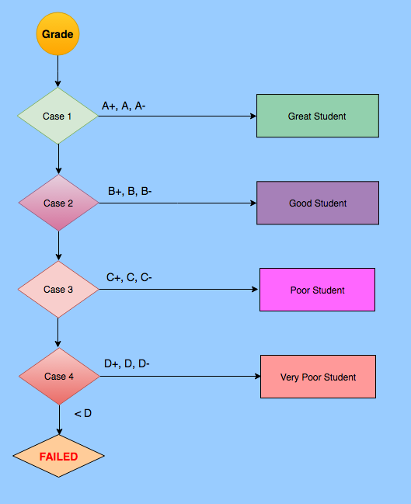
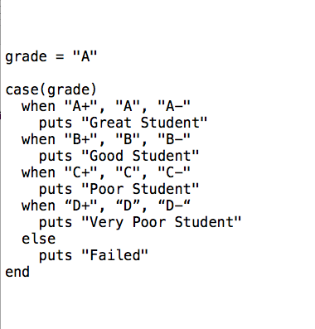
Conditional Execution – Case(Switch)

Slide 3
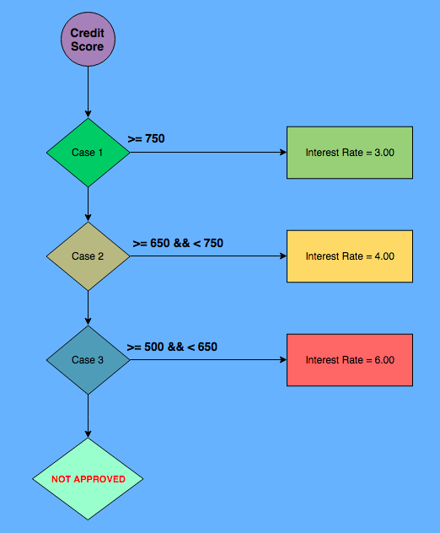
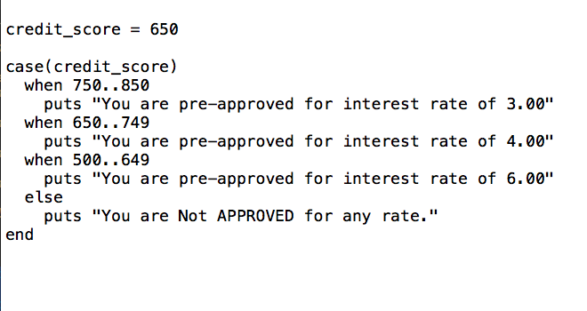
Conditional Execution – Case(Switch)

