Slide 1





Complete Selenium Automation Engineer Bootcamp: Go from Zero to Hero

Slide 2
Brief History of Selenium
Selenium was created by Jason Huggins at Thoughtworks.
Selenium primarily is divided into three versions.
Selenium 1.0 (Selenium RC/ Selenium IDE)
JavaScript library that drives interactions with the page allowing to re-run the tests against multiple browsers which eventually became Selenium RC.
Selenium IDE – Record and Run tool where users can record and run the tests using selenium scripts.
Deprecated version of Selenium
Selenium 2.0 (WebDriver)
Created by Simon Stewart at Google.
Commonly used version of Selenium which uses the native support of browser and OS making the tests faster and resilient.
Includes more cohesive and object oriented API also answering the limitations of Selenium RC.
Supports the WebDriver API as well as Selenium RC for backward compatibility.
Selenium 3.0
Newest version of Selenium which completely relies on WebDriver API and removes Selenium Core(RC) Implementation.
Contains W3C specification for a browser based automation based on the Open Source WebDriver.

Slide 3
Brief History of Selenium
Selenium Grid (Selenium 1, Selenium 2, Selenium 3)
Framework that allows you to run your tests on different machines against different browsers in parallel.
Most commonly used Automation framework to run multiple tests in short duration of time.
Able to run multiple tests at the same time.
Saves lot of time and resources.
1hr – 10 tests x 10VM = 100 tests

Slide 4
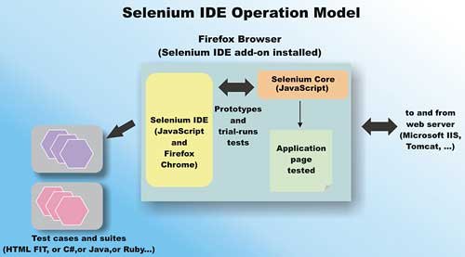
How Selenium IDE Works!
Selenium IDE is a Firefox plugin which records and plays back user interactions from the browser. You can use this tool to create simple scripts or do some exploratory tests. You can also export the test case with your choice of programming language as well.

Slide 5
Validation Testcase For Automation
Launch the browser(Firefox)
Install the Selenium IDE from this link https://addons.mozilla.org/en-US/firefox/addon/selenium-ide/
Restart Firefox.
Go to http://www.newtours.demoaut.com/ website.
Enter the following credentials.
username: selenium
password: selenium
Click Sign in Button.

Slide 6
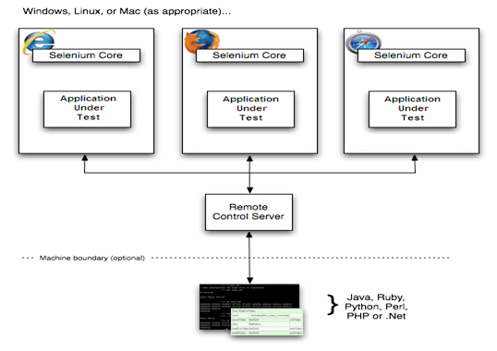
How Selenium RC Works!
Selenium R.C uses Selenium Server which receives Selenium commands from your test program, interprets them, and reports back to your program the results of running those tests.

Slide 7
How Selenium WebDriver Works!
WebDriver was designed to provide a simpler, more concise programming interface in addition to addressing some limitations in the Selenium-RC API.
Selenium-WebDriver was developed to better support dynamic web pages where elements of a page may change without the page itself being reloaded. WebDriver’s goal is to supply a well-designed object-oriented API that provides improved support for modern advanced web-app testing problems.
Selenium WebDriver makes a direct calls to the browser using each browser’s native support for Automation. How these direct calls are made depends on the browser you are using.
Every browser has a API(Application Program Interface) so webdriver is making direct call to those API for each browser.
Firefox – FirefoxDriver/GeckoDriver
Internet Explorer - Internet Explorer Driver
Safari - Safari Driver
Chrome - Chrome Driver

Slide 8
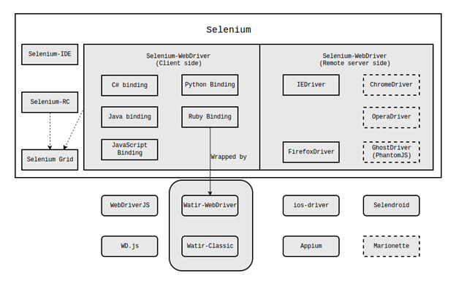
How Selenium WebDriver Works!

Slide 9
How Selenium WebDriver Differs from Selenium RC
Selenium RC | Selenium WebDriver
1. Deprecated version of Selenium. Not supported anymore in Selenium 3.0. | 1. Newest version of Selenium
2. Selenium RC injects JavaScript functions using Selenium RC Server to the browser when the browser gets loaded and then uses its JavaScript interpreter to drive the AUT(Application under test) within the browser. | 2. WebDriver drivers the browser directly using the browser’s built in support for Automation.
3. Selenium RC doesn’t have support for mobile apps automation. | 3. WebDriver framework can be used to automate both iOS and Android mobile apps using Appium, ios-driver and selendroid framework.
4. Slower than WebDriver as it uses JavaScript Library. | 5. Lot faster as it is an cleaner and is well-designed object-oriented API that provides improved support for modern advanced web-app testing problems.

