Slide 1





Complete Selenium Automation Engineer Bootcamp: Go from Zero to Hero

Slide 2
Variables
Variables are the memory locations which holds any data to be used by any program.
Variable Types
Instance Variables
Class Variables
Global Variables
Local Variables
Constants

Slide 3
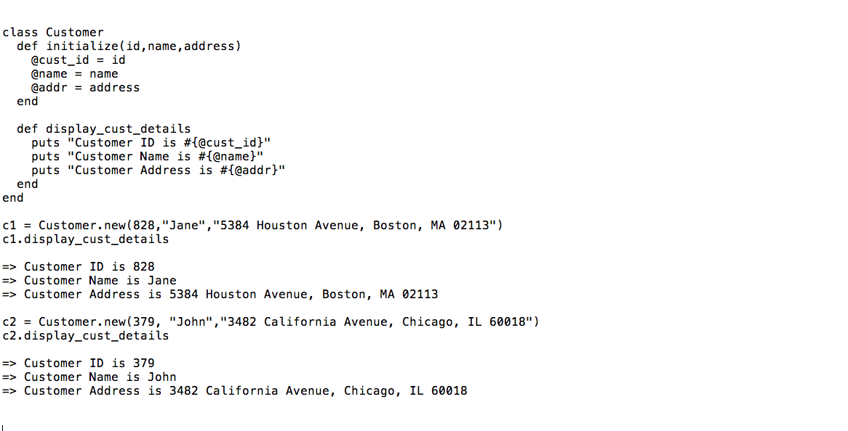
Instances Variables
Variables that are used by instance methods.
Instance variables start with symbol @

Slide 4
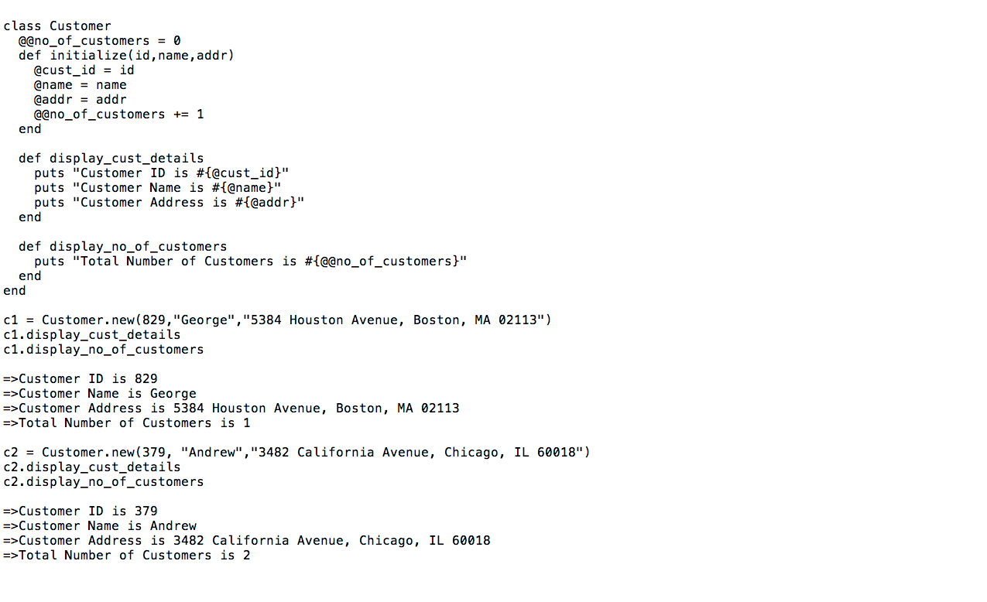
Class Variables
Variables that are used by the class and also can be shared among the descendants.
Class variables start with symbol @@

Slide 5
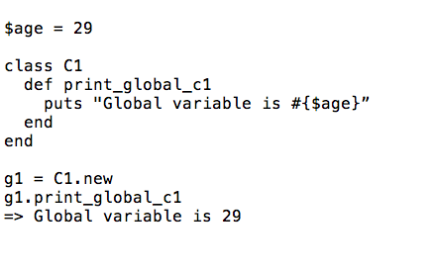
Global Variables
Variables that are used throughout the program.
It can be used anywhere in the program.
Global Variable in Ruby always start with $.

Slide 6
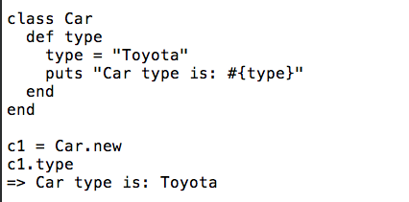
Local Variables
Variables that are used inside the method and are normally hard coded values.

Slide 7
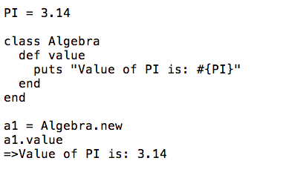
CONSTANTS
Variables that are permanent and cannot change.
Always written in Upper Case.

