Slide 1





Complete Selenium Automation Engineer Bootcamp: Go from Zero to Hero

Slide 2
Classes
Class is a specification or a blue print (set of instructions) of how to provide some service.
Like Blueprint, Class has some exact specifications.
Many Objects can be created from the same class.
Classes can contain methods, variables for an object.
A class can have subclasses that can inherit all or some of the characteristics of the class.
Subclasses can also define their own methods and variables that are not part of their superclass.
Example:
Animal – Dog, Cat, Giraffe, Monkey
Vehicle – Car, Bicycle, Motorbike, SUV
Ford – Focus, F-150, Mustang, Explorer, Fiesta
Dog – Corgi, German Shepherd, Labrador
Honda – Accord, Civic, Pilot, CR-V

Slide 3
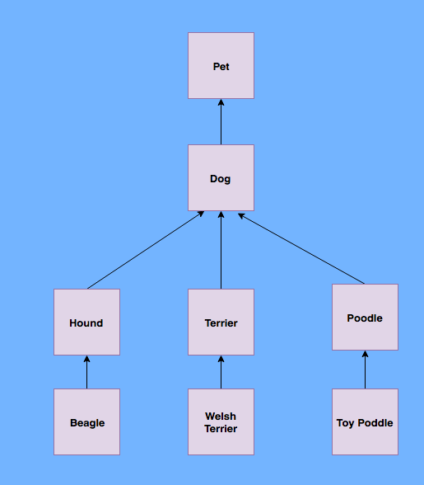
Classes Contd..
class Dog
def name_of_dog(name)
puts "I am #{name}"
end
def bark
puts "I am barking"
end
def eat
puts "I am eating"
end
def sleep
puts "I am sleeping"
end
def play
puts "I am playing"
end
end

Slide 4
Method Types in Class
Constructor Method: Default method of the class that will be run at the time when the object is created or instantiated.
Used to declare default behavior for all objects.
Example:
class Student
#Constructor method
def initialize
puts "I am Constructor method"
end
def print_name(name)
puts "My name is #{name}"
end
end
#Creating objects from student class
student1 = Student.new => ”I am constructor method”
student1.print_name("George") => ”My name is George”
student2 = Student.new => ”I am constructor method”
student2.print_name(”Yang") => ”My name is Yang”

Slide 5
Method Types in Class
Instance Method: Methods that are called after instantiation of class or object creation.
Used to declare common characteristics from the class.
Example:
class Dog
def name_of_dog(name)
puts "I am #{name}"
end
def bark
puts "I am barking"
end end
#Create an object(instance) from the class
labrador= Dog.new
labrador.name_of_dog("Jackie") => ”I am Jackie”
labrador.bark => ”I am barking”

