Slide 1





Complete Selenium Automation Engineer Bootcamp: Go from Zero to Hero

Slide 2
Acceptance Test Driven Development
ATDD (Acceptance Test Driven Development): As per agilealliance.org, ATDD involves team members with different perspectives (customer, development, testing) collaborating to write acceptance tests in advance of implementing the corresponding functionality.
User Story: A story or a requirement written by the product owner that have certain objective or functionality.
User Acceptance Testing (UAT): Tests done by the end user which could be the product owner or BA or manual tester or SME(Subject Matter Expert) to ensure the requirements are met.
Life Cycle of UAT
As per agile methodology, BA (Business Analyst) /PO(Product Owner) creates requirements, put it in back log and discusses with the team.
Team decides on the priority and the estimation points of the requirements.
Team pulls the requirements(user story) for the Sprint to work on them.
Developers code for the requirements.
Developers pushes it to the QA environment.
QA(Quality Assurance) Engineers tests(Automation/Manual) the code
Once QA is completed for the requirement, he/she submits it to BA/PO
BA/PO performs user acceptance testing.
Once passed, the PO/BA accepts the requirement.
Once PO/BA accepts the requirements, it is pushed to the production.

Slide 3
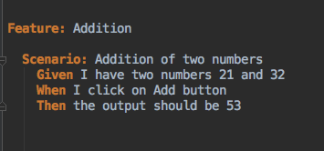
Cucumber
Cucumber is a framework that enables the software teams to use the business readable language and collaborate to develop a software product.
Cucumber lets software development teams describe how software should behave in plain text.
The text is written in a business-readable domain-specific language and serves as documentation, automated tests and development-aid - all rolled into one format

Slide 4
Cucumber Contd..
Cucumber works with Ruby, Java, .NET, Flex or web applications written in any language
Testing done by the end user which could be product owner or business analyst or SME(Subject Matter Expert) to ensure the requirements are met.
Cucumber uses the gherkin format to create a business domain specific language which can be read and understood by everyone including the non-technical personnel like Business Analyst/Product Owner and technical persons such as Developers and Automation Engineers.
Gherkin: Business Specific Readable language that Cucumber understands. Gherkin uses the format of Given, When, Then and But. Gherkin Language lets you describe how the software behavior is implemented.
Keywords of Gherkin are: Feature, Scenario, Given, When, Then, And and But.
Given - Pre-condition
And - Pre-condition
When - Action
Then - Consequence
But - Negative result

Slide 5
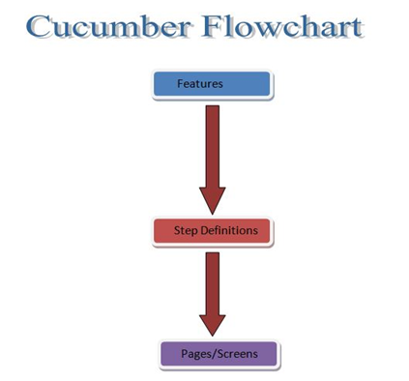
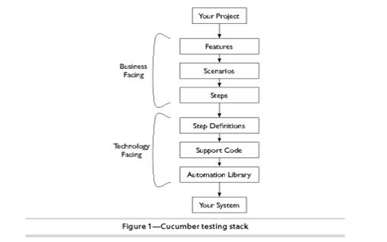
Cucumber Framework Architecture

Slide 6
Cucumber
Feature: File written in plain text english language by the product owner/BA describing the functionality of the application.
The text is written in Gherkin Format serving as a living documentation.
The feature file extension is .feature.
Install gem using terminal/command prompt with following command
gem install cucumber

Slide 7
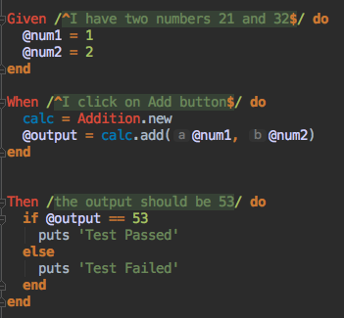
Cucumber
Step Definitions: File/s that maps the business readable language of each gherkin step with programming code to carry out whatever action is being described.
Normally the step definition contains one or more two lines of code that connects to your programming code.

Slide 8
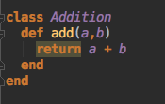
Cucumber
Source Code: Programming Code that defines all the functions/actions of the feature.

Slide 9
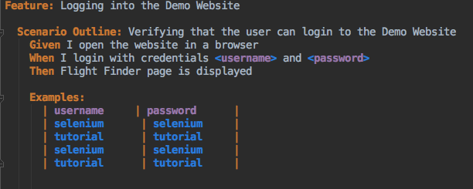
Cucumber Parameterization
Cucumber Framework can also be used for parameterization i.e. running multiple set of data at one time.

Slide 10
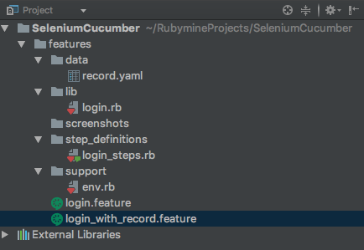
Cucumber Parameterization Using YAML

Slide 11
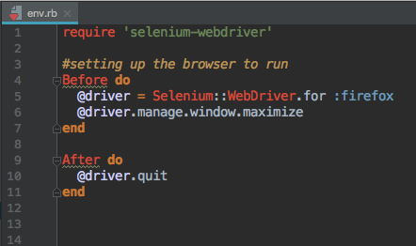
Cucumber Parameterization Using YAML

Slide 12
Cucumber Parameterization Using YAML

Slide 13
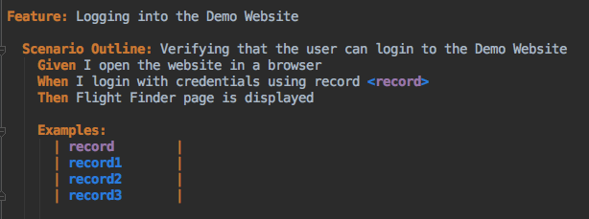
Cucumber Parameterization Using YAML

Slide 14
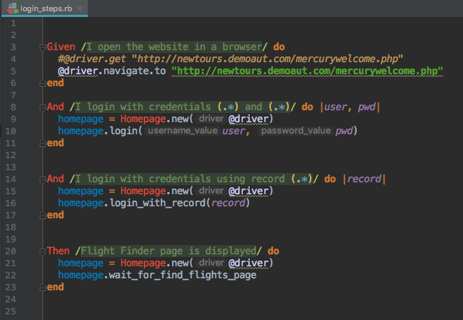
Cucumber Parameterization Using YAML

Slide 15
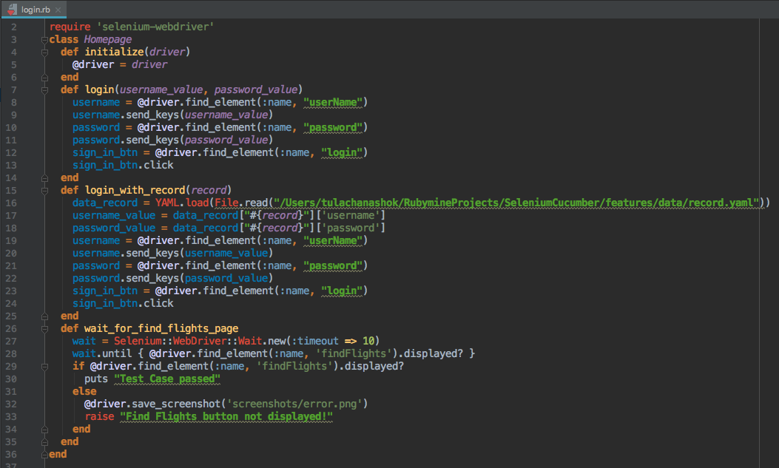
Cucumber Parameterization Using YAML

Slide 16
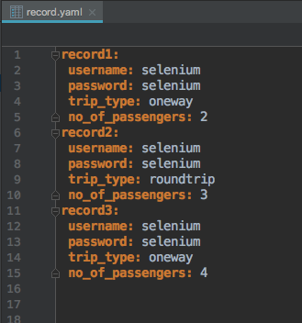
Cucumber Parameterization Using YAML

Slide 17
Cucumber Terminal Commands
Get Cucumber Helpful Commands
cucumber --help
Run one feature at a time
cucumber features/<featurename>
Run all features
cucumber features
Run by tags
cucumber features --t @smoke_test
Create a report(website) after running all your features/feature
cucumber features --format html --out=regression_report.html

Slide 18
Cucumber Gem File
Gemfile: A Gemfile is a file that is created which is used for describing gem dependencies for Ruby programs.
A gem is a collection of Ruby code that we can extract into a collection which we can call later.
Bundler: Bundler is used to install all the required gem files needed for your project so other users can use and run your project.
You can install bundler gem with the command below
gem install bundler
Create a Gemfile with the content as below.
source "https://rubygems.org"
gem 'selenium-webdriver'
gem 'simple-spreadsheet'
gem 'cucumber’
Now run the bundler install command from command line to install the gems.
bundler install
Tools > Bundler > Install

