Slide 1
Statistical Arbitrage
Neelesh Upadhye
Notes:
Chris

Slide 2
Background
Developed in the 1980’s by a group of Quants at Morgan Stanley, who reportedly made over $50 million profit for the firm in 1987
A contrarian strategy that tries to profit from the principles of mean-reversion processes
In theory, one could expand the strategy to include a basket of more than a pair of related stocks
Notes:
Chris

Slide 3
Main Idea
Choose a pair of stocks that move together very closely, based on a certain criteria (i.e. Coke & Pepsi)
Wait until the prices diverge beyond a certain threshold, then short the “winner” and buy the “loser”
Reverse your positions when the two prices converge --> Profit from the reversal in trend
Notes:
Emmanuel

Slide 4
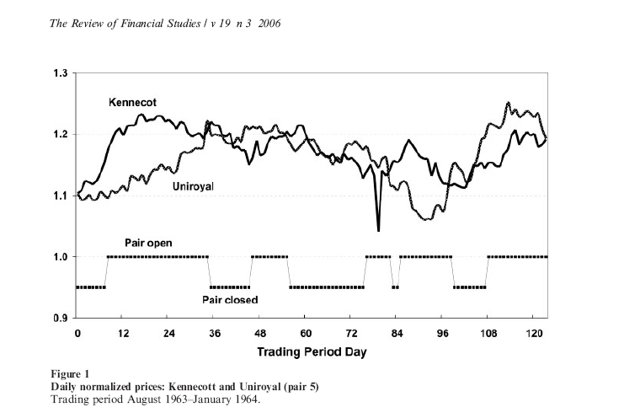
Example of a Pairs Trade
Notes:
Emmanuel

Slide 5
Investor Decisions
Pair Selection Criteria
Correlation (Parametric & Non-Parametric Spearman’s Rho)
Dickey-Fuller Test Statistic (Cointegration)
Trading Threshold (areas of consideration)
Volatility of the Market
Historical returns
Cost of each transaction
Notes:
James

Slide 6
Normalization of Stock Data
METHOD:
Find pair that has maximal correlation
Normalize price series, plot spread over 1 year “formation period”
Generate optimal threshold non-parametrically: choose a threshold T_{i}=c*sd(spread), calculate profit for each T_{i}, choose T_{i} generating max profit
Calculate profit by going $1 short on winner, $1 long on loser; close position when prices converge, i.e. spread=0
Normalize price series in 6 month “trading period” using mean and sd from formation period
Plot spread using optimal threshold found from formation period, calculate profit
Lower thresholds→ More transactions→ Higher transaction costs → Lower Returns
Higher transaction costs→ Smaller Returns
Notes:
E

Slide 7
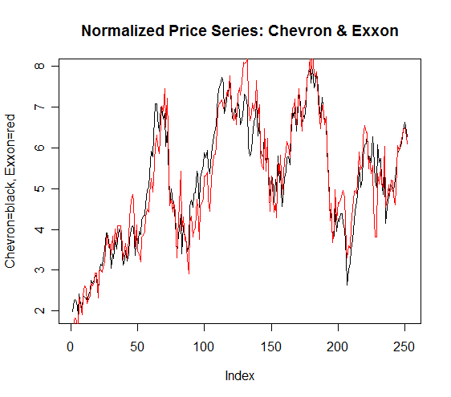
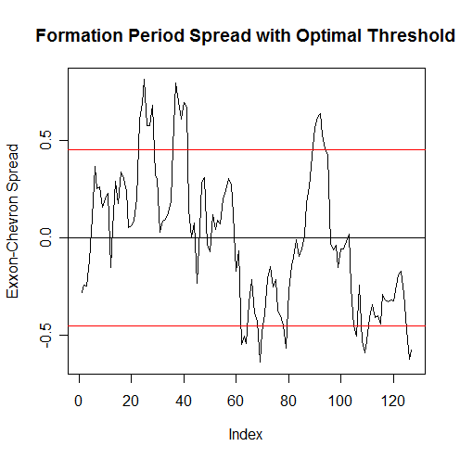
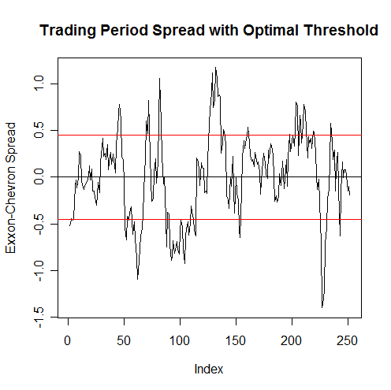
Chevron & Exxon
Formation Period Corr=0.93
Trading Period Corr=0.96
Optimal Threshold=1.25*sd’s
# Transactions=10
Returns=15%
Win.
Notes:
E

Slide 8
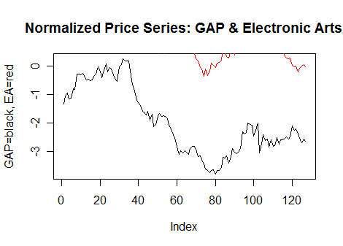
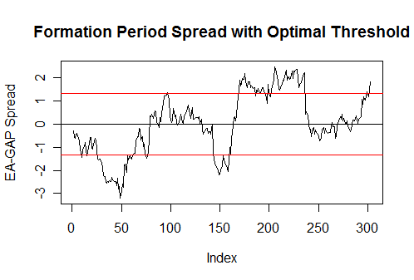
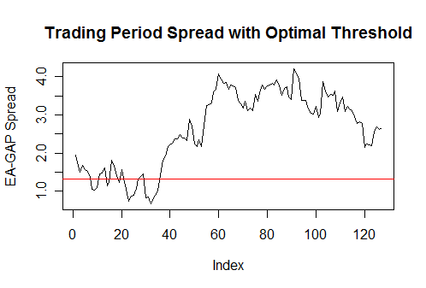
Electronic Arts & GAP
Formation Corr=0.12
Trading Corr=0.56
Optimal Threshold=1 sd
# Transactions=0 (Open a position, but spread never returns to 0)
Return= -0.04
Lose.
Notes:
E

Slide 9
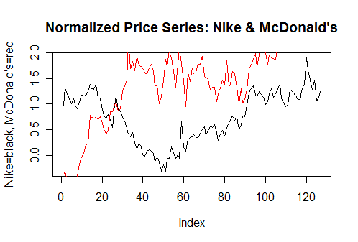
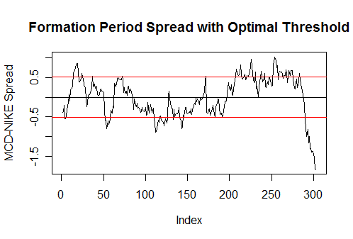
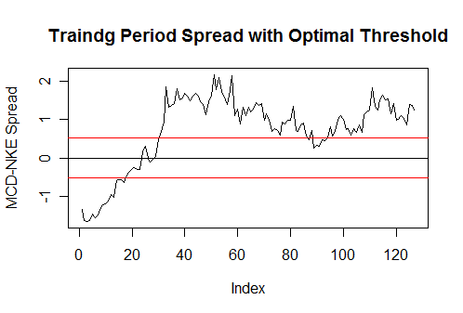
Nike & McDonald’s
Formation Corr=0.87
Trading Corr=0.02
#Transactions=1
Return= -0.05
Lose.
Correlation is imperfect criteria for selecting pairs.
Notes:
E

Slide 10
Cointegration
If there exists a relationship between two non-stationary I(1) series, Y and X , such that the residuals of the regression
are stationary, then the variables in question are said to be cointegrated
Note: X and Y here are clearly not stationary, but they seem to move together. In fact, they are cointegrated -->
(Y- β₁X-β₀ )should be stationary
Notes:
J

Slide 11
Application to Pairs Trading
If we have two stocks, X & Y, that are cointegrated in their price movements, then any divergence in the spread from zero should be temporary and mean-reverting.
The important issues here are: 1) how to test for cointegration between prices and 2) estimating the constant
Spread
0
Notes:
J

Slide 12
Testing For Cointegration
Many Methods – most of them focus on testing whether the residuals of are stationary processes
We use the Cointegrating Regression Dickey-Fuller Test, which essentially operates the following regression:
Δu_{t} = φ u_{t-1} + e_{t}
H₀: φ = 0 => no cointegration*
H_{a}: φ < 0 => cointegration*
To obtain the cointegration factor estimates, we must regress the de-trended Y_{t} on the de-trended X_{t}
* We must use critical values different from Gaussian ones due to non-symmetric properties of the Dickey-Fuller distribution
Notes:
J

Slide 13
Results of Test
NO PAIR OF PRICES ARE COINTEGRATED!
No surprise there
Alternative: take the “most cointegrated” pair & optimize thresholds as we did with normalized data
Compare the results against normalized thresholds in the same time period
Notes:
J

Slide 14
Auto-Regressive Time Series
Cointegration is an ideal construct for pairs trading
But Dickey-Fuller Hypothesis Test is inconclusive
Instead we can fit a time series to the spread data
AR(1): Y_{t} = β Y_{t-1} + ε_{t}
Looking for a spread that produces an AR(1) with |β| < 1, so that will be stationary.
Notes:
C

Slide 15
Choosing thresholds with AR(1)
For the interest of time, we are only going to focus our most cointegrated pair: LUV and PLL.
We will fit an AR(1) to the data by estimating β and the standard deviation of each iid white noise ε_{t.}
Then we will run one thousand simulations of this AR(1) model and estimate each of their optimal benchmarks
The average of the optimal benchmarks from each simulation will serve as our estimate for the optimal benchmark in the formation period.

Slide 16
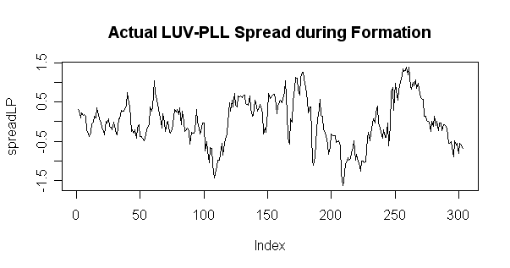
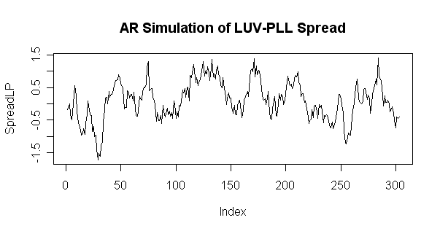
Results of AR(1) Thresholds
AR(1) Coefficient estimate (μ-hat) | 0.8605
Optimal Threshold estimate | 1.046
SD of Optimal Threshold | 0.2597
Number of Transactions | 12
Returns over Trading Period | 17.7%

Slide 17
Alternative Strategies
Conditional correlation or some other measure of “relatedness”, such as Copulas
Modeling the spread as GARCH processes
Optimize profits w.r.t. certain global indicators (i.e. market volatility, industry growth, etc.)
Factor Analysis on the spread
Notes:
J

Slide 18
Bibliography
Gatev, Evan, William N. Goetzmann, and K. Geert Rouwenhorst, “Pairs Trading: Performance of a Relative-Value Arbitrage Rule,” Review of Financial Studies (2006): 797-827.
Vidyamurthy, Ganapathy, Pairs Trading: Quantitative Methods and Analysis (New Jersey: John Wiley & Sons, Inc., 2004).
Wooldridge, Jefferey M., Introductory Econometrics, A Modern Approach, Third Edition (Ohio: Thomson South-Western, 2006).

Slide 19
Thank You!
Questions?

