Slide 1
Objective
6,061 Broadcast
49,974 Piles
575 Unknown
56,610 Total
Create an all-lands prescribed fire records database for 11 western states
State | Information tracked |  |  |  | Years of data
 | Permitted acres | Requested acres | Completed acres | Burn type | pre-2010 | 2010 | 2011 | 2012 | 2013 | 2014 | 2015 | 2016 | 2017 | 2018 | 2019 | 2020 | 2021 | 2022
AZ
CA
CO
ID
MT
NM
NV
OR
UT
WA
WY
Notes:
Public records requests for state permits to get more complete picture
State permit data are, to our knowledge, an untapped resource for tracking prescribed burns. These data will be especially useful for tracking burning on private lands, which are largely left out of other data collection efforts.
prescribed fire records database - PFRD
~275k points
ND IS WRONG HERE
Make a horizontal bar plot w/ # of records and give the n as shown in screen cap above
Map: burn type reported, ag burns, Indian lands burns, permitted, complete, request

Slide 2
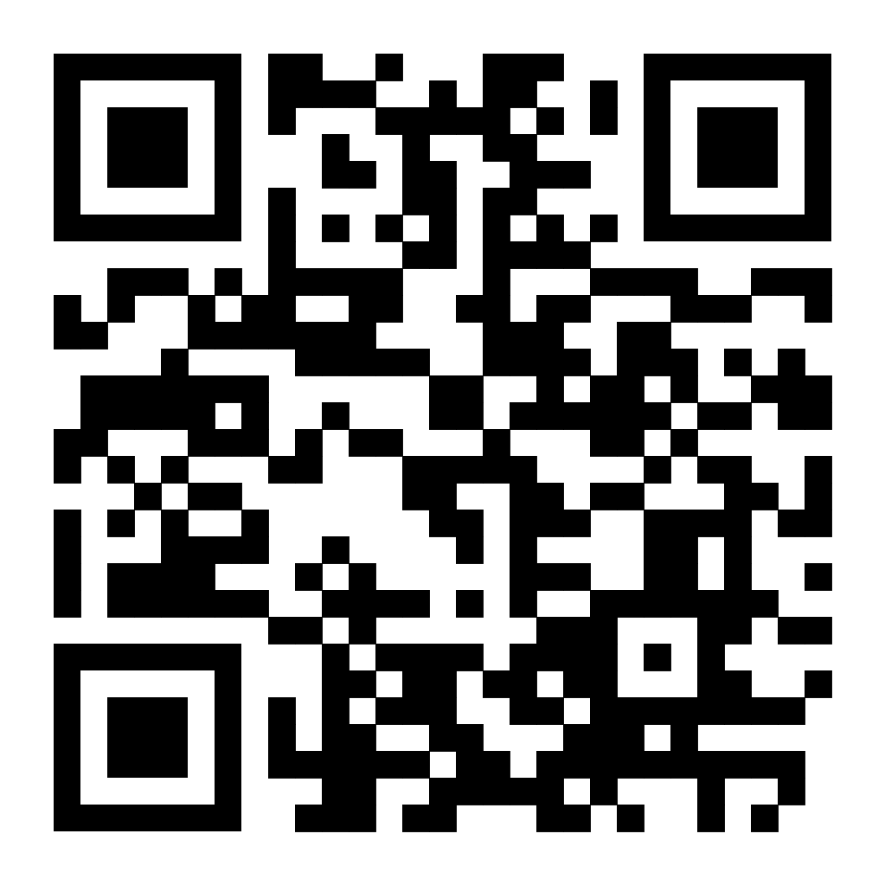
Draft interactive map:
koriblankenship.github.io/StateRx/map.html
Feedback google sheet:
https://docs.google.com/spreadsheets/d/1yOqS-3IICJEIaDMrL68rAZxslNYItUcV6FIYsdXRkTU/edit?usp=sharing

Slide 3
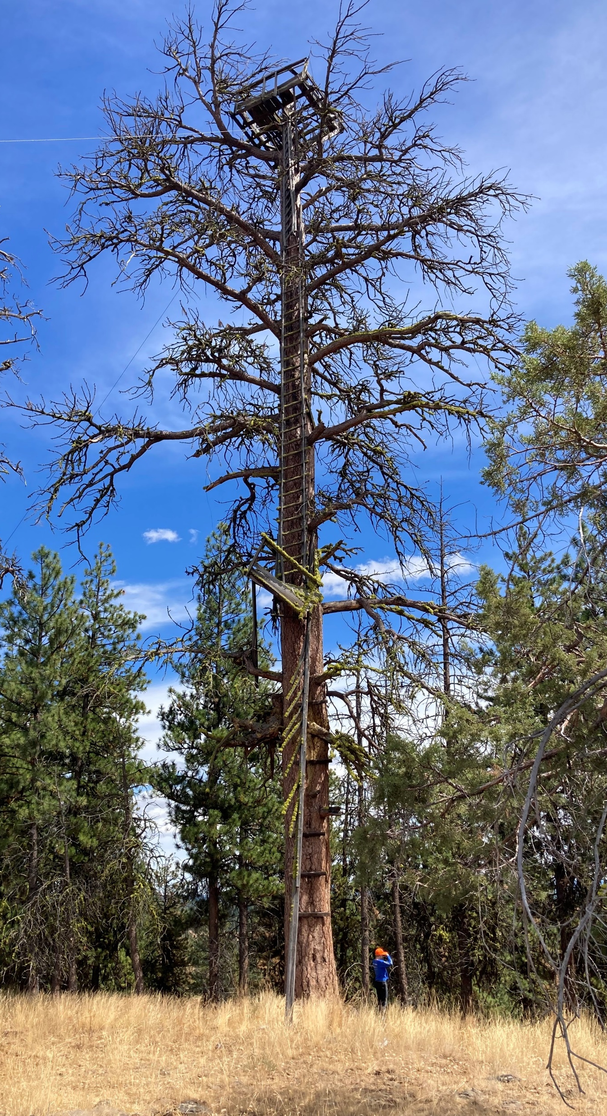
Opportunities
We will: publish code, data, methods
We could use: feedback, data checking, information on additional data sources
Leverage existing federal + other records systems to better understand completeness of Prescribed Fire Records Database.
Integrate Prescribed Fire Records Database with remotely sensed products to validate burn completeness and understand remote detection of prescribed fire.
Black Mountain Lookout tree, OR.
Notes:
Understanding of prescribed burning is limited due to lack of data consistency and completeness.
Validate public records with the federal records
Use products (e.g. usgs burned area, fired) to
validate if burns in the public record occurred
Improve our understanding of what burns can be remotely sensed
Original wording of bullets:
Leverage current efforts to create comprehensive prescribed fire databases on federal lands to better understand completeness of public records.
Integrate public record data with remotely sensed products to validate burn completeness and understand detection of prescribed fire.

