Slide 1
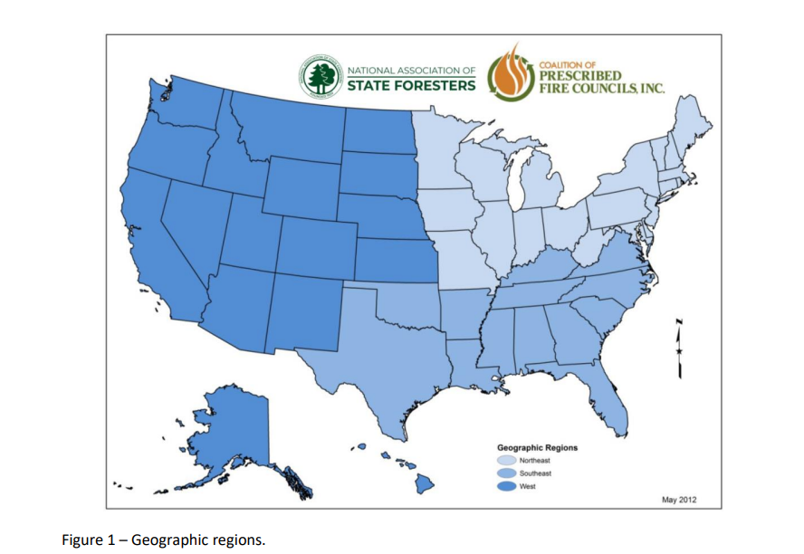

Slide 2
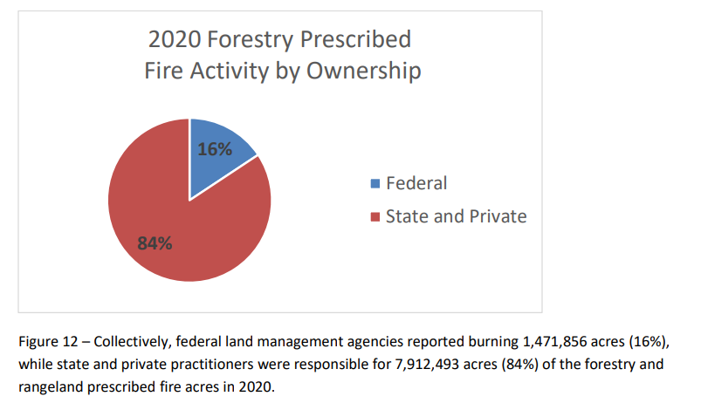
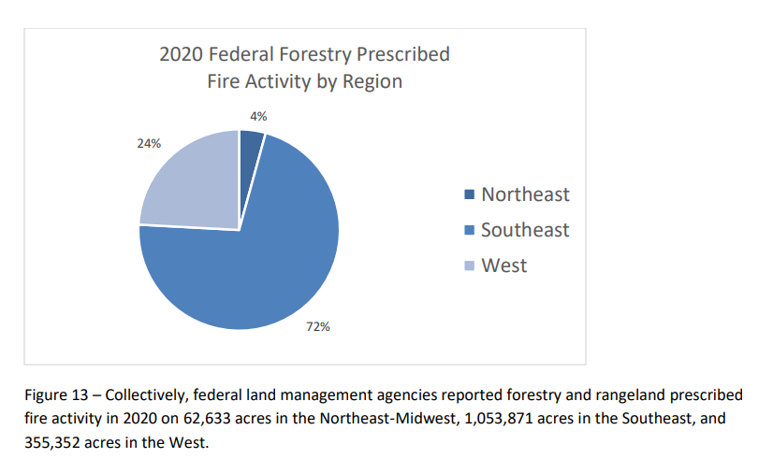
2020
9,384,349 sum, 2020, all US
1,471,856 federal
* .24 (24% in west)
= 353,245 acres federal in West
Notes:
2021-National-Rx-Fire-Use-Report_FINAL.pdf (prescribedfire.net)

Slide 3
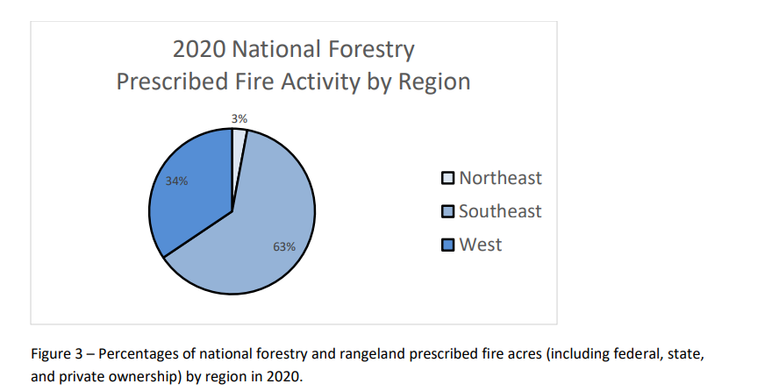
9,384,349 sum, 2020, all US
* .34 in the west
= 3,190,678 ac , west, all ownership, 2020

Slide 4
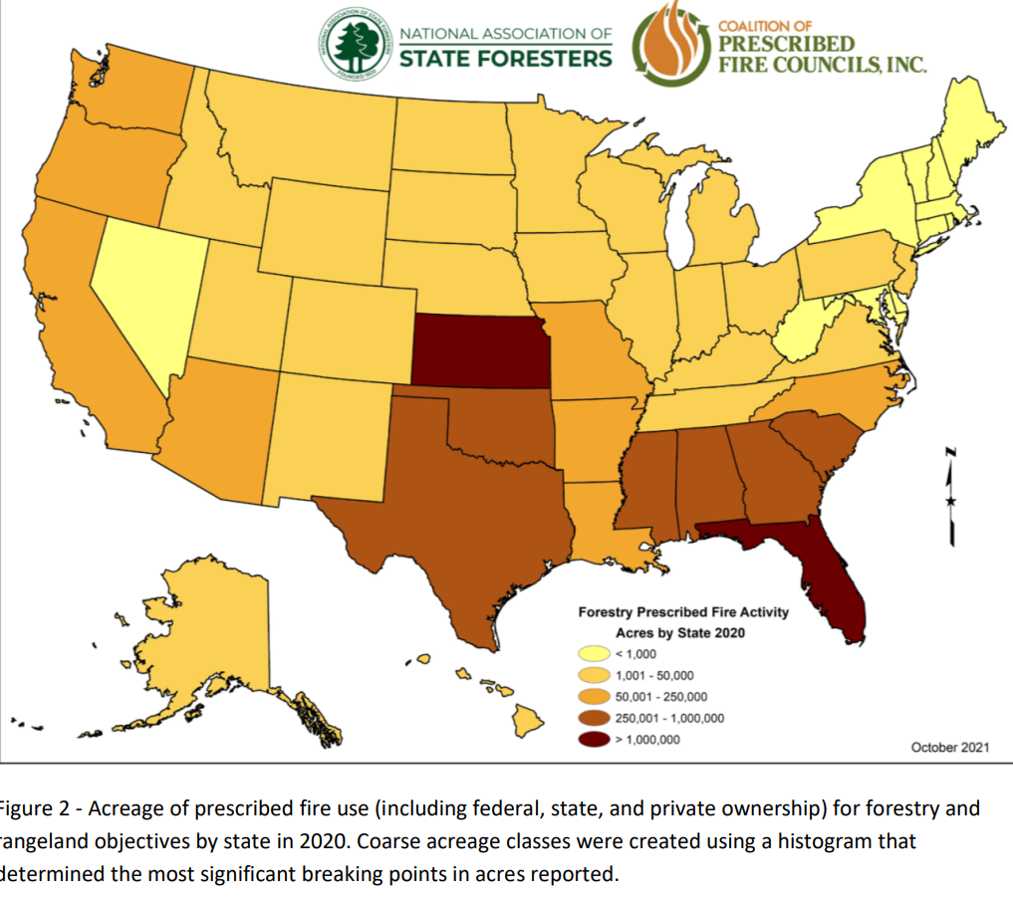

Slide 5
