Slide 1
Objective
Piles | 49,992
Broadcast | 6,065
Unknown | 575
Total | 56,632
Create an all-lands prescribed fire records database for 11 western states
State | Information tracked |  |  |  | Years of data
 | Permitted acres | Requested acres | Completed acres | Burn type | pre-2010 | 2010 | 2011 | 2012 | 2013 | 2014 | 2015 | 2016 | 2017 | 2018 | 2019 | 2020 | 2021 | 2022
AZ
CA
CO
ID
MT
NM
NV
OR
UT
WA
WY

Slide 2
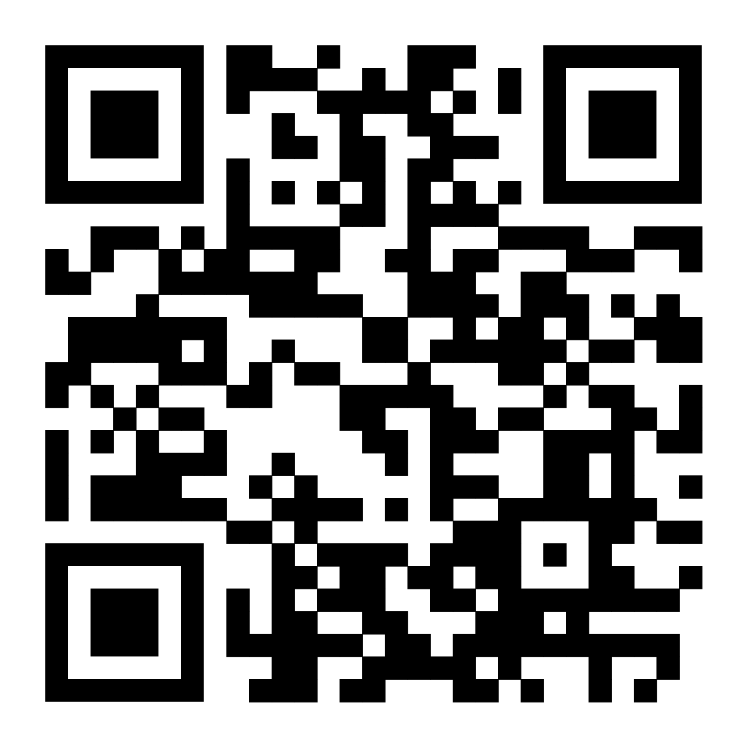
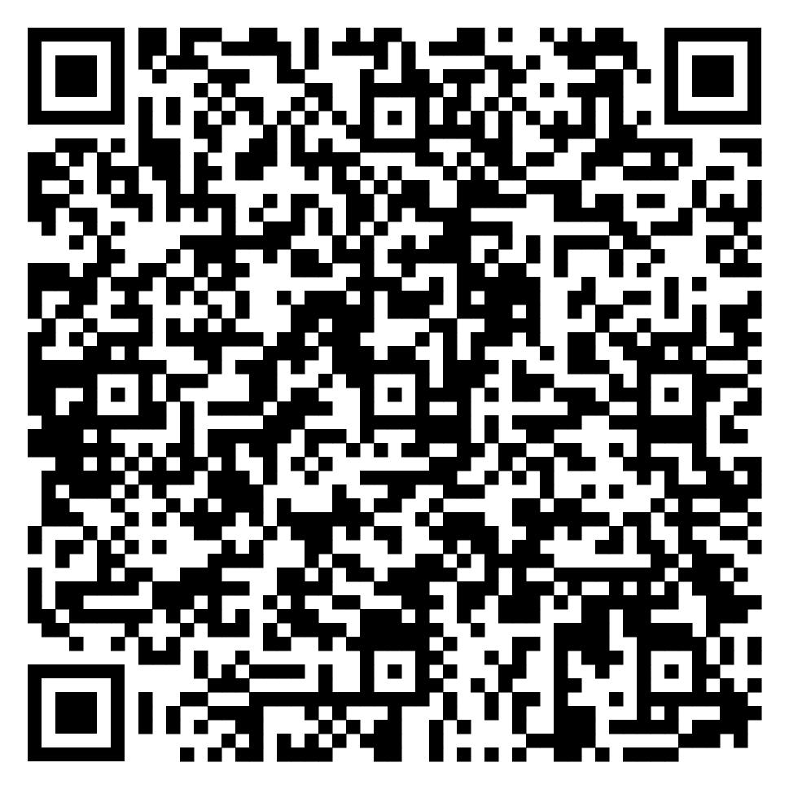
Draft interactive map
https://koriblankenship.github.io/StateRx/map.html
Feedback google sheet
https://docs.google.com/spreadsheets/d/1yOqS-3IICJEIaDMrL68rAZxslNYItUcV6FIYsdXRkTU/edit?usp=sharing
kblankenship@tnc.org

Slide 3
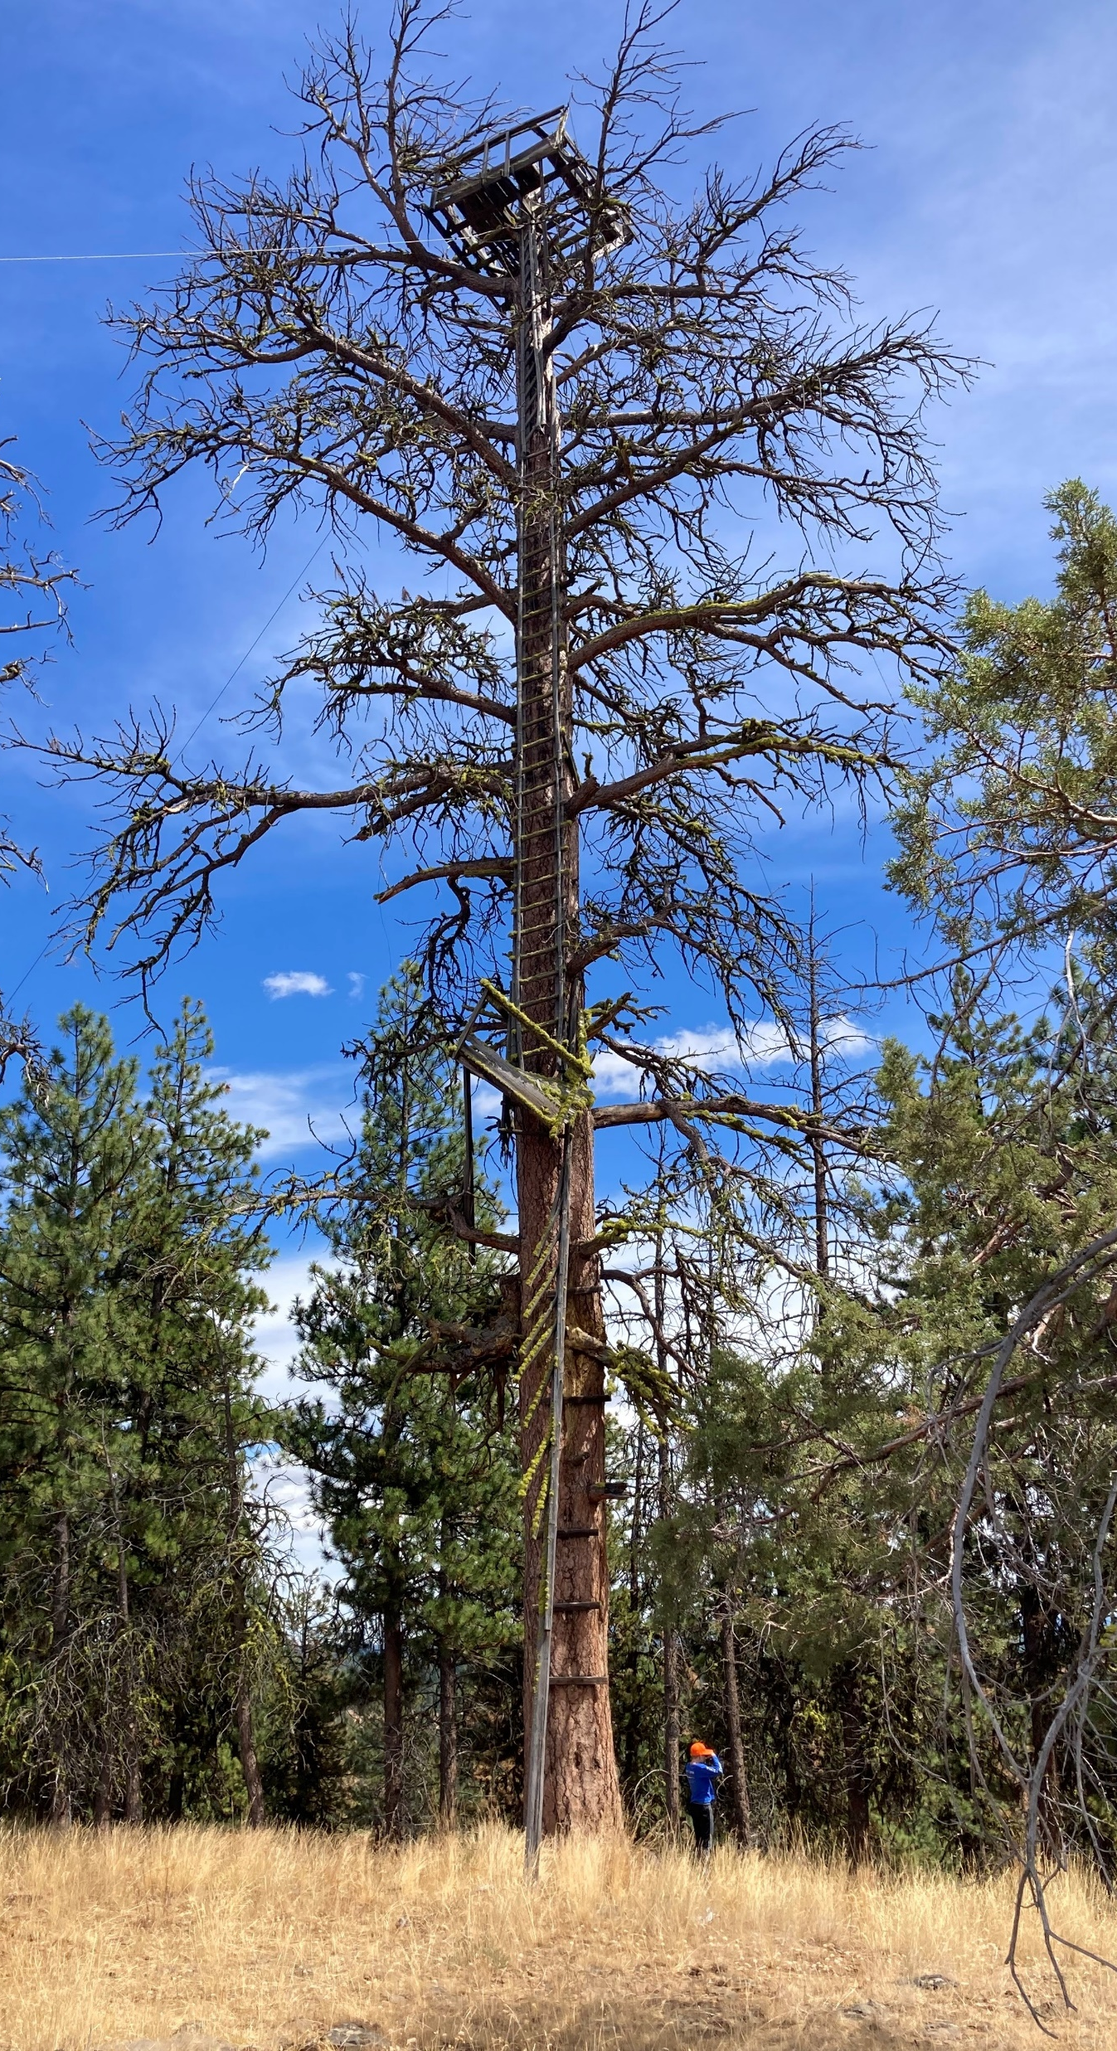
Opportunities
We will:
Share data, code, methods
Support database users
We could use:
Data review
Information on additional data sources
Feedback on validation methods
Data standard for fuel treatment tracking
Black Mountain Lookout tree, OR.

