Slide 1
Special Course in Software Engineering ‘24
MINI-PROJECT PRESENTATION
GROUP NO. 23

Slide 2
Group Introduction

Slide 3
Group members and their contribution
Member Name | Contribution to the Mini-project
Chang Liwen | code for other parts,make the silds
Wu Guxuanang | code for data_analysis
Xia Rui | code for visualization

Slide 4
Dataset

Slide 5
Dataset introduction
Dataset name:laptop_price - dataset
Brief description: This dataset contains detailed information about various laptop models, including attributes such as the manufacturer (Company), product name, type (TypeName), display size (Inches), screen resolution, CPU specifications (CPU_Company, CPU_Type, CPU_Frequency), RAM size, memory type, GPU details, operating system, weight, and price in Euros. It is a comprehensive collection used to analyze pricing patterns and technical specifications across different laptop brands and models
Variable | Type of data | Mean / Median / Mode | Kurtosis | Skewness | Normality
Company | Categorical | Dell
Product | Categorical | XPS 13
TypeName | Categorical | Notebook
Inches | Numeric | 15.02290196 | -0.083968898 | -0.438622182 | 1.88E-30
ScreenResolution | Categorical | Full HD 1920x1080
CPU_Company | Categorical | Intel
CPU_Type | Categorical | Core i5 7200U

Slide 6
Dataset introduction
Variable | Type of data | Mean / Median / Mode | Kurtosis | Skewness | Normality
CPU_Frequency (GHz) | Numeric | 2.302980392 | -0.133106932 | -0.838245748 | 5.01E-29
RAM (GB) | Numeric | 8.440784314 | 15.40037269 | 2.698716026 | 2.92E-42
Memory | Categorical | 256GB SSD
GPU_Company | Categorical | Intel
GPU_Type | Categorical | HD Graphics 620
OpSys | Categorical | Windows 10
Weight (kg) | Numeric | 2.04052549 | 2.428372389 | 1.150803874 | 2.33E-25
Price (Euro) | Numeric | 1134.969059 | 4.340816227 | 1.51114675 | 1.32E-28

Slide 7
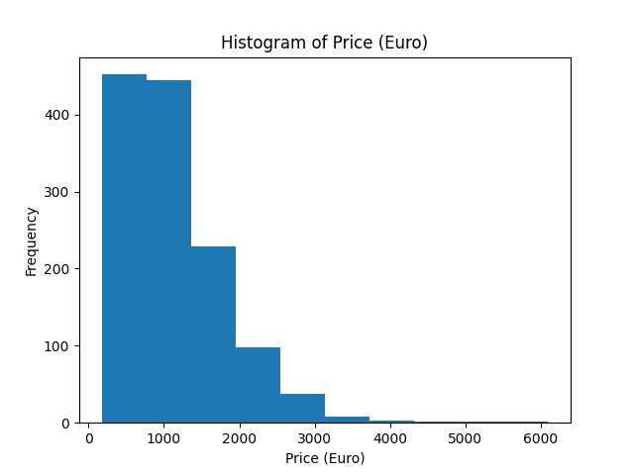
Price（Euro） distribution
Plot Type: Histogram
Description: "The distribution of laptop prices shows a wide range, with most laptops priced between €500 and €1500. The peak concentration around €1000 suggests that mid-range laptops are the most common in the market. There are a few high-priced outliers, which likely correspond to premium or high-performance laptops, such as those used for gaming or professional tasks.

Slide 8
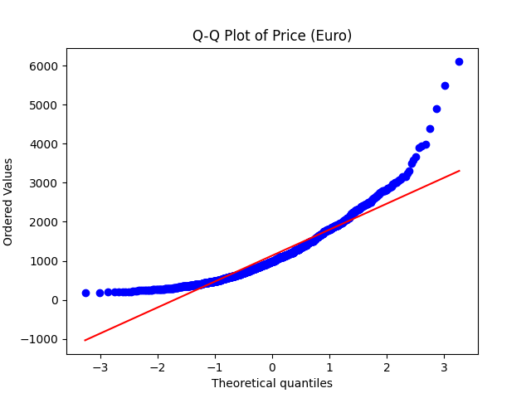
The distribution of price data does not fully conform to a normal distribution. In particular, the high-priced part shows a large deviation, indicating that the price of these high-end notebooks is much higher than the average level, forming a right-skewed distribution. This phenomenon may be due to the fact that some high-end brands, such as Apple or Razer, have significantly higher prices than the market average.

Slide 9
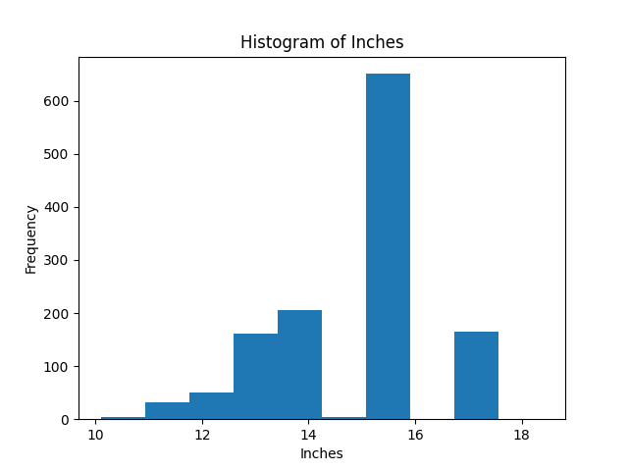
Inches distribution
Plot Type: Histogram
Description: "The screen size distribution reveals that most laptops have screen sizes between 14 and 16 inches. This suggests that mid-sized laptops are the most popular, likely due to their balance between portability and usability. Laptops smaller than 14 inches are less common and are likely ultra-portable models, while larger laptops (17-18 inches) cater to gaming, design, or multimedia users who prioritize screen real estate. The mean and median screen sizes are both around 15 inches, further supporting this trend."

Slide 10
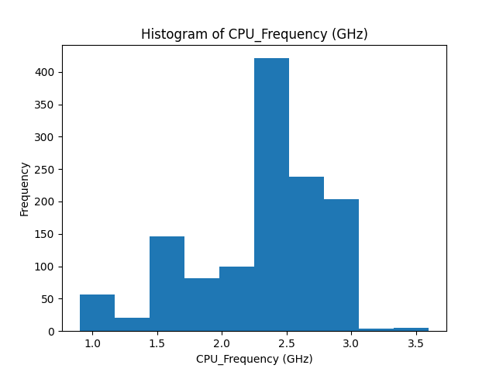
CPU_Frequency(GHZ) distribution
Plot Type: Histogram
Description: "The distribution of CPU frequencies shows a strong concentration around 2.5 to 3.0 GHz, which indicates that most laptops in the dataset are equipped with mid-range processors. This range is typical for everyday use laptops, providing sufficient power for standard tasks like web browsing, office work, and light programming. The tail of the distribution extends slightly higher, suggesting the presence of high-performance laptops designed for more demanding tasks, such as video editing, 3D rendering, or gaming."

Slide 11
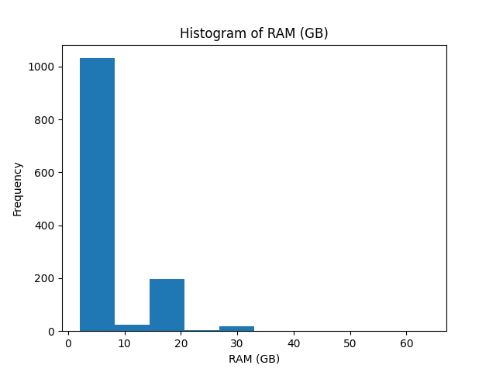
RAM（GB） distribution
Plot Type: Histogram
Description: "The most common RAM configuration among the laptops is 8 GB, which is standard for general-purpose laptops and sufficient for most users. There is a smaller number of laptops with 16 GB of RAM, often found in high-performance laptops used for tasks requiring more memory, like gaming, programming, or professional software development. A few outliers with 32 GB or even 64 GB of RAM represent top-tier models, likely used in specialized fields such as data science, machine learning, or professional video editing, where large amounts of memory are necessary."

Slide 12
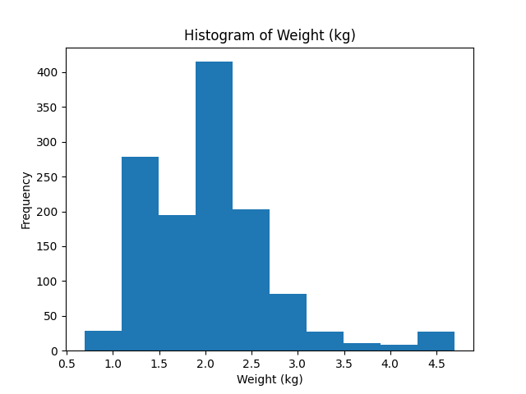
Weight distribution
Plot Type:Histogram
Description: "The weight distribution shows that the majority of laptops fall between 1.5 kg and 2.5 kg, suggesting that most models are designed to balance portability and performance. Lightweight laptops, under 1.5 kg, likely represent ultra-portable models, ideal for users who prioritize mobility. Laptops heavier than 2.5 kg are less common and are likely high-performance gaming laptops or workstations with powerful hardware that necessitates more cooling and larger battery capacity, which adds to the weight."

Slide 13
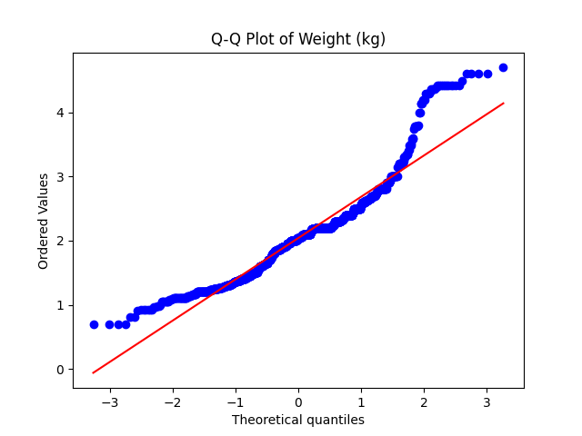
Overall, the middle part of the weight data is closer to a normal distribution, but at the high end (heavier devices) it deviates from the normal distribution and shows a right-biased phenomenon. This may be due to the asymmetry of data due to some heavy laptop devices, such as gaming laptops or workstations.

Slide 14
Analysis

Slide 15
Hypothesis #1: RAM and Price Relationship
H0: There is no relationship between RAM size and laptop price.
Ha: There is a significant relationship between RAM size and laptop price.
Analysis: Based on correlation analysis, a strong positive correlation (0.74) between RAM size and price indicates a significant relationship between the two variables.

Slide 16
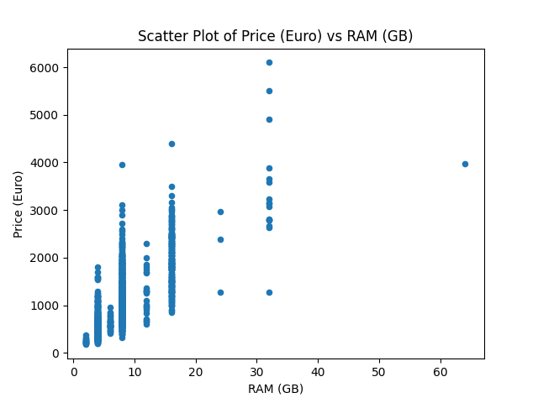
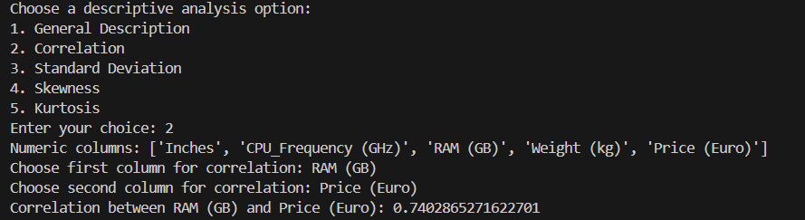
Testing Hypothesis #1: RAM and Price
The correlation analysis results suggest that laptops with higher RAM tend to be more expensive. The correlation coefficient of 0.74 strongly supports this hypothesis.

Slide 17
Hypothesis #2: CPU Frequency and Price Relationship
H0: There is no significant relationship between CPU frequency and laptop price.
Ha: There is a significant relationship between CPU frequency and laptop price.
Analysis: A moderate correlation (0.43) between CPU frequency and price suggests that laptops with higher CPU frequencies are moderately more expensive.

Slide 18
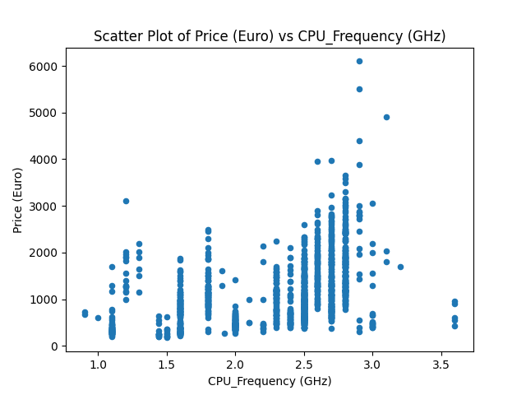
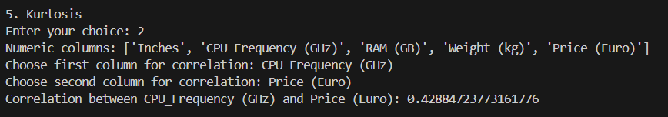
Testing Hypothesis #2: CPU Frequency and Price
The correlation coefficient of 0.43 suggests a moderate relationship between CPU frequency and laptop price, indicating that laptops with higher clock speeds tend to cost more.
The scatter plot shows that notebooks with higher CPU frequencies are generally more expensive, but there are also some outliers that indicate that the price is not only determined by CPU frequency, but also by other hardware configuration and brand factors.

Slide 19
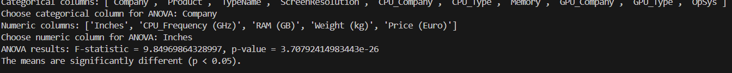
Hypothesis #3: Screen Size and Company
H0: There is no significant relationship between screen size and company.
Ha: There is a significant relationship between screen size and company.
Analysis: F-statistic = 9.8497: This value represents the ratio of the variance between the groups (different companies) to the variance within the groups (within each company's laptop screen sizes). A higher F-statistic suggests that the variability between the companies' average screen sizes is significantly larger than the variability within each company. This means there is likely a difference in screen size across companies.
p-value = 3.7079e-26: The p-value is extremely small, effectively close to 0, and much smaller than the commonly used significance level of 0.05. This indicates strong evidence against the null hypothesis.

Slide 20
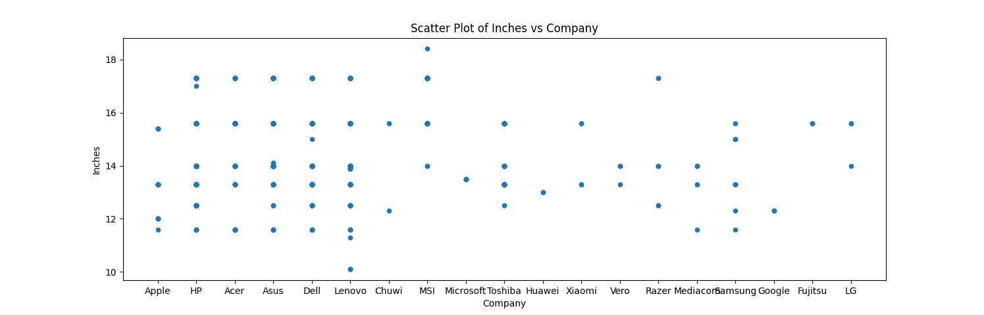
Testing Hypothesis #3: Screen Size and Company
There is a significant relationship between screen size and company. This means that different companies have significant variations in the average screen size of their laptops. Certain companies may favor smaller screen sizes, while others may offer laptops with larger screens, and these differences are statistically significant.

Slide 21
End

