Slide 1
The Kernel Trick
Kenneth D. Harris
3/6/15

Slide 2
Multiple linear regression
What are you predicting?
Data type | Continuous
Dimensionality | 1
What are you predicting it from?
Data type | Continuous
Dimensionality | p
How many data points do you have? | Enough
What sort of prediction do you need? | Single best guess
What sort of relationship can you assume? | Linear

Slide 3
GLMs, SVMs…
What are you predicting?
Data type | Discrete, integer, whatever
Dimensionality | 1
What are you predicting it from?
Data type | Continuous
Dimensionality | p
How many data points do you have? | Not enough
What sort of prediction do you need? | Single best guess or probability distribution
What sort of relationship can you assume? | Linear – nonlinear

Slide 4
Kernel approach
What are you predicting?
Data type | Discrete, integer, whatever
Dimensionality | 1
What are you predicting it from?
Data type | Anything
Dimensionality | p
How many data points do you have? | Not enough
What sort of prediction do you need? | Single best guess or probability distribution
What sort of relationship can you assume? | Nonlinear

Slide 5
The basic idea
Before, our predictor variables lived in a Euclidean space, and predictions from them were linear.
Now they live in any sort of space.
But we have a measure of how similar any two predictors are.

Slide 6
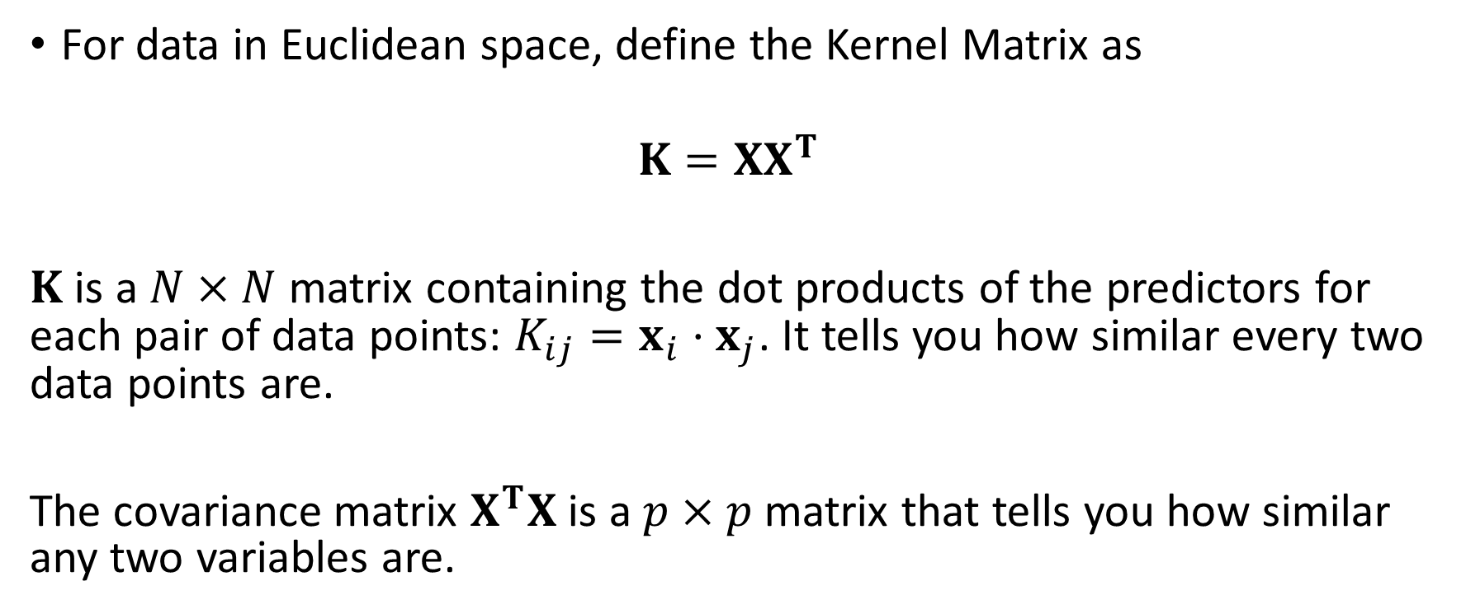
The Kernel Matrix
For data in Euclidean space, define the Kernel Matrix as
$$K=XX^{T}$$
$K$ is a $N×N$ matrix containing the dot products of the predictors for each pair of data points: $K_{ij}=x_{i}⋅x_{j}$. It tells you how similar every two data points are.
The covariance matrix $X^{T}X$ is a $p×p$matrix that tells you how similar any two variables are.

Slide 7
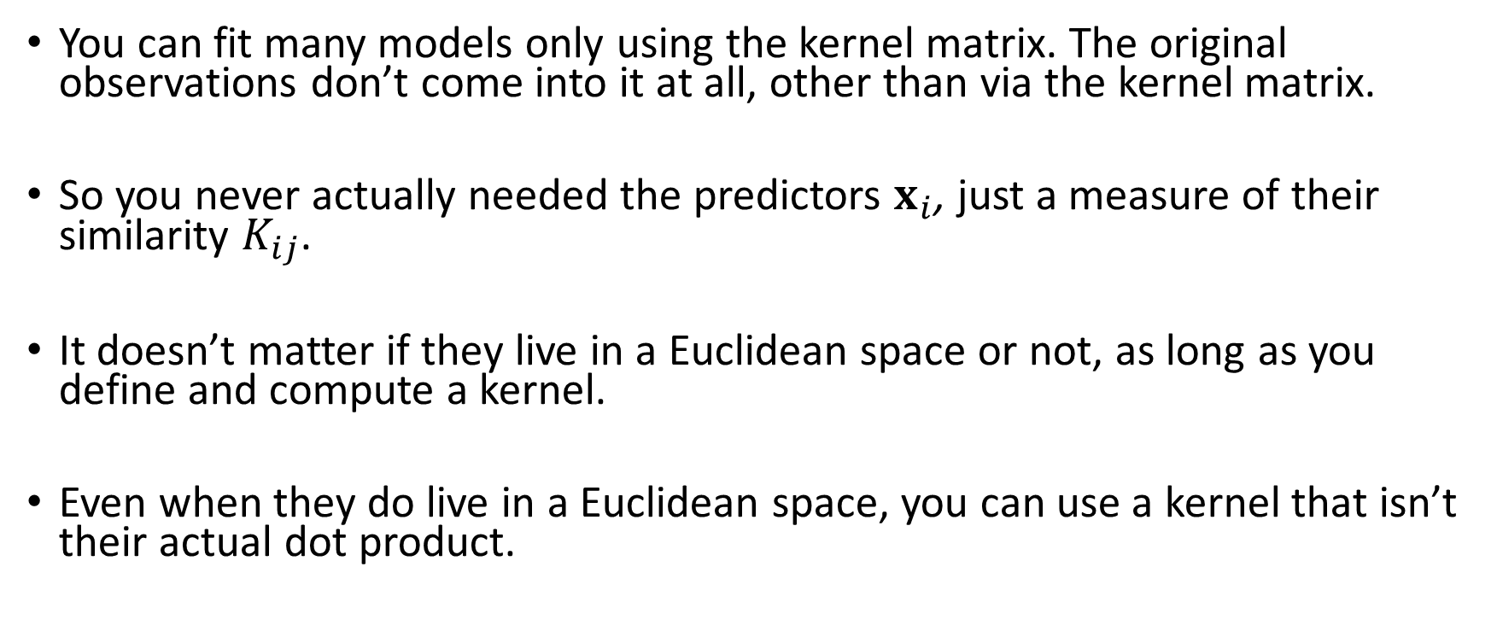
The Kernel Trick
You can fit many models only using the kernel matrix. The original observations don’t come into it at all, other than via the kernel matrix.
So you never actually needed the predictors $x_{i}$, just a measure of their similarity $K_{ij}$.
It doesn’t matter if they live in a Euclidean space or not, as long as you define and compute a kernel.
Even when they do live in a Euclidean space, you can use a kernel that isn’t their actual dot product.

Slide 8
Some of what you can do with the kernel trick
Support vector machines (where it was first used)
Kernel ridge regression
Kernel PCA
Density estimation
Kernel logistic regression and other GLMs
Bayesian methods (also called Gaussian Process Regression)
Kernel adaptive filters (for time series)
Many more….

Slide 9
Some of what you can do with the kernel trick
Support vector machines (where it was first used)
Kernel ridge regression
Kernel PCA
Density estimation
Kernel logistic regression and other GLMs
Bayesian methods (also called Gaussian Process Regression)
Kernel adaptive filters (for time series)
Many more….

Slide 10
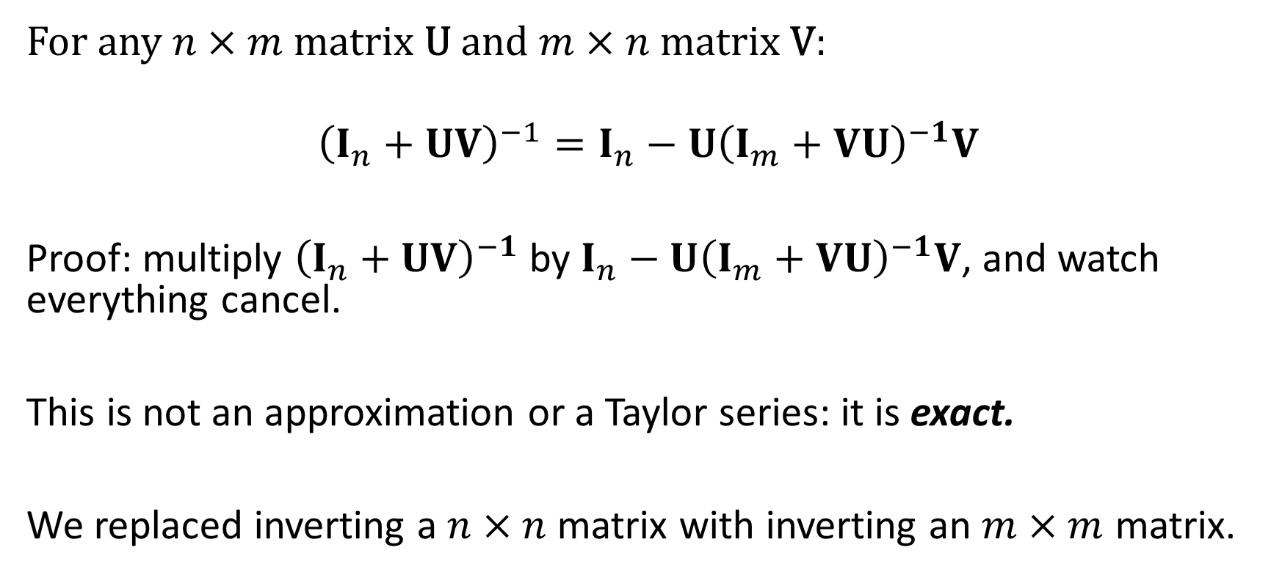
The Matrix Inversion Lemma
For any $n×m$matrix U and $m×n$matrix V:
$${\left(I_{n}+UV\right)}^{−1}=I_{n}−{U\left(I_{m}+VU\right)}^{−1}V$$
Proof: multiply ${\left(I_{n}+UV\right)}^{−1}$ by $I_{n}−{U\left(I_{m}+VU\right)}^{−1}V$, and watch everything cancel.
This is not an approximation or a Taylor series: it is exact.
We replaced inverting a $n×n$matrix with inverting an $m×m$ matrix.

Slide 11
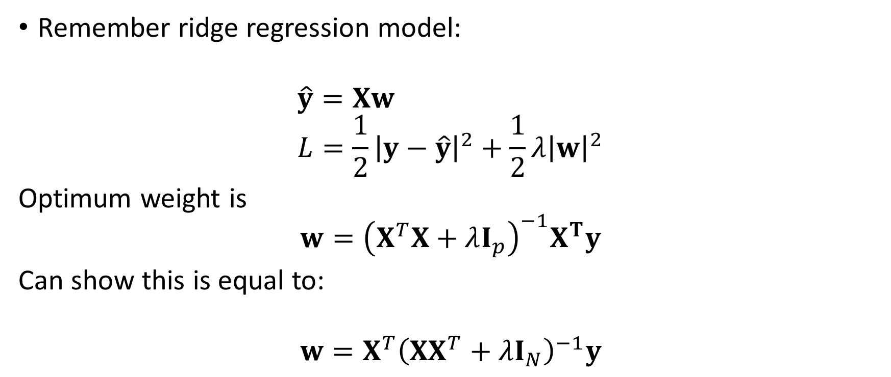
Kernel Ridge Regression
Remember ridge regression model:
$$\hat{y}=Xw \\ L=\frac{1}{2}{\left|y−\hat{y}\right|}^{2}+\frac{1}{2}λ{\left|w\right|}^{2}$$
Optimum weight is
$$w={\left(X^{T}X+λI_{p}\right)}^{−1}X^{T}y$$
Can show this is equal to:
$$w=X^{T}{\left(XX^{T}+λI_{N}\right)}^{−1}y$$
Covariance matrix
Kernel matrix

Slide 12
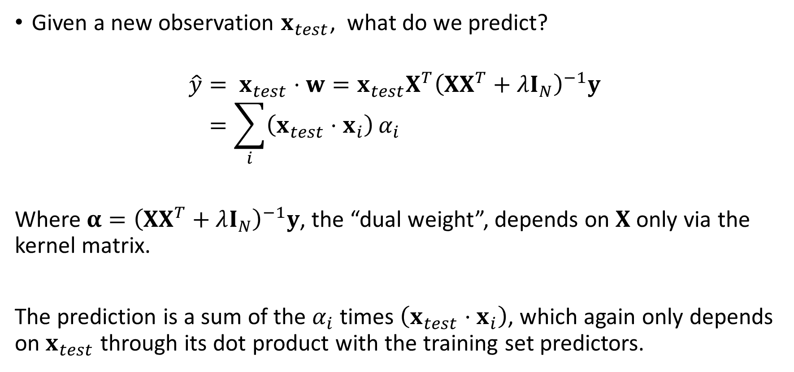
Response to a new observation
Given a new observation $x_{test}$, what do we predict?
$$\hat{y}= x_{test}⋅w={{x_{test}X}^{T}\left(XX^{T}+λI_{N}\right)}^{−1}y \\ =\sum_{i}{\left(x_{test}⋅x_{i}\right)}α_{i}$$
Where$α={\left(XX^{T}+λI_{N}\right)}^{−1}y$, the “dual weight”, depends on $X$ only via the kernel matrix.
The prediction is a sum of the $α_{i}$ times $\left(x_{test}⋅x_{i}\right)$, which again only depends on $x_{test}$ through its dot product with the training set predictors.

Slide 13


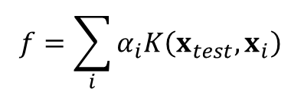
Network view
$$x_{test}$$
$$K\left(x_{test}, x_{i}\right)$$
$$f=\sum_{i}{α_{i}K\left(x_{test}, x_{i}\right)}$$
Input
1 node per training set point
1 node per input dimension

Slide 14
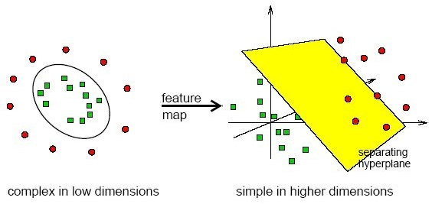
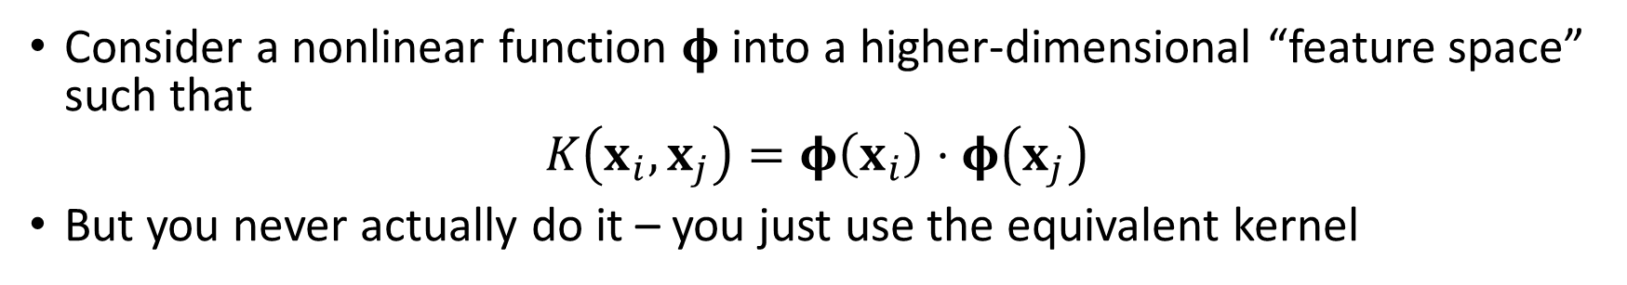


Intuition 1: “Feature space”
$$φ$$
$$\hat{y}=w⋅φ(x)$$
Consider a nonlinear function $φ$into a higher-dimensional “feature space” such that
$$K\left(x_{i}, x_{j}\right)=φ\left(x_{i}\right)⋅φ\left(x_{j}\right)$$
But you never actually do it – you just use the equivalent kernel

Slide 15
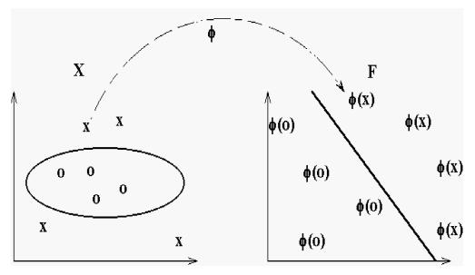
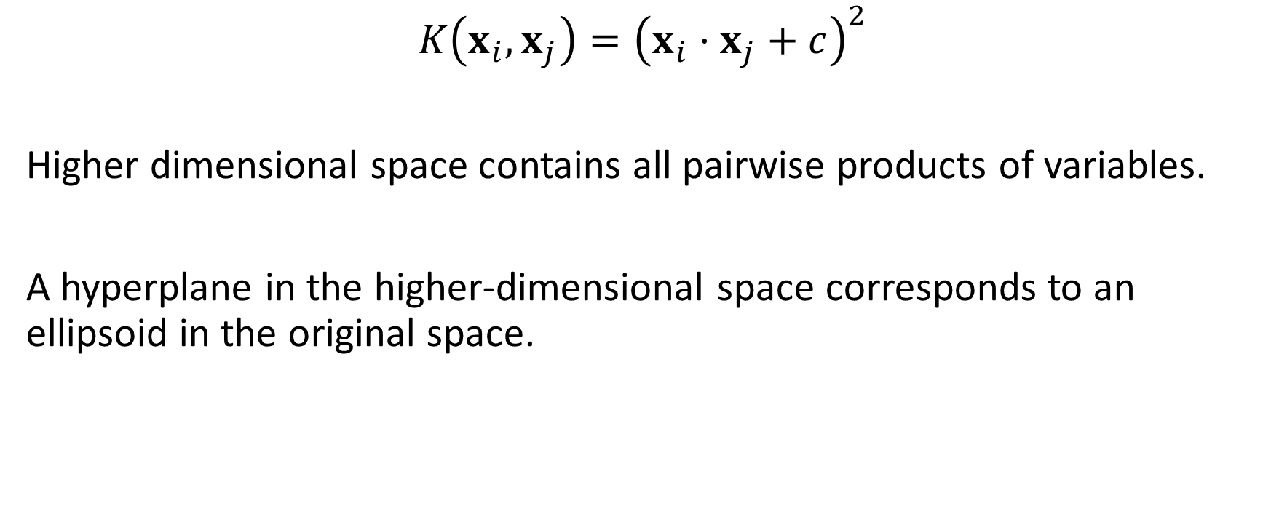
Quadratic Kernel
$$K\left(x_{i}, x_{j}\right)={\left(x_{i}⋅x_{j}+c\right)}^{2}$$
Higher dimensional space contains all pairwise products of variables.
A hyperplane in the higher-dimensional space corresponds to an ellipsoid in the original space.

Slide 16
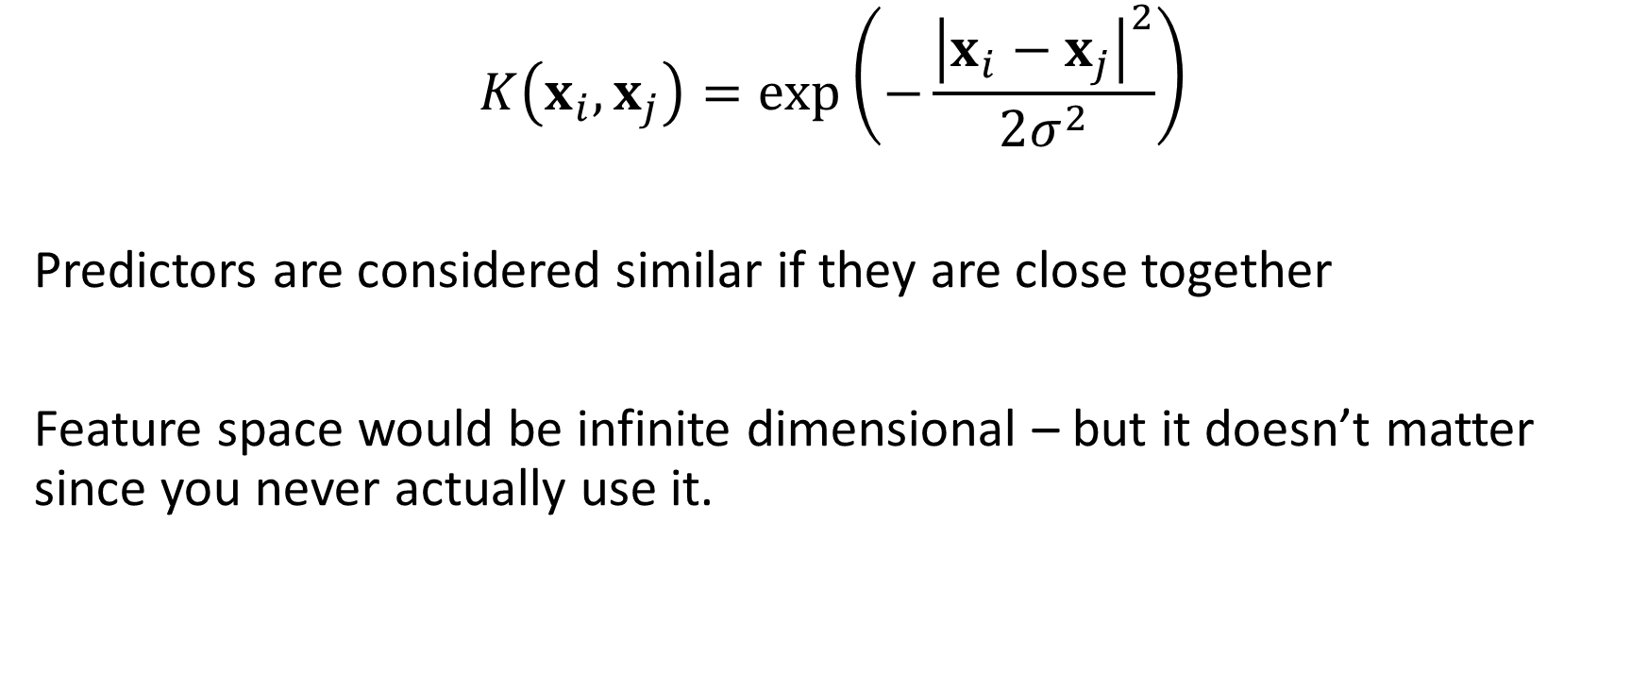
Radial basis function kernel
$$K\left(x_{i}, x_{j}\right)=\exp\left(−\frac{{\left|x_{i}−x_{j}\right|}^{2}}{2σ^{2}}\right)$$
Predictors are considered similar if they are close together
Feature space would be infinite dimensional – but it doesn’t matter since you never actually use it.

Slide 17
Something analogous in the brain?
DiCarlo, Zoccolan, Rust, “How does the brain solve visual object recognition?”, Neuron 2012

Slide 18
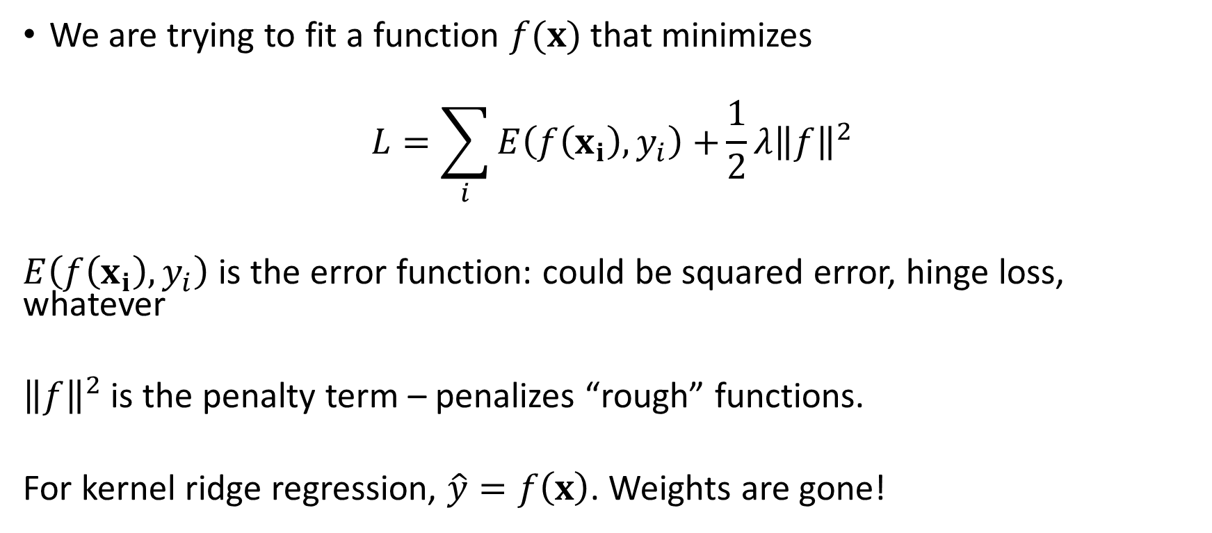
Intuition 2: “Function space”
We are trying to fit a function $f(x)$ that minimizes
$$L=\sum_{i}{E\left(f\left(x_{i}\right), y_{i}\right)+}\frac{1}{2}λ{\left\|f\right\|}^{2}$$
$E\left(f\left(x_{i}\right), y_{i}\right)$ is the error function: could be squared error, hinge loss, whatever
${\left\|f\right\|}^{2}$ is the penalty term – penalizes “rough” functions.
For kernel ridge regression, $\hat{y}=f\left(x\right)$. Weights are gone!

Slide 19
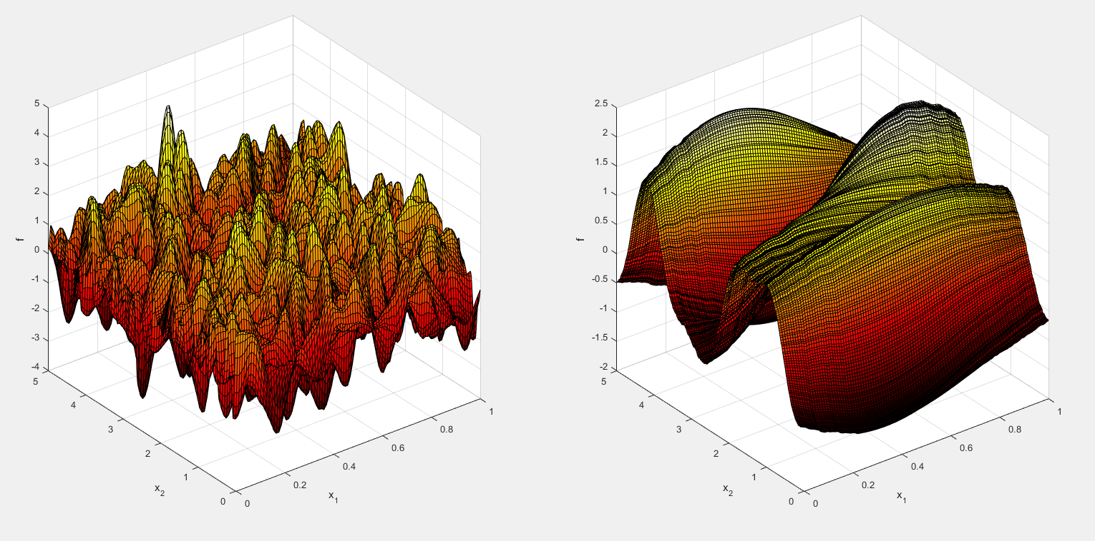



Function norms
$\left\|f\right\|$ is a “function norm” - has to be larger for wiggly functions, smaller for smooth functions.
$\left\|f\right\|$ large
$\left\|f\right\|$ small

Slide 20
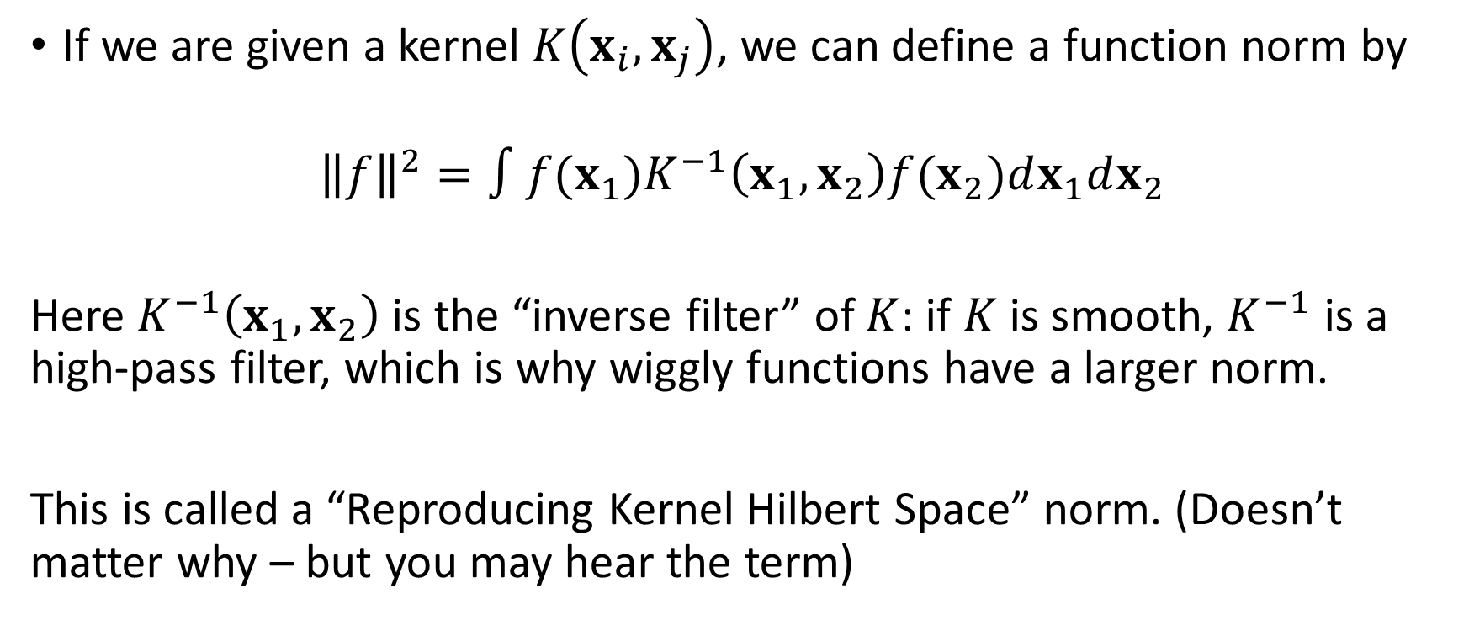
Norms and Kernels
If we are given a kernel $K\left(x_{i}, x_{j}\right)$, we can define a function norm by
$${\left\|f\right\|}^{2}=∫{f(x_{1})K}^{−1}\left(x_{1},x_{2}\right)f(x_{2})dx_{1}dx_{2}$$
Here $K^{−1}\left(x_{1},x_{2}\right)$ is the “inverse filter” of $K$: if $K$ is smooth, $K^{−1}$ is a high-pass filter, which is why wiggly functions have a larger norm.
This is called a “Reproducing Kernel Hilbert Space” norm. (Doesn’t matter why – but you may hear the term)

Slide 21
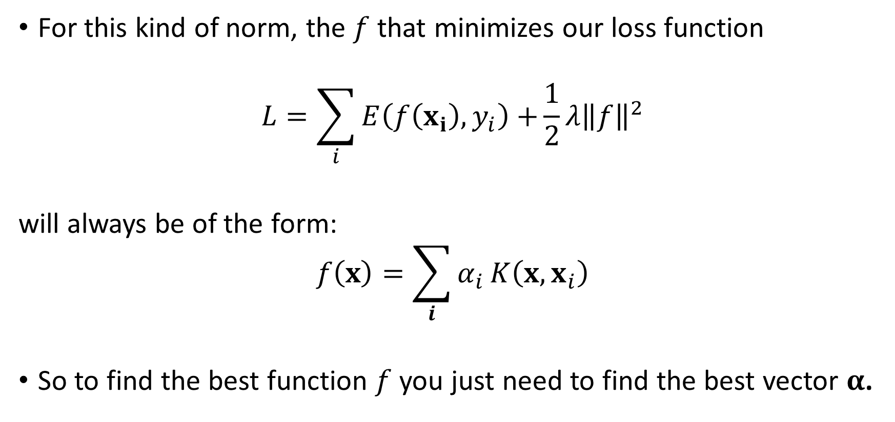
Representer theorem
For this kind of norm, the $f$ that minimizes our loss function
$$L=\sum_{i}{E\left(f\left(x_{i}\right), y_{i}\right)+}\frac{1}{2}λ{\left\|f\right\|}^{2}$$
will always be of the form:
$$f\left(x\right)=\sum_{i}{α_{i}}K\left(x, x_{i}\right)$$
So to find the best function $f$ you just need to find the best vector $α$.

Slide 22
Two views of the same technique
Nonlinearly map data into a high-dimensional feature space, then fit a linear function with a weight penalty
Fit a nonlinear function, penalized by its roughness

Slide 23
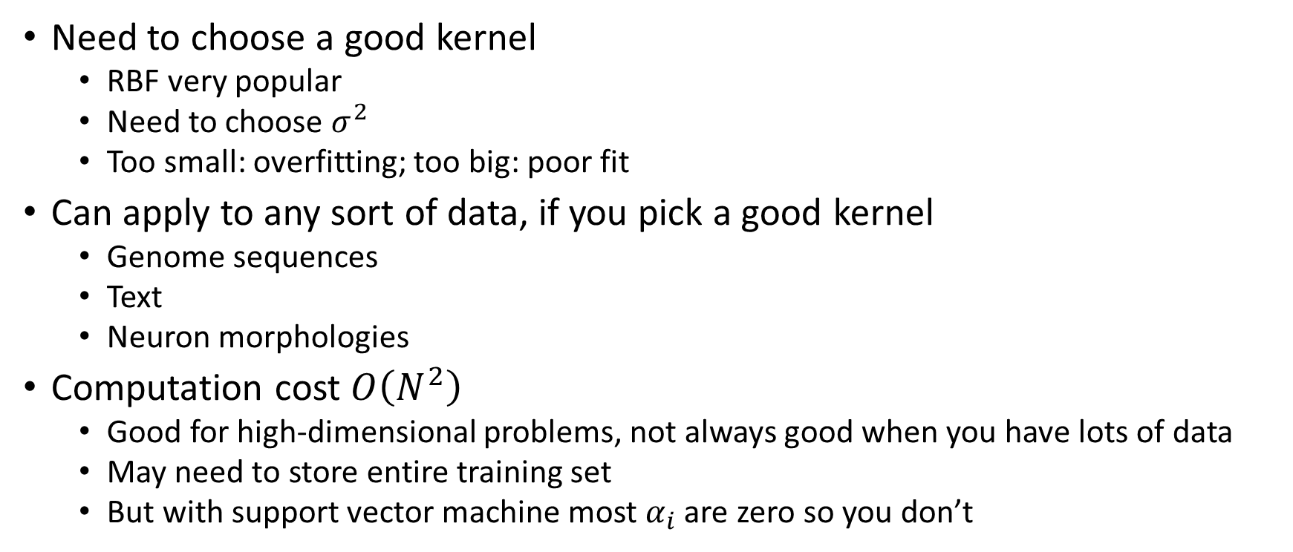
Practical issues
Need to choose a good kernel
RBF very popular
Need to choose $σ^{2}$
Too small: overfitting; too big: poor fit
Can apply to any sort of data, if you pick a good kernel
Genome sequences
Text
Neuron morphologies
Computation cost $O\left(N^{2}\right)$
Good for high-dimensional problems, not always good when you have lots of data
May need to store entire training set
But with support vector machine most $α_{i}$ are zero so you don’t

Slide 24
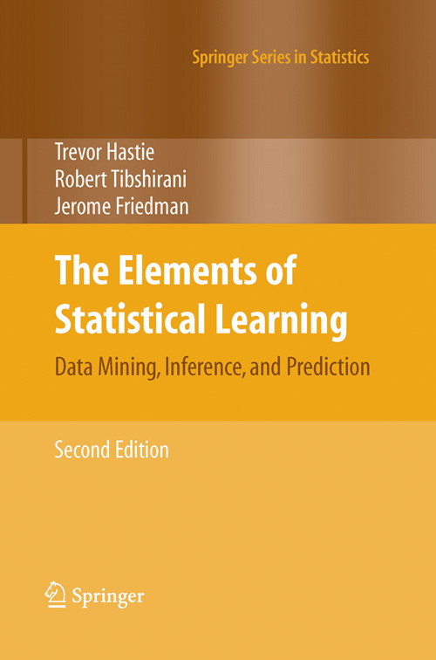
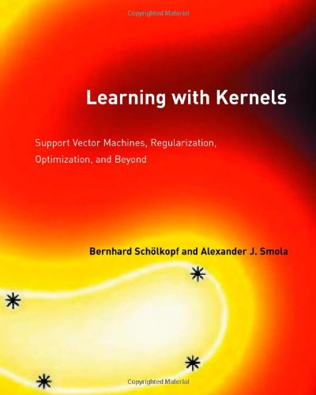
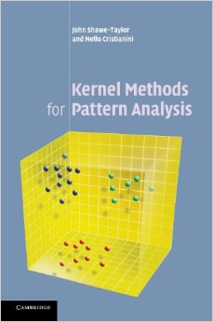
If you are serious…
And if you are really serious:
T. Evgeniou, M. Pontil, T. Poggio. Regularization networks and support vector machines. Adv Comp Math 2000
Ryan M. Rifkin and Ross A. Lippert. Value Regularization and Fenchel Duality. J. Machine Learning Res 2007

