Slide 1
Dimensionality reduction
Kenneth D. Harris 24/6/15

Slide 2
Exploratory vs. confirmatory analysis
Exploratory analysis
Helps you formulate a hypothesis
End result is usually a nice-looking picture
Any method is equally valid – because it just helps you think of a hypothesis
Confirmatory analysis
Where you test your hypothesis
Multiple ways to do it (Classical, Bayesian, Cross-validation)
You have to stick to the rules
Inductive vs. deductive reasoning (K. Popper)

Slide 3
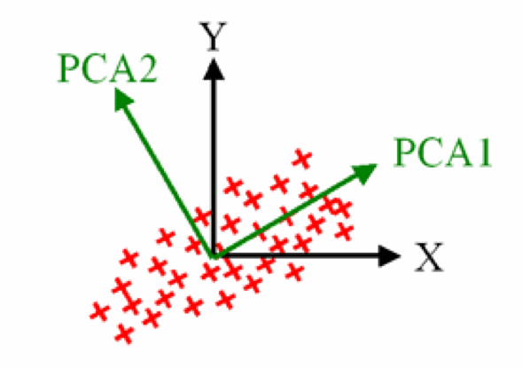
Principal component analysis
Finds directions of maximum variance in a data set
These correspond to the eigenvectors of the covariance matrix

Slide 4
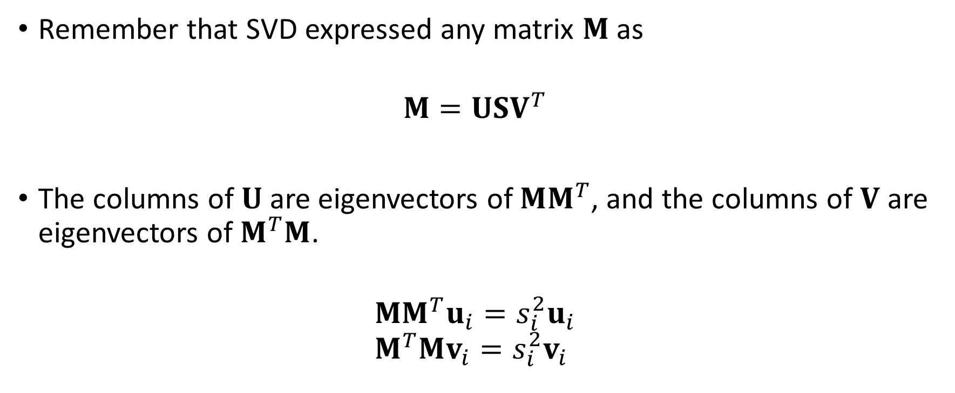
Relation to SVD
Remember that SVD expressed any matrix $M$ as
$$M=USV^{T}$$
The columns of $U$ are eigenvectors of $MM^{T}$, and the columns of $V$ are eigenvectors of $M^{T}M$.
$$MM^{T}u_{i}=s_{i}^{2}u_{i} \\ M^{T}Mv_{i}=s_{i}^{2}v_{i}$$

Slide 5
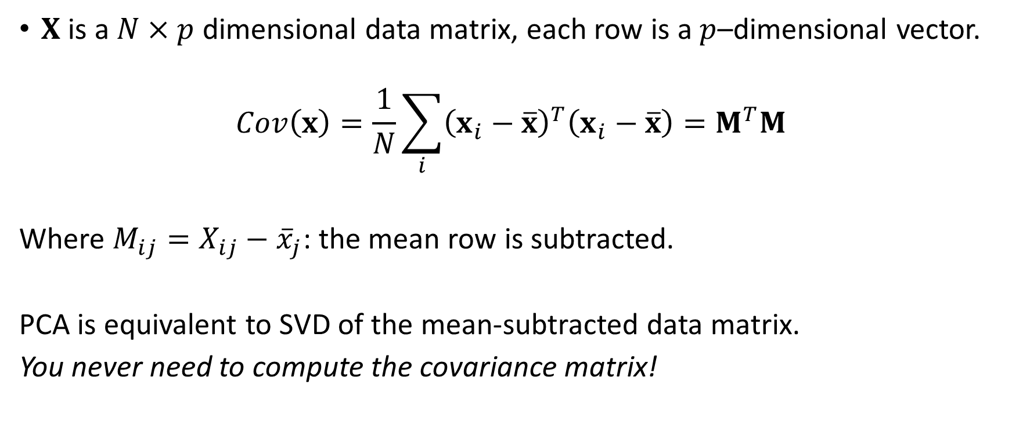
Relation to SVD
$X$ is a $N×p$ dimensional data matrix, each row is a $p$–dimensional vector.
$$Cov\left(x\right)=\frac{1}{N}\sum_{i}{{\left(x_{i}−\overline{x}\right)}^{T}\left(x_{i}−\overline{x}\right)}=M^{T}M$$
Where $M_{ij}=X_{ij}−{\overline{x}}_{j}$: the mean row is subtracted.
PCA is equivalent to SVD of the mean-subtracted data matrix.
You never need to compute the covariance matrix!

Slide 6
PCA: auditory cortex population vectors
Bartho et al, EJN 2009

Slide 7
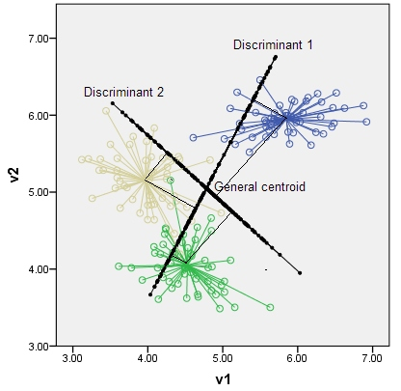
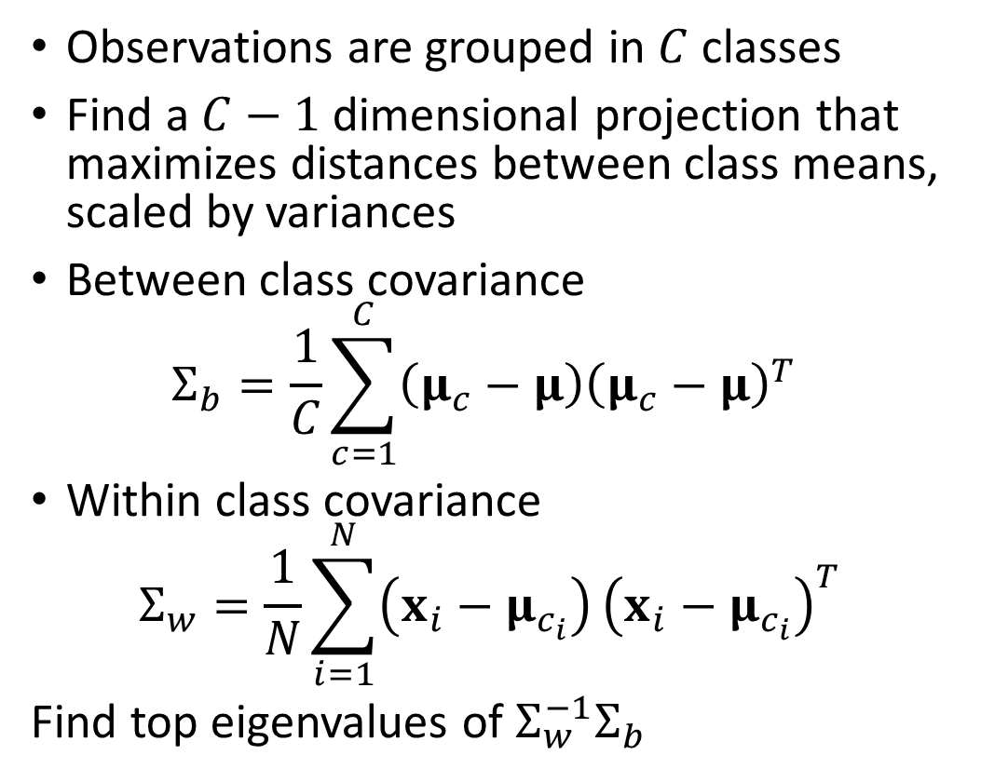
Discriminant analysis
Observations are grouped in $C$ classes
Find a $C−1$ dimensional projection that maximizes distances between class means, scaled by variances
Between class covariance
$$Σ_{b}=\frac{1}{C}\sum_{c=1}^{C}{\left(μ_{c}−μ\right){\left(μ_{c}−μ\right)}^{T}}$$
Within class covariance
$$Σ_{w}=\frac{1}{N}\sum_{i=1}^{N}{\left(x_{i}−μ_{c_{i}}\right)}{\left(x_{i}−μ_{c_{i}}\right)}^{T}$$
Find top eigenvalues of $Σ_{w}^{−1}Σ_{b}$

Slide 8
Discriminant analysis: auditory cortex
Projections chosen to maximally separate sustained responses
Looks completely different to PCA!
Bartho et al, EJN 2009

Slide 9
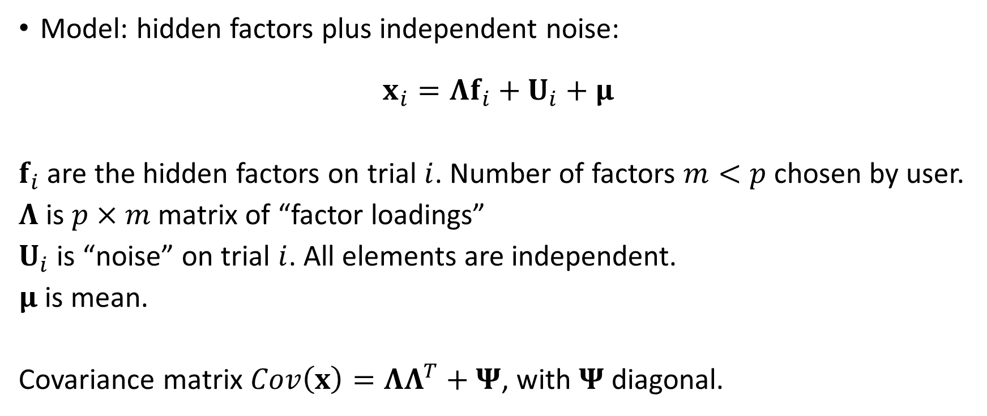
Factor analysis
Model: hidden factors plus independent noise:
$$x_{i}=Λf_{i}+U_{i}+μ$$
$f_{i}$ are the hidden factors on trial $i$. Number of factors $m<p$chosen by user.
$Λ$ is $p×m$ matrix of “factor loadings”
$U_{i}$ is “noise” on trial $i$. All elements are independent.
$μ$ is mean.
Covariance matrix $Cov\left(x\right)=ΛΛ^{T}+Ψ$, with $Ψ$ diagonal.

Slide 10

Canonical correlation analysis
Given two variables $x$ and $y$, choose projections $w$ and $v$ to maximize correlation of $x⋅w$ and $y⋅v$.
For example these could be two neural populations.

Slide 11
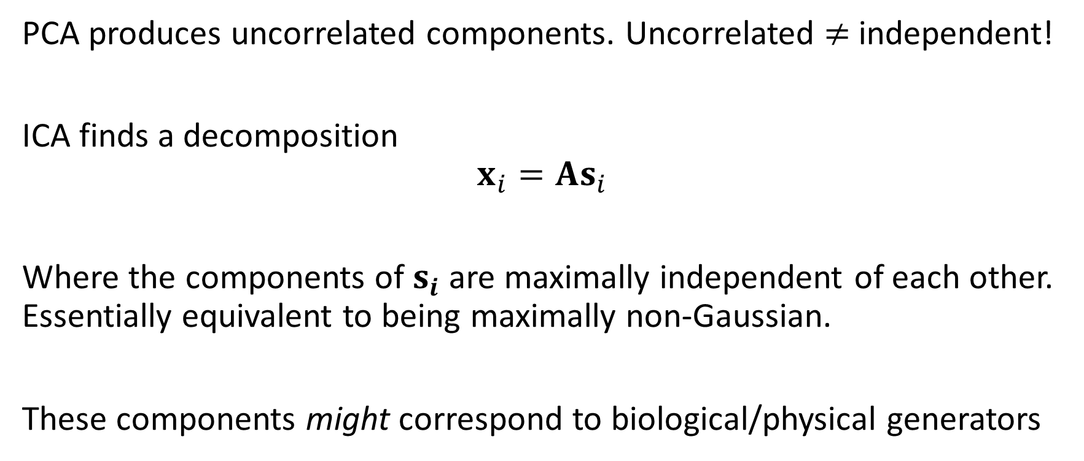
Independent component analysis
PCA produces uncorrelated components. Uncorrelated $≠$ independent!
ICA finds a decomposition
$$x_{i}=As_{i}$$
Where the components of $s_{i}$ are maximally independent of each other. Essentially equivalent to being maximally non-Gaussian.
These components might correspond to biological/physical generators

Slide 12
ICA in practice
Fast ICA algorithm
Need to chose a measure of non-Gaussianity
Do an SVD first!
It will take less time
It will give better results

Slide 13
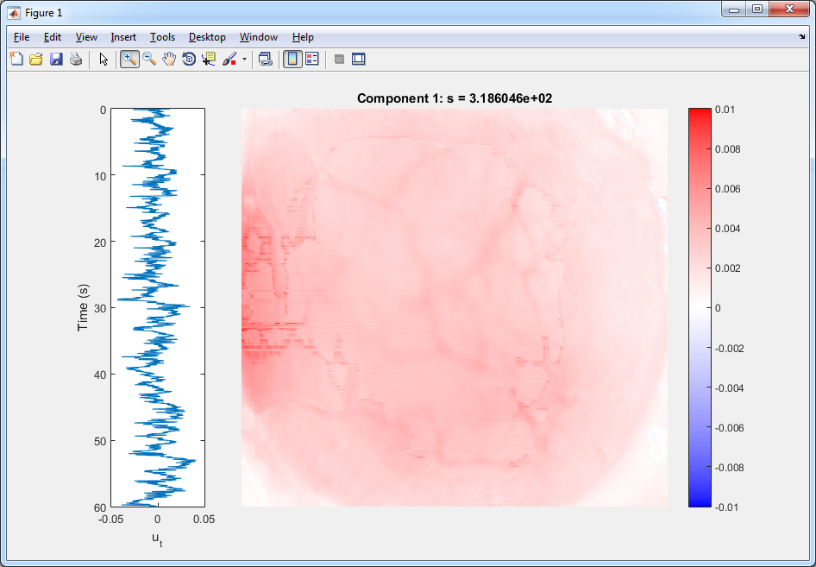
Wide-field movie: SVD 1

Slide 14
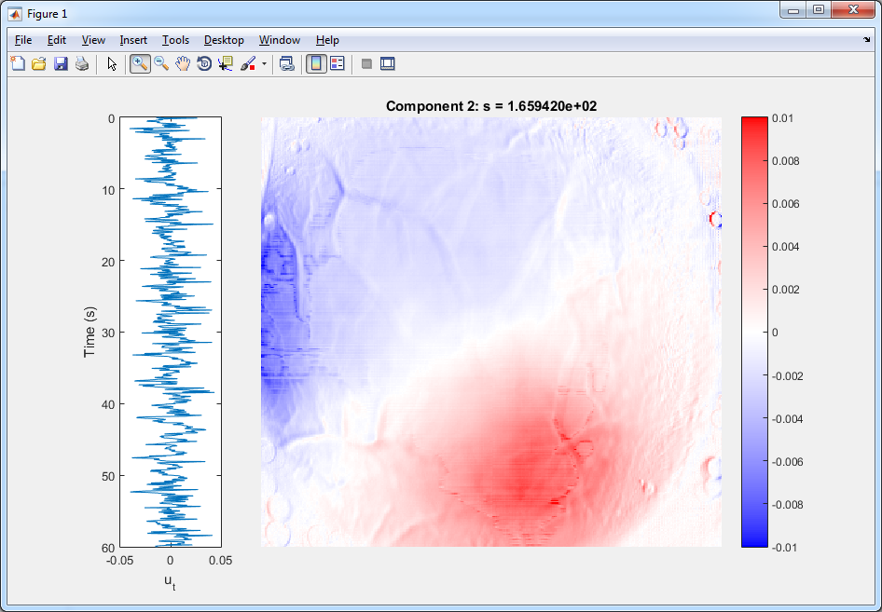
Wide-field movie: SVD 2

Slide 15
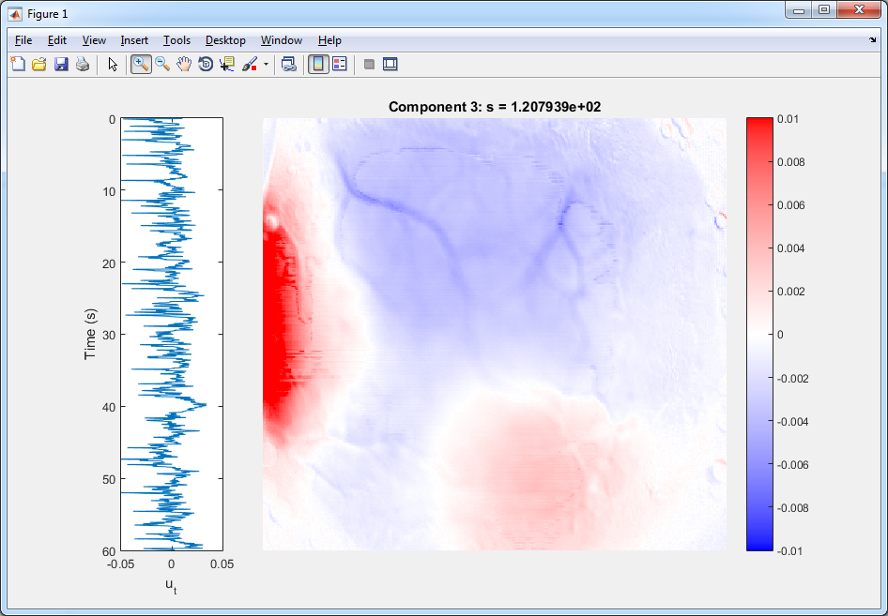
Wide-field movie: SVD 3

Slide 16
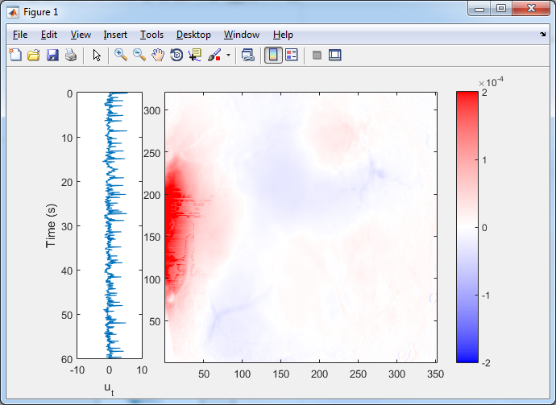
IC 1 (from 12 SVDs)

Slide 17
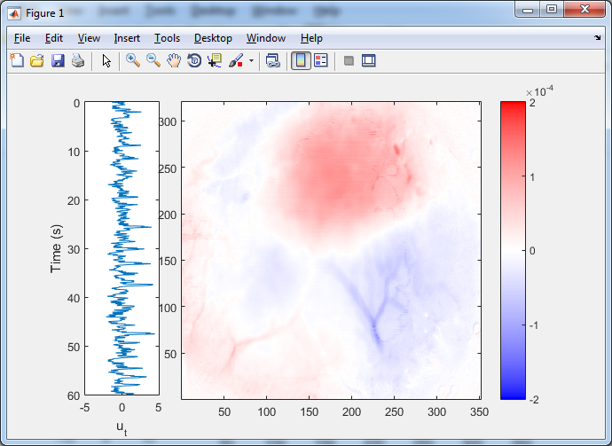
IC 2 (from 12 SVDs)

Slide 18
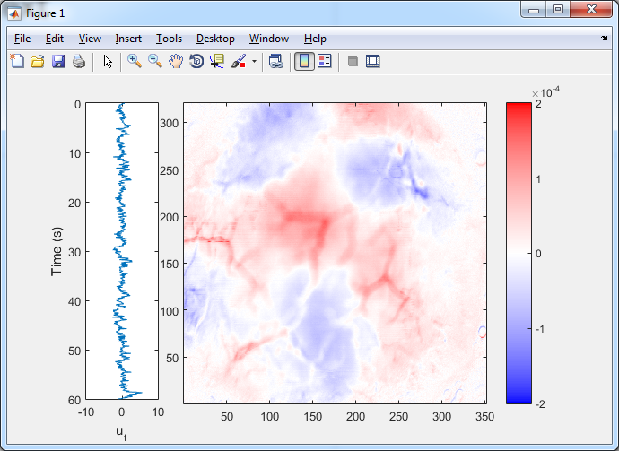
IC 3 (from 12 SVDs)

Slide 19
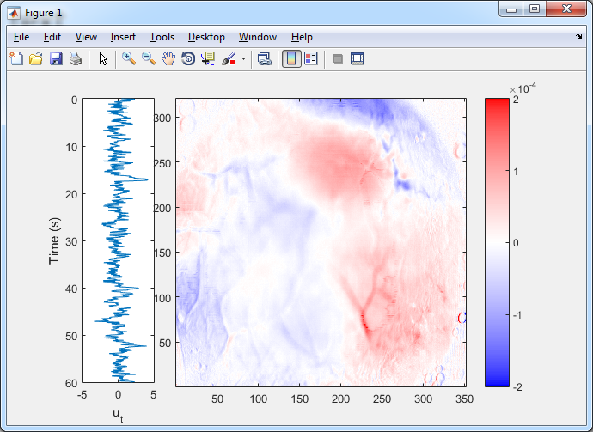
IC 4 (from 12 SVDs)

Slide 20
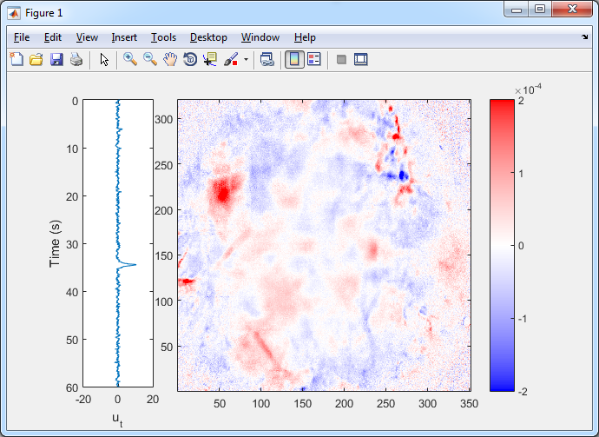
IC 1 (from 100 SVDs)

Slide 21
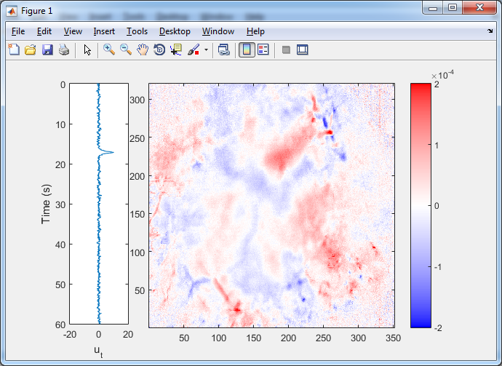
IC 2 (from 100 SVDs)

Slide 22
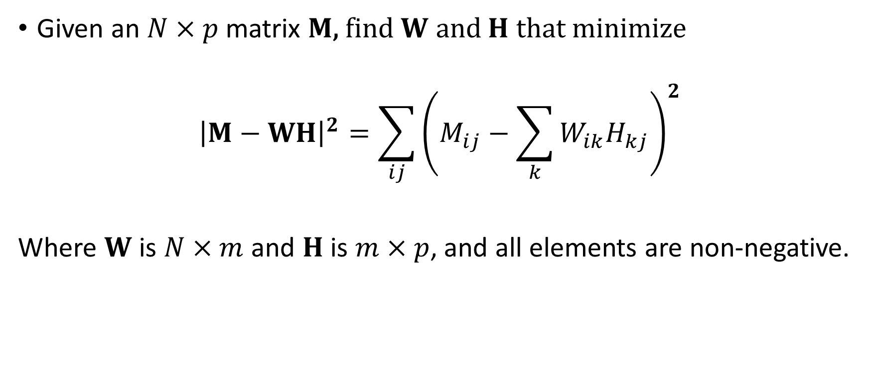
Non-negative matrix factorization
Given an $N×p$ matrix $M$, find $W$ and $H$ that minimize
$${\left|M−WH\right|}^{2}=\sum_{ij}{{\left(M_{ij}−\sum_{k}{W_{ik}H_{kj}}\right)}^{2}}$$
Where $W$ is $N×m$ and $H$ is $m×p$, and all elements are non-negative.

Slide 23
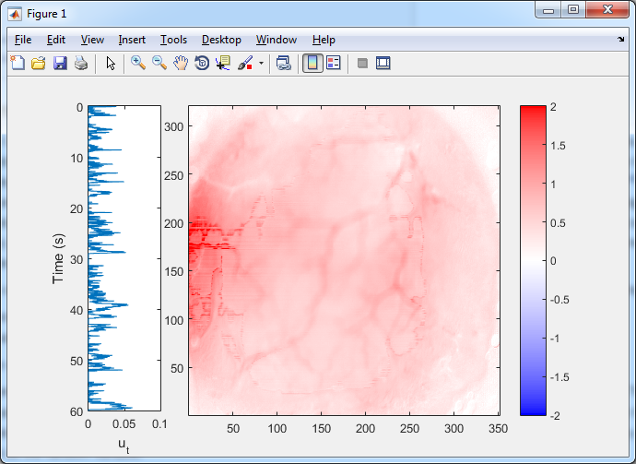
Non-negative factor 1

Slide 24
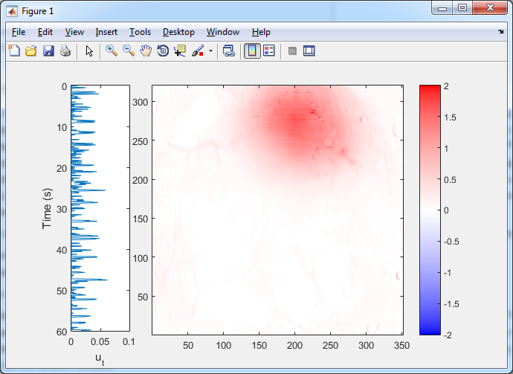
Non-negative factor 2

Slide 25
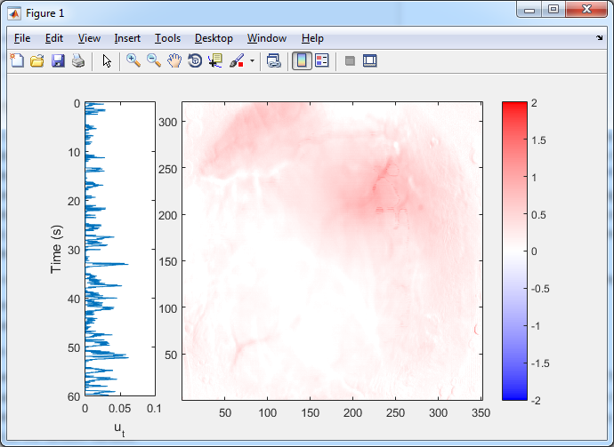
Non-negative factor 3

Slide 26
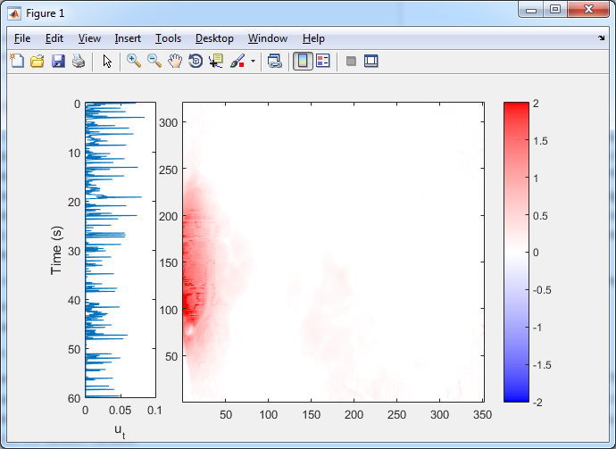
Non-negative factor 4

Slide 27
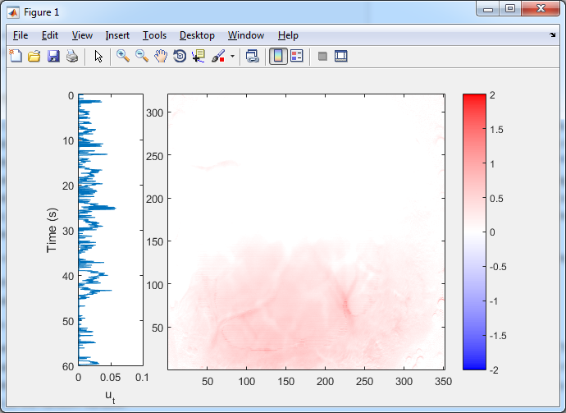
Non-negative factor 5

Slide 28
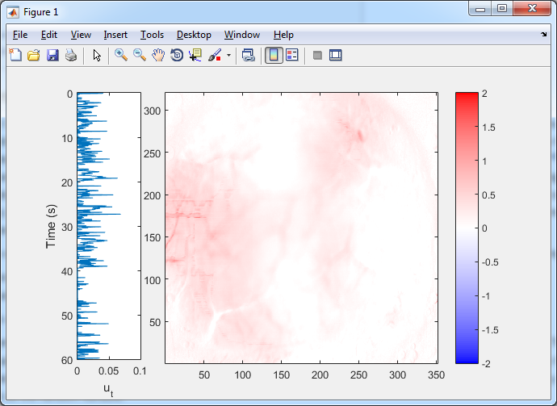
Non-negative factor 6

Slide 29
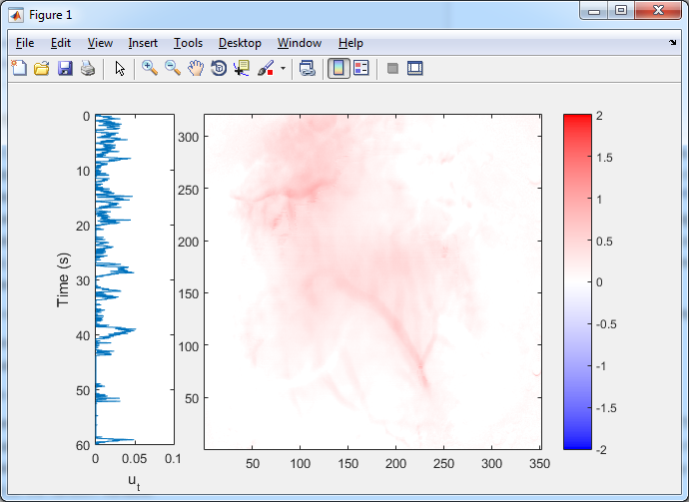
Non-negative factor 7

Slide 30
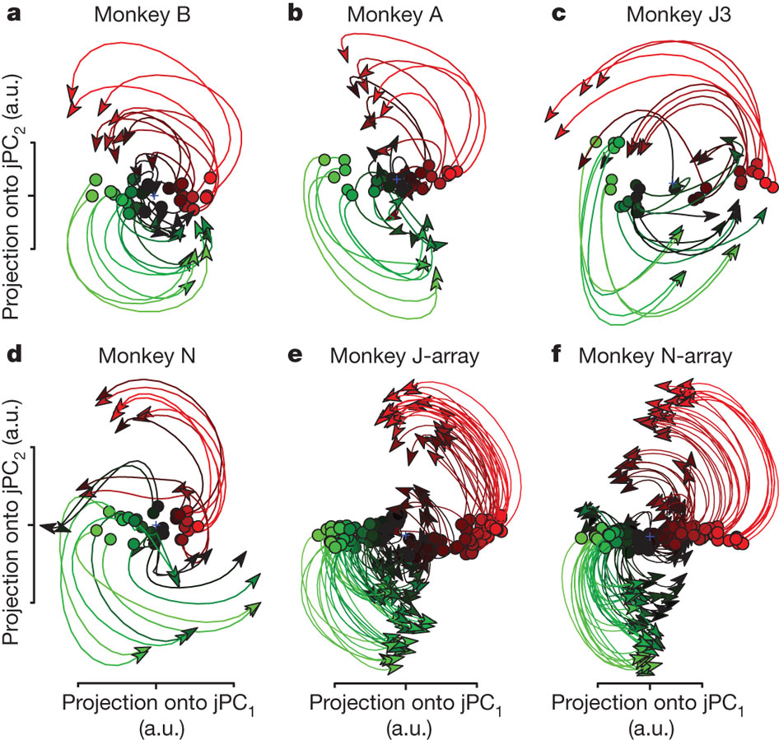
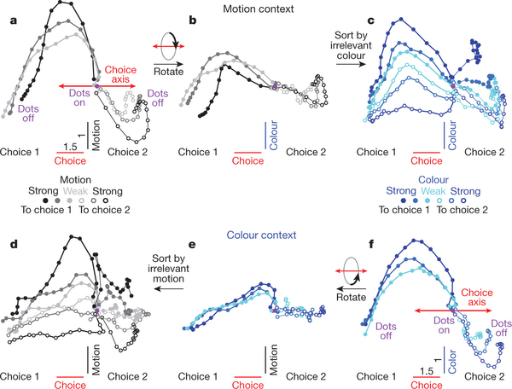
Many more methods…
jPCA: Churchland, Cunningham et al, Nature 2012
Mante, Sussillo et al, Nature 2013

Slide 31
Summary
There are lots of methods for doing dimensionality reduction
THEY ARE EXPLORATORY ANALYSES
Different methods will often give you different results
Use them – they might help you formulate a hypothesis
Then do a confirmatory analysis. These usually do not use dimensionality reduction.

