Slide 1
Spectral analysis of multiple timeseries
Kenneth D. Harris
18/2/15

Slide 2

Continuous processes
A continuous process defines a probability distribution over the space of possible signals
$$x\left(t\right)$$
Sample space =
all possible LFP signals
Probability density 0.000343534976

Slide 3

Multivariate continuous processes
A continuous process defines a probability distribution over the space of possible signals
$$x\left(t\right)$$
Sample space =
all possible multiple signals
Probability density 0.00000343534976

Slide 4


Cross-spectrum
Power spectrum
$$P\left(f\right)=E\left({\left|\tilde{x}\left(f\right)\right|}^{2}\right)$$
$$P_{ij}\left(f\right)=E\left({\tilde{x}}_{i}^{∗}{\left(f\right)\tilde{x}}_{j}\left(f\right)\right)$$

Slide 5
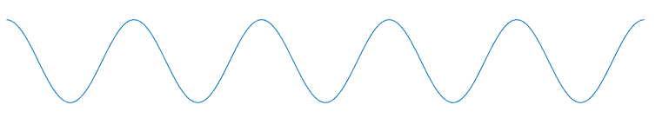
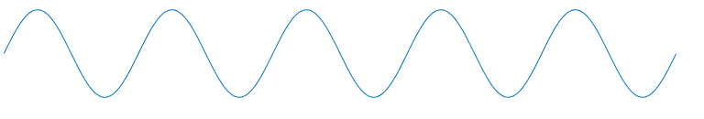
Fourier transform: amplitude and phase

Slide 6
Constant phase relationship?

Slide 7
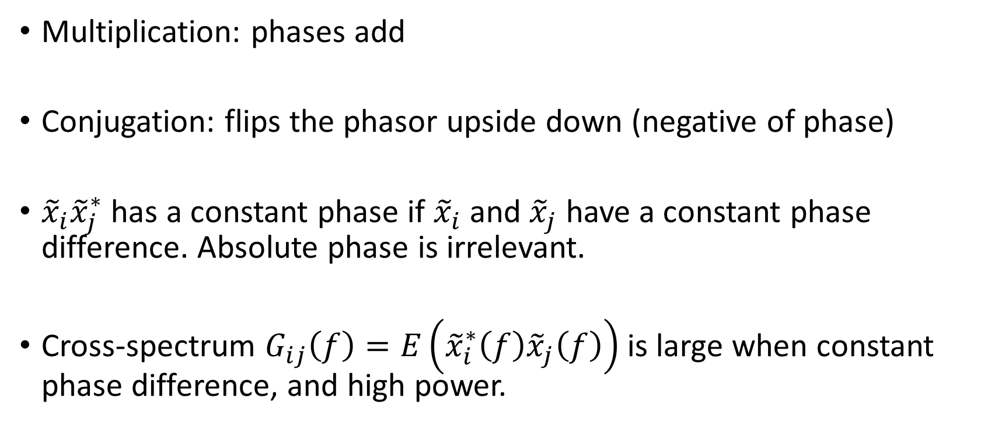
Complex conjugate
Multiplication: phases add
Conjugation: flips the phasor upside down (negative of phase)
${\tilde{x}}_{i}{\tilde{x}}_{j}^{∗}$ has a constant phase if ${\tilde{x}}_{i}$ and ${\tilde{x}}_{j}$ have a constant phase difference. Absolute phase is irrelevant.
Cross-spectrum $G_{ij}\left(f\right)=E\left({\tilde{x}}_{i}^{∗}\left(f\right){\tilde{x}}_{j}\left(f\right)\right)$ is large when constant phase difference, and high power.

Slide 8
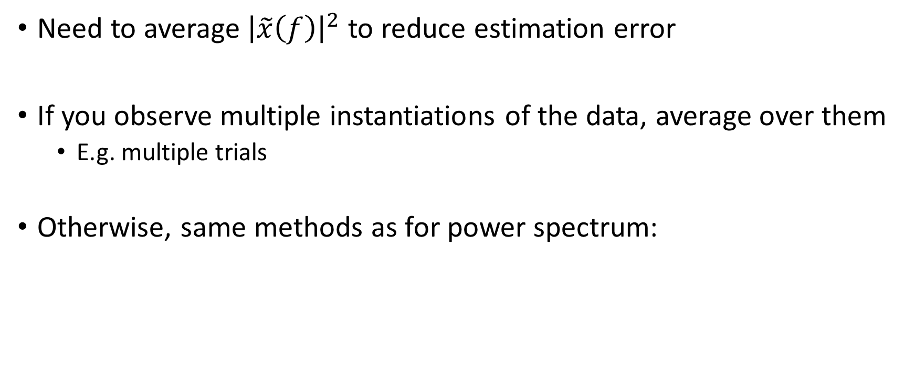
Cross spectrum estimation
Need to average ${\left|\tilde{x}\left(f\right)\right|}^{2}$ to reduce estimation error
If you observe multiple instantiations of the data, average over them
E.g. multiple trials
Otherwise, same methods as for power spectrum:

Slide 9
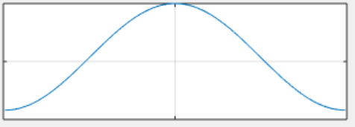
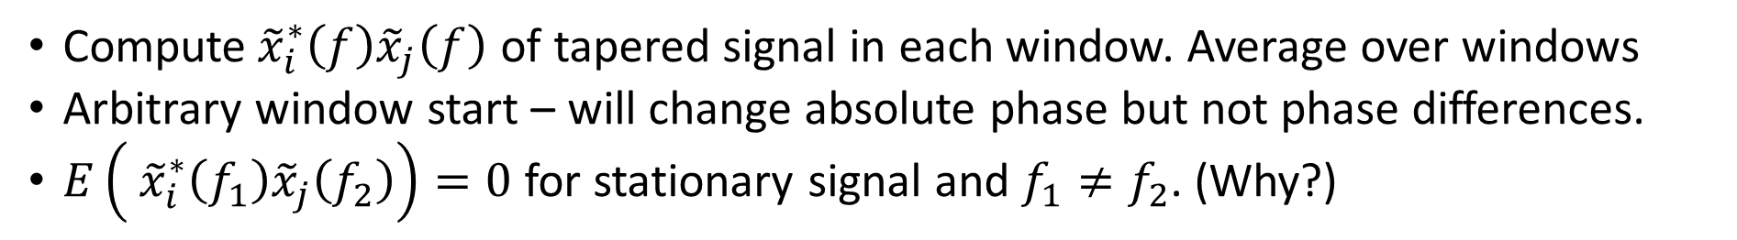
Welch’s method
Average the squared FFT over multiple windows
Compute${ \tilde{x}}_{i}^{∗}\left(f\right){\tilde{x}}_{j}\left(f\right)$ of tapered signal in each window. Average over windows
Arbitrary window start – will change absolute phase but not phase differences.
$E\left({ \tilde{x}}_{i}^{∗}\left(f_{1}\right){\tilde{x}}_{j}\left(f_{2}\right)\right)=0$ for stationary signal and $f_{1}≠f_{2}$. (Why?)

Slide 10
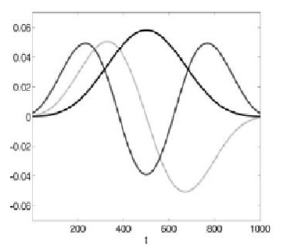
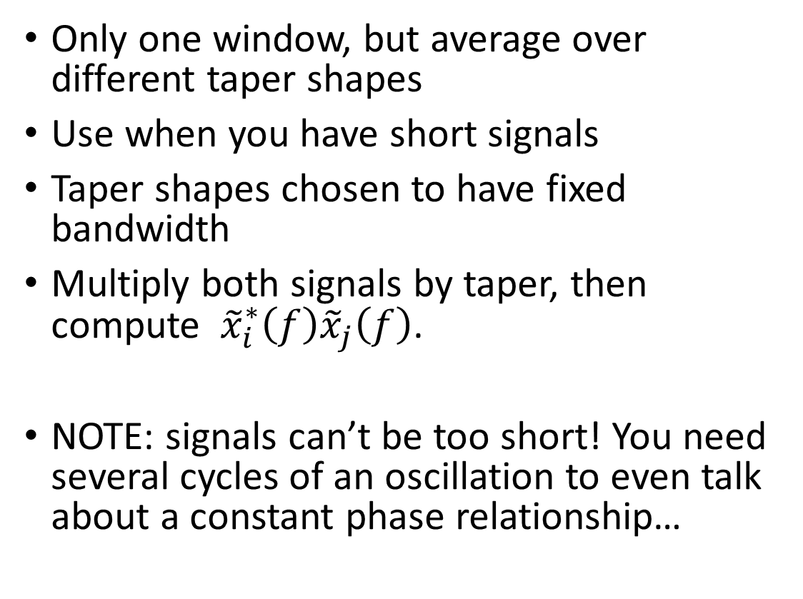
Multi-taper method
Only one window, but average over different taper shapes
Use when you have short signals
Taper shapes chosen to have fixed bandwidth
Multiply both signals by taper, then compute ${ \tilde{x}}_{i}^{∗}\left(f\right){\tilde{x}}_{j}\left(f\right)$.
NOTE: signals can’t be too short! You need several cycles of an oscillation to even talk about a constant phase relationship…

Slide 11
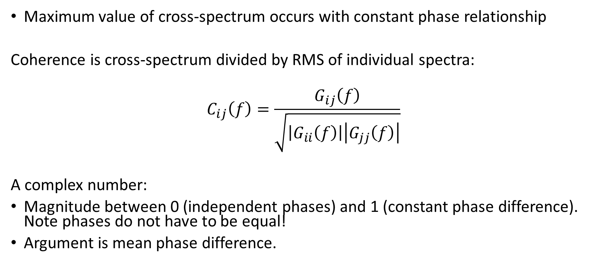
Coherence
Maximum value of cross-spectrum occurs with constant phase relationship
Coherence is cross-spectrum divided by RMS of individual spectra:
$$C_{ij}\left(f\right)=\frac{G_{ij}\left(f\right)}{\sqrt{\left|G_{ii}\left(f\right)\right|\left|G_{jj}\left(f\right)\right|}}$$
A complex number:
Magnitude between 0 (independent phases) and 1 (constant phase difference). Note phases do not have to be equal!
Argument is mean phase difference.

Slide 12
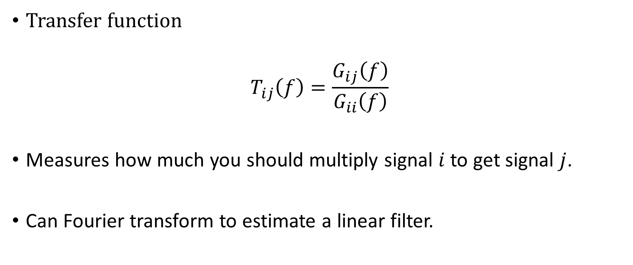
Transfer function
Transfer function
$$T_{ij}\left(f\right)=\frac{G_{ij}\left(f\right)}{G_{ii}\left(f\right)}$$
Measures how much you should multiply signal $i$to get signal $j$.
Can Fourier transform to estimate a linear filter.

Slide 13

Seizure over visual cortex
Federico Rossi

Slide 14
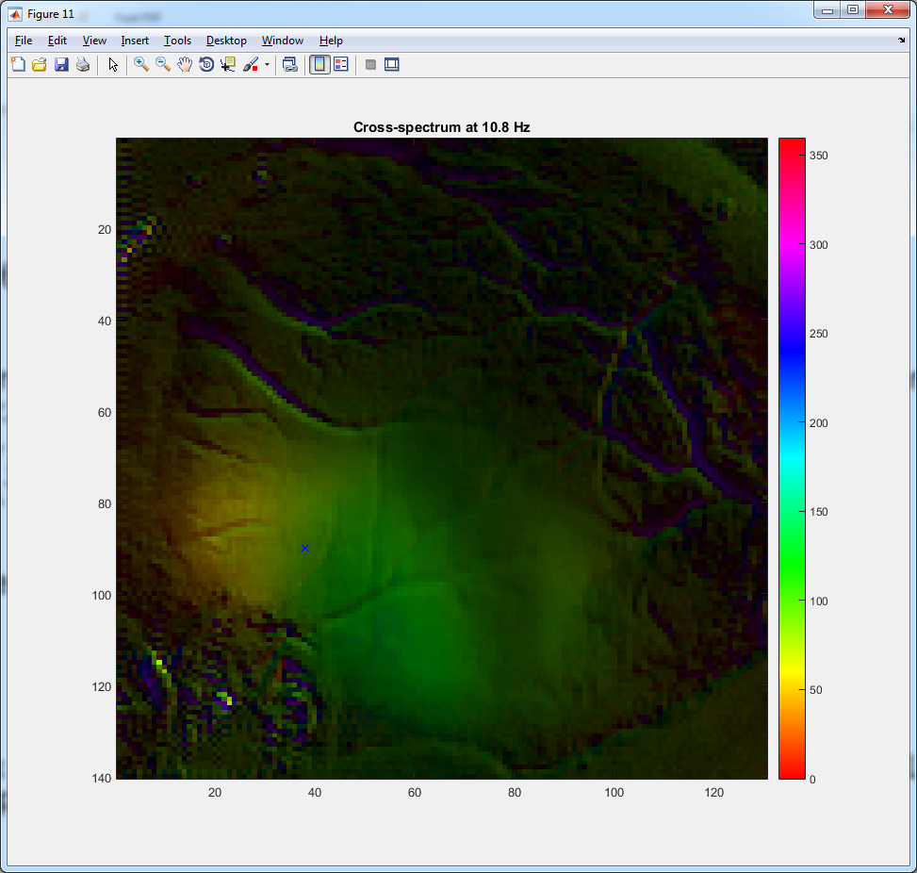
Cross-spectrum with seed pixel

Slide 15
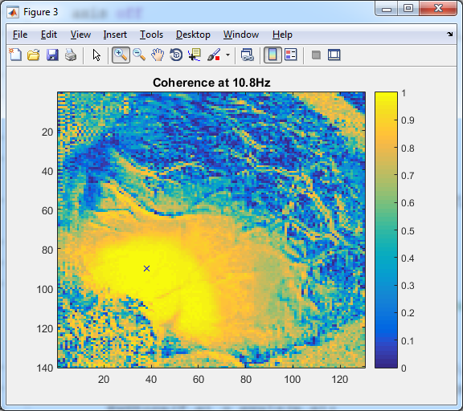
Coherence magnitude with seed pixel

Slide 16

Cross-spectral matrix
Cross-spectral matrix $G_{ij}\left(f\right)$ is complex and Hermitian
Complex version of a symmetric matrix
It’s transpose is the same as its complex conjugate
All eigenvalues are real

Slide 17
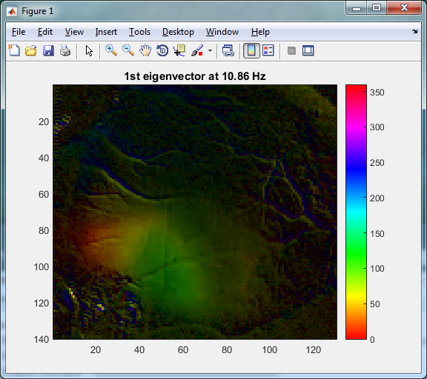
1st Eigenvector of cross-spectral matrix
No need for a seed pixel
Shows how wave propagates across cortex
Computed using SVD first!

